Slide 1
1. Microprocessor
Md. Atiqur Rahman Ahad
atiqahad@yahoo.com
http://aa.binbd.com

Slide 2
Must buy & have during classes
Yu & Marut, 8086 Microprocessor & Assembly Language
MA Mazidi et al., ‘PIC Microcontroller and Embedded Systems’, Pearson, 2012

Slide 3
http://aa.binbd.com/eee308
Attendance – at the beginning
Late-entry: 10/20/30/ -- fine & no attendance
No sleeping or disturbance
Mobile phone must be switched OFF [not silent]
No best count on exams
Assembly Languages for Intel 8086 and PIC – MUST learn seriously. Recap C Programming [Part of exam]
10 times more reading at outside the class

Slide 4
Evaluation Process
Home work – by default, what we cover in the class. If anything else/more, I will inform.
HW seriously - no copy, no cheating, no fakibaji-submission.
Hand-written in Bangla-English
Project: Hardware-based using PIC microcontroller: Robocar or an useful system
Submit proposal by week 2: written proposal – 2 pages: title, purpose, background, what u need, how u do, etc.
[submit project at the 1st class after Summer vacation: with HW project, 6~10 pages printed report as per IEEE template in LaTeX [now PDF based on MSWord]. Demonstration.
PPT presentation w 5 slides.
Class tests – on-the-fly [Open-book exams] & negative-marking
Mid-term – 1 [Open-book exams] & negative-marking
Final exam

Slide 5
mp
mp vs. CPU
Intel family of mp
General purpose mp
Single chip mp
Bit slice mp

Slide 6
Accumulator
In a computer's central processing unit (CPU), an accumulator is a register in which intermediate arithmetic and logic results are stored.
Without an accumulator, it would be necessary to write the result of each calculation (addition, multiplication, shift, etc.) to main memory, perhaps only to be read right back again for use in the next operation.
Access to main memory is slower than access to a register like the accumulator because the technology used for the large main memory is slower (but cheaper) than that used for a register.

Slide 7
Early electronic computer systems were often split into two groups,
those with accumulators and
those without.
Modern computer systems often have multiple general purpose registers that operate as accumulators.
However, a number of special-purpose processors still use a single accumulator for their work, to simplify their design.

Slide 8
An accumulator machine, also called a 1-operand machine, or a CPU with accumulator-based architecture, is a kind of CPU where, although it may have several registers, the CPU mostly stores the results of calculations in one special register, typically called "the accumulator".
Almost all early computers were accumulator machines
Only the high-performance "supercomputers" would have multiple registers.
As of 2010, 68HC12, PICmicro, and 8051 among others, are basically accumulator machines.

Slide 9
Modern CPUs are typically 2-operand or 3-operand machines—the additional operands specify which one of many general purpose registers are used as the source and destination for calculations.
These CPUs are not considered "accumulator machines".

Slide 10
Early 4-bit and 8-bit microprocessors such as the 4004, 8008 and numerous others, typically had single accumulators.
The 8051 microcontroller has two,
a primary accumulator and
a secondary accumulator,
where the second is used by instructions only when multiplying (MUL A, B) → splits the 16-bit result between the two 8-bit accumulators,
or dividing (DIV A, B) → stores the quotient on the primary accumulator A and the remainder in the secondary accumulator B.
Modern Intel x86 processors still uses the primary accumulator EAX and the secondary accumulator EDX for multiplication and division of large numbers.

Slide 11
Moore’s Law
Since the early 1970s, the increase in capacity of microprocessors has followed Moore's law
that the no. of components that can be fitted onto a chip doubles every year.
With present technology, it is actually every two years, and as such Moore later changed the period to two years.

Slide 12
Multi-core processor
A multi-core processor is simply a single chip that contains more than one microprocessor core.
CPU = core
Usually, a processor has → one CPU, or one core
This effectively multiplies the processor's potential performance by the number of cores (as long as the operating system and software is designed to take advantage of more than one processor core).

Slide 13
Some components, such as bus interface and cache, may be shared between cores.
Because the cores are physically very close to each other, they can communicate with each other much faster than separate processors in a multi-processor system, which improves overall system performance.

Slide 14
Multi-core → Dual-core, …
In 2005, the first PC dual-core processors were announced.
Dual-core and quad-core processors are widely used in home PCs and laptops,
while quad, six, eight, ten, twelve, and sixteen-core processors are common in the professional and enterprise markets with workstations and servers.
Motherboards are designed to support more CPUs

Slide 15
Bit-slicing…
Bit slicing is a technique for constructing a processor from modules of smaller bit width.
Each of these components processes one bit field or "slice" of an operand.
The grouped processing components would then have the capability to process the chosen full word-length of a particular software design.

Slide 16
Bit slice processors usually consist of an ALU of 1, 2, 4 or 8 bits and control lines (including carry or overflow signals that are internal to the processor in non-bit-sliced designs).
E.g.,
two 4-bit ALUs could be arranged side by side, with control lines between them, to form an 8-bit CPU;
with 4 slices a 16-bit CPU (4x4=16) can be built;
it takes 8 slices for a 32-bit word CPU [8x4=32] (so the designer can add as many slices as required to manipulate increasingly longer word lengths).

Slide 17
Using multiple simpler (and cheaper) ALUs was seen as a way to increase computing power in a cost-effective manner.
No more
May read: http://educationalstuff1.tripod.com/bsp.pdf

Slide 18
2. Memory

Slide 19
Organization of RAM
RAM – Random Access Mem
Static RAM [SRAM] - In SRAM, a bit of data is stored using the state of a flip-flop.
This form of RAM is more expensive to produce,
but is generally faster and
requires less power than DRAM and,
in modern computers, is often used as cache memory for the CPU.

Slide 20
RAM
Dynamic RAM [DRAM] – It stores a bit of data using a transistor and capacitor pair, which together comprise a memory cell.
The capacitor holds a high or low charge (1 or 0, respectively), and the transistor acts as a switch that lets the control circuitry on the chip read the capacitor's state of charge or change it.
less expensive to produce than SRAM,
it is the predominant form of computer memory used in modern computers.

Slide 21
RAM
A random-access device [RAM] allows stored data to be accessed directly in any random order.
In contrast, other data storage media [e.g., hard disks, CDs, DVDs and magnetic tape], read and write data only in a predetermined order, consecutively, because of mechanical design limitations.
So, the time to access a given data location varies significantly depending on its physical location.

Slide 22
Virtual mem
Virtual memory → OS allows to extend the RAM’s capacity - where, a portion of hard disk is considered as RAM!
N.B.: Hard drives r much slower than RAM.
So excessive use of this mechanism may not be good for overall performances.

Slide 23
RAM disk
Software can "partition" a portion of a computer's RAM, allowing it to act as a much faster hard drive that is called a RAM disk.
It loses the stored data when the computer is shut down, unless memory is arranged to have a standby battery source.

Slide 24
EcoRAM – Green RAM
Anything that saves/reduces power/energy ➔ GREEN tech.
EcoRAM are specifically designed for server farms, where low power consumption is more important than speed
Read –
http://www.zdnet.com/blog/green/news-on-flash-ecoram-held-up-as-less-power-hungry-option-than-dram-for-server-farms/1165

Slide 25
ROM
ROM – Read-Only Mem
Programmable ROM – PROM
Erasable PROM – EPROM
Electrically-EPROM – EEPROM
Other types of memories

Slide 26
RAM – Volatile mem → its stored information is lost if the power is removed
ROM – non-volatile → stores data by permanently enabling or disabling selected transistors, such that the memory cannot be altered.

Slide 27
Writeable variants of ROM
Writeable variants of ROM (e.g., EEPROM and flash memory) share properties of both ROM and RAM,
enabling data to persist without power and
to be updated without requiring special equipment.
These persistent forms of semiconductor ROM include USB flash drives, memory cards for cameras and portable devices, etc.

Slide 28
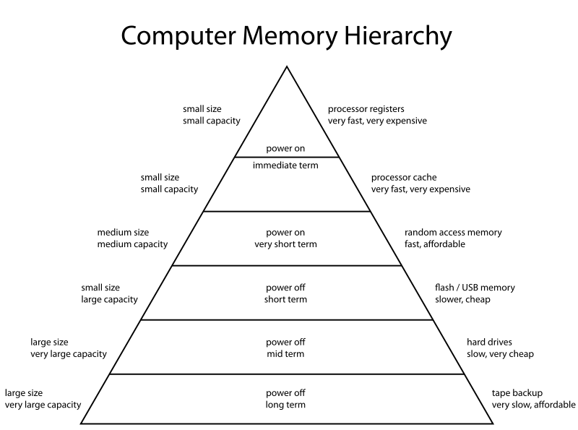

Slide 29
USB Flash Drive
A USB flash drive is a data storage device that includes flash memory with an integrated Universal Serial Bus (USB) interface.
Capacity – now up to TeraByte
Some allow up to 100,000 write/erase cycles, depending on the exact type of memory chip used, and a 10-year shelf storage time.
Flash memory has a finite number of program-erase cycles (typically written as P/E cycles).

Slide 30
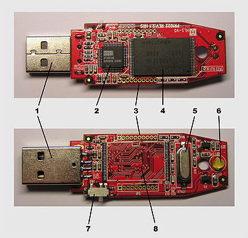
USB standard, A-plug
USB mass storage controller device
Test point
Flash memory chip
Crystal oscillator
LED (Optional)
Write-protect switch (Optional)
Space for second flash memory chip

Slide 31
Essential components –
Plug
USB mass storage controller – It is a small microcontroller with a small amount of on-chip ROM & RAM.
Test point
NAND flash memory chip(s) – It stores data (NAND flash is typically also used in digital cameras).
Crystal oscillator – produces the device's main 12 MHz clock signal and controls the device's data output through a phase-locked loop.

Slide 32
3. Intel 8086
Microprocessor
History a bit
Machine instructions
Moore’s law
Internal organization of 8086 mp.
BIU, EU
8086 – registers
Memory management, Physical address, logical address of 8086
Addressing modes
Interrupt & interrupt service routines – read

Slide 33
4. Advanced Microprocessors
Internal architecture & memory management of
80186
80286
80386
Watchdog timers, DMA, SMM
80486

Slide 34
Pentium processor
Co-processor
Alpha processor
Pipeline processor

Slide 35
5. Assembly Language

Slide 36
Basics of AL
Program data
Pseudo-ops
Array
Program structures
Data, stack, code segments

Slide 37
Some instructions –
MOV, XCHG
ADD, SUB
INC, DEC
NEG
I/O instructions
INT – interrupt
LEA
SHIFT, ROTATE
JUMP – JMP, Jxxx, etc.
CMP
Signed vs. unsigned jumps
MUL, IMUL
DIV, IDIV
DUP

Slide 38
Conditional flow structure
If – then
If – then – else
Case
Control flow structure
FOR loop
WHILE loop
REPEAT-UNTIL loop

Slide 39
Logic instructions
AND, OR, XOR, NOT
TEST
Shift ins., Rotate ins.
Logical shift/rotate
Arithmetic shift/rotate
Stack, Queue
PUSH, POP

Slide 40
String data transfers [ch.11 [Marut], ch.4 [Brey]]
LODS, STOS, MOVS, INS and OUTS
Addressing modes

Slide 41
Read
Interrupts
Procedures & macro
Virtual memory management
Cache memory management
Exception handler

Slide 42
6. Microcontrollers
Microcontroller [mc] vs. microprocessor
mc of different manufacturers
Classifications of mc

Slide 43
PIC 16/18
Block diagram
Architecture
Memory organization
Special purpose registers
I/O ports
Instruction set
Programming
Read -
Simulation using MPLAB
Microcontrollers with internal ADC and DAC

