Slide 1

Credit Card Fraud Detection
1705064 Md. Tanvir Raihan
1705084 Asif Ahmed Utsa

Slide 2
Problem Scope
Identify and prevent fraudulent transactions made using credit cards
Improving the accuracy and speed of fraud detection
Reducing false positives

Slide 3
DataSet Description
The dataset we used for the can be found here: fraud_detection
This dataset is imbalanced as it contains 284315 non-fraud transactions and only 492 fraud transactions

Slide 4
Implementation
In this project, we used two techniques for Fraud Detection. These are:
CNN with SMOTE
LSTM-Attention Mechanism

Slide 5
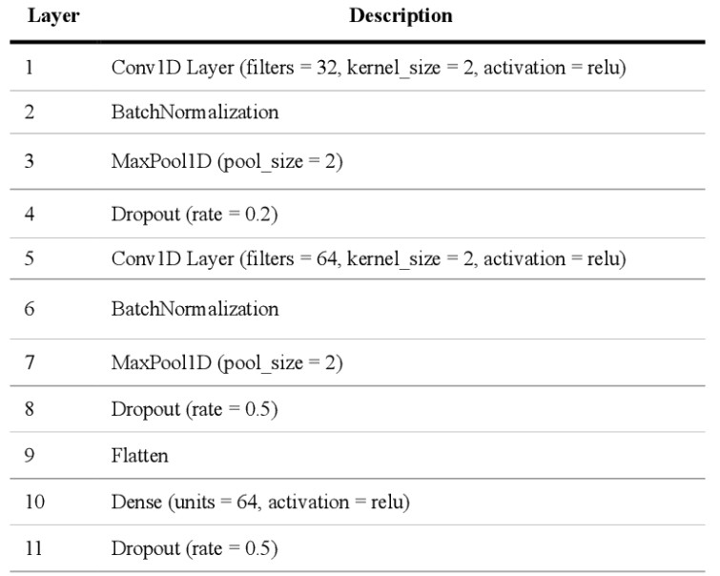
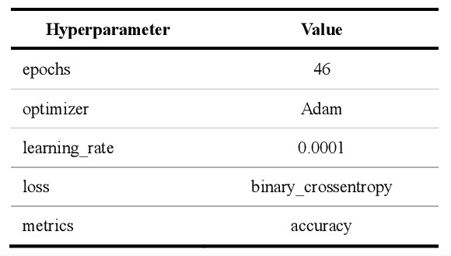
Implementation(CNN+SMOTE)
For implementing CNN,we followed the paper cited below. The model and hyperparameters we used are mentioned here:
M. L. Gambo, A. Zainal and M. N. Kassim, "A Convolutional Neural Network Model for Credit Card Fraud Detection," 2022 International Conference on Data Science and Its Applications (ICoDSA), Bandung, Indonesia, 2022, pp. 198-202, doi: 10.1109/ICoDSA55874.2022.9862930.

Slide 6
Implementation(CNN+SMOTE)
SMOTE (Synthetic Minority Over-sampling Technique) is a data augmentation technique to address class imbalance in datasets.
SMOTE generates synthetic data for the minority class by creating new data points along the line segments connecting minority class instances
As our dataset was highly imbalanced, we used SMOTE to balance the non-fraud and fraud transactions.

Slide 7
Testing
We used 70% of our dataset for training the model and remaining 30% for testing. Again, we used 20% of the training data for validation
This standard was used for testing both the techniques

Slide 8
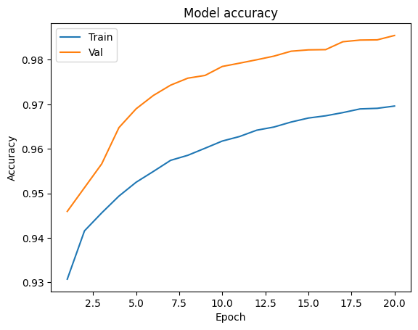
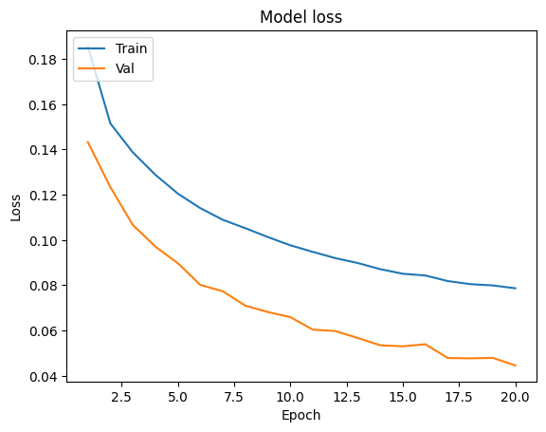
Experimental Results(validation data)
Before adding the Maxpooling Layer:

Slide 9
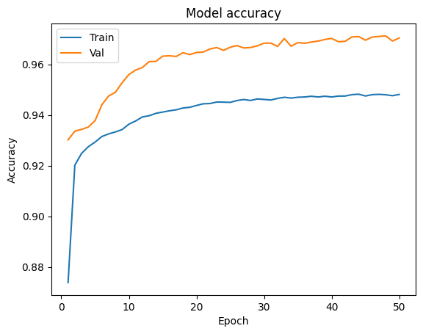
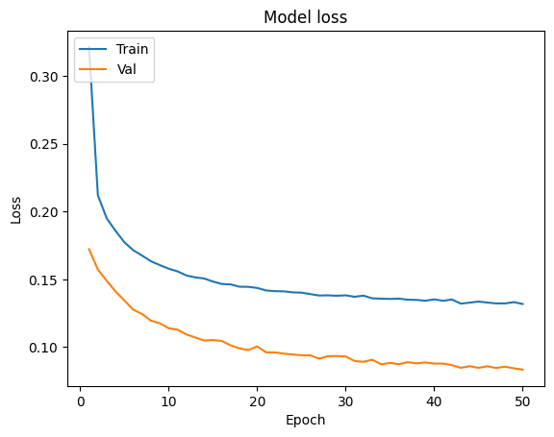
Experimental Results
Experimental Results(validation data)
After adding the Maxpooling Layer:

Slide 10
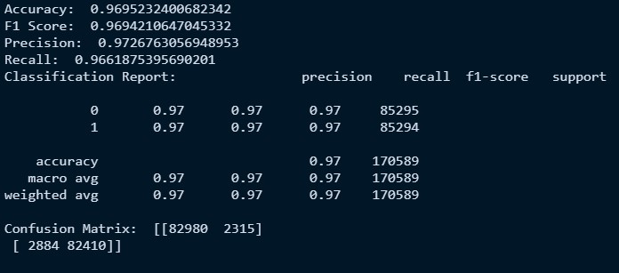
Experimental Results(testing data)

Slide 11
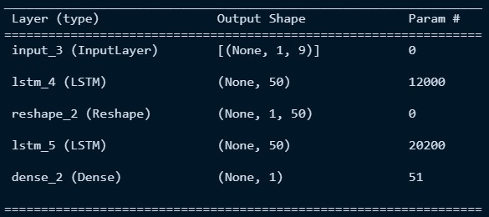
Implementation(LSTM+ATTENTION)
For implementing LSTM, we followed the paper cited below. Our model looks like:
Benchaji, I., Douzi, S., El Ouahidi, B. et al. Enhanced credit card fraud detection based on attention mechanism and LSTM deep model. J Big Data 8, 151 (2021). https://doi.org/10.1186/s40537-021-00541-8

Slide 12
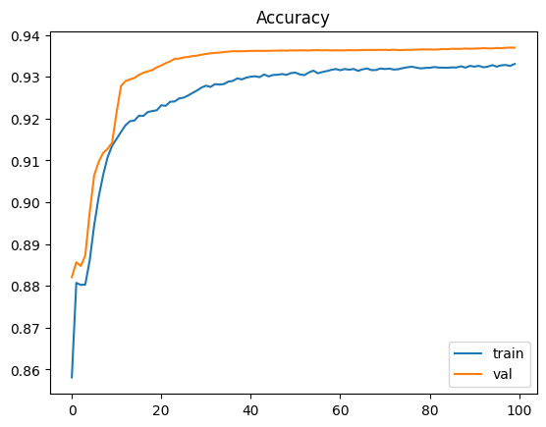
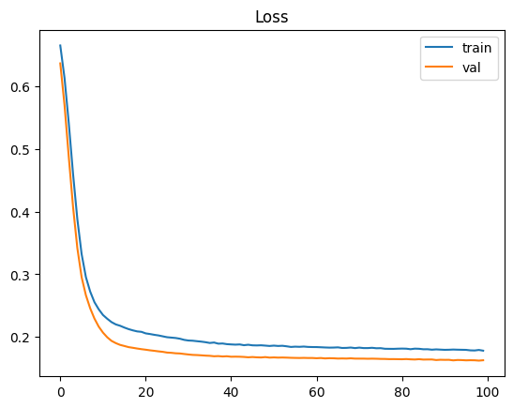
Experimental Results(validation data)

Slide 13
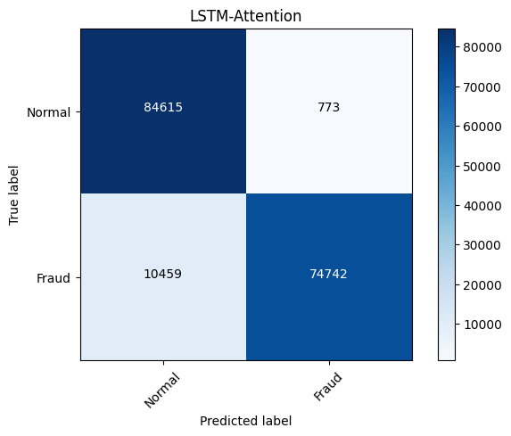

Experimental Results(test data)
Without using Attention Mechanism

Slide 14


Experimental Results(test data)
Using Attention Mechanism

Slide 15
Intuition
The reason why SMOTE may perform better than LSTM in credit card fraud detection is the handling of class imbalance issue
SMOTE helps to address this problem by generating synthetic examples of the minority class, which can help to balance the class distribution and make it easier for the algorithm to learn the patterns associated with fraud. In contrast, LSTM may struggle with class imbalance because it is designed to process sequences of data and may not be as effective at detecting rare events.

Slide 16
Conclusion
CNN implemented with SMOTE performs better with highly imbalanced dataset like the one we used. But LSTM can still be a useful technique in credit card fraud detection, particularly when combined with other techniques such as SMOTE

Slide 17
THANK YOU!

