Slide 1
BINIMOY
Presented by:
Tanvir Hasan
ID: 20131201027
Dept. of CSE
BSMRSTU
Supervised by:
Md. Nesarul Hoque
Assistant Prefessor
Dept. of CSE
BSMRSTU

Slide 2
PRESENTATION OUTLINES
Introduction
Related Works
Proposed System
Design and User manual
Features
Conclusion

Slide 3
PRESENTATION OUTLINES
Introduction
Related Works
Proposed System
Design and User manual
Features
Conclusion

Slide 4
Introduction
Binimoy is a information sharing desktop application.
This application able to share screen with other users.
Our application works on Wi-Fi network.

Slide 5
INTRODUCTION (CONT…)
Applied Java Networking
Socket programming
TCP
Here, we work on large file sharing in same network via Wi-Fi network without single byte data loss.
Computer A
Wifi or Lan
Computer B

Slide 6
PRESENTATION OUTLINES
Introduction
Related Works
Proposed System
Design and User manual
Features
Conclusion

Slide 7
RELATED WORKS
TeamViewer
  Uses peer to peer technology.
  Can share file in global network and also can share screen.
  Can’t create Wi-Fi network. That means without internet it is use less.
Shareit
  Can share file in Wi-Fi network.
  Can’t share screen with others.
  Skype
  Uses peer to peer technology.
  Can share file ,screen and able to make video call.
  Only works is internet connection is available.

Slide 8
LIMITATIONS OF EXISTING SYSTEMS AND OUR GOAL
Limitations:
Existing Systems can’t work on offline mode.
Very few of them have screen sharing feature.
Our Goal: to achieve
Transfer large data without single byte loss.
Make better communication style.

Slide 9
COMPARISON WITH EXISTING SYSTEMS
Existing Systems can’t work on offline mode.
Very few of them have screen sharing feature.

Slide 10
PRESENTATION OUTLINES
Introduction
Related Works
Proposed System
Design and User manual
Features
Conclusion

Slide 11
PROPOSED SYSTEM
Our application divide into two mode.
Server mode and client mode.
Sender will select server mode and Receiver will select client mode.
Server and client mode both containing Tcp socket.
Client need to put the IP number of server computer.
Then sender will send data throw Tcp protocol.
Receiver are ready to get the data.
As we know video is a set of images.
We capture server screen and send that to the client pc and update it very quickly. It makes the screen sharing technology.

Slide 12



PROPOSED SYSTEM(CONT…)
Server or Client
Server
Control pc
Select & send
Share screen
Client
Responsive control
Receive file
Get shared screen
Request & Response
Figure : Structural View of Binimoy

Slide 13
PRESENTATION OUTLINES
Introduction
Related Works
Proposed System
Design and User manual
Features
Conclusion

Slide 14
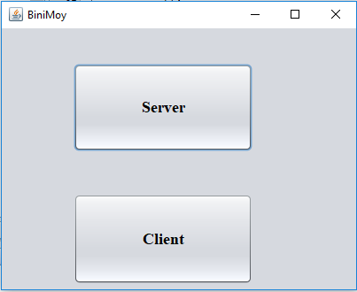
HOME WINDOW
WICT 2011, Mumbai, INDIA

Slide 15
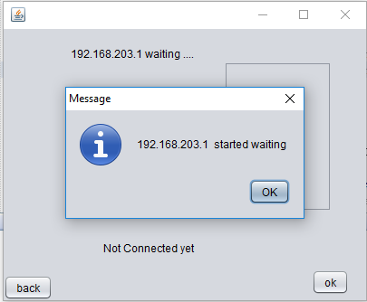
SERVER IS WAITING FOR CLIENT
WICT 2011, Mumbai, INDIA

Slide 16
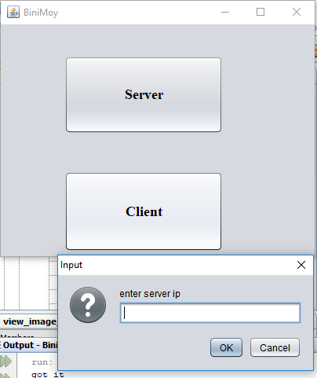
CLIENT NEEDS SERVER IP
WICT 2011, Mumbai, INDIA

Slide 17
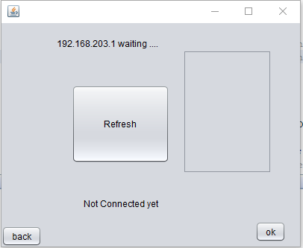
SERVER
WICT 2011, Mumbai, INDIA

Slide 18
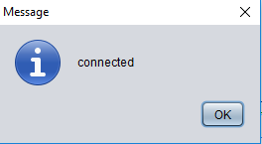
CLIENT CONNECTED TO SERVER
WICT 2011, Mumbai, INDIA

Slide 19
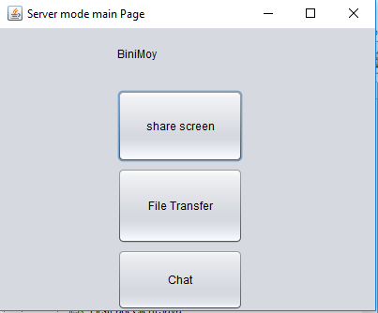
SECOND WINDOW
WICT 2011, Mumbai, INDIA

Slide 20
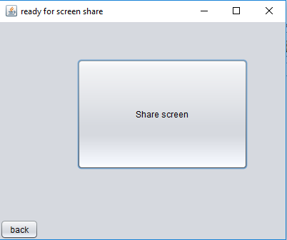
SHARE SCREEN BUTTON
WICT 2011, Mumbai, INDIA

Slide 21
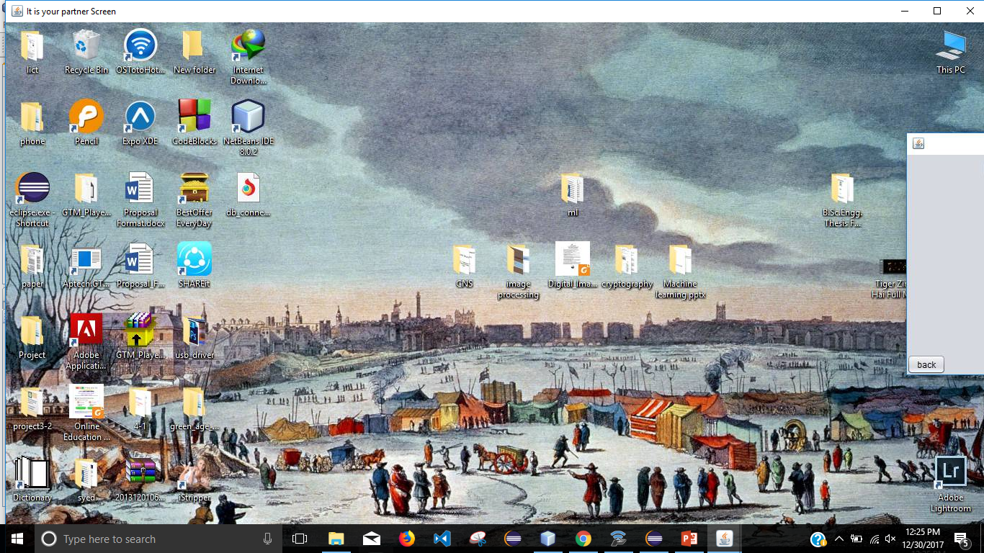
SHARE SCREEN WINDOW
THIS IS ORIGINAL CLIENT SCREEN
WICT 2011, Mumbai, INDIA

Slide 22
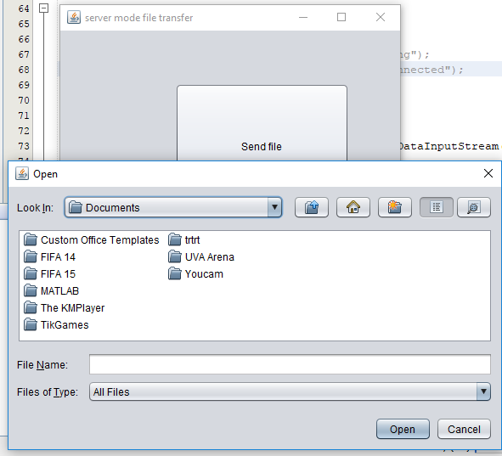
FILE SHARE
SEND PART
WICT 2011, Mumbai, INDIA

Slide 23

SENDING PROCESS
WICT 2011, Mumbai, INDIA

Slide 24
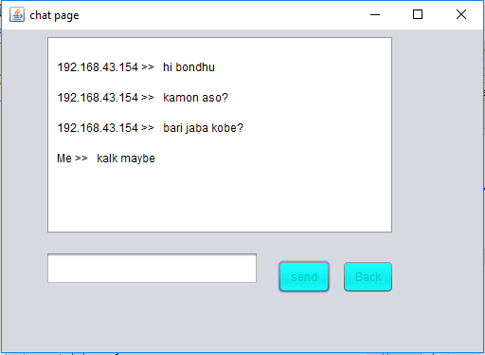
CONVERSATION WINDOW
WICT 2011, Mumbai, INDIA

Slide 25
PRESENTATION OUTLINES
Introduction
Related Works
Proposed System
Features
Conclusion

Slide 26
FEATURES
Transfer files from computer to computer over wireless network.
Sharing screen with others.
Help user to discuss about project or work with partner from away.
Share files and folders to let others download anytime over networks

Slide 27
PRESENTATION OUTLINES
Introduction
Related Works
Proposed System
Features
Conclusion

Slide 28
CONCLUSION
The “Binimoy” software is useful for all windows pc user.
It is noiseless network Software.
A user can transfer his file between two computers very easily.
User can share his project work live with his teammate from away.

Slide 29
Thank You…

