Slide 1
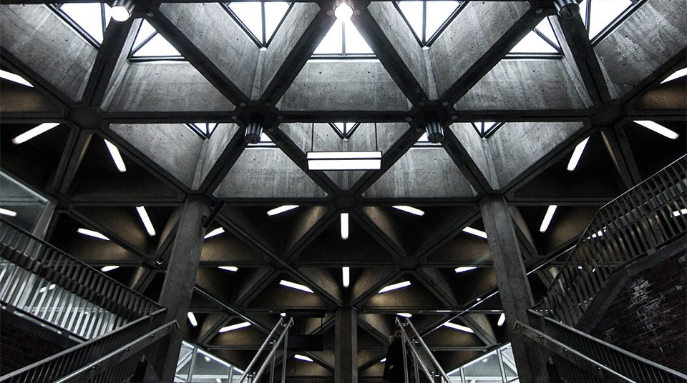
own token sale

Slide 2
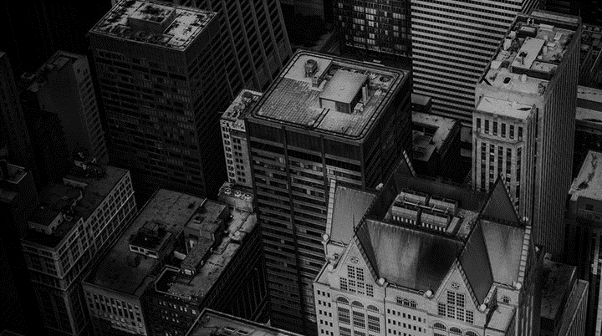

Welcome to our presentation
Let’s get started

Slide 3
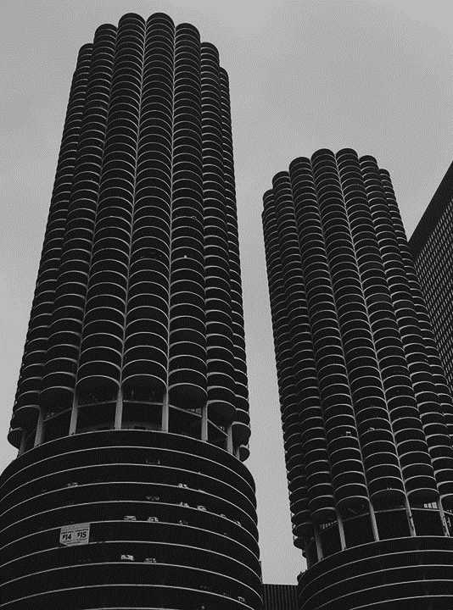
presented by: presented to:
Tanvir Ahmed Anik
16172103004
Afra Anjuman Anti
16172103019
Sadia Islam Asha
16172103034
Md. Kamruzzaman
16172103038
Md. Zahidul Islam
16172103451
Moniruz Zaman,
Lecturer Department of Computer Science & Engineering
Bangladesh University of Business and Technology (BUBT)

Slide 4
introduction
What is a token sell?
What is ICO token?

Slide 5
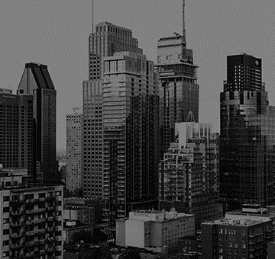
cryptocurrency
So basically a cryptocurrency is a digital currency that are created from codes.
Strings of data or hash
Decentralized system
Distributed leader technology
Bitcoin, Ethereum, Bitcoin cash, Light coin, XRP are the examples of it.

Slide 6
Properties of cryptocurrency
Irreversible
Tracing Identity
Fast initiation
Secure

Slide 7
bitcoin
Bitcoin is the first decentralized block chain based cryptocurrency.
There are two ways to get Bitcoin:
Mining
Exchange

Slide 8
Bitcoin transfer
Finding the peer
Message initiation
Performing the functions:
Wallet
Mining
Full Block-chain
Network Routing

Slide 9
Comparison between bitcoin and money
Divisible
Non-consumable
Portable
Durable
Secure
Scarce
Fungible
Recognizable
Easily Transferable

Slide 10
Comparison between bitcoin and money(c0nt…)
Money creator
Not alterable
Control
Ensure transparent transaction
Enjoy world-wide accessibility

Slide 11
Ethereum
Ethereum(ETH) is a smart contract platform that enables developers to build decentralized application.
Price of Ethereum: $158.85
Smart contract facilities the exchange of money, content, property, shares or anything that have values.

Slide 12
Lite coin
Light coin is a peer-to-peer internet currency that enables instant , near-zero cost payments to anyone in the world.
Miners are currently awarded with 25 new lite coins per block
Price of Lite coin: $71.73

Slide 13
Where to buy
BTC-e
Kraken
Crypts.

Slide 14
Disadvantage of cryptocurrency
Doubt the viability
Perfect tool for criminals
Highly volatile

Slide 15
THANK YOU
For giving your time to us.

Slide 16
Any question?

