Slide 1

Paper Review of
Grammar-Based Anomaly Detection of Microservice Systems
CSE713 - Advance Pattern Recognition
Tanvir Rahman (22241134)
BRAC University

Slide 2


PAPER OVERVIEW
Core Identification
Publication Context
Title: Grammar-Based Anomaly Detection of Microservice Systems Execution Traces
Published in May 2024, focusing on distributed trace analysis for modern software infrastructures.
Authors: Andrea D'Angelo & Giordano d'Aloisio
Research aimed at bridges the gap between ML accuracy and human interpretability.
Conference: ICPE '24 Companion

Slide 3






1. SUMMARY - MOTIVATION
The Problem
Black-Box ML
The Objective
Trace volumes in microservices are exploding. Manual investigation is no longer feasible or scalable.
Current high-accuracy ML models are computationally expensive and lack interpretability for operators.
Deliver efficient, explainable anomaly detection that reduces training overhead while maintaining accuracy.

Slide 4

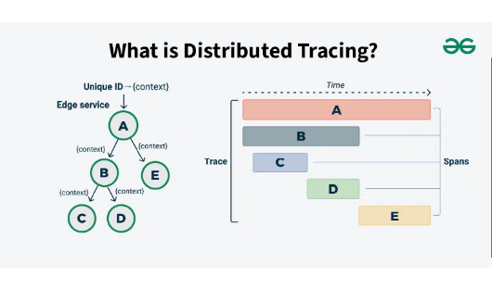
1. SUMMARY - CONTRIBUTION
SAX + Sequitur Approach
Converts numerical latency into discrete symbolic patterns.
15s faster training than Logistic Regression with ~5% accuracy loss.
Provides human-readable Context-Free Grammar rules.

Slide 5
1. SUMMARY - METHODOLOGY
Stage 1: SAX
Stage 2: Induction
Stage 3: Testing
Latency discretization using Symbolic Aggregate Approximation into 5 specific bins.
Sequitur algorithm constructs Context-Free Grammar from the symbolic traces.
Traces are checked for membership in the Grammar. Non-members are flagged as anomalies.

Slide 6


1. SUMMARY - RESULTS
Empirical Evaluation
Diagnostic Output
Evaluated on E-Shopper and Train-Ticket datasets.
The system generates parse trees that help pinpoint where pattern deviations occur in the execution flow.
Significant reduction in training latency.
Competitive F1, Precision, and Recall scores.

Slide 7
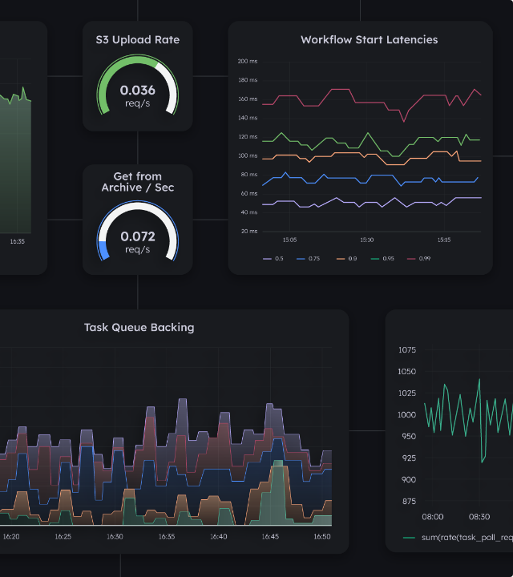
2. CRITIQUE: FEATURE MYOPIA
Latency-Only Limitation
The paper relies exclusively on temporal (latency) data. It fails to account for service topology or call graph dependencies.
Impact: Bottlenecks caused by circular dependencies or cascading failures are missed if they don't produce unique latency signatures.

Slide 8

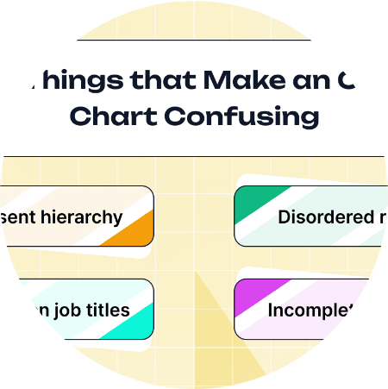
2. CRITIQUE: THE DIAGNOSTIC GAP
Ambiguous Root Causes
Parse trees identify pattern violations, but they do not identify which specific service failed or why.
The Sequitur grammars are often large and non-optimal, creating a "data fog" rather than clear diagnostic instructions for SREs.

Slide 9
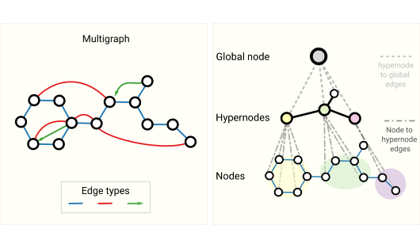
3. SYNTHESIS: THE XHYBRID PROJECT
A Multi-Modal Future
GNN: Incorporates service topology and dependencies.
LSTM: Enhances temporal sequence recognition.
SHAP: Quantifies feature contributions for true RCA.

Slide 10






SYNTHESIS: IMPLEMENTATION STACK
Frameworks
Processing
Explainability
PyTorch, PyTorch Geometric, and NetworkX for graph modeling.
saxpy and sksequitur for grammar-based feature extraction.
SHAP integration to highlight critical services for operators.

Slide 11
Thank you
Tanvir Rahman (22241134)
Brac University | CSE713 Pattern Recognition
Paper DOI: 10.1145/3629527.3651844

