Slide 1

xHybrid: Explainable Hybrid
Anomaly Detection
A Fusion of Grammar and Neural Networks for Traces
TANVIR RAHMAN - 22241134
CSE713 - Advance Pattern Recognition | Fall 2025

Slide 2

PROBLEM STATEMENT
The Challenge
Current Landscape
Microservices generate millions of traces daily. Real-time anomaly detection is critical for maintaining high system reliability.
Approach | Accuracy | Interpretability
Deep Learning | High | Low
Rule-Based | Medium | High
xHybrid (Proposed) | High | High
The central trade-off lies between the accuracy of deep learning and the interpretability of rule-based systems.

Slide 3
LITERATURE REVIEW
Year | Paper / Venue | Key Contribution | Best Metric
2025 | FC-ADL (SoCC) | Causal discovery, 152× faster | F1: 0.95
2024 | Few-Shot (arXiv) | Cross-system transfer | Acc: 93.26%
2024 | CHASE (FSE) | Causal hypergraph RCA | +36.2% A@1
2023 | MSTGAD (ASE) | Twin graph learning | F1: 0.961
2022 | DeepTraLog (ICSE) | Graph-based SVDD | F1: 0.954
2020 | TraceAnomaly (ISSRE) | Service-level VAE | P/R: 0.97

Slide 4
Research Gap
Existing literature fails to combine Structural (GNN), Temporal (LSTM), and Syntactic (Grammar) features with comprehensive multi-level Explainable AI.

Slide 5

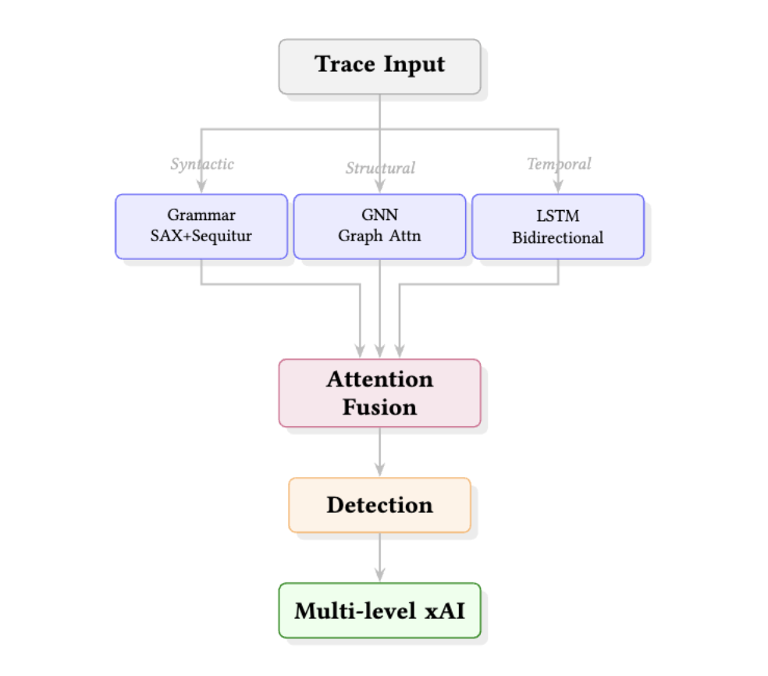
xHybrid ARCHITECTURE
Grammar: SAX + Sequitur for syntactic rules.
GNN: Graph Attention for structural patterns.
LSTM: Bidirectional for temporal features.
Attention: Fuses all branches dynamically.

Slide 6





MULTI-LEVEL EXPLAINABILITY
Level 1
Level 2
Level 3
Grammar Rules
Translates traces into human-readable patterns.
Attention Weights
Highlights specific services contributing to anomalies.
SHAP Values
Quantifies individual feature contributions to the score.
Powered by PyTorch, PyTorch Geometric, LIME, and SHAP.

Slide 7
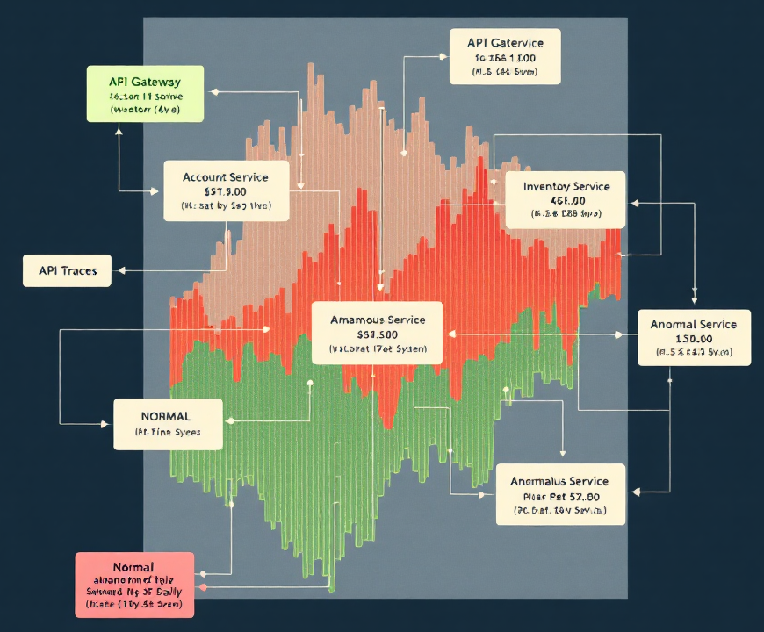
DATASETS & FAULTS
Train-Ticket: 2.8GB, ~76.7M traces (41 services).
Sock-Shop: 13 services (Cross-system validation).
6 Fault Types: CPU, Memory, Disk, Delay, Loss, Socket.
Current Sample: 10K processed traces.

Slide 8
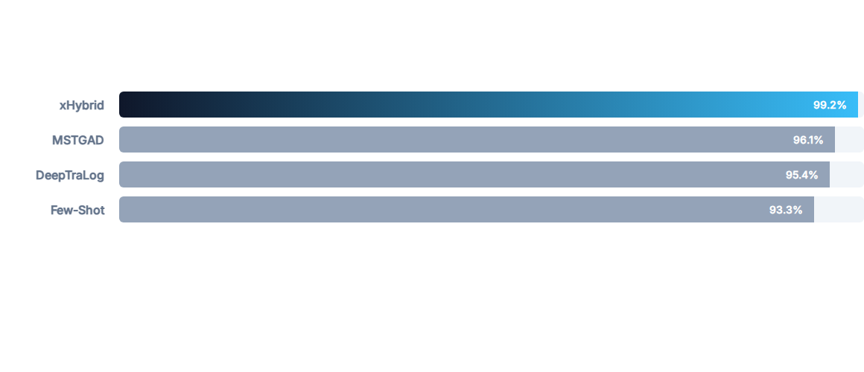
PRELIMINARY PERFORMANCE
Note: xHybrid results are preliminary on 10K sample. Precision/Recall/F1: 0.979.

Slide 9

CURRENT LIMITATIONS
Sample Size: Initial evaluation on 10K traces; full ~76.7M trace validation is required.
Diversity: Currently only single-system (Train-Ticket) testing complete.
Modality: Trace-only input; logs and metrics fusion not yet integrated into the PoC.

Slide 10

FUTURE WORK
Full-scale evaluation on the complete 76.7M trace dataset.
Ablation studies to analyze the contribution of each branch (GNN vs LSTM vs Grammar).
Cross-system validation on Sock-Shop and DeathStarBench.
Visualization of XAI: Attention heatmaps and detailed SHAP plots.

Slide 11





PROJECT SUMMARY
Innovation
Reliability
Validation
Grammar + Neural Fusion for structural and temporal insights.
Addresses the accuracy-interpretability gap in production.
State-of-the-art results (99.2% Accuracy) in early testing.

Slide 12
Thank You
xHybrid: Explainable Hybrid Anomaly Detection
22241134 TANVIR RAHMAN
CSE713 - Advance Pattern Recognition | Fall 2025

