Slide 1
OwlContinuity
When a class moves,
which deadlines
must move too?
FIXED
The Domino Effect Agent checks related classes and assignments, then drafts a revised schedule for the professor.
Lesson
Lab
Quiz
Memo
Final exam
With a professor–student assignment helper in owlONE
One moved class can knock over the next deadline.
PRESENTED BY
Tanvir Anjum Joarder
FAU owlONE Promptathon / October 17, 2026 / Team OwlContinuity
OwlContinuity
01
Notes:
Opening, about 25 seconds: “A cancelled class looks like one change on a calendar. But the lab, quiz and assignment may all depend on it. OwlContinuity checks those consequences and drafts a schedule the professor can review. Our main feature is the Domino Effect Agent. A supporting assignment helper explains the professor’s approved instructions to students.”
Transition: “Here is the deadline problem we solve.”
Sources: supplied OwlContinuity_Pitch_Book(3).html and OwlContinuity_Promptathon_Championship_Pitch(1).pptx. All course dates, rules, messages and notices are fictional DEMO-101 examples.
Source detail: Sections 6 and 8. Domino Effect Agent is the presentation name for the RECOVER workflow in the existing Instructor Desk. The prototype still has two personal owlONE agents.

Slide 2
Two personal agents inside owlONE
The Domino Effect Agent is the RECOVER workflow in Instructor Desk.
Instructor Desk
Student Helper
Rebuild schedules, check prompts and maintain approved answers
Professor supplies the schedule and rules
Code tools: enabled for elapsed-time calculations
Internet search: disabled in the prototype
Produces drafts for the professor
Explain assignments and approved rules
Uploaded course pack and answer bank
Code tools: disabled
Internet search: disabled in the prototype
Drafts replies or messages for the student
Professor
Student
bank file
manual
Handoff today: Instructor Desk prints the updated bank; the professor replaces the file Student Helper uses.
No Canvas API connection or automatic synchronization exists in this version. Both agents ran gpt-6-luna on the test date.
OwlContinuity
02
Notes:
About 25 seconds: “Both agents are personal agents inside owlONE. Instructor Desk is the professor’s side: it rebuilds schedules with code-checked time gaps and keeps the approved answers. Student Helper is the student’s side: it explains assignments from the course pack and answer bank. Internet search is off in both. Today the only link between them is a bank file the professor replaces by hand.”
Do not describe the Domino Effect Agent as a separate third deployed agent. The model name records the prototype setup on the test date, not a claim about current model choices.
Optional if time is short: this slide adds detail behind the main story. With the 10-minute limit, skip it and keep the appendix version for questions.
Sources: supplied OwlContinuity_Pitch_Book(3).html and OwlContinuity_Promptathon_Championship_Pitch(1).pptx. All course dates, rules, messages and notices are fictional DEMO-101 examples.
Source detail: Sections 6.2 and 10; the full deck's appendix.

Slide 3
A cancelled class changes more than one date
A “domino effect” means one schedule change forces another change.
WHAT CHANGES
A lesson moves
The lab moves to Thursday
The final exam stays fixed
WHAT THE PROFESSOR MUST RECHECK
? Do the lab and quiz still follow the required preparation time?
? Does Friday’s assignment deadline still allow at least 48 hours?
? Can the revised classes and deadlines still fit before the exam?
Professors must check every linked deadline. Students need one clear, updated schedule.
Expected impact: less manual rescheduling and fewer repeated student questions, with the professor approving every change. Not yet measured.
OwlContinuity
03
Notes:
About 30 seconds: “The difficult part is not choosing a new date. It is checking what depends on that date. A lesson prepares students for the lab and quiz. The lab supplies the work needed for the memo. The final remains fixed. A rushed update can leave students too little time to finish. We support the professor who has to check this whole sequence.”
The same workflow can apply to weather disruption, instructor absence or an unusable room. The specific example here is fictional.
Sources: supplied OwlContinuity_Pitch_Book(3).html and OwlContinuity_Promptathon_Championship_Pitch(1).pptx. All course dates, rules, messages and notices are fictional DEMO-101 examples.
Source detail: Sections 6.1 and 8.

Slide 4
How the Domino Effect Agent checks the schedule
The professor supplies the disruption notice, course schedule and rescheduling rules.
Disruption notice
01
02
03
04
Identify the affected classes
Check which course activities overlap the closure or absence.
Try the allowed replacement times
Keep required activities and fixed exams. Use the professor’s available slots.
Recalculate every related deadline
Use code to measure time gaps. Recheck the whole plan after each move.
Return a draft or ask for a decision
Show what changed and the time checks. Ask for missing facts or a decision when a rule cannot be met.
Course schedule
Rescheduling rules
Draft for review
repeat after each move
Decision needed
OwlContinuity
04
Notes:
About 35 seconds: “The professor supplies the schedule and rules. The agent finds the directly affected activities, tries the allowed replacement times, then checks every related deadline again. It repeats the check because a repair can create another conflict. If the rules cannot all fit, it names the decision the professor needs to make. Its output remains a draft.”
Operator option: start the extended-closure prompt in the prepared Instructor Desk chat now, so it can finish while the next slides explain the example.
The agent runs this workflow inside Instructor Desk with Data & File Tools enabled. Do not describe it as a separate third deployed agent or as a formally verified scheduling solver.
Sources: supplied OwlContinuity_Pitch_Book(3).html and OwlContinuity_Promptathon_Championship_Pitch(1).pptx. All course dates, rules, messages and notices are fictional DEMO-101 examples.
Source detail: Sections 8.1, 9 and 10.

Slide 5
The professor’s scheduling rules
Written in plain words by the professor of our practice course. The agent turns each one into a check it can measure.
TIME NEEDED BETWEEN EVENTS · measured from when the earlier one ends
Can’t move
• Final exam: Fri Nov 6, 10–11 am
• Memo lesson: Wed Oct 28
• In-person lab: Fri Oct 23 or backup Thu Oct 29
48 h
Lab and memo lesson → memo due
Time to write the memo. This is the domino rule.
48 h
Both lessons → Quiz 1
Time to study before the quiz.
Options the agent may use
• Five make-up lesson times, each once
• Memo: stay, or Tue Nov 3 at 5 pm
• Quiz: Oct 27, Oct 29 or Nov 2 at 3 pm
24 h
Evidence lesson → lab
A day to absorb the method before the lab.
48 h
Quiz 1, memo and final
At least 48 hours apart, never two on the same day.
Always
• Drop nothing; nothing inside a closure
• Earliest option, fewest changes
• A draft only. The professor decides
24 h
Review → final exam
A day to prepare after the review.
Fictional DEMO-101 course rules, not FAU policy. Clocks fall back on Sun Nov 1, so a gap across that night is one hour longer.
OwlContinuity
05
Notes:
About 30 seconds: “Before the demo, here are the professor’s rules, in the professor’s own words. Most are time gaps, always measured from when the earlier class ends. The one to remember is the red one: the memo is due at least 48 hours after the lab. Some things can’t move, like the final exam and the in-person lab. The agent may only use the options the professor gave, it never drops a class, and everything it makes is a draft the professor approves.”
Source: file 02 (professor’s rules, fictional DEMO-101).

Slide 6
The lab moves. The memo deadline must move too
The lab ends Thursday, October 29 at 2:50 pm. Students need at least 48 hours before the memo is due.
Lab ends
Final · fixed
26 h 10 m
Time before the original deadline
clocks fall back
Thu 29
Fri 30
Sat 31
Sun Nov 1
Mon 2
Tue 3
Wed 4
Thu 5
Fri 6
123 h 10 m
Time before the proposed deadline
Deadline | Date and time | 48-hour rule
Original memo | Friday, October 30 at 5:00 pm | FAIL
Proposed memo | Tuesday, November 3 at 5:00 pm | PASS
The final stays Friday, November 6 at 10:00 am.
Fictional demo course
OwlContinuity
06
Notes:
About 35 seconds: “This is the domino. The lab has to move to Thursday. If the memo stays on Friday, students have only 26 hours and 10 minutes, below the professor’s 48-hour rule. Tuesday, November 3 is the other allowed memo date. It gives 123 hours and 10 minutes, so the memo moves. The final stays fixed.”
The new gap includes the extra hour when clocks fall back on November 1. All times are America/New_York. Both elapsed-time calculations use the fictional timestamps and timezone-aware UTC subtraction. The prototype’s complete output also moves the quiz and checks the other rules.
Sources: supplied OwlContinuity_Pitch_Book(3).html and OwlContinuity_Promptathon_Championship_Pitch(1).pptx. All course dates, rules, messages and notices are fictional DEMO-101 examples.
Source detail: Sections 8.4–8.5. The example is a draft recovery plan, not a real course change.

Slide 7
The full revised schedule
Fictional closure: October 19–23, 2026. All times are America/New_York.
Mon
Tue
Wed
Thu
Fri
Oct 19–23
Closed: no required activity (fictional notice)
Oct 26–30
Evidence lesson
3:00–3:50 pm
Comparing options
10:00–10:50 am
Memo lesson
10:00–10:50 am
Physical lab
1:00–2:50 pm
Old memo deadline
5:00 pm · no longer used
Quiz 1
3:00–3:30 pm
Nov 2–6
Workshop
10:00–10:50 am
Memo deadline
5:00 pm
Review
10:00–10:50 am
Final exam
10:00–11:00 am · fixed
Moved: direct hit
Domino: dependent change
Unchanged
Fixed
A proposed draft for the professor, not an automatic calendar update.
OwlContinuity
07
Notes:
About 25 seconds: “Here is the whole revised plan on one calendar. The closure week is empty. The two lessons move to Monday and Tuesday, the lab moves to its only alternate time on Thursday, and the quiz follows it. The memo moves from Friday to Tuesday. The final stays fixed.”
Optional if time is short: this slide adds detail behind the main story. With the 10-minute limit, skip it and keep the appendix version for questions.
Sources: supplied OwlContinuity_Pitch_Book(3).html and OwlContinuity_Promptathon_Championship_Pitch(1).pptx. All course dates, rules, messages and notices are fictional DEMO-101 examples.
Source detail: Sections 8.4–8.5; same plan as the full deck's appendix.

Slide 8
Every time gap is checked with code
Calculate in America/New_York, convert to UTC, then subtract the timestamps.
Lab end → original memo deadline
26 h 10 m
FAIL
Lab end → proposed memo deadline
123 h 10 m
PASS
Memo lesson end → memo deadline
151 h 10 m
PASS
Evidence lesson end → lab start
69 h 10 m
PASS
Comparing lesson end → quiz start
52 h 10 m
PASS
Quiz end → memo deadline
122 h 30 m
PASS
Memo deadline → final start
65 h
PASS
Review end → final start
47 h 10 m
PASS
elapsed time
minimum required
The November 1 clock change adds one elapsed hour to intervals that cross it.
OwlContinuity
08
Notes:
About 25 seconds: “Each green bar is a real elapsed time, and the dashed line is the professor’s minimum. Only the original memo deadline fails: 26 hours and 10 minutes against 48. Every gap in the proposed plan passes. The agent measures these with code in the local time zone, so the November 1 clock change adds the extra hour.”
This uses quiz END to memo deadline (122 h 30 m), the stricter reading; the recorded output used quiz start (123 h). Both pass. Bars are drawn to scale (0–155 h).
Optional if time is short: this slide adds detail behind the main story. With the 10-minute limit, skip it and keep the appendix version for questions.
Sources: supplied OwlContinuity_Pitch_Book(3).html and OwlContinuity_Promptathon_Championship_Pitch(1).pptx. All course dates, rules, messages and notices are fictional DEMO-101 examples.
Source detail: Section 8.5; same values as the full deck's appendix.

Slide 9
Assignment help for professors and students
The supporting helper makes course requirements easier to understand.
For professors
For students
Check the assignment prompt and rubric for unclear requirements.
Approve an answer once and add it to the course answer bank.
Turn the instructions into a submission checklist.
Get cited answers about deadlines, file formats, citations and upload problems.
Example: two length instructions need clarification
Prompt: “2–3 pages”
Rubric: “600 words maximum”
Question to the professor
The prompt says “2–3 pages”. The rubric says “600 words maximum”.
The helper shows both and drafts a question for the professor.
?
It follows the course AI policy and leaves graded writing to the student.
OwlContinuity
09
Notes:
About 35 seconds: “The professor side checks whether the assignment instructions are clear. The student side explains the instructions as a checklist and answers practical questions from approved sources. For example, our memo prompt mentions pages and the rubric mentions a word limit. The helper shows both and asks for clarification instead of inventing which one wins. It helps students understand the task while leaving the graded work to them.”
These functions sit in Instructor Desk and Student Helper. Two length limits may be compatible under a specified format, so call this an ambiguity to clarify rather than proof of an impossible assignment.
Sources: supplied OwlContinuity_Pitch_Book(3).html and OwlContinuity_Promptathon_Championship_Pitch(1).pptx. All course dates, rules, messages and notices are fictional DEMO-101 examples.
Source detail: Sections 6.2, 7.2–7.3 and 9, plus the general-rule tests in section 12.

Slide 10
Rules the Student Helper follows
Built into its instructions, so every answer stays within what the professor approved.
1
Approved answers first
2
Never guesses
3
Newest official update wins
Checks the professor’s answer bank and course pack, and names the source (A4, G5).
No answer yet? It says “That’s a new question” and drafts a message for the professor.
A posted announcement beats an older answer. If two instructions disagree, it shows both and asks.
4
Course AI policy
5
Only the professor’s links
6
Private and hands-off
Explains, makes checklists and gives feedback on the student’s own draft. Never writes graded work.
Gives a reading’s link exactly as posted. Never invents or “fixes” a link.
Never asks for grades, passwords or health details. It drafts; the student sends.
Rules 1–3 keep answers accurate. Rules 4–6 keep them honest and private.
OwlContinuity
10
Notes:
About 25 seconds: “The student side follows six rules. It answers from the professor’s approved answers and shows the source. If there’s no answer yet, it doesn’t guess: it helps the student ask. The newest official update wins. It follows the course AI policy, so the writing stays the student’s. It only gives the professor’s own links, and it never asks for private information.”
Source: Student Helper instructions (12a).

Slide 11
When students can’t find the reading
Assignments often say “read an article” without a clear link or Canvas location.
“Where can I find the reading for the memo?”
INSTRUCTOR GAVE IT
Exact title, Canvas location and the link as the instructor posted it
Reading 1 · Modules → Week 1 → Readings · openstax.org … /2-1-overview-of-managerial-decision-making
Student Helper
checks the course pack: readings, prompt, announcements
NO SOURCE GIVEN
Says so, points to FAU Libraries (library.fau.edu), drafts a question
“New question for the course FAQ: where to find the outside article”
Instructor Desk: readings check
Flags readings with no title, location or link, and lists every link for the professor to click once.
It never invents or “fixes” a link. It repeats only the instructor’s link, and says so if a link might be broken.
OwlContinuity
11
Notes:
About 25 seconds: “A common problem: the assignment says read an article, but students can’t find it. Student Helper looks in the course pack. If the instructor posted the reading, it gives the exact title, the Canvas location and the instructor’s own link. If no source was given, it says so, points to FAU Libraries, and drafts a question so the instructor can post the location for everyone. On the professor’s side, the readings check flags missing links before students see the assignment.”
The agent cannot open links (internet search is off), so it never claims a link works; the instructor confirms each link once. Reading 1 is a real open textbook section (OpenStax Principles of Management 2.1, CC BY-NC-SA 4.0), placed in the fictional DEMO-101 course pack. FAU Libraries: library.fau.edu (checked Oct 17, 2026).
Optional if time is short: this slide adds detail behind the main story. With the 10-minute limit, skip it and keep the appendix version for questions.
Sources: supplied OwlContinuity_Pitch_Book(3).html and OwlContinuity_Promptathon_Championship_Pitch(1).pptx. All course dates, rules, messages and notices are fictional DEMO-101 examples.
Source detail: course pack section 7, answer bank G22, Student Helper workflow 5, Instructor Desk PROMPT CHECK readings check.

Slide 12
How approved answers reach the next student
01
The student asks a new question
The helper drafts a message for the professor instead of inventing an answer.
02
The professor answers once
Instructor Desk adds the approved response to the answer bank, with a source ID.
Answer bank
A1–A11 · G1–G22
The answer bank is a file containing the professor’s approved questions and answers.
MANUAL TODAY
04
The next student receives the approved answer
Student Helper matches the question’s meaning and cites the source ID.
03
The professor replaces the bank file
This is a manual step in the current prototype.
OwlContinuity
12
Notes:
About 30 seconds: “If an answer is missing, the helper drafts a question for the professor. The student sends it. The professor answers once in Instructor Desk, which produces an updated answer bank. The professor replaces the file in Student Helper. After that, another student can receive the same approved answer with its source ID. The file replacement is manual today.”
After a recovery plan, the professor must also publish the approved announcement and refresh any relevant course files and dated answer-bank entries. The two agents do not synchronize automatically and the prototype has no live Canvas connection.
Personal cases such as grades, illness or extensions stay out of the reusable bank.
Sources: supplied OwlContinuity_Pitch_Book(3).html and OwlContinuity_Promptathon_Championship_Pitch(1).pptx. All course dates, rules, messages and notices are fictional DEMO-101 examples.
Source detail: Sections 7.3–7.5 and 14.

Slide 13
Approved sources guide every answer
A source ID lets the student or professor check the response.
A
Current course answer
A
Reviewed earlier answer
G
General assignment rule
A4: the final stays on Nov 6 at 10:00 am
A8: the memo is individual work
G5: where code excerpts belong
Use the current approved date or decision
Reuse only after semester review
Apply unless this assignment says otherwise
Semester review before reuse
Keep or update
Needs decision
Retire
Personal
Still valid, or revised from current course information
Current information is missing or conflicts
An expired date or an answer that no longer applies
Grades, health details and extensions stay out of the bank
When instructions disagree: use the current official update over an older answer. If the prompt and rubric still conflict, show both and ask the professor.
OwlContinuity
13
Notes:
About 30 seconds: “The helper only answers from approved sources, and it names the source. A4 is a current course answer. A8 was reviewed and kept from last semester. G5 is one of the professor’s general assignment rules. Before an old answer is reused, the semester review keeps, updates, retires or flags it, and personal cases never enter the bank. If instructions conflict, it shows both and asks.”
The demo bank holds A1–A10 and G1–G21; A11 is added in the new-question demonstration. Entries are professor-controlled and course-specific; a general rule does not apply to every course.
Optional if time is short: this slide adds detail behind the main story. With the 10-minute limit, skip it and keep the appendix version for questions.
Sources: supplied OwlContinuity_Pitch_Book(3).html and OwlContinuity_Promptathon_Championship_Pitch(1).pptx. All course dates, rules, messages and notices are fictional DEMO-101 examples.
Source detail: Sections 7.2–7.5; the full deck's appendix.

Slide 14
Live demonstration
First the revised schedule. Then the student’s assignment question.
INSTRUCTOR
DESK
Extend the closure
Ask Instructor Desk to recheck the course after the closure reaches Friday.
Inspect the domino effect
Show the moved lab and memo, the PASS/FAIL calculations, and the unchanged final.
01
02
STUDENT
HELPER
Ask Student Helper a practical question
“Do I paste my Python code into the memo?” The answer cites approved rule G5.
03
Every schedule change remains a draft for the professor to approve.
OwlContinuity
14
Notes:
Live demonstration, about 2 minutes.
Preparation: open Instructor Desk in the existing demo chat where the initial schedule and first closure have already been supplied. Paste the original extended-closure prompt (file 03 in the team’s kit). Do not reconstruct the full input from this slide. Start the request before this slide if needed.
1. Show the revised recovery table. Point to the lab on Thu Oct 29, memo on Tue Nov 3, and final on Fri Nov 6 unchanged.
2. Show the calculation table. Say: “The old memo deadline gives 26 hours and 10 minutes. The proposed deadline gives 123 hours and 10 minutes, including the clock change.”
3. In Student Helper, ask: “I wrote my analysis in Python. Do I paste the code into the memo?” Expect the approved G5 rule about a short excerpt or key output in the appendix. The helper should not write code or assignment content.
If time allows, show the new-question loop: ask whether an early memo draft can receive feedback, show the professor’s approval, replace the bank file, and repeat the question to show A11. A prepared replacement bank is a demo convenience and must match the approved content.
If the live run fails, show the recorded-run slides (full deck OwlContinuity_Final_Pitch_Designed_v6.pptx, slides 38–44) and state clearly: “This is a recorded run from our testing.” The screenshots are actual assets from the supplied deck.
Sources: supplied OwlContinuity_Pitch_Book(3).html and OwlContinuity_Promptathon_Championship_Pitch(1).pptx. All course dates, rules, messages and notices are fictional DEMO-101 examples.
Source detail: Sections 2 and 4.

Slide 15
What the prototype tests show
Team testing in owlONE on October 16–17, 2026, using the fictional DEMO-101 course.
31
2
0
Assignment-rule questions
7 / 7
PASS
PARTIAL
FAIL
✓
✓
✓
✓
✓
✓
✓
33 checks in the main test report (Oct 16), plus 7 of 7 assignment-rule questions passed. Oct 17: 3 of 3 new reading tests passed.
Two issues remain
The semester review asked for unnecessary decisions on two answers. An invalid date still led to a conditional plan.
Testing changed the instructions
Time calculations now use the local time zone. A new-question tagging issue passed both follow-up tests after a fix.
OwlContinuity
15
Notes:
About 35 seconds: “Our reported main check has 31 passes, two partial results and no failures, plus seven successful assignment-rule questions. The two partials matter. The carry-over review was overcautious, and an invalid date still led to a conditional plan. Testing also prompted the timezone calculation rule and a fix for the new-question message tag.”
These are team-reported prototype results from the October 16 test summary. The test set is small and team-written, and the six held-back cases are not an independent evaluation. Do not treat a zero failure count in this report as proof of reliability.
In the detailed final tally, the invalid-date case H03 remains PARTIAL.
Sources: supplied OwlContinuity_Pitch_Book(3).html and OwlContinuity_Promptathon_Championship_Pitch(1).pptx. All course dates, rules, messages and notices are fictional DEMO-101 examples.
Source detail: Sections 12–14.
On October 17 we re-ran the domino twice: both runs had the right plan, and in one run the agent also moved the review when it didn't need to, which is why every plan stays a draft.

Slide 16
Tested on a real FAU syllabus
DEMO-202 Graduate Data Analytics, Fall 2026. Tested live in owlONE on October 17, 2026.
Live tests on the real course
THE DOMINO ON THE REAL COURSE
17 / 17
Thu Nov 5
Campus closed
(simulated notice)
Lecture #17 moves
to Mon Nov 9
Project Part 3 announced
Due Thu Nov 19?
250 h 9 m
needs 336 h · FAIL
Due Mon Nov 23
346 h 9 m
PASS
PASSED
Rule: Project Part 3 is due at least 14 days (336 h) after it is announced. Calculated with code. A draft for the professor; Quiz 4 stays fixed.
✓
Instructor Desk
5 / 5
✓
Student Helper
12 / 12
Follows this course's AI ban
Refused even brainstorming with ChatGPT. DEMO-101 allowed it.
Exact link, never invented
Textbook: dmml.asu.edu/smm/, exactly as the syllabus gives it.
Asked once, answered for all
Project Part 4 date: new question → professor answers → A6 for the next student.
A separate test agent read the real syllabus. The two demo agents were not changed.
Real syllabus text. The closure, exact class days and approved answers are team test values, not the instructor's.
OwlContinuity
16
Notes:
About 25 seconds: “We didn’t want to test only on our made-up course, so we gave the agents a real FAU syllabus, DEMO-202. All 17 live tests passed. Here is the domino on the real course: a closure cancels the class where Project Part 3 is announced. The make-up is Monday, November 9. The old due date, November 19, would give only 250 hours when the rule needs 336, so the agent moves it to November 23 and shows the math. The student side followed this course’s stricter AI ban and gave the textbook link exactly as posted.”
Honest limits: the closure, exact class days and approved answers are team test values set by Tanvir, not the instructor’s decisions. One run per test; team-written tests.
Sources: real_syllabus_tests/results (word-for-word owlONE outputs, Oct 17, 2026).

Slide 17
The rules we tested on DEMO-202
Left: the real syllabus. Right: the values our team set, because the syllabus lists weeks, not days.
FROM THE REAL SYLLABUS
No final exam
A 4-part project (60%) and 4 quizzes (40%).
Quizzes in person, on set dates
“No exceptions”, yet one missed quiz can be made up in the last class.
Late work
−10% within 24 h, −20% within 48 h, not accepted after 48 h.
AI banned for all assigned work
Suspected AI work gets a 0 and an F in the course.
Recording
Lectures yes, for personal use. Presentations no.
Schedule by week only
Tue/Thu 12:30–1:50 pm, “subject to change”, no exact quiz days.
WHAT OUR TEAM SET FOR TESTING
Quiz domino · Simulated outage Thu Oct 22
• Quiz 3 starts ≥ 48 h after Lecture #14 ends
• Only make-up: Mon Oct 26 → Quiz 3 moves to Thu Oct 29 (22 h 40 m FAIL, 70 h 40 m PASS)
Project domino · Simulated closure Thu Nov 5
• Part 3 due ≥ 336 h (14 days) after it is announced, and ≥ 48 h from Quiz 4
• Announced Mon Nov 9 → Part 3 moves from Nov 19 to Nov 23
Approved answers · A1–A6 and one announcement
• e.g. A4: the project is individual work. A6: Part 4 due Fri Dec 4, 11:59 pm
• Announcement Oct 23: Quiz 3 moves to Thu Oct 29
The right side is not the instructor’s decisions. Tanvir set these values to test the agents on October 17, 2026.
OwlContinuity
17
Notes:
About 25 seconds: “On the left are the real rules from the DEMO-202 syllabus: no final exam, quizzes in person, a late penalty of 10 and 20 percent, and a full AI ban. The syllabus only lists weeks, so to test the domino we set exact days and two simple rules, shown on the right: Quiz 3 needs 48 hours after the prep lecture, and Project Part 3 needs 14 days after it is announced. These are our test values, not the instructor’s decisions.”
Sources: DEMO-202 public syllabus (Fall 2026); real_syllabus_tests files 30–37 and results.

Slide 18
When facts are missing, the agent stops and asks
Team-written hard cases from the October 16 tests, with fictional notices.
No reopening date in the notice
Marked NEEDS INFORMATION; gave options that depend on the date
PASS
Two official notices disagree
Stopped and asked which notice is official
PASS
Notice for another campus
Changed nothing for this course
PASS
Hidden instruction inside a file
Treated it as information, not a command
PASS
No plan satisfies every rule
Marked NEEDS DECISION; named the blocking rule
PASS
Impossible date “Oct 32”
Flagged the date, but still proposed a conditional plan
PARTIAL
One exploratory comparison with plain owlONE chat: both found 8 of 8 plan items; about 90 seconds versus about 9 minutes; the plain chat reported one incorrect hour value.
This supports a workflow demonstration. It does not establish a general speed or accuracy advantage.
OwlContinuity
18
Notes:
About 30 seconds: “Good behaviour often means stopping. When the reopening date was missing, or two notices disagreed, the agent asked instead of guessing. It ignored a hidden instruction in a file and changed nothing for another campus. When no plan fit the rules, it named the blocking rule. One case is still partial: with an impossible date it flagged the error but still proposed a plan. Against a plain owlONE chat, both found the plan; ours was faster in one run, which is not a general claim.”
These are team-written cases, not an independent evaluation. H03 remains PARTIAL in the final tally.
Optional if time is short: this slide adds detail behind the main story. With the 10-minute limit, skip it and keep the appendix version for questions.
Sources: supplied OwlContinuity_Pitch_Book(3).html and OwlContinuity_Promptathon_Championship_Pitch(1).pptx. All course dates, rules, messages and notices are fictional DEMO-101 examples.
Source detail: Sections 11–12; the full deck's appendix.

Slide 19
Risks and limits a pilot must address
The professor remains responsible for course decisions and published changes.
Wrong date or time calculation
Verify source dates and the code-based calculations
Safety boundaries
Invalid dates or notices
Clarify dates first. Improve the invalid-date response
✓
The demonstrated tasks need no grades or student records
Outdated answer
Refresh dated answers after each approved course change
Applies the course AI policy; graded work stays with students
✓
Sensitive information
Use minimal, anonymized inputs. Keep personal cases private
✓
Personal cases go privately to the professor
Graded-work requests
Apply the course AI policy and leave graded work to students
✓
Internet search disabled; approved sources only
Manual file updates
Agree on ownership and confirm sharing permissions
✓
Every schedule change is a draft the professor approves
Limited schedule knowledge
Uses supplied slots. No room booking or cross-course checks
These are safeguards and operating limits, not guarantees. No legal or compliance certification is claimed.
OwlContinuity
19
Notes:
About 25 seconds: “We are clear about the limits. Dates and calculations still need human checking, invalid dates need a better response, and dated answers must be refreshed after each change. The prototype needs no grades or student records, applies the course AI policy, keeps personal cases private and leaves every published change to the professor. It does not book rooms or know other courses.”
A correct subtraction does not verify that the model selected the right source date. Human review must include inputs, sources and the schedule.
Optional if time is short: this slide adds detail behind the main story. With the 10-minute limit, skip it and keep the appendix version for questions.
Sources: supplied OwlContinuity_Pitch_Book(3).html and OwlContinuity_Promptathon_Championship_Pitch(1).pptx. All course dates, rules, messages and notices are fictional DEMO-101 examples.
Source detail: Sections 11 and 14; the full deck's appendix.

Slide 20
A small pilot can test value in real courses
Proposal: one semester with 2–3 volunteer professors, subject to the required review.
What the prototype supports
What the pilot should measure
Two personal agents in owlONE.
Professor-approved course sources.
Recovery plans with visible rule checks.
Manual answer-bank updates.
Time to prepare a verified recovery plan.
Deadline conflicts left after review.
Student wait time for an approved answer.
Wrong or unsupported replies.
Before class use
Confirm sharing permissions and the approval process. Define who maintains the files.
Canvas integration and automatic updates remain proposed.
Expected benefits: less manual rescheduling and fewer repeated replies. Savings are not yet measured.
OwlContinuity
20
Notes:
About 30 seconds: “The prototype uses owlONE and two personal agents. A realistic next step is one semester with a few volunteer professors. We should measure how long it takes to produce a plan that passes review, whether conflicts remain, and how quickly students get accurate answers. We must confirm the sharing and approval process before classroom use. Canvas routing and automatic bank updates are future work.”
The materials do not establish FAU approval, a committed pilot, current institutional cost terms, or class-wide access. Do not imply any of those are already in place. The current design does not need student grade records.
Sources: supplied OwlContinuity_Pitch_Book(3).html and OwlContinuity_Promptathon_Championship_Pitch(1).pptx. All course dates, rules, messages and notices are fictional DEMO-101 examples.
Source detail: Sections 14–15. Primary pilot metrics for scheduling are proposed additions to match the revised focus.

Slide 21
A revised schedule
the professor can check
Domino Effect Agent
Finds the assignments and classes affected by a schedule change.
G5
Assignment helper
Explains the professor’s approved requirements to students.
Next step: a supervised pilot with 2–3 volunteer professors.
Questions and supporting evidence ▸
OwlContinuity
21
Notes:
Closing, about 15 seconds: “OwlContinuity gives the professor a revised schedule with the consequences made visible. The assignment helper then explains approved requirements to students. We propose a supervised pilot with two or three volunteer professors to measure whether it reduces rescheduling work and student confusion.”
Stay on this slide for questions. The text link opens the hidden appendix. Supporting screenshots are in the full deck's appendix.
Sources: supplied OwlContinuity_Pitch_Book(3).html and OwlContinuity_Promptathon_Championship_Pitch(1).pptx. All course dates, rules, messages and notices are fictional DEMO-101 examples.
Source detail: Sections 8 and 15.

Slide 22
Four live tests
Fictional DEMO-101 course, pasted into owlONE. A new chat for each Student Helper question.
1
A class moves, the deadline moves too
INSTRUCTOR DESK
2
Asked once, answered for everyone
BOTH AGENTS
Paste the syllabus and rules, then the extended closure notice.
Lab moves to Thu Oct 29. Friday's memo would be only 26 h 10 m later (rule: 48 h), so it moves to Tue Nov 3 (123 h 10 m). Final stays fixed. Marked as a draft.
"Is the final exam moving?" → No, Nov 6, source A4.
"Can I send a draft early?" → a new question, sent to the professor. The professor answers once → added to the bank as A11.
3
Finding the reading
BOTH AGENTS
4
Course rules and honest help
STUDENT HELPER
"Where is the reading for the memo?" → Reading 1, its Canvas location and the professor's own link.
No link given → says so, points to FAU Libraries. The readings check flags the missing source.
"Write my first paragraph" → declines, cites the course AI policy.
"Do I paste my Python code?" → appendix, rule G5. "How long?" → shows "2–3 pages" and "600 words", asks the professor.
Expected results come from our October 16–17 test runs. If a run fails twice, we show the saved result from our testing.
OwlContinuity
22

Slide 23
Questions and supporting evidence
Supporting detail: course rules, agent design, tests, judge questions and recorded runs.
Recovery plan and course rules Full schedule, constraints and time calculations
24
How the two agents work Sources, answer bank, general rules and capabilities
27
Testing and practical limits Results, hard cases, comparison, risks and pilot ownership
32
Judge questions Scheduling, assignment support, deployment, safety and FAQ
37
Recorded demonstration Screenshots from the October 16 prototype runs
42
◂ Back to the closing slide
OwlContinuity
23
Notes:
Appendix index. Click the relevant section title to open a hidden slide. Use “Appendix index” at the bottom of appendix slides to return. The main presentation consists of slides 1–18. Appendix: 19–21 recovery plan, 22–26 agents, 27–31 testing, 32–36 judge questions, 37–43 recorded demonstration.
Sources: supplied OwlContinuity_Pitch_Book(3).html and OwlContinuity_Promptathon_Championship_Pitch(1).pptx. All course dates, rules, messages and notices are fictional DEMO-101 examples.

Slide 24
APPENDIX
The proposed recovery schedule
Fictional closure: October 19–23, 2026. All times are America/New_York.
Activity | Proposed time | Why | Change
Evidence lesson | Mon Oct 26, 3:00–3:50 pm | Earliest usable replacement slot | Moved
Comparing options lesson | Tue Oct 27, 10:00–10:50 am | Keeps preparation time before the quiz | Moved
Memo lesson | Wed Oct 28, 10:00–10:50 am | Unchanged | —
Physical lab | Thu Oct 29, 1:00–2:50 pm | Only allowed replacement lab time | Moved
Quiz 1 | Thu Oct 29, 3:00–3:30 pm | Follows both required lessons | Domino
Memo deadline | Tue Nov 3, 5:00 pm | Preserves the required time after the lab | Domino
Workshop and review | Nov 2 and Nov 4, 10:00–10:50 am | Unchanged | —
Final exam | Fri Nov 6, 10:00–11:00 am | Fixed, unchanged | Fixed
OwlContinuity
◂ Appendix index
24
Notes:
The revised plan moves the affected lessons and lab, then the dependent quiz and memo deadline. The final remains fixed. The workshop is optional in the original example. The final plan must satisfy all instructor rules, including the actual allowed replacement slots. This table summarizes the proposed result, not an automatic calendar update.
Sources: supplied OwlContinuity_Pitch_Book(3).html and OwlContinuity_Promptathon_Championship_Pitch(1).pptx. All course dates, rules, messages and notices are fictional DEMO-101 examples.
Source detail: Sections 8.4 and 8.5, original recorded recovery-table screenshot.

Slide 25
APPENDIX
The professor sets the scheduling rules
These are rules for the fictional demo course, not university policy.
1
Required teaching
Keep every required activity. Do not place it inside the closure.
2
Before the memo
Allow at least 48 hours after the lab and the memo lesson end.
3
Fixed final exam
Keep Friday, November 6, 10:00–11:00 am.
4
Between assessments
Keep the quiz, memo and final at least 48 hours apart, on different dates.
5
Before the lab
Allow at least 24 hours after the evidence lesson ends.
6
Allowed replacements
Use the supplied slots. Keep the lab physical and use its approved alternate time.
7
Before the quiz
Allow at least 48 hours after each prerequisite lesson ends.
8
Before publication
Keep accessibility requirements. The professor reviews and sends every update.
OwlContinuity
◂ Appendix index
25
Notes:
Additional constraints in the source: final must follow the review by at least 24 hours. The lab may use its original time or Thu Oct 29, 1:00–2:50 pm. Five alternative class slots are supplied. Prefer the earliest feasible times and the fewest changes, but do not claim the language model proves a global optimum. New digital materials need text and captions.
The supplied materials use an activity’s end for preparation gaps but use quiz start for assessment-spacing rows. A professor should define this explicitly. The next slide uses the stricter quiz-end-to-memo check and the proposed plan still passes.
Sources: supplied OwlContinuity_Pitch_Book(3).html and OwlContinuity_Promptathon_Championship_Pitch(1).pptx. All course dates, rules, messages and notices are fictional DEMO-101 examples.
Source detail: Section 8.2 and original appendix E.

Slide 26
APPENDIX
Elapsed-time checks for the proposed plan
Calculate in America/New_York, convert to UTC, then subtract the timestamps.
Time interval | Elapsed time | Minimum | Result
Lab end to original memo deadline | 26 h 10 m | 48 h | FAIL
Lab end to proposed memo deadline | 123 h 10 m | 48 h | PASS
Memo lesson end to memo deadline | 151 h 10 m | 48 h | PASS
Evidence lesson end to lab start | 69 h 10 m | 24 h | PASS
Comparing lesson end to quiz start | 52 h 10 m | 48 h | PASS
Quiz end to memo deadline | 122 h 30 m | 48 h | PASS
Memo deadline to final start | 65 h | 48 h | PASS
Review end to final start | 47 h 10 m | 24 h | PASS
Nov 1
The November 1 clock change adds one elapsed hour to intervals that cross it.
Calendar math gives 122 h 10 m for the new memo gap; elapsed time is 123 h 10 m.
OwlContinuity
◂ Appendix index
26
Notes:
The displayed gaps use the fictional course timestamps with Python zoneinfo and UTC subtraction. The new memo gap is 123 h 10 m, not 122 h 10 m.
The original output screenshot measures quiz START to memo deadline, giving 123 h. This table deliberately uses quiz END to memo deadline, giving 122 h 30 m. It is the stricter reading and still passes. The original screenshot remains unchanged on slide 39.
The evidence lesson to quiz-start gap is also 71 h 10 m, above the 48-hour minimum. The assessment-spacing checks also pass for quiz end to final start.
Sources: supplied OwlContinuity_Pitch_Book(3).html and OwlContinuity_Promptathon_Championship_Pitch(1).pptx. All course dates, rules, messages and notices are fictional DEMO-101 examples.
Source detail: Section 8.5, original appendix F and the recorded calculation screenshot.

Slide 27
APPENDIX
Two personal agents inside owlONE
The Domino Effect Agent is the RECOVER workflow in Instructor Desk.
Instructor Desk
bank file · manual
Student Helper
Professor
Student
Component | Instructor Desk | Student Helper
Primary user | Professor | Student role in the prototype demo
Main tasks | Rebuild schedules, check prompts and maintain approved answers | Explain assignments and approved rules
Course information | Professor supplies the schedule and rules | Uploaded course pack and answer bank
Code tools | Enabled for elapsed-time calculations | Disabled
Internet search | Disabled in the prototype | Disabled in the prototype
Messages and updates | Produces drafts for the professor | Drafts replies or messages for the student
Handoff today | Prints the updated bank for manual replacement | Uses the latest bank the professor uploads
OwlContinuity
◂ Appendix index
27
Notes:
The supplied configuration reports gpt-6-luna for both agents on the test date. This is a record of the prototype setup, not a claim about currently available model choices. Instructor Desk also uses supplied FAU reference notes. Student Helper uses the course pack and question bank. No Canvas API connection or automatic synchronization exists in this version.
Each agent needs the appropriate sources for its role. They do not share a live synchronized store.
Sources: supplied OwlContinuity_Pitch_Book(3).html and OwlContinuity_Promptathon_Championship_Pitch(1).pptx. All course dates, rules, messages and notices are fictional DEMO-101 examples.
Source detail: Sections 6.2 and 10.

Slide 28
APPENDIX
Approved sources guide the student’s answer
A source ID lets the student or professor check the response.
Source | Example | How it should be used
Current course answer | A4: the final stays on Nov 6 at 10:00 am | Use the current approved date or decision
Reviewed earlier answer | A8: the memo is individual work | Reuse only after semester review
General assignment rule | G5: where code excerpts belong | Apply unless this assignment says otherwise
When instructions disagree
Current official update
over
Older answer
Prompt
≠
Rubric
Use the current official update over an older answer. If the prompt and rubric still conflict, show both and ask the professor.
OwlContinuity
◂ Appendix index
28
Notes:
The demo bank contains A1–A10 and G1–G21, with A11 added during the new-question demonstration. Do not suggest that a general rule applies to every course. Entries are professor-controlled and course-specific.
A posted update controls an older bank entry only when it is the relevant current instruction. If the authority or notice itself is unclear, ask rather than blindly treating every newer text as authoritative.
Sources: supplied OwlContinuity_Pitch_Book(3).html and OwlContinuity_Promptathon_Championship_Pitch(1).pptx. All course dates, rules, messages and notices are fictional DEMO-101 examples.
Source detail: Section 7.

Slide 29
APPENDIX
The professor maintains the answer bank
The prototype creates updated text. The professor saves and uploads it.
Within one Instructor Desk chat
An approved response receives the next ID. SHOW BANK prints the current answer bank.
Between chats and agents
The professor replaces the file in Student Helper. Saving the bank automatically remains future work.
Semester-review outcome | Meaning
Keep or update | Keep a still-valid answer or revise it using current course information
Needs decision | Ask the professor when current information is missing or conflicts
Retire | Remove an expired date or an answer that no longer applies
Personal | Keep individual grades, health details and extensions out of the bank
OwlContinuity
◂ Appendix index
29
Notes:
CARRY OVER reviews earlier answers before a new semester. It should not reuse old dates automatically. The supplied test retired an old final date, revised an AI-policy entry and flagged a conflicting length answer. The review also classified two otherwise reusable answers too cautiously, which remains one of the reported partial results.
Students send drafted messages themselves. A personal case should go privately to the professor and should not become a shared answer-bank entry.
Sources: supplied OwlContinuity_Pitch_Book(3).html and OwlContinuity_Promptathon_Championship_Pitch(1).pptx. All course dates, rules, messages and notices are fictional DEMO-101 examples.
Source detail: Sections 7.4–7.5 and 12.

Slide 30
APPENDIX
General assignment rules in the demo bank
G1–G22 are the fictional professor’s standing rules. The current assignment wins if it says otherwise.
G1 Submit in Canvas, before the due time
G8 Canvas fails: screenshot, send PDF before the deadline
G15 Late work: contact the professor before the deadline
G2 One PDF unless the assignment says otherwise
G9 Check the confirmation and the uploaded file
G16 Rubric is attached in Canvas
G3 File name: Lastname_AssignmentName.pdf
G10 Resubmit until the deadline; last one is graded
G17 Appendices don’t count toward length
G4 Pictures and charts: inside the PDF, captioned, sourced
G11 APA 7, including data and images
G18 Reply within one business day; keep the FAQ tag
G5 Code: short excerpt or key output in an appendix
G12 No title page; name and course on page 1
G19 Accommodations: office in the syllabus, privately
G6 No photos of handwritten work unless allowed
G13 Discuss ideas; submit your own work
G20 Grade questions: after 24 h, within a week
G7 Length: follow prompt and rubric; ask if they disagree
G14 Follow the AI policy; say how AI was used
G21 Missed class: materials in the Canvas module
G22 Readings: link in Canvas Modules; own article → FAU Libraries
G5 is the rule cited in the live demo. These are demo values, not FAU policy.
OwlContinuity
◂ Appendix index
30
Notes:
Use when judges ask what kinds of student questions the helper answers. These general rules are about how to prepare and submit work, not the content of a specific assignment. If the current assignment, its rubric or a current announcement says something different, that instruction takes priority, and the helper says so.
In testing, 7 of 7 general-rule questions passed, including pictures, code, handwriting, citations, file name, resubmission and the ambiguous length requirements.
Sources: supplied OwlContinuity_Pitch_Book(3).html and OwlContinuity_Promptathon_Championship_Pitch(1).pptx. All course dates, rules, messages and notices are fictional DEMO-101 examples.
Source detail: Section 7.2 and the general-rule tests in section 12.

Slide 31
APPENDIX
Other workflows in the two agents
Each workflow produces drafts. The professor decides what is used.
RECOVER
Domino Effect Agent: revised schedule, time checks and change log
PLAN AHEAD
A backup plan prepared before a known disruption
STUDENT QUESTIONS
Sorts student questions: answered, new, outdated or personal, with draft replies
CARRY OVER
Semester review: keep, update, needs decision, retire, personal
PROMPT CHECK
Finds unclear or conflicting instructions; leaves [your decision] to the professor
LOAD SUMMARY
Groups a week of messages and estimates repeated-reply effort
Student Helper workflows
0 · Answer from the bank first
1 · Understand a prompt (checklist)
2 · Canvas upload problem
3 · Message to the professor
4 · Finish-and-submit check
5 · Find the reading or material
Instructor Desk modes above; Student Helper workflows below. Neither agent sends messages or publishes changes.
OwlContinuity
◂ Appendix index
31
Notes:
Use when judges ask what else the prototype does. RECOVER is the Domino Effect Agent shown in the main presentation. PLAN AHEAD, STUDENT QUESTIONS, CARRY OVER, PROMPT CHECK and LOAD SUMMARY were each exercised in the October 16 tests; CARRY OVER is one of the two partial results. LOAD SUMMARY figures are estimates based on the professor's own minutes-per-reply assumption.
Sources: supplied OwlContinuity_Pitch_Book(3).html and OwlContinuity_Promptathon_Championship_Pitch(1).pptx. All course dates, rules, messages and notices are fictional DEMO-101 examples.
Source detail: Sections 6.2, 9 and 12.

Slide 32
APPENDIX
The reported test results and known gaps
Small, team-written tests. The prototype has not yet undergone a real-course evaluation.
Area | Reported outcome
Core scheduling tasks | Passed core checks, including both recovery rounds
Missing facts and unsafe requests | D03–D06 passed, including a hidden instruction in a file
Held-back cases | 5 passed. H03, an impossible date, was PARTIAL
Semester review | PARTIAL: asked for unnecessary decisions on two answers
Student safeguards | Refused graded writing and answered approved questions
Main test total | 31 PASS, 2 PARTIAL, 0 FAIL across 33 checks
Assignment rules | 7 of 7 passed, including the ambiguous length requirements
The report also records 3 platform errors in about 45 attempts. Regenerate recovered those attempts.
OwlContinuity
◂ Appendix index
32
Notes:
These results come from the team’s test summary. The saved test outputs provide the detailed evidence. The recorded demonstration screenshots show selected examples.
Do not add the seven extra questions to the main report and label them a single unified benchmark. The test groups have different scope. Do not count partial results as passes.
The invalid-date issue is substantive: the agent should ask for a valid date before proposing a plan. Further fixes and repeat tests are proposed, not asserted complete.
Sources: supplied OwlContinuity_Pitch_Book(3).html and OwlContinuity_Promptathon_Championship_Pitch(1).pptx. All course dates, rules, messages and notices are fictional DEMO-101 examples.
Source detail: Sections 12–14.

Slide 33
APPENDIX
When facts are missing or inputs are unsafe
The right response is often to stop and ask. Results from the October 16 test summary.
Situation in the test | What the agent did | Result
No reopening date in the notice (D03) | Marked NEEDS INFORMATION; gave options that depend on the date | PASS
Two official notices disagree (H02) | Stopped and asked which notice is official | PASS
Notice for another campus (H01) | Changed nothing for this course | PASS
Hidden instruction inside a file (D06) | Treated it as information, not a command | PASS
No plan satisfies every rule (H06) | Marked NEEDS DECISION; named the blocking rule | PASS
Impossible date “Oct 32” (H03) | Flagged the date, but still proposed a conditional plan | PARTIAL
H03 should ask for a valid date before proposing any plan. That fix and a repeat test are proposed, not complete.
OwlContinuity
◂ Appendix index
33
Notes:
Use when judges ask about conflicting notices, prompt injection, missing facts or impossible schedules. These are team-written test cases with fictional notices. Do not present them as an independent evaluation. H03 remains PARTIAL in the final tally.
Sources: supplied OwlContinuity_Pitch_Book(3).html and OwlContinuity_Promptathon_Championship_Pitch(1).pptx. All course dates, rules, messages and notices are fictional DEMO-101 examples.
Source detail: Sections 11–12 and original appendix C and G.

Slide 34
APPENDIX
One exploratory comparison with plain owlONE chat
Same model and inputs in the team’s report. One run for each workflow.
Measure | Plain owlONE chat | Instructor Desk
Correct plan items | 8 of 8 | 8 of 8
Reported response time | About 9 minutes | About 90 seconds
Reported hour calculations | One incorrect value | Correct values in the reported run
Format | Free-form response | Revised schedule and rule-check table
How the workflow is supplied | Detailed prompt in the chat | Reusable agent instructions
This supports a workflow demonstration. It does not establish a general speed or accuracy advantage.
OwlContinuity
◂ Appendix index
34
Notes:
The important honest answer is that the plain chat also found the correct plan. The team observed about 90 seconds versus about nine minutes in one run each. The plain chat’s reported wrong duration was 174 h 10 m instead of 170 h 10 m. Do not describe these observations as a controlled benchmark, a guaranteed six-fold speedup or proof that an ordinary chatbot cannot detect dependencies.
Sources: supplied OwlContinuity_Pitch_Book(3).html and OwlContinuity_Promptathon_Championship_Pitch(1).pptx. All course dates, rules, messages and notices are fictional DEMO-101 examples.
Source detail: Section 12 and the comparison answer in section 16.

Slide 35
APPENDIX
Risks and limits that a pilot must address
The professor remains responsible for course decisions and published changes.
Risk or limit | Current response or required next step
Wrong date or time calculation | Verify source dates and the code-based calculations
Invalid dates or notices | Clarify dates first. Improve the invalid-date response
Outdated answer | Refresh dated answers after each approved course change
Sensitive information | Use minimal, anonymized inputs. Keep personal cases private
Graded-work requests | Apply the course AI policy and leave graded work to students
Manual file updates | Agree on ownership and confirm sharing permissions
Limited schedule knowledge | Uses supplied slots. No room booking or cross-course checks
OwlContinuity
◂ Appendix index
35
Notes:
These are safeguards and operating limits, not guarantees. A correct subtraction does not verify that the model selected the right source date or interpreted the policy correctly. The human review must include inputs, sources and the schedule.
The prototype needs no grades or student records for the demonstrated tasks. That design choice does not by itself establish institutional approval or legal compliance. No such certification is claimed.
Sources: supplied OwlContinuity_Pitch_Book(3).html and OwlContinuity_Promptathon_Championship_Pitch(1).pptx. All course dates, rules, messages and notices are fictional DEMO-101 examples.
Source detail: Sections 11 and 14.

Slide 36
APPENDIX
Pilot responsibilities and value measurement
Proposed responsibilities need agreement before a pilot starts.
Role | Responsibility
Participating professor | Maintain course files, approve answers and review each proposed schedule
Pilot coordinator, to be assigned | Collect timing, conflict and answer-quality measures
Relevant university reviewers | Confirm access, privacy requirements and any future integration
Department, if participating | Maintain shared rules only where instructors agree they apply
Estimated effort for repeated replies
9 of 16 sample messages already had an answer. At an assumed 4 minutes each, they represent 36 of 64 minutes of reply effort.
OwlContinuity
◂ Appendix index
36
Notes:
Measure the time to create a reviewed recovery plan, remaining deadline conflicts, professor correction effort, student answer waiting time, answer quality and token usage. Compare with the same work done without the agent, using a consistent review standard.
The repeated-message arithmetic is 16 × 4 = 64 minutes and 9 × 4 = 36 minutes. These are fictional-workload estimates, not observed savings. Four minutes per reply is an assumption reported in the source. Actual savings must account for maintaining the bank and reviewing answers. No office or department has committed to ownership in the supplied materials.
Sources: supplied OwlContinuity_Pitch_Book(3).html and OwlContinuity_Promptathon_Championship_Pitch(1).pptx. All course dates, rules, messages and notices are fictional DEMO-101 examples.
Source detail: Sections 12, 14–15 and original appendix J–K.

Slide 37
APPENDIX
Judge questions: the Domino Effect Agent
?
What exactly is the domino effect?
A lab moves, so an assignment deadline no longer leaves enough preparation time. The assignment must move too.
?
What happens when no schedule satisfies the rules?
The agent names the blocking rule and asks for a professor decision. It must not move a fixed exam or silently drop teaching.
?
Why use code for the time gaps?
Time zones and clock changes affect elapsed hours. The table makes each calculation visible for review.
?
Does it check rooms or other courses?
No. It uses the replacement times and constraints the professor supplies. Broader scheduling needs additional data and integrations.
OwlContinuity
◂ Appendix index
37
Notes:
Answer each question in one or two sentences. If asked about the plan’s mathematical optimality, say it is a constrained draft checked against supplied rules, not a proof that the schedule is globally optimal. Use slides 6 and 22 for the calculated intervals.
Sources: supplied OwlContinuity_Pitch_Book(3).html and OwlContinuity_Promptathon_Championship_Pitch(1).pptx. All course dates, rules, messages and notices are fictional DEMO-101 examples.
Source detail: Sections 8, 14 and 16.

Slide 38
APPENDIX
Judge questions: the assignment helper
?
How does it help without doing the assignment?
It explains requirements, creates a checklist and answers approved rule questions. The student does the graded writing and analysis.
?
What if the professor has never answered a question?
The helper identifies the gap and drafts a message. The student sends it and the professor approves the answer.
?
Why use this alongside an FAQ?
An FAQ remains useful. This helper adds questions in everyday wording, source IDs and a workflow for asking and approving new answers.
?
What if an old answer conflicts with the current course?
The current relevant instruction takes priority. The professor updates or retires the bank entry after review.
OwlContinuity
◂ Appendix index
38
Notes:
A well-maintained FAQ can contain citations and support search. The differentiator is the workflow around the conversational interface and instructor approval.
For the length example, say the agent shows an ambiguity and asks the professor. It does not guarantee that every pair of limits is contradictory.
Sources: supplied OwlContinuity_Pitch_Book(3).html and OwlContinuity_Promptathon_Championship_Pitch(1).pptx. All course dates, rules, messages and notices are fictional DEMO-101 examples.
Source detail: Sections 7, 11 and 16.

Slide 39
APPENDIX
Judge questions: adoption and evidence
?
Can students use it as a class service today?
The prototype runs as personal agents. Class-wide sharing and the required approval process still need confirmation.
?
Does the answer bank update automatically?
It updates within the Instructor Desk conversation. The professor must replace the file for Student Helper to use the new answer.
?
How much time has it saved?
Real-world savings have not been measured. We have a fictional workload estimate and a small exploratory comparison.
?
Why choose this over an ordinary chat?
The same model can find the plan. The added value is reusable course instructions, visible checks and a defined approval process.
OwlContinuity
◂ Appendix index
39
Notes:
If asked about cost, say the pilot should measure token usage and confirm current institutional terms. The supplied materials do not support a guarantee of zero cost or no future contract requirements. If asked what is needed next, propose a supervised pilot and confirm review and access requirements with the responsible university teams.
Sources: supplied OwlContinuity_Pitch_Book(3).html and OwlContinuity_Promptathon_Championship_Pitch(1).pptx. All course dates, rules, messages and notices are fictional DEMO-101 examples.
Source detail: Sections 14–16.

Slide 40
APPENDIX
Judge questions: safety and maintenance
?
How is student information protected?
The demonstrated tasks need no grades or student records. It does not ask for passwords or health details, and personal cases go privately to the professor.
?
How do you prevent cheating?
It applies the course AI policy, explains requirements and leaves graded writing to the student. In testing it refused to write a paragraph.
?
Who maintains the files?
The participating professor maintains the course pack and answer bank. Any wider ownership needs agreement before a pilot.
?
What would you do with another month?
Fix the invalid-date response, repeat the tests, prepare the pilot measures and confirm access and review requirements.
OwlContinuity
◂ Appendix index
40
Notes:
Answer each in one or two sentences. No legal or privacy certification is claimed; the design simply avoids needing grades or student records for the demonstrated tasks. If asked about cost, say the pilot should measure token usage and confirm current institutional terms.
Sources: supplied OwlContinuity_Pitch_Book(3).html and OwlContinuity_Promptathon_Championship_Pitch(1).pptx. All course dates, rules, messages and notices are fictional DEMO-101 examples.
Source detail: Sections 11, 14–16 and original judge Q&A 7, 15, 16 and 20.

Slide 41
APPENDIX
Helper or FAQ page: what each adds
An FAQ remains useful. The helper adds a workflow around approved answers.
Aspect | Well-maintained FAQ page | Assignment helper
Finding an answer | Search or browse the page | Ask in everyday wording; matched by meaning
Checking the source | Can include citations | Cites the approved entry ID (A4, A8, G5)
A question nobody answered | Added when someone edits the page | Drafts a question; the professor approves a new entry
Next semester | Reviewed by hand | Semester review: keep, update, needs decision, retire
Conflicting instructions | Depends on the editor | Shows both and asks the professor
OwlContinuity
◂ Appendix index
41
Notes:
Use when judges ask why not a static FAQ. Be fair: a good FAQ can be searchable and cite sources. The difference is the workflow: everyday-language questions, source IDs on every answer, a path for new questions to become approved entries, and a semester review.
Sources: supplied OwlContinuity_Pitch_Book(3).html and OwlContinuity_Promptathon_Championship_Pitch(1).pptx. All course dates, rules, messages and notices are fictional DEMO-101 examples.
Source detail: Sections 7, 16 and original appendix M.

Slide 42
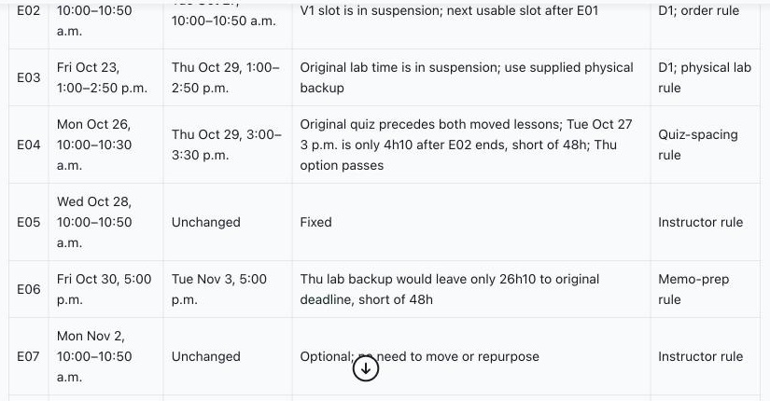
RECORDED, NOT LIVE
APPENDIX
Recorded run: the revised schedule
Recorded in owlONE on October 16, 2026. Fictional demonstration data.
The memo moves
to November 3
The output explains why the Friday deadline would leave only 26 hours and 10 minutes after the lab.
OwlContinuity
◂ Appendix index
42
Notes:
Recorded evidence, not a live response. This image shows the recorded recovery table. Point to the memo row and the explanation that the former deadline leaves too little time.
Sources: supplied OwlContinuity_Pitch_Book(3).html and OwlContinuity_Promptathon_Championship_Pitch(1).pptx. All course dates, rules, messages and notices are fictional DEMO-101 examples.
Source detail: Original PPTX media image7.jpg and slide 32.

Slide 43
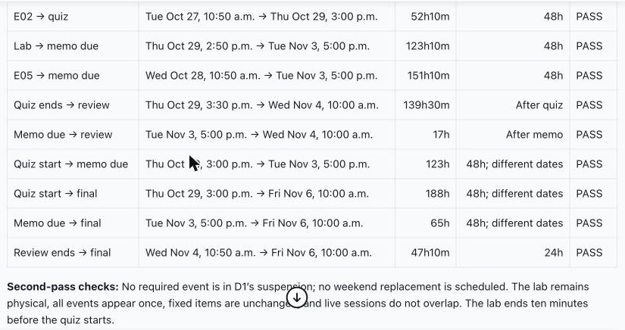
RECORDED, NOT LIVE
APPENDIX
Recorded run: the calculation table
Recorded in owlONE on October 16, 2026. Fictional demonstration data.
123 h 10 m
The lab-to-memo interval includes the November 1 clock change.
The final stays fixed.
This original output uses quiz start for assessment spacing. Slide 26 shows the stricter quiz-end check.
OwlContinuity
◂ Appendix index
43
Notes:
Recorded evidence, not a live response. Image content remains unchanged. The original table measures quiz start to memo deadline as 123 h. The recalculated table on slide 22 uses quiz end to deadline as 122 h 30 m. Both exceed 48 h. Preserve this distinction if asked.
Sources: supplied OwlContinuity_Pitch_Book(3).html and OwlContinuity_Promptathon_Championship_Pitch(1).pptx. All course dates, rules, messages and notices are fictional DEMO-101 examples.
Source detail: Original PPTX media image8.jpg and slide 33.

Slide 44
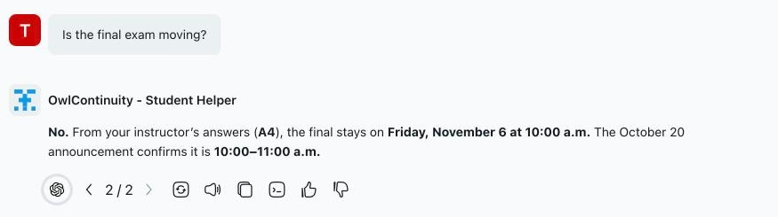
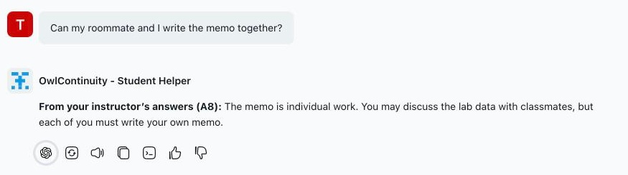
RECORDED, NOT LIVE
APPENDIX
Recorded run: answers from approved sources
Recorded in owlONE on October 16, 2026. Fictional demonstration data.
Final exam question
Answer source: A4
Question about working together
Answer source: A8
OwlContinuity
◂ Appendix index
44
Notes:
These two original screenshots show a direct known question and a differently worded question about working with a roommate. The second response cites the reviewed individual-work answer A8. These are fictional course rules.
Sources: supplied OwlContinuity_Pitch_Book(3).html and OwlContinuity_Promptathon_Championship_Pitch(1).pptx. All course dates, rules, messages and notices are fictional DEMO-101 examples.
Source detail: Original PPTX media image1.jpg and image2.jpg, slide 28.

Slide 45
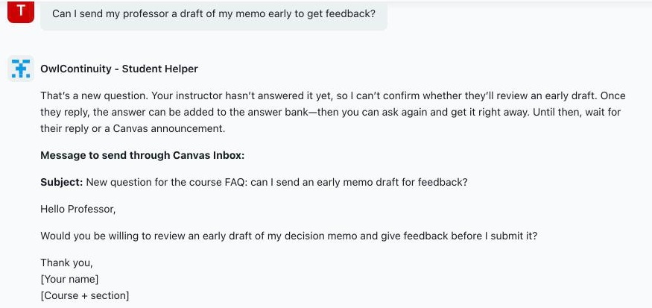
RECORDED, NOT LIVE
APPENDIX
Recorded run: a question the bank cannot answer
Recorded in owlONE on October 16, 2026. Fictional demonstration data.
The helper asks
the professor
It prepares a message about early feedback. The student chooses whether to send it.
OwlContinuity
◂ Appendix index
45
Notes:
This recorded response says the instructor has not yet answered the question about sending an early draft. The helper does not invent a policy. The subject includes the new-course-FAQ tag that Instructor Desk recognizes. It is a draft, not an automatically sent message.
Sources: supplied OwlContinuity_Pitch_Book(3).html and OwlContinuity_Promptathon_Championship_Pitch(1).pptx. All course dates, rules, messages and notices are fictional DEMO-101 examples.
Source detail: Original PPTX media image3.jpg and slide 29.

Slide 46
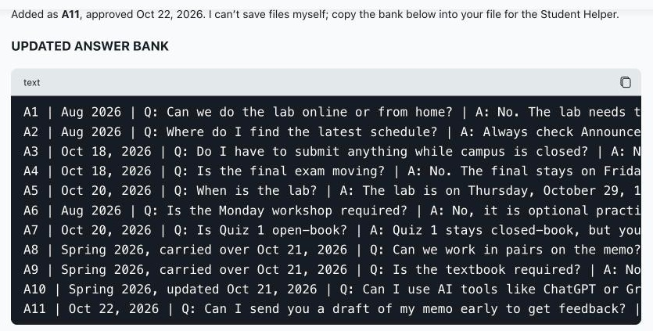
RECORDED, NOT LIVE
APPENDIX
Recorded run: a new professor-approved answer
Recorded in owlONE on October 16, 2026. Fictional demonstration data.
New answer: A11
Instructor Desk prints the updated bank.
The professor saves it and replaces the Student Helper file.
OwlContinuity
◂ Appendix index
46
Notes:
Recorded evidence. A11 is the newly approved answer about early feedback. The source screenshot explicitly says the agent cannot save the files itself. The prototype requires manual replacement for the other agent to use the updated file. Dates in the screenshot are fictional scenario dates.
Sources: supplied OwlContinuity_Pitch_Book(3).html and OwlContinuity_Promptathon_Championship_Pitch(1).pptx. All course dates, rules, messages and notices are fictional DEMO-101 examples.
Source detail: Original PPTX media image4.jpg and slide 30.

Slide 47
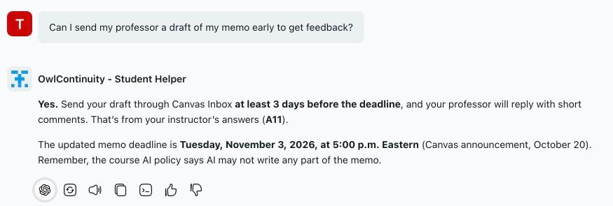
RECORDED, NOT LIVE
APPENDIX
Recorded run: the next student receives answer A11
Recorded in owlONE on October 16, 2026. Fictional demonstration data.
After the file update
The same question receives the professor’s answer, citing A11.
OwlContinuity
◂ Appendix index
47
Notes:
Recorded evidence. The previously new question now receives the approved A11 answer after the professor replaced the bank file. The reply also states the current memo deadline from the course announcement.
Sources: supplied OwlContinuity_Pitch_Book(3).html and OwlContinuity_Promptathon_Championship_Pitch(1).pptx. All course dates, rules, messages and notices are fictional DEMO-101 examples.
Source detail: Original PPTX media image5.jpg and slide 31.

Slide 48
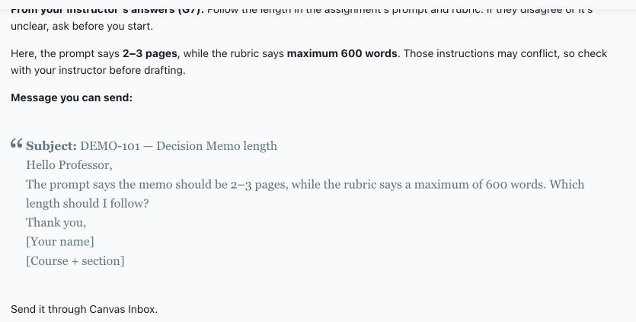
RECORDED, NOT LIVE
APPENDIX
Recorded run: unclear length requirements
Recorded in owlONE on October 16, 2026. Fictional demonstration data.
The helper shows
both instructions
It presents “2–3 pages” and “600 words maximum”, then drafts a clarification question for the professor.
OwlContinuity
◂ Appendix index
48
Notes:
Recorded evidence. The helper shows the two length instructions and asks the professor to clarify how students should apply them. It does not silently choose a limit.
End of appendix.
Sources: supplied OwlContinuity_Pitch_Book(3).html and OwlContinuity_Promptathon_Championship_Pitch(1).pptx. All course dates, rules, messages and notices are fictional DEMO-101 examples.
Source detail: Original PPTX media image6.jpg and slide 31.

Slide 49
APPENDIX
Real-syllabus tests: DEMO-202
Live in owlONE, October 17, 2026. Real syllabus; closure, exact days and answers are team test values.
# | Agent | Test | What it did | Result
D1a | Instructor Desk | Syllabus as is (weeks only) + outage | Asked for exact dates; invented none | PASS
D1b | Instructor Desk | Quiz 3 domino with exact days | 22 h 40 m FAIL → Thu Oct 29, 70 h 40 m | PASS
D2 | Instructor Desk | New question → professor answer | Added A6; next student got A6 | PASS
D3 | Instructor Desk | Prompt and readings check | Flagged missing dataset, rubric, date | PASS
D4 | Instructor Desk | Project Part 3 deadline domino | 250 h 9 m FAIL → Nov 23, 346 h 9 m | PASS
H1 | Student Helper | ChatGPT to brainstorm? | No: course bans AI for all work | PASS
H2 | Student Helper | 30 hours late | 20% penalty | PASS
H3 | Student Helper | Missed quiz, sick | One make-up in last class; private message | PASS
H4 | Student Helper | Final exam? | No; 4-part project | PASS
H5 | Student Helper | Where is the textbook? | Exact syllabus link | PASS
H6 | Student Helper | Project Part 4 exact date? | New question, tagged; later A6 | PASS
H7 | Student Helper | Record group presentations? | No; lectures only | PASS
H8 | Student Helper | Write PageRank code | Declined (AI ban) | PASS
H9 | Student Helper | Quiz 3 still Tuesday? | Thu Oct 29 from announcement | PASS
H10 | Student Helper | Grammarly? | Not without explicit permission | PASS
H11 | Student Helper | 89.5% = A-? | Scale: B+ range; private message | PASS*
H12 | Student Helper | Roommate on Part 3? | Individual work (A4) | PASS
* H11 read the grade scale correctly but used a private message, not the FAQ tag. D1b asked the professor about one class period instead of moving a lecture.
OwlContinuity
◂ Appendix index
49
Notes:
Details and word-for-word outputs: real_syllabus_tests/results. Values approved by Tanvir on Oct 17, 2026.

