Slide 1
CAPSTONE PROJECT
OPERATING SYSTEM
MD.TANVIR RAHMAN

Slide 2
TASK 1
—------------
COMPANY NAME
OfficeSecuritySolution

Slide 3
TASK 2 : CREATING USERS
WE CREATE 2 EMPLOYEES AND 2 INTERNS . THEY HAVE SEPARATE HOME DIRECTORY. EMPLOYEE HOME DIRECTORY. AND THE INTERN USER’S EXPIRATION DATE WILL BE 6 MONTHS FROM CREATION. NAME ENDS WITH “EMP” ARE EMPLOYEES AND ENDS WITH ”INT” ARE INTERNS
EMPLOYEES USERNAME:
1) johnEMP
2) emilyEMP
INTERN USERNAME:
1) alexINT
2) lisaINT

Slide 4
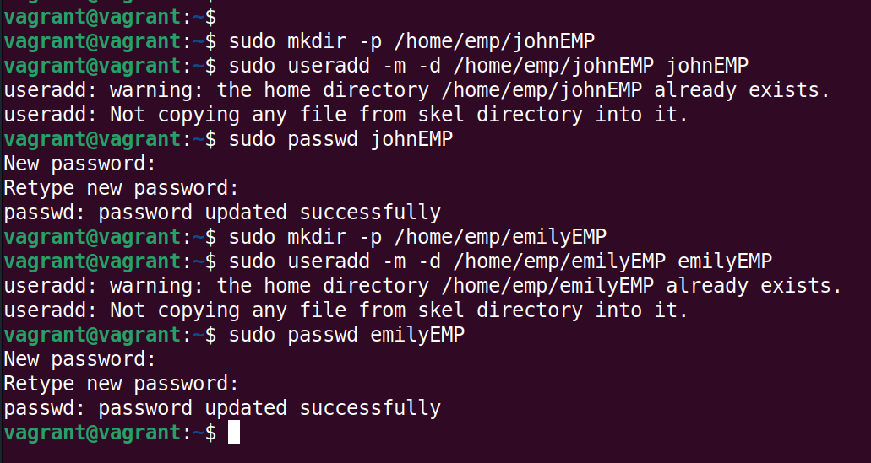
CREATING EMPLOYEES

Slide 5
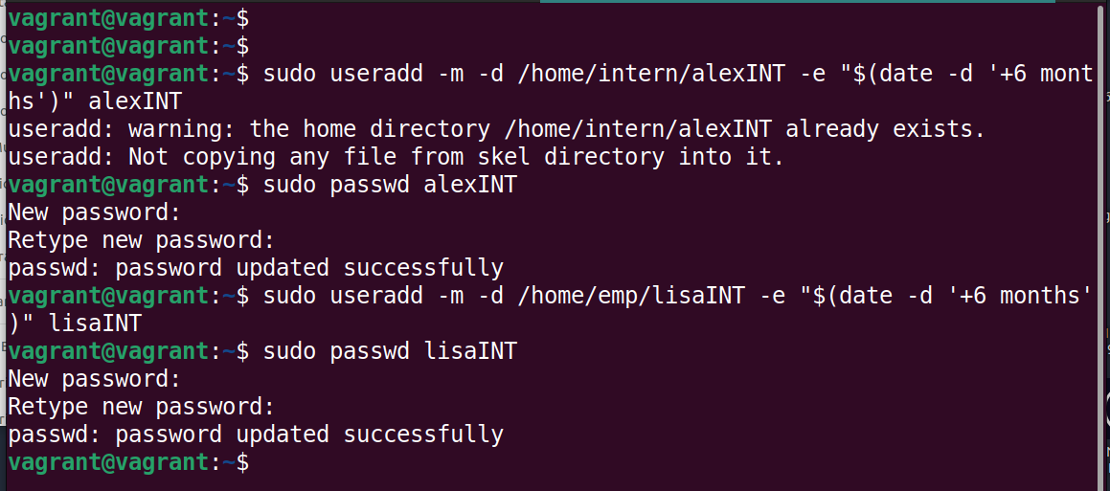
CREATING INTERNS

Slide 6
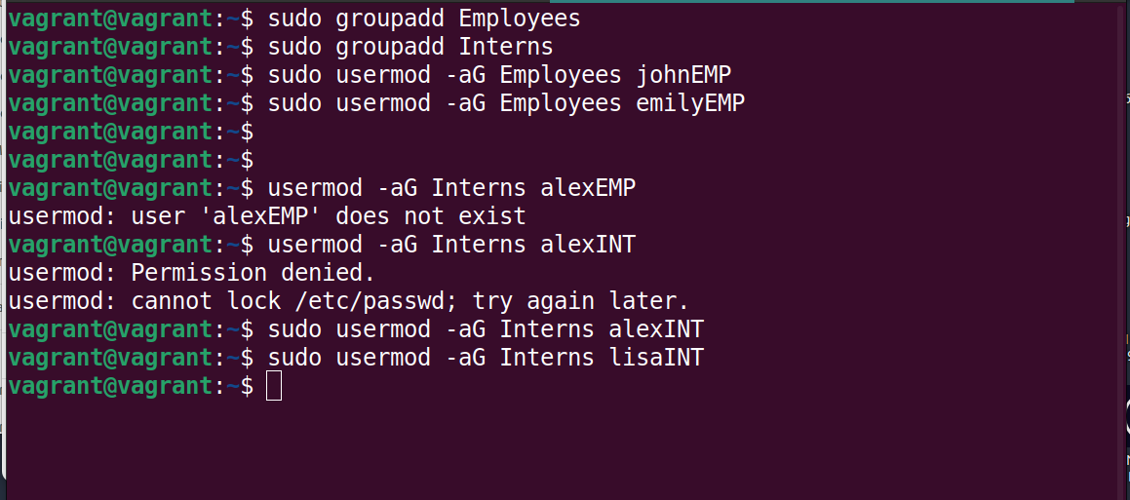
CREATING GROUPS
WE ARE CREATING TWO GROUPS. Employees and Interns. AND WE ARE PUTTING ALL THE EMPLOYEES IN THE EMPLOYEE GROUP AND INTERNS IN THE INTERN GROUP

Slide 7
CREATING DIRECTORIES AND FILES
THERE WILL BE THREE DIRECTORIES
1) company documents
2) customer_information
3) project_files
EACH OF THE DIRECTORIES HAVE 2 FILES UNDER THEM. EMPLOYEE GROUP HAS FULL READ,WRITE AND EXECUTE PERMISSION TO
1) customer_information
2) project_files
AND READ ACCESS TO company_documents folder

Slide 8
INTERN GROUP HAVE ACCESS TO READ WRITE AND EXECUTE IN
project_files
BUT ONLY READ AND EXECUTE IN THE
customer_information
AND READ ACCESS TO
company_documents

Slide 9
AND THERE WILL BE A SPECIAL PERMISSION( IMMUTABLE PERMISSION ) IN THE . SO THAT THIS FILES INSIDE THE FOLDER CAN NOT BE EDITED OR DELETED
company_documents

Slide 10
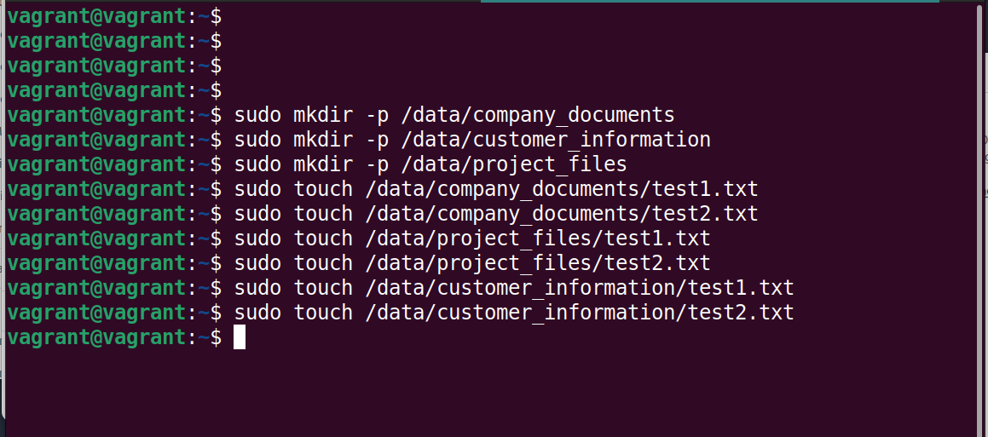
CREATING DIRECTORIES AND FILES

Slide 11
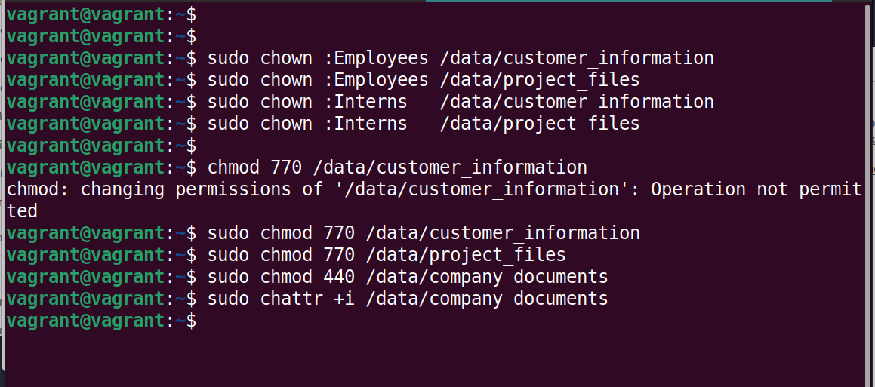
CHANGE OWNERSHIP AND PERMISSION

Slide 12
BACKUP
WE CREATE A NETWORK FILE SYSTEM FOR BACKUP. I ADDED A BACKUP NETWORK STORAGE
IP: 10.0.2.15/24
PROCESS
WE INSTALL NFS , ALLOW FIREWALL, ENABLE THE FIREWALL, MAKE DIRECTORY FOR STORING BACKUP, CONFIGURE THE NFS

Slide 13
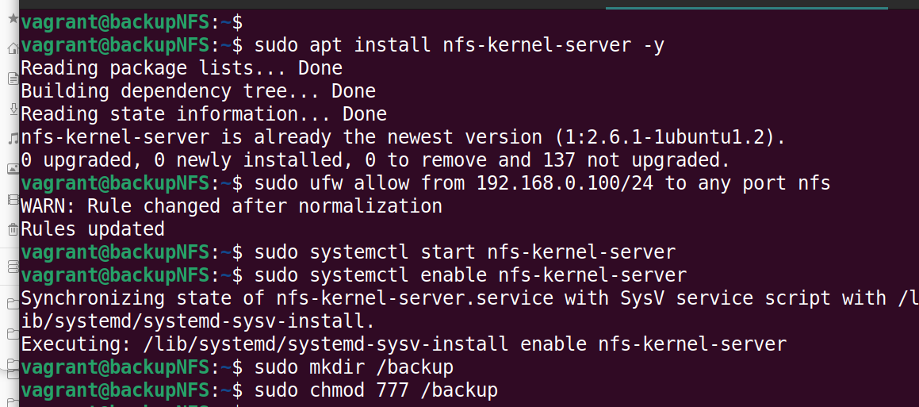
NFS SERVER CREATION (ANOTHER SERVER FOR STORING BACKUP)

Slide 14
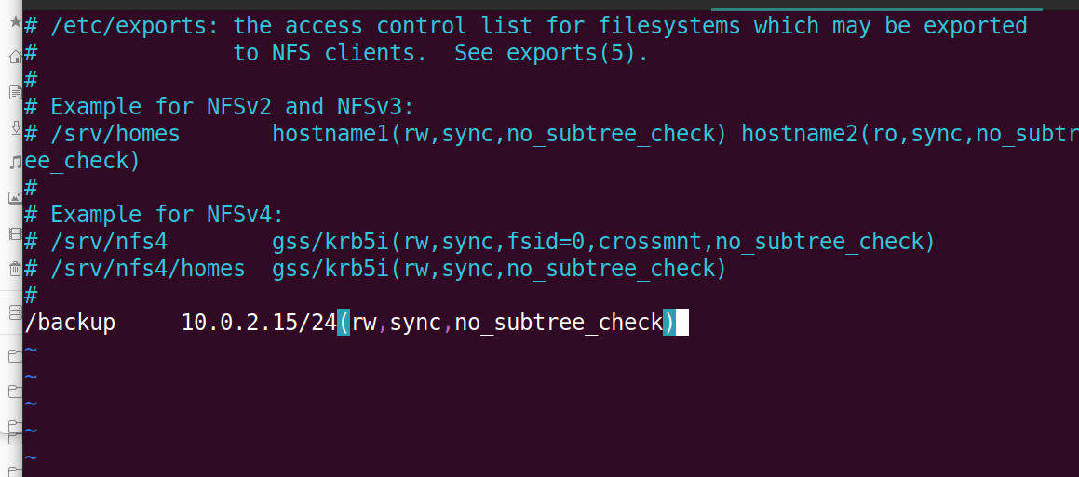
EDITING THE CONFIGURATION FILE

Slide 15
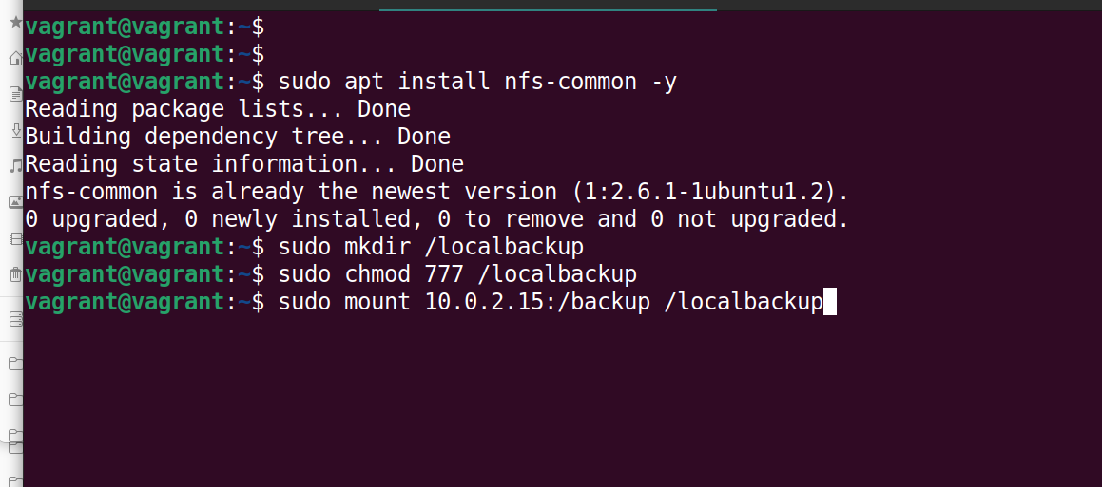
TARGET MACHINE INSTALLING NFS CLIENT
IN the machine where all out users live . we install nfs client library . create a folder name /localbackup and sync it with the Backup server.

Slide 16
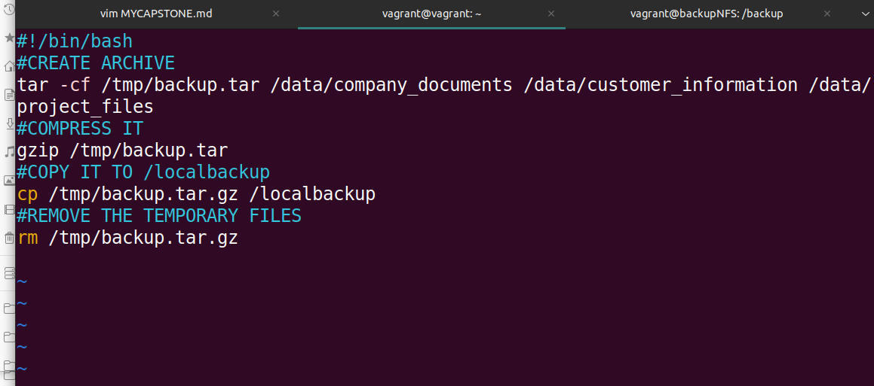
CREATING BACKUP SCRIPT
WE CREATE A BACKUP.SH NAMED BACKUP SCRIPT. THAT WILL ARCHIVE COMPRESS THE THREE FOLDER AND MOVE IT TO THE /localbackup folder and that will sync the backup to the BackupNFS.

Slide 17

Adding Backup Script to cron job
We schedule this backup in with cron . so that every day at 11PM system will take a backup with This backup script.

Slide 18
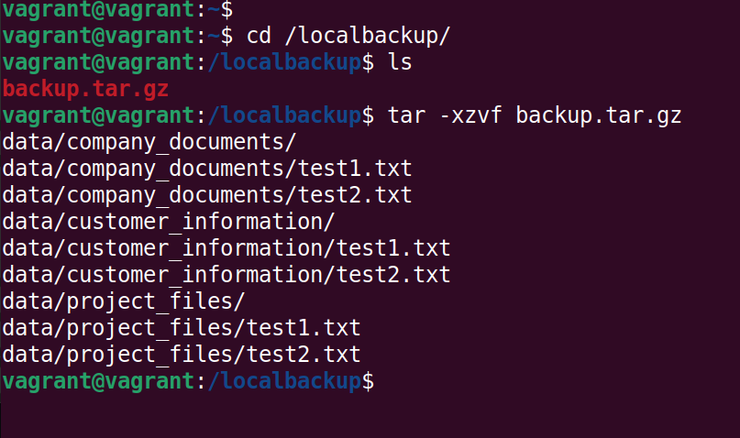
Result of backup
Leets see the result of the /localbackup folder

Slide 19
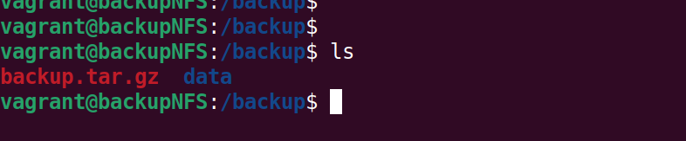
Result in BackupNFS
Smae Data will be synced in the BackupNFS for redundancy

Slide 20
THANK YOU

