Slide 1


Your Gym and Personal Trainer to Go.
EXIST Gov.-Grant
BA-Financing
70+ Beta Users
130% Kickstarter
5+ LOI Distribution
Ⓒ STRAFFR 2020
EXIST-Grant BA-Financing | Kickstarter | 70+ Beta user | 5+ Distribution LOI
Notes:
Hi, we‘re STRAFFR.
My name is [presenter].

Slide 2












STRAFFR SOFTWARE ARCHITECTURE
User
Coach
STRAFFR APP
Data Analytics
Big Data Analytics
API
BigQuery
Google Cloud Plattform
Machine Learning & AI
Cloud ML Engine
Integrate with other services
Cloud Firestore
Cloud Functions
Cloud Storage
Cloud Pub/Sub

Slide 3


CLOUD FIRESTORE BASICS
Documents
In Cloud Firestore, the unit of storage is the document. A document is a lightweight record that contains fields, which map to values. Each document is identified by a name.
A document representing a user thellmuth might look like this:
thellmuth
first : “Torben"
last : “Hellmuth"
born : 1991
You may notice that documents look a lot like JSON. In fact, they basically are. There are some differences (for example, documents support extra data types and are limited in size to 1 MB), but in general, you can treat documents as lightweight JSON records.
Collections
Documents live in collections, which are simply containers for documents. For example, you could have a users collection to contain your various users, each represented by a document:
users
thellmuth
first : “Torben"
last : “Hellmuth"
born : 1991
hstorz
first : “Hanno"
last : “Storz"
born : 1989

Slide 4
CLOUD FIRESTORE TOP LEVEL ARCHITECTURE
User Data
Workout Data
Exercise Data
Users
Workouts
Exercises
User
1
User
2
User
3
User
x
WO
1
WO
2
WO
x
WO
1
WO
2
WO
x
Workouts
Stats/Achievements
Exercise
WO
1
WO
2
WO
x
Stats
Ach
EX
1
EX
2
EX
x
Exercise
EX
1
EX
2
EX
x

Slide 5
CLOUD FIRESTORE TOP LEVEL ARCHITECTURE
STRAFFR Collections
The STRAFFR database is structured into three major data collections to store the data most effectively and reduce the amount of reads and writes.
User Data
Containing all user specific data, such as:
personal information
workout results
statistics and achievements
Workout Data
Containing all workout specific data, such as:
title
tescription short and long
intensity
duration
workout Picture UID
workout UID
exercise UIDs
Exercise Data
Containing all exercise specific data, such as:
name
instructions
areas
difficulty
repetitions
speed
exercise Picture Reference
exercise Video Reference
exercise UID

Slide 6
CLOUD FIRESTORE USER DATA EXAMPLE
The user data collection stores all stats and achievements as well as the results of a every workout. The workout information such as name and description, belonging to the results can be retrieved through the unique workout ID that is stored with the results. This separation reduces duplicate data storage as well as reads and writes. The exercise subcollection is optional and can store the results of every single exercise.
users
UID (Bsp.: lUSJ0geQlEXYYGPEILWyPjQiBAZ2)
title: 29
firstFitnessGoal: 3
fullName: “Torben Hellmuth”
height: 183
imageUrl1: “https://firebasestorage.googleapis.com/v0/b/straffr-5.appspot.com/o/images%2F8EF0BED9-125C-449B-90F5-F11DAFF41ABC?alt=media&token=6ef1f168-d76d-4be8-82e3-f2cfd3fc96d4”
secondFitnessGoal: 4
Uid: lUSJ0geQlEXYYGPEILWyPjQiBAZ2
workout
UID (Bsp.: 051WwxyxwYayvR6VOYzHe2pciVy2)
con : 28.250
ecc: 30.330
reps: 8
sumKg: 32
Time: 28 May 2020 at 15:18:05 UTC+2
tut: 45.549
wd: 108
wo_ref: “lUSJ0geQlEXYYGPEILWyPjQiBAZ2”

Slide 7
CLOUD FIRESTORE WORKOUT DATA EXAMPLE
Predefined workouts are stored in the workout collection and used to display the available workouts in the app. The app frontend is listening to changes and only fetches the data if a document was changed. This enables on the fly updates of workout descriptions and parameters such as languages or reps without an app update. The exercise subcollection references the single exercises and enables parametrization.
workout
Performance Quickie
title: “Performance Quickie”
description short: “Effective and challenging workout plan to get in shape”
intensity: “high”
duration: 25
workout UUID: lUSJ0geQlEXYYGPEILWyPjQiBAZ2
…
exercise
Seated Row
title: “Seated Row”
uuid:”….”
reps: 8
speed: 5
…
Dead Bug Push
title: “Dead Bug Push”
…

Slide 8
CLOUD FIRESTORE EXERCISE DATA EXAMPLE
All exercise available in the app are predefined here. Every exercise is stored as a separate document containing all corresponding information, as described in the cloud firestore top level architecture. When a new workout is created, those exercises only have to be referenced and parameters like reps and speed can be adjusted according to the coaches needs. When training a single exercise or creating your own workout the singe exercise can be fetched and adjusted as well.
exercise
Seated Row
title: “Seated Row”
instructions: “ ….!
areas: “Back”
difficulty: “Medium”
exercise_uid: “…”
reps: 8
speed: 5
…
Dead Bug Push
title: “Dead Bug Push”
instructions: “ ….!
areas: “Back”
difficulty: “Low”
…
…

Slide 9

FRONT-END / BACK-END INTERACTION
exercise & workout updates
notifications
stats & achievements
wakeup
start workout
API
resistance value
timestamp
user data
workout results
stats & achievements

Slide 10
Backup

Slide 11
Data Collection
Option 1
Option 2
Option 3
Exercise Data
Exercise Data
Exercise Data
User Data – no separate calculation needed
Exercise data saved in itself
Exercise data is being saved in WO document
Exercise data is being saved in a different location
WO Data
WO ID: Integer
Timestamp: Floating-point number
TUT: Floating-point number
Conc/Exc: Integer
Grip: Integer
Reps: Integer
Speed: Integer

Slide 12
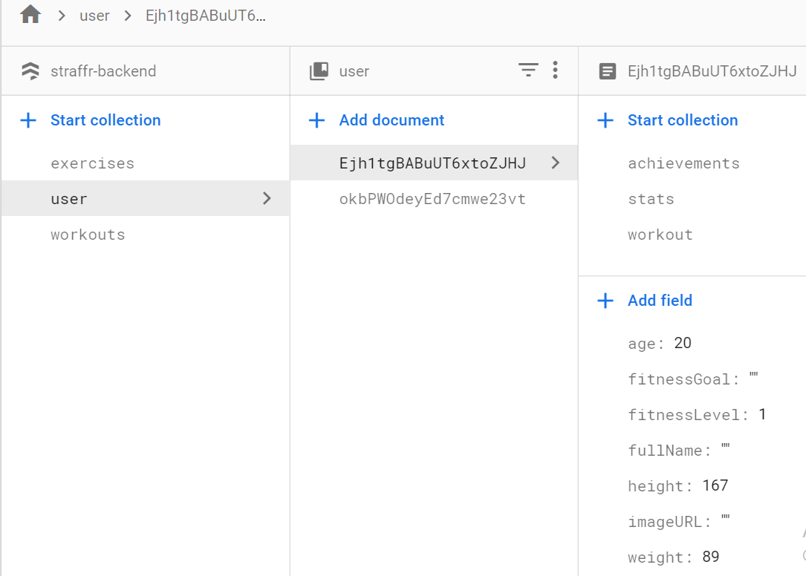
User

Slide 13
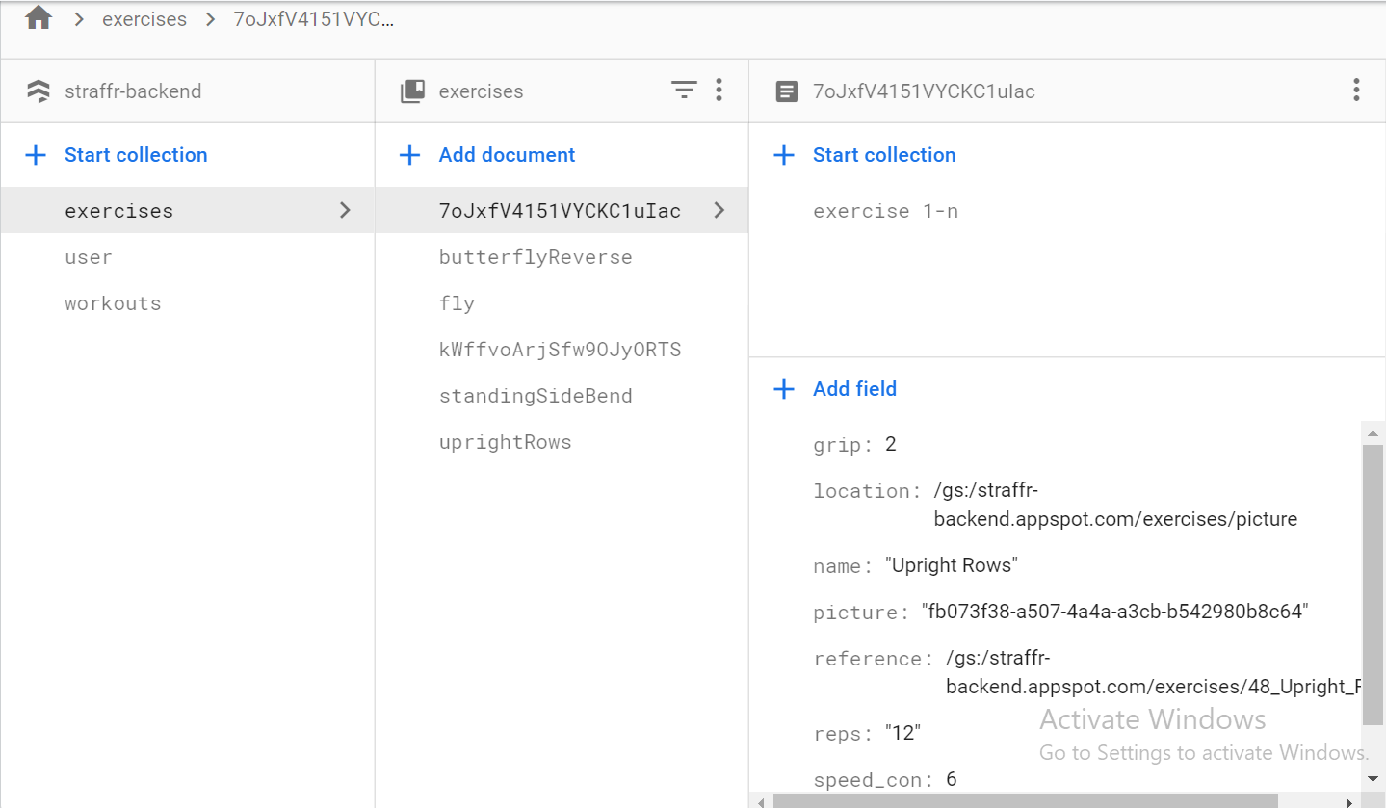
Database Structure

Slide 14
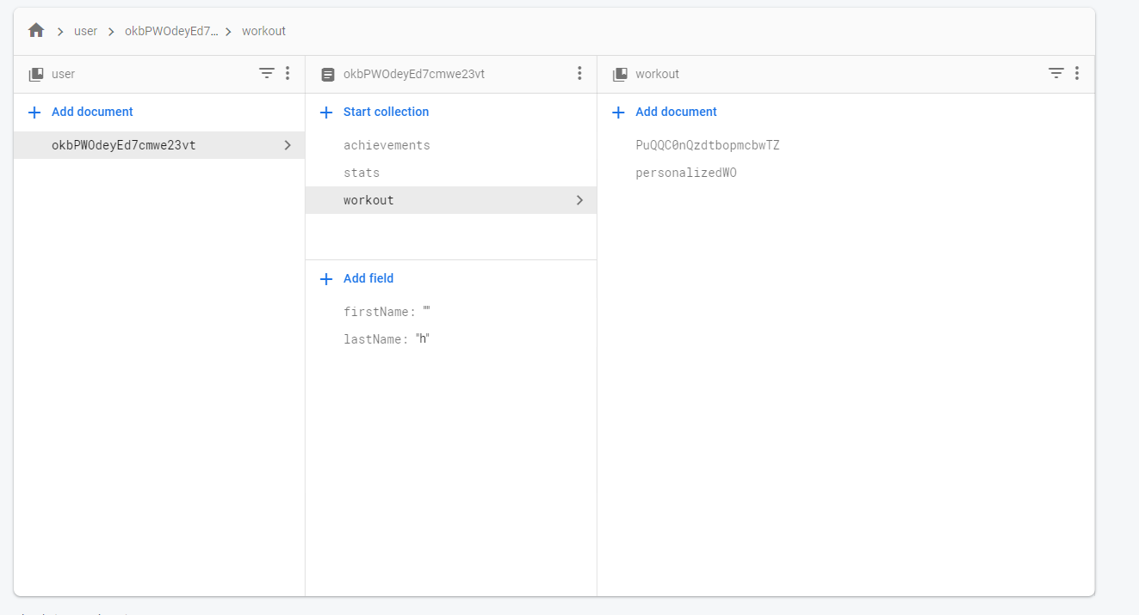
Personalized Workouts

Slide 15
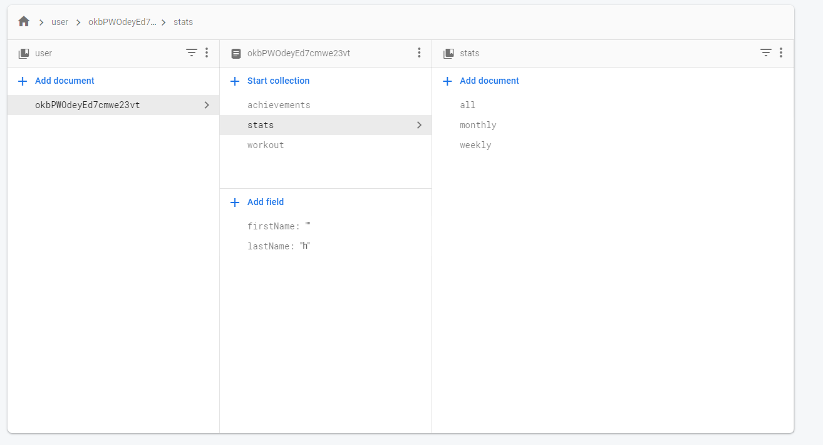
Stats

Slide 16
How to save your achievements?

Slide 17
Workout Database
Example Workflow
New User Registers
New user chooses fitness goals and fitness level => STRAFFR sets personalized workout plan. (Standard Plan, tweeked based on inputs)
Personalized workout always on top in workout section
After finishing a perosnalized workout, the calculated results will be saved with the stats.
The raw results will be saved with information about the excersise etc and can be used for backend functions to calculate the personalized workouts

Slide 18
Excersise Database (Modified)
Visible for all app users/coaches
Document IDs
Avoid the document IDs . and …
Avoid using / forward slashes in document IDs.
Do not use monotonically increasing document IDs such as:
Customer1, Customer2, Customer3, ...
Product 1, Product 2, Product 3, ...
Such sequential IDs can lead to hotspots that impact latency.
Excercise 1-n
EX ID : Integer
Cover Pic ID : Integer
Area: Integer
Intensity: Integer
Field Names
Avoid the following characters in field names because they require extra escaping:
. period
[ left bracket
] right bracket
*asterisk
` backtick
Excercise
A EN
Video ID: Integer
- Name: Text string
- Setup: Text string
- Description: Text string
Areas of Focus: Text string
Excercise A DE
ExcerciseA xx

Slide 19
Workout Database (Modified)
Visible for all app users/coaches
Different and only visible for a single user and their coach
Unpersonalied Workout 1-n
- WO ID: Integer
- Category: Text string
- Duration: Integer
- Intensity: Integer
Instructions: Text string
Cover Pic : Image
Preview Pics : Image
Personalized Workout User 1-n
- WO ID: Integer
- Duration: Integer
- Intensity: Integer
Instructions: Text string
Cover Pic: Image
Preview Pics: Image
Excercise A
Preview Pic: Image
Video UID: Integer
Grip: Integer
Reps: Integer
Speed: Integer
...
Excercise D
Excercise F
Excercise A
Video: Video
Grip: Integer
Reps: Integer
Speed: Integer
...
Excercise A
Excercise C

Slide 20
User Database (Modified)
User A
uid: Integer
Name: Text string
Age: Integer
Height: Floating-point number
Weight: Floating-point number
Image: Image
Fitness goal: Text string
Fitness level: Integer
Coach A
uid: Integer
Name: Text string
Age: Integer
Height : Floating-point number
Weight: Floating-point number
Image: Image
Company: Text string
Education/Experience: Text string
WO Data
WO ID: Integer
Timestamp: Floating-point number
TUT: Floating-point number
Conc/Exc: Integer
Reps: Integer
Speed: Integer
Stats
- Graph: Image
Achievements/ Batches: -Graph: Image
User A
uid: Integer
Name: Text string
Age: Integer
Height : Floating-point number
Weight: Floating-point number
Image: Image
Fitness goal: Text string
Fitness level: Integer
Customer B
Customer C
Excercise 1-n
ReferenceID : reference
CoverPicID : reference
GifID: reference
Reps: number
Grip: number
Speed_con: number
Speed_exc: number

