Slide 1


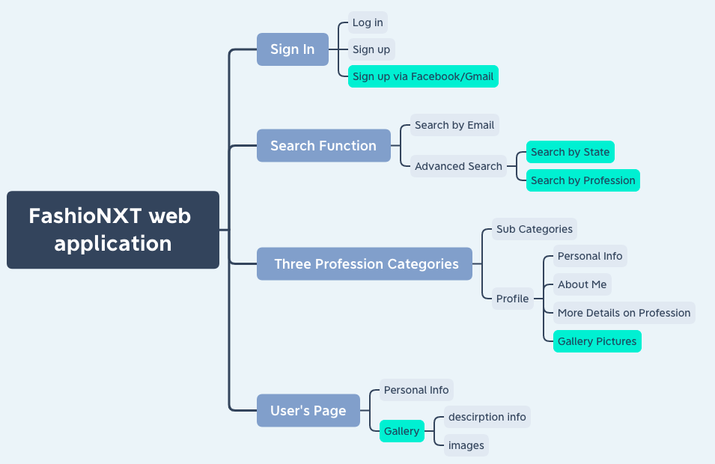
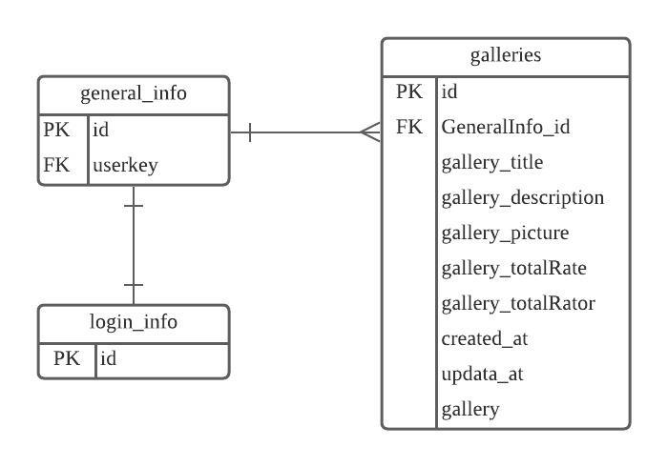
FashionNXT Web Application
InvalidTeamName: Chienpeng Huang, Xiaomeng Liu, Jiahua Cheng, Mingyu Tao, Elizabeth Park, Szukai Chen, Chunjung Huang
Introduction
Design
The goal of the project is to allow people in fashion industry to show their creative work and network with professionals they have interest
The web-based application allows users to search for the matching profiles in fashion domain
The application allows users to upload project and rate on other’s project
Our new features will affect the sign in process, User’s page, profile module, and search function of the current system
New added features
UI changes to improve user experience, including landing page, personal profile page and search page
Login with Gmail/Facebook
Add rating on Gallery
Upload images to personal project, fixed bugs in previous version
Display project information when hovered on homepage
Search by State, profession
User Stories
User Story 1: Add Homepage UI Improvement & Create a link for redirecting to search engine page to improve experience
User Story 2: Add more industrial categories, each can have several subcategories, create an expanded bar feature
User Story 3: Show information of members when hovered on the profile on homepage so that users can have a quick view of information
User Story 4: Add Login/Signup via Facebook & Gmail
User Story 5: Fix project gallery for User Profile Page and allows users to upload multiple projects into gallery
User Story 6: Rate on Gallery of other members with multiple projects
User Story 7: Refine personal profile and add more information required by the client
User Story 8: Improve Searching page UI required by the client
User Story 9: Improve search function that allows users to search by state and profession
Database Structure
New added table galleries to store project uploaded
Iterations
Conclusions
ITERATION 0
SCOPE
EXPECTATION
ITERATION 1
USER STORY 1
USER STORY 2
ITERATION 1
USER STORY 3
USER STORY 4
ITERATION 1
USER STORY 5, 6,
7, 8 ,9
This application is designed to meet the requirements of the client using Ruby on Rails framework, html, css and JavaScript. It is a web application that works as a networking platform for people in fashion industry to connect with each other. Users are allowed to build portfolios that illustrate their skills work experience along with the work conditions and compensation. It is free to sue by singing up or connecting with Facebook or Gmail.
Challenges
We faced a big problem on linking our application to the previous AWS S3 account since there is no instruction in the document provided by the previous team. Therefore, we spend some time on rebuilding a bucket to store the pictures uploaded by website users. We will write down the AWS access ID and KEY for the next team so they will avoid this pitfall
We left the search by state and profession function as incomplete. It worked on local machine but we haven’t deployed on Heroku. We will send a document to our client with detail information of incomplete features for next team
Acknowledgement
We would like to thank Prof Dr. Duncan Walker, our TA Shravani Sridhar and our client Mr.Tito Choudhary for providing us with clear requirements and clearing our doubts when ever needed. Their extensive support made it possible for us to complete the project.

