Slide 1
Green University of Bangladesh
Subject Title: Artificial Intelligence Lab
Code: CSE-404
Group Members
Name | ID
Tanvir Ahmed | 191015102
Shahajady Khatun Juthy | 191015105
Sanzida Yesmin | 191015123

Slide 2
2
PROJECT TITLE : Speech Recognition Web Application
The new JavaScript Web Speech API makes it easy to add speech recognition to our web pages. The speech recognition part of the Web Speech API allows authorized Web applications to access the device's microphone and produces a transcript of the voice being recorded. This allows Web applications to use voice as one of the input & control method, similar to touch or keyboard. Technically, the speech recognition functionality can also be achieved by accessing the microphone and processing the audio stream using Web Audio API.
ABOUT

Slide 3
3
PROJECT TITLE : Speech Recognition Web Application
Analyze the audio
Digitization in a computer-readable format
OBJECTIVES
Use an algorithm to match the most appropriate text presentation
Hearing Assistance
Automatic Speech Recognition

Slide 4

4
PROJECT TITLE : Speech Recognition Web Application
Signal
Pre-processing
Feature
Extraction
Output
(Recognized Speech)
Language
Model
Feature
Matching

Slide 5
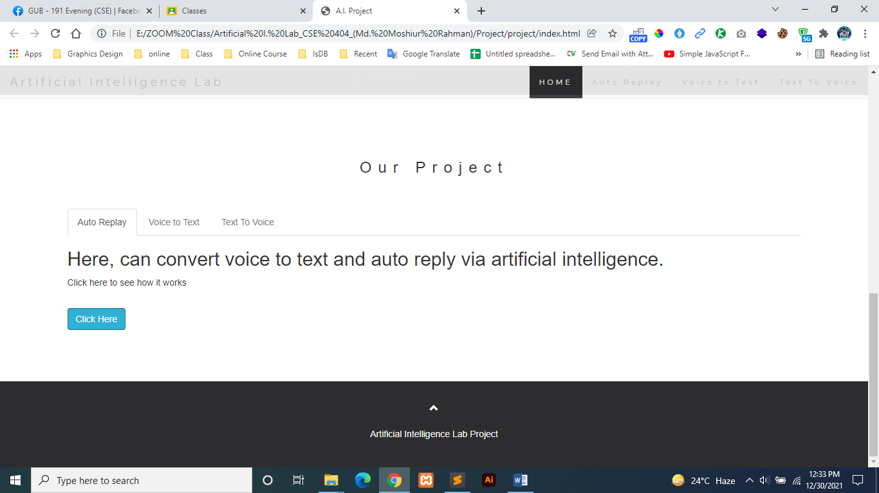
Signal pre-processing
Feature extraction
Feature matching

Slide 6
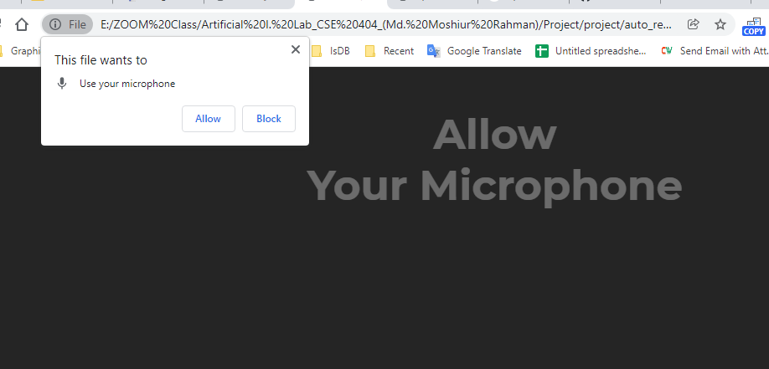
4. Language model:

Slide 8
Thankyou
For your attention

