Slide 1

Project Title: Hijack detection system
Green University of Bangladesh
Department of Computer Science and Engineering
Presented By:
Name | ID
Md. Tanvir Ahmed | 191015102
Shahajady khatun juthy | 191015105
Sanzida Yesmin | 191015123
Ahmed Imtiaz | 191015132
1

Slide 2
index
Topics Page No
Team and Project information ------------------------ 03
Feasibility Study ----------------------------------------- 04
Complexity ------------------------------------------------ 05
Market analysis ------------------------------------------ 06
Functional Requirements ------------------------------ 07
Non-Functional Requirements ------------------------ 08
Data Analysis --------------------------------------------- 09
Database Design(Normalization) ------------------ 10-13
Use Case Diagram --------------------------------------- 14
Sequence Diagram --------------------------------------- 15
Class Diagram -------------------------------------------- 16
Project Prototype ------------------------------------- 17-20
2

Slide 3
Team information
Our Team Name: Hashtag
Project Name: Hijack detection system.
Manager | Leader | Writer | Information Researcher
Tanvir Ahmed | Sanzida Yesmin | Shahajady khatun juthy | Ahmed Imtiaz
3

Slide 4
Feasibility Study
In the Bangladeshi aspect, hijacking is a very common problem in the city area.
This Project Scopes and
Advantage
Suspicious person detection
Suspicious Hijacker detection
Project Scopes
High risky hijacking area identification
Hijacker's location identification.
Current Hijack location detection
Warning on that zone and report to police.
4

Slide 5
Complexity
Equipment used in forensics is expensive
Project Complexity
This process will be much more complicated
Scientific analysis consumes a lot of time.
It may not have 100% accuracy
5

Slide 6
Market analysis
The market size of digital investigation is increasing day by day.
Market analysis
If we can bring it to market successfully then there will be a lot of demand for it.
6

Slide 7
Functional Requirement
Hijacker Detection.
Support to affected people find out the hijacked things.
Suspicious person detection.
Current Hijack place detection.
Hijacked instrument detection.
Hijacker movement detection.
Detect the location of hijacker movement.
Alarm on that zone or report to police
7

Slide 8
Non-Functional Requirement
Central Database.
This system will have safety and security, no hijacker can destroy the system.
Its performance will work very well.
8

Slide 9
Data Analysis
Suspicious person face data collection.
Current hijack location data collection.
Hijack Time
Analyze the occurrence of hijacking from video/ image data.
Face reorganization from video/ image data.
9

Slide 10
Database Design(Normalization)
Normalization
User Name | List of items | Address | Time | Hijacked type | Hijacker face
Kamal | Laptop | Shewrapara | 10:10am | Snatch | Image_1
Papon | Mobile | Mirpur-10 | 2:00pm | Snatch | Image_2
Pappu | Moneybag | Farmgate | 6:00pm | Snatch | Image_3
Polas | Ornaments | Gulistan | 12:15pm | Snatch | Image_4
Tipu | Bag | Gazipur | 11:19am | Snatch | Image_5
10

Slide 11
Database Design(Cont..)
1st Normalization
Id | User Name | List of items | Address | Time | Hijacked type | Hijacker face
01 | Kamal | Laptop | Shewrapara | 10:10am | Snatch | Image_1
02 | Papon | Mobile | Mirpur-10 | 2:00pm | Snatch | Image_2
03 | Pappu | Moneybag | Farmgate | 6:00pm | Snatch | Image_3
04 | Pappu | Ornaments | Gulistan | 12:15pm | Snatch | Image_4
05 | Tipu | Bag | Gazipur | 11:20am | Snatch | Image_5
11

Slide 12
Database Design(Cont..)
2nd Normalization
Id | Name | Address | Time | List of items
01 | Kamal | Shewrapara | 10:10 | Laptop
02 | Papon | Mirpur-10 | 2:00 | Mobile
03 | Pappu | Farmgate | 6:00 | Moneybag
04 | Pappu | Gulistan | 12:15 | Ornaments
05 | Tipu | Gazipur | 11:19 | Bag
Id | Hijacked type | Hijacker face
01 | Snatch | Image_1
02 | Snatch | Image_2
03 | Snatch | Image_3
04 | Snatch | Image_4
05 | Snatch | Image_5
Hijack Affected People id | Hijacker id
01 | 01
01 | 02
02 | 04
04 | 01
03 | 05
12

Slide 13
Database Design(Cont..)
3rd Normalization
Id | Name | Address | Time | List of items
01 | Kamal | Shewrapara | 10:10 | Laptop
02 | Papon | Mirpur-10 | 2:00 | Mobile
03 | Pappu | Farmgate | 6:00 | Moneybag
04 | Pappu | Gulistan | 12:15 | Ornaments
05 | Tipu | Gazipur | 11:19 | Bag
Id | Hijacked type
01 | Snatch
02 | Snatch
03 | Snatch
04 | Snatch
05 | Snatch
Hijack Affected People id | Hijacker id
01 | 01
01 | 02
02 | 04
04 | 01
03 | 05
Hijacked type | Hijacker face
Snatch | Image_1
Snatch | Image_2
Snatch | Image_3
Snatch | Image_4
Snatch | Image_5
13

Slide 14
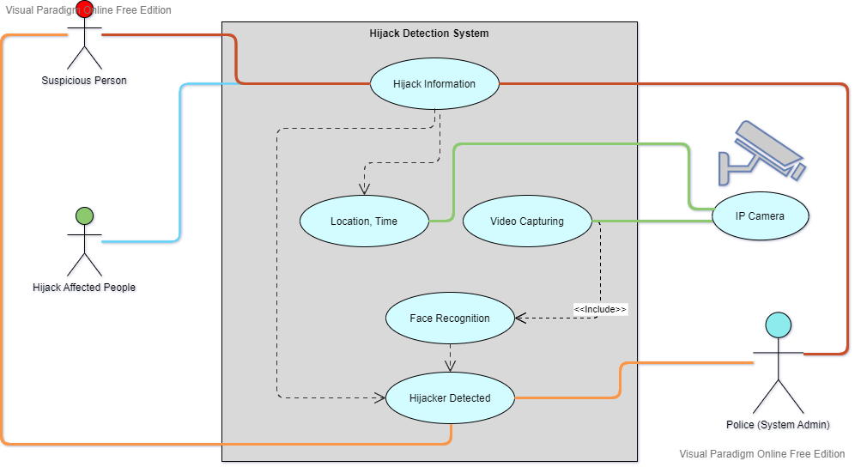
Use Case Diagram
14

Slide 15
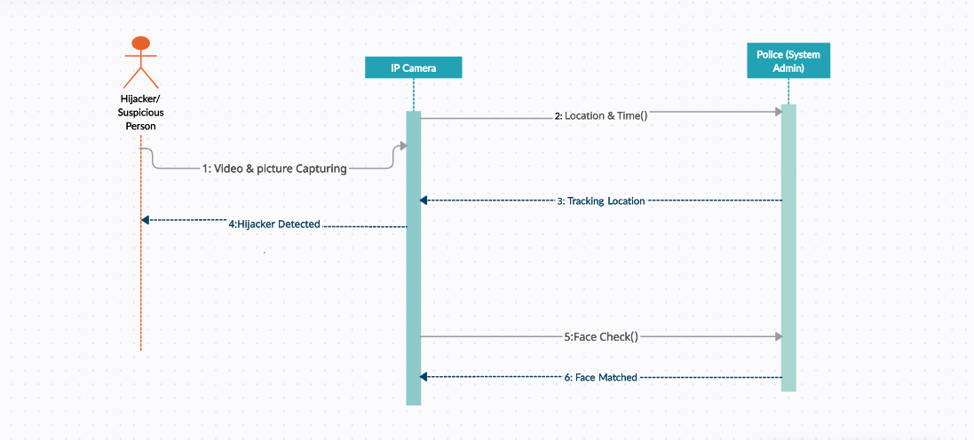
Sequence Diagram
15

Slide 16
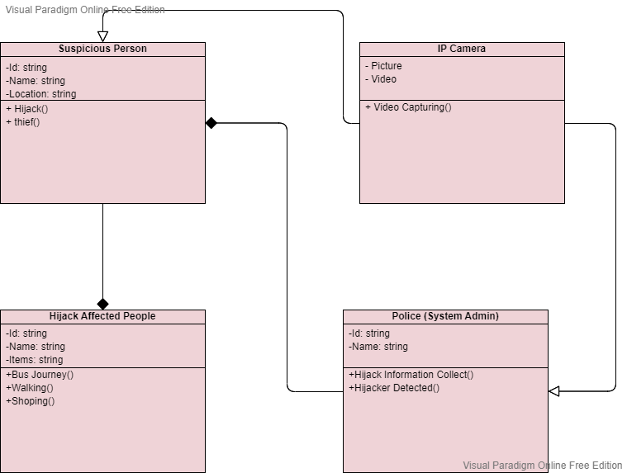
Class Diagram
16

Slide 17
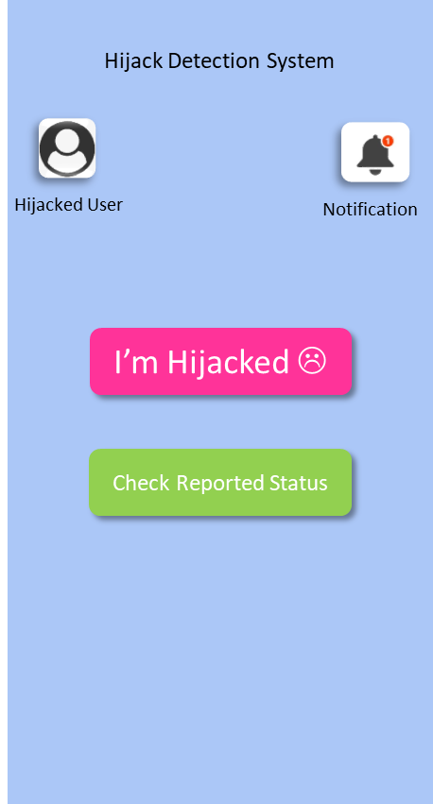
Prototype
17

Slide 18
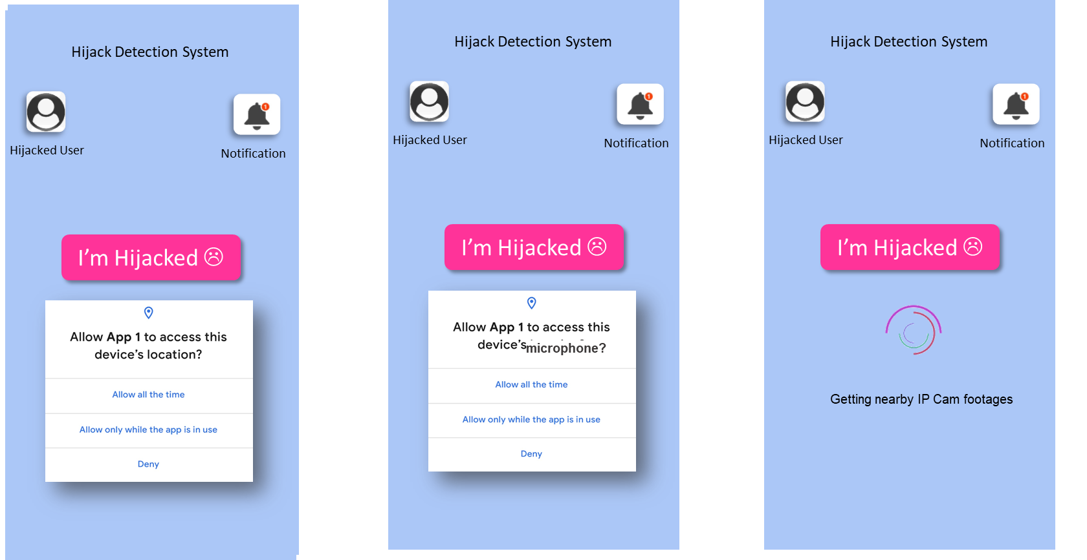
Prototype(Cont..)
18

Slide 19
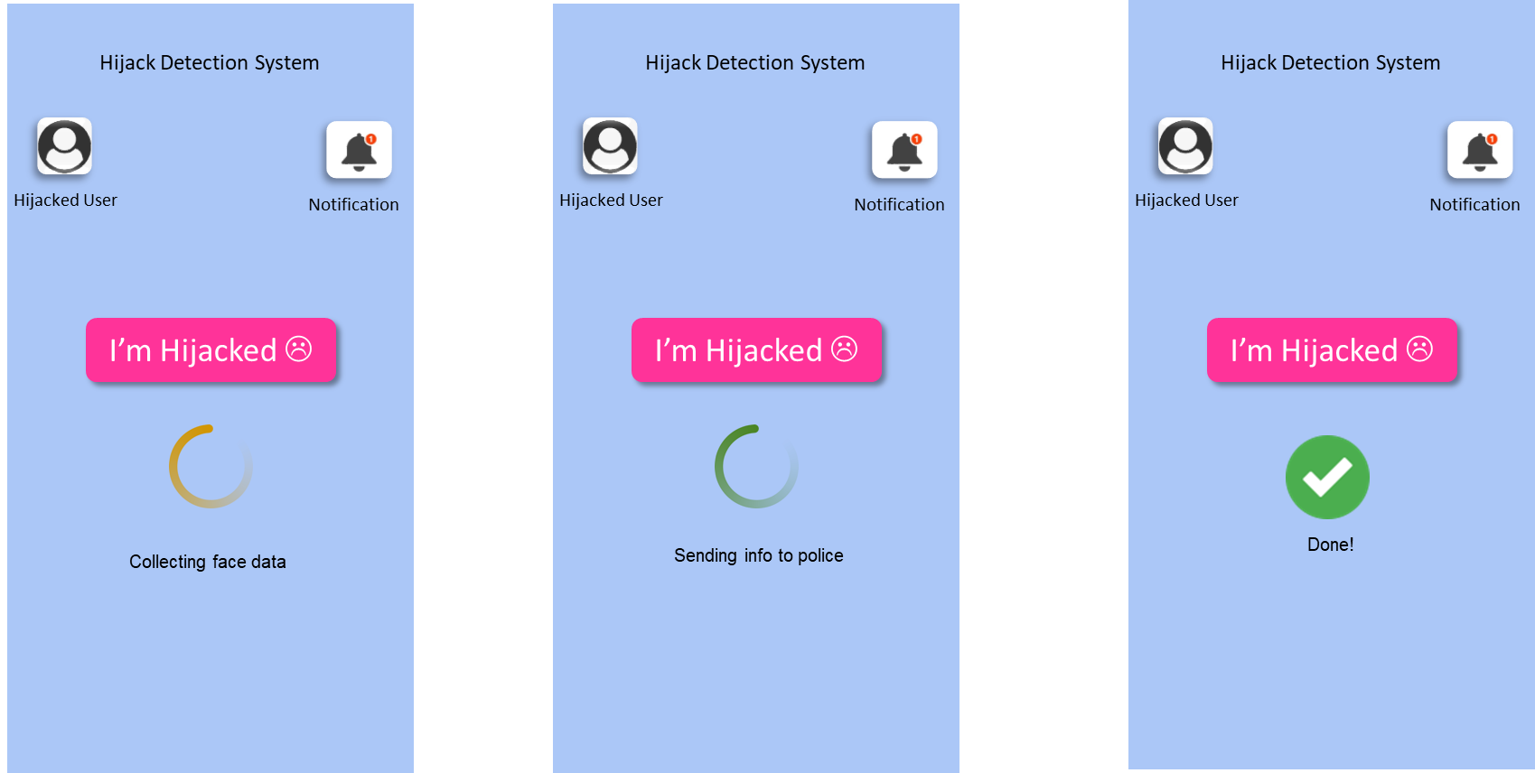
Prototype(Cont..)
19

Slide 20
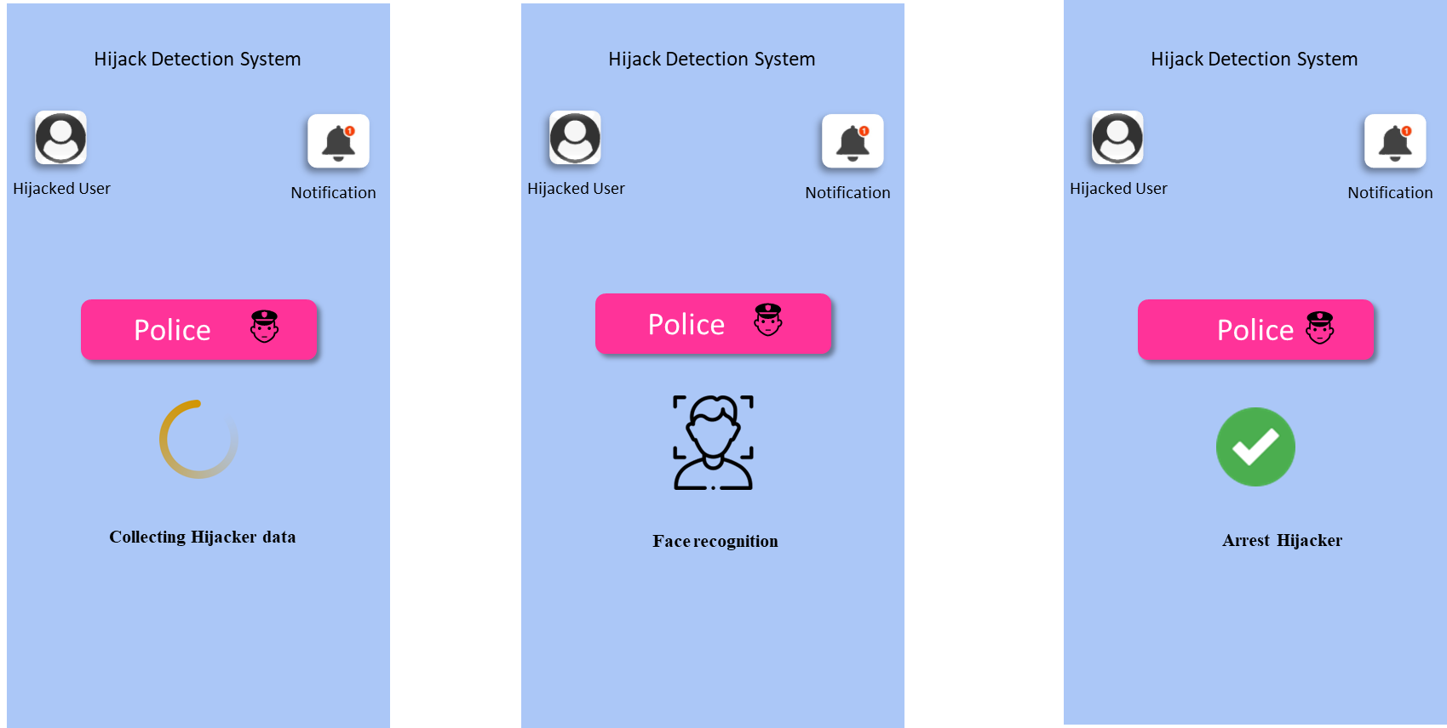
Prototype(Cont..)
20

Slide 21
21

