Slide 1


Hijack Detection System
Hijacked User
Notification
I’m Hijacked ☹
Check Reported Status

Slide 2
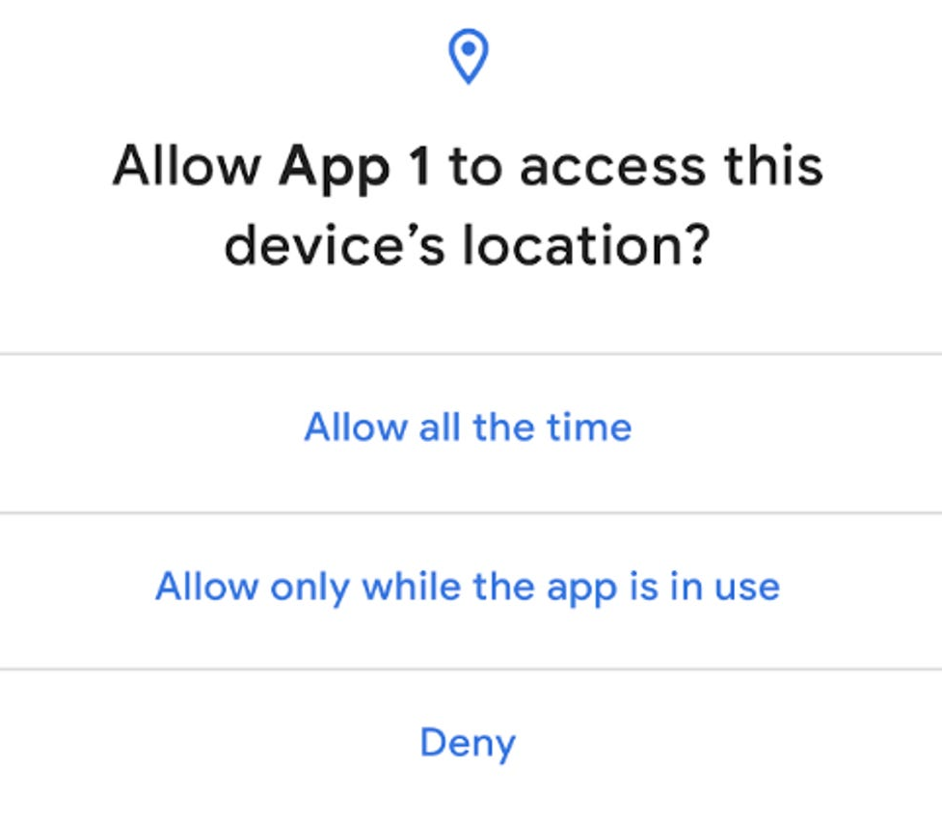

Hijack Detection System
Hijack Detection System
Hijack Detection System
Hijack Detection System
Hijacked User
Notification
Hijacked User
Notification
Hijacked User
Notification
Hijacked User
Notification
I’m Hijacked ☹
I’m Hijacked ☹
I’m Hijacked ☹
I’m Hijacked ☹
Check Reported Status
Check Reported Status
Check Reported Status
microphone?
Getting nearby IP Cam footages

Slide 3

Hijack Detection System
Hijack Detection System
Hijack Detection System
Hijacked User
Notification
Hijacked User
Notification
Hijacked User
Notification
I’m Hijacked ☹
I’m Hijacked ☹
I’m Hijacked ☹
Collecting face data
Sending info to police
Done!

