Slide 1
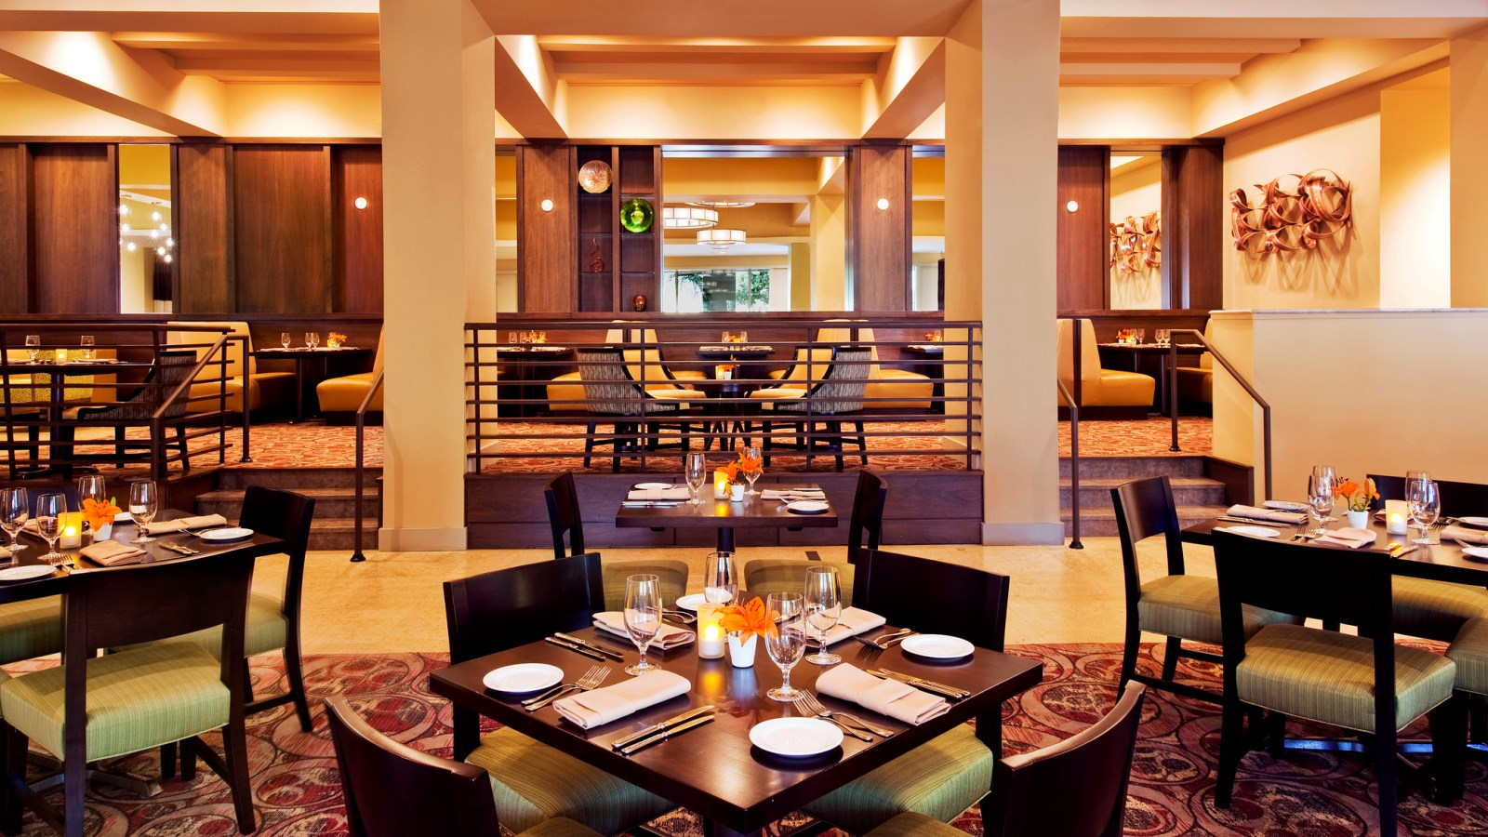
Welcome to Our
Online Restaurant

Slide 2


Green University of Bangladesh
Our Group Members :
Name | ID
Tanvir Ahmed (Team Leader) | 191015102
Shahajady Khatun Juthy | 191015105
Sanzida Yesmin | 191015123
Razuanul Islam | 191015116
Bristy ghosh | 191015062
Online Restaurant

Slide 3

Online Food Order
About Us
It is an online food shopping website where customers can order food of their choice, the ordered food will be delivered to the customer's home in a very short time.
Our Goal
1) Increase Daily Net Restaurant Sales
2) Increase Monthly Net Restaurant Sales
3) Improve Our Top-Selling Items
4) Test New Menu Items
5) Timely Product Delivery
Online Restaurant

Slide 4
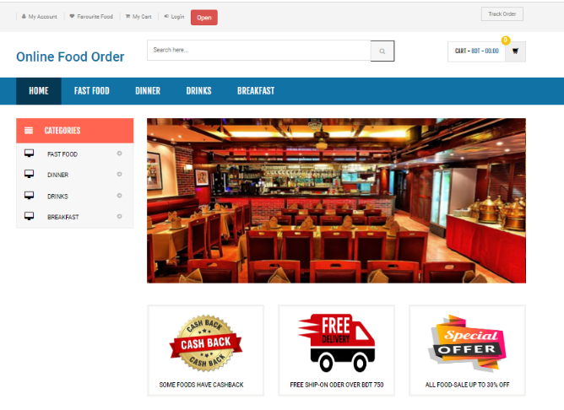


index page
User Home page
Header
Product Search Options
Product Categories
Product Display
Footer
Online Restaurant

Slide 5

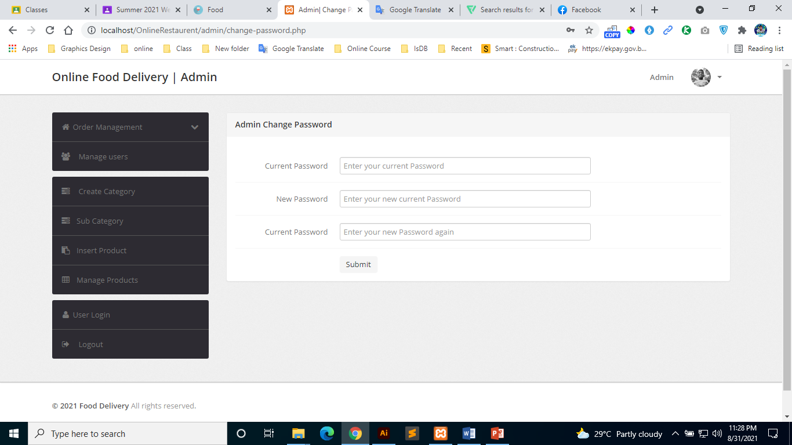


Admin Dashboard
Admin Panel
Login & Logout
Header & Footer
Order Management
Manage Users
Create Category
Insert Product
Manage Products
Online Restaurant

Slide 6
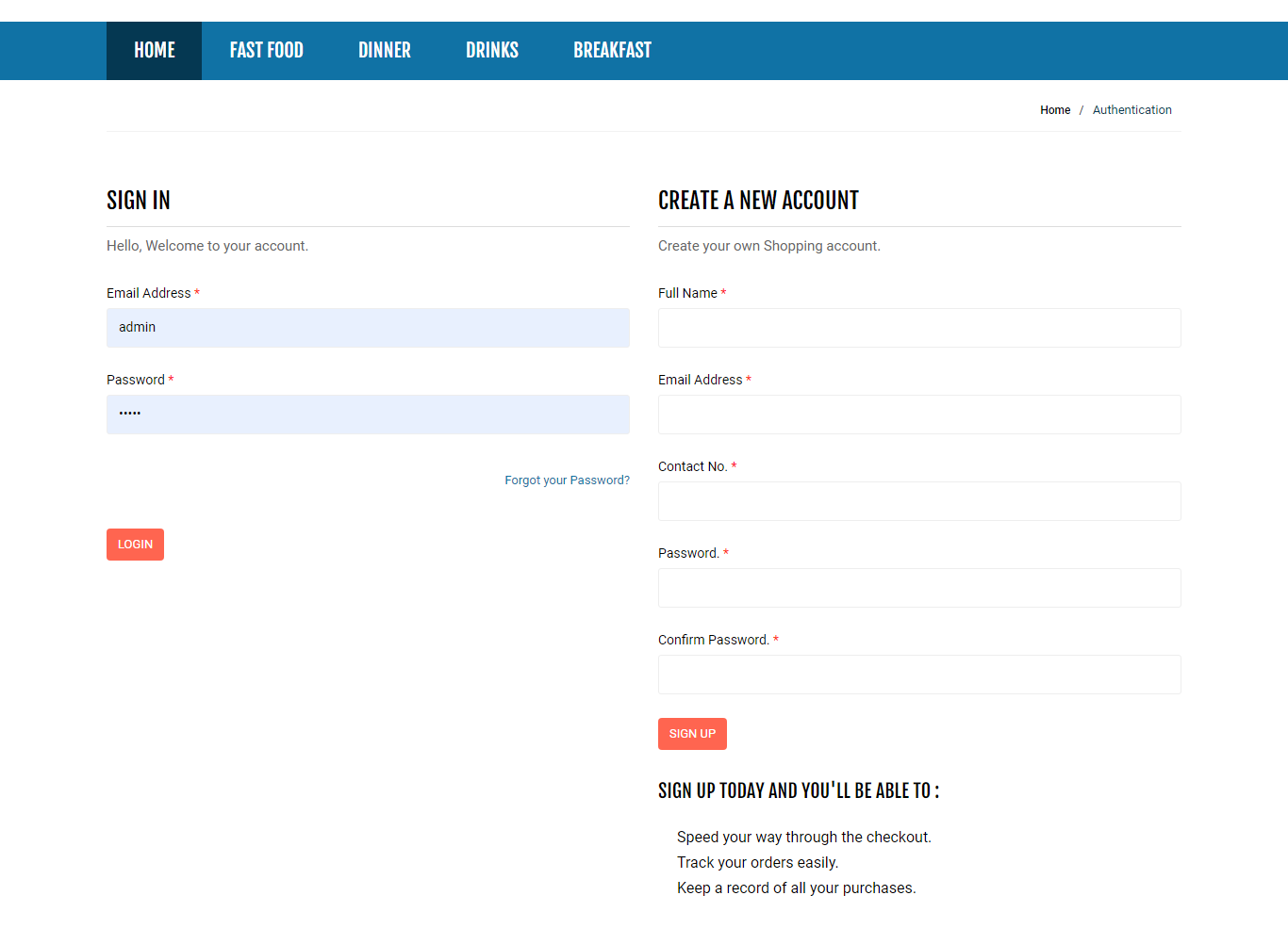
CREATE A NEW ACCOUNT & Login
User Create Account & Login Page
User Registration Form
User Login Options
Header & Footer
Online Restaurant

Slide 7
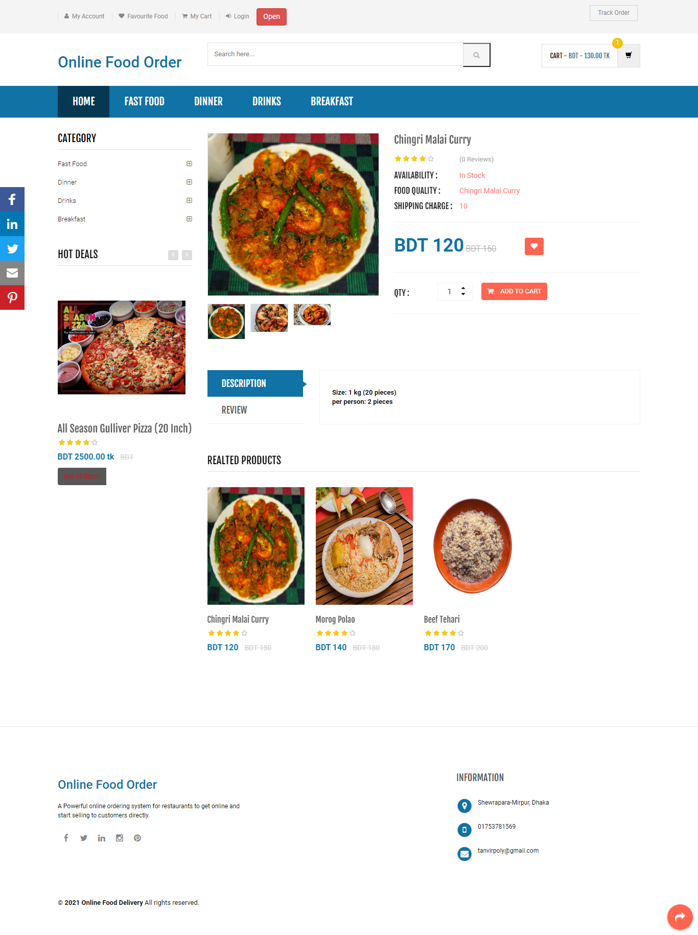


Add to Cart & Product details
Product Add to Cart & Show Product details
Product Name
Product Availability
Product Quality
Product Price
Product Review
Product Description
Online Restaurant

Slide 8
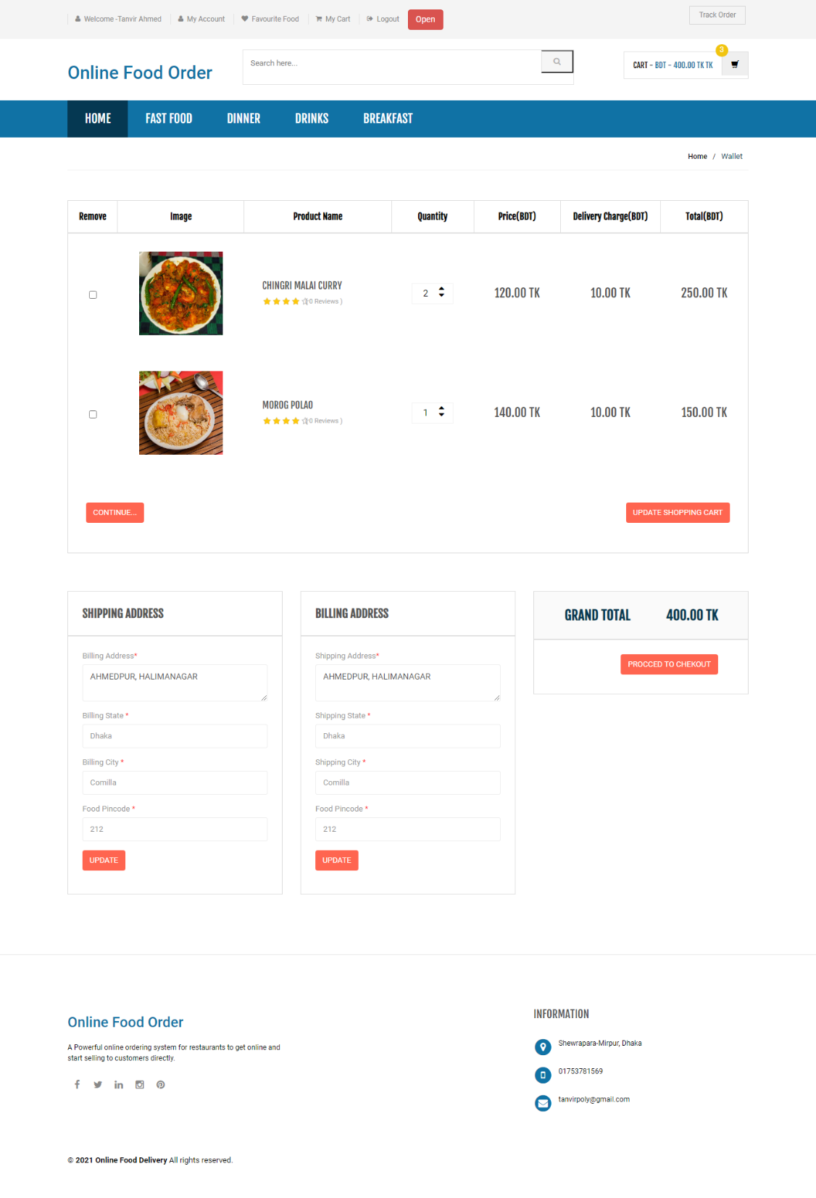
Product Purchase
User Create Account & Login
Shipping & Billing Address
Order Update
Grand Total
Show Product Quantity
Product Review
Manage Products
Online Restaurant

Slide 9
THANKS FOR WATCHING

