Slide 1
Chapter 7: Entity-Relationship Model
Notes:
‹#›

Slide 2
Chapter 7: Entity-Relationship Model
Design Process
Modeling
Constraints
E-R Diagram
Design Issues
Weak Entity Sets
Extended E-R Features
Design of the Bank Database
Reduction to Relation Schemas
Database Design
UML
Notes:
‹#›

Slide 3
Design Phases
The initial phase of database design is to characterize fully the data needs of the prospective database users.
Next, the designer chooses a data model and, by applying the concepts of the chosen data model, translates these requirements into a conceptual schema of the database.
A fully developed conceptual schema also indicates the functional requirements of the enterprise. In a “specification of functional requirements”, users describe the kinds of operations (or transactions) that will be performed on the data.
Notes:
‹#›

Slide 4
Design Phases (Cont.)
The process of moving from an abstract data model to the implementation of the database proceeds in two final design phases.
Logical Design – Deciding on the database schema. Database design requires that we find a “good” collection of relation schemas.
Business decision – What attributes should we record in the database?
Computer Science decision – What relation schemas should we have and how should the attributes be distributed among the various relation schemas?
Physical Design – Deciding on the physical layout of the database
Notes:
‹#›

Slide 5
Design Approaches
Entity Relationship Model (covered in this chapter)
Models an enterprise as a collection of entities and relationships
Entity: a “thing” or “object” in the enterprise that is distinguishable from other objects
Described by a set of attributes
Relationship: an association among several entities
Represented diagrammatically by an entity-relationship diagram:
Normalization Theory (Chapter 8)
Formalize what designs are bad, and test for them
Notes:
‹#›

Slide 6
Outline of the ER Model
Notes:
‹#›

Slide 7
ER model -- Database Modeling
The ER data mode was developed to facilitate database design by allowing specification of an enterprise schema that represents the overall logical structure of a database.
The ER model is very useful in mapping the meanings and interactions of real-world enterprises onto a conceptual schema. Because of this usefulness, many database-design tools draw on concepts from the ER model.
The ER data model employs three basic concepts:
entity sets,
relationship sets,
attributes.
The ER model also has an associated diagrammatic representation, the ER diagram, which can express the overall logical structure of a database graphically.
Notes:
‹#›

Slide 8
Entity Sets
An entity is an object that exists and is distinguishable from other objects.
Example: specific person, company, event, plant
An entity set is a set of entities of the same type that share the same properties.
Example: set of all persons, companies, trees, holidays
An entity is represented by a set of attributes; i.e., descriptive properties possessed by all members of an entity set.
Example:
instructor = (ID, name, street, city, salary ) course= (course_id, title, credits)
A subset of the attributes form a primary key of the entity set; i.e., uniquely identifiying each member of the set.
Notes:
‹#›

Slide 9
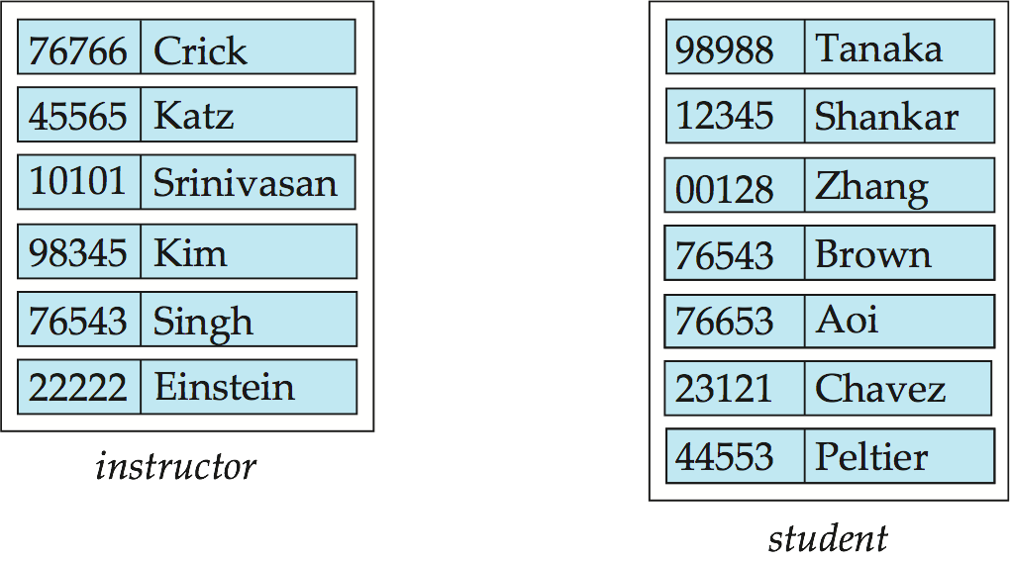
Entity Sets -- instructor and student
instructor_ID instructor_name student-ID student_name
Notes:
‹#›

Slide 10
Relationship Sets
A relationship is an association among several entities
Example: 44553 (Peltier) advisor 22222 (Einstein) student entity relationship set instructor entity
A relationship set is a mathematical relation among n ≥ 2 entities, each taken from entity sets
{(e₁, e₂, … e_{n}) | e₁ ∈ E₁, e₂ ∈ E₂, …, e_{n} ∈ E_{n}} where (e₁, e₂, …, e_{n}) is a relationship
Example:
(44553,22222) ∈ advisor
Notes:
‹#›

Slide 11
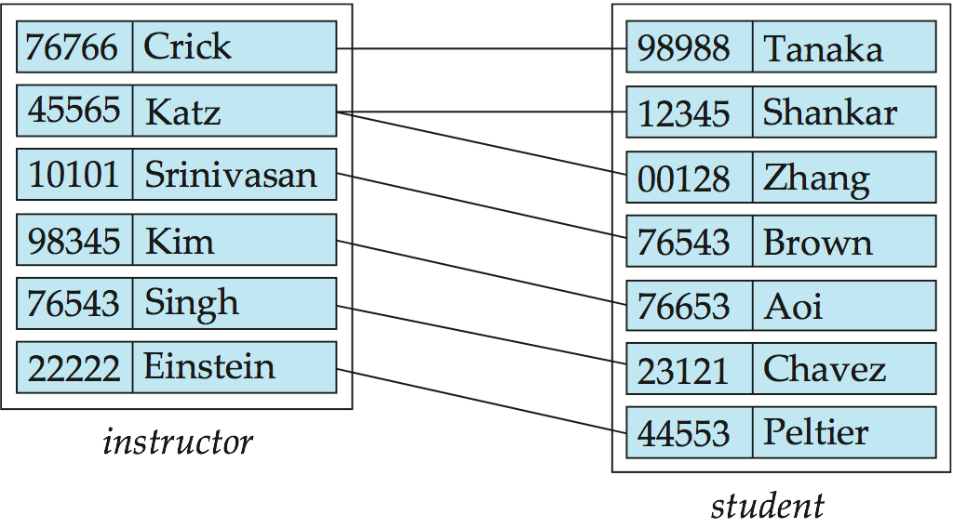
Relationship Set advisor
Notes:
‹#›

Slide 12
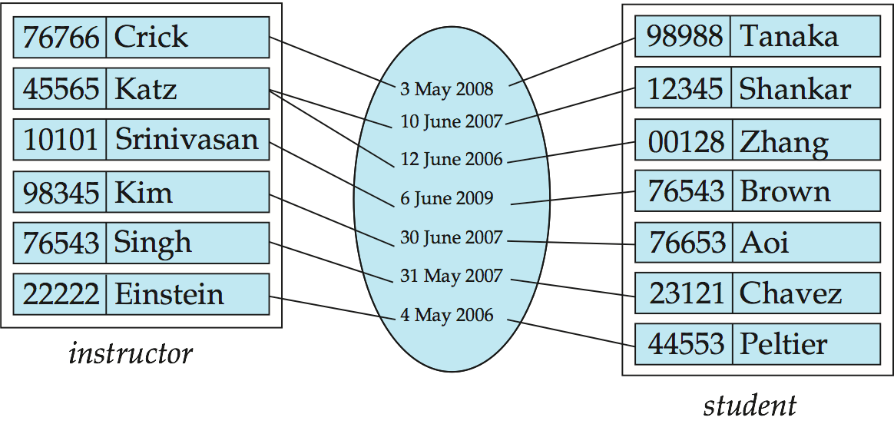
Relationship Sets (Cont.)
An attribute can also be associated with a relationship set.
For instance, the advisor relationship set between entity sets instructor and student may have the attribute date which tracks when the student started being associated with the advisor
Notes:
‹#›

Slide 13
Degree of a Relationship Set
binary relationship
involve two entity sets (or degree two).
most relationship sets in a database system are binary.
Relationships between more than two entity sets are rare. Most relationships are binary. (More on this later.)
Example: students work on research projects under the guidance of an instructor.
relationship proj_guide is a ternary relationship between instructor, student, and project
Notes:
‹#›

Slide 14
Mapping Cardinality Constraints
Express the number of entities to which another entity can be associated via a relationship set.
Most useful in describing binary relationship sets.
For a binary relationship set the mapping cardinality must be one of the following types:
One to one
One to many
Many to one
Many to many
Notes:
‹#›

Slide 15
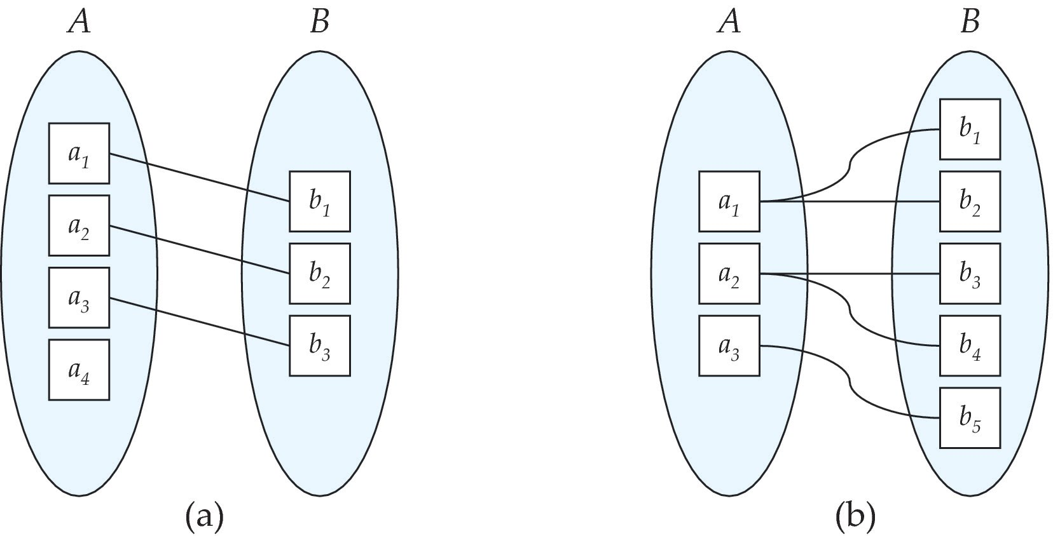
Mapping Cardinalities
One to one
One to many
Note: Some elements in A and B may not be mapped to any
elements in the other set
Notes:
‹#›

Slide 16
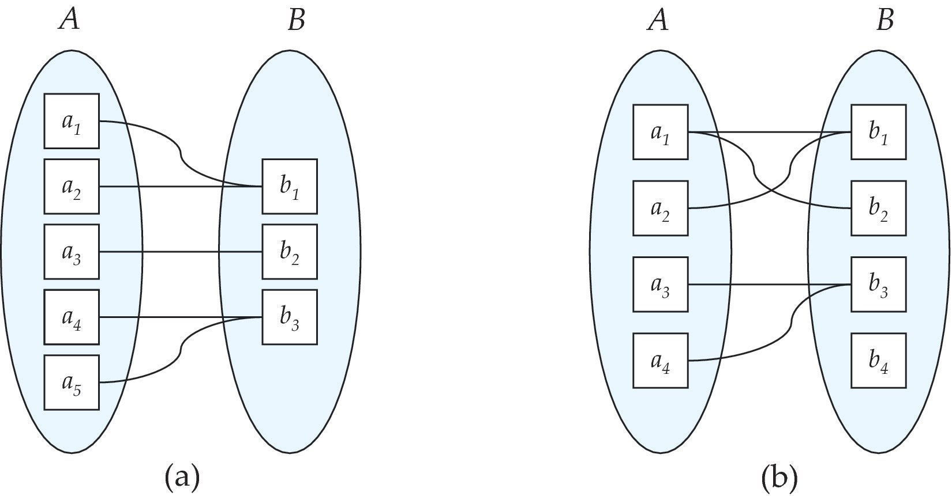
Mapping Cardinalities
Many to one
Many to many
Note: Some elements in A and B may not be mapped to any
elements in the other set
Notes:
‹#›

Slide 17
Complex Attributes
Attribute types:
Simple and composite attributes.
Single-valued and multivalued attributes
Example: multivalued attribute: phone_numbers
Derived attributes
Can be computed from other attributes
Example: age, given date_of_birth
Domain – the set of permitted values for each attribute
Notes:
‹#›

Slide 18
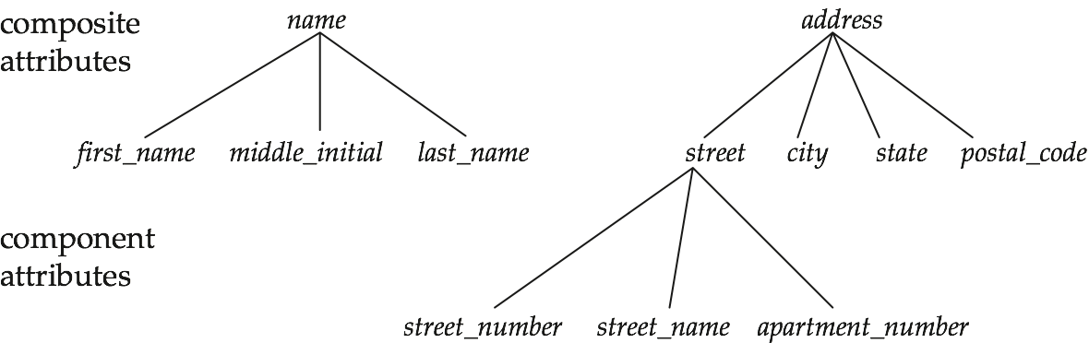
Composite Attributes
Notes:
‹#›

Slide 19
Redundant Attributes
Suppose we have entity sets:
instructor, with attributes: ID, name, dept_name, salary
department, with attributes: dept_name, building, budget
We model the fact that each instructor has an associated department using a relationship set inst_dept
The attribute dept_name appears in both entity sets. Since it is the primary key for the entity set department, it replicates information present in the relationship and is therefore redundant in the entity set instructor and needs to be removed.
BUT: when converting back to tables, in some cases the attribute gets reintroduced, as we will see later.
Notes:
‹#›

Slide 20
Weak Entity Sets
Consider a section entity, which is uniquely identified by a course_id, semester, year, and sec_id.
Clearly, section entities are related to course entities. Suppose we create a relationship set sec_course between entity sets section and course.
Note that the information in sec_course is redundant, since section already has an attribute course_id, which identifies the course with which the section is related.
One option to deal with this redundancy is to get rid of the relationship sec_course; however, by doing so the relationship between section and course becomes implicit in an attribute, which is not desirable.
Notes:
‹#›

Slide 21
Weak Entity Sets (Cont.)
An alternative way to deal with this redundancy is to not store the attribute course_id in the section entity and to only store the remaining attributes section_id, year, and semester. However, the entity set section then does not have enough attributes to identify a particular section entity uniquely; although each section entity is distinct, sections for different courses may share the same section_id, year, and semester.
To deal with this problem, we treat the relationship sec_course as a special relationship that provides extra information, in this case, the course_id, required to identify section entities uniquely.
The notion of weak entity set formalizes the above intuition. A weak entity set is one whose existence is dependent on another entity, called its identifying entity; instead of associating a primary key with a weak entity, we use the identifying entity, along with extra attributes called discriminator to uniquely identify a weak entity. An entity set that is not a weak entity set is termed a strong entity set.
Notes:
‹#›

Slide 22
Weak Entity Sets (Cont.)
Every weak entity must be associated with an identifying entity; that is, the weak entity set is said to be existence dependent on the identifying entity set. The identifying entity set is said to own the weak entity set that it identifies. The relationship associating the weak entity set with the identifying entity set is called the identifying relationship.
Note that the relational schema we eventually create from the entity set section does have the attribute course_id, for reasons that will become clear later, even though we have dropped the attribute course_id from the entity set section.
Notes:
‹#›

Slide 23
E-R Diagrams
Notes:
‹#›

Slide 24
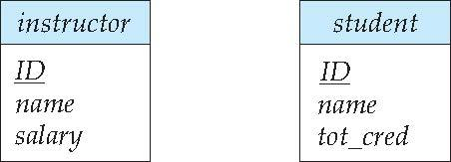
Entity Sets
Entities can be represented graphically as follows:
Rectangles represent entity sets.
Attributes listed inside entity rectangle
Underline indicates primary key attributes
Notes:
‹#›

Slide 25
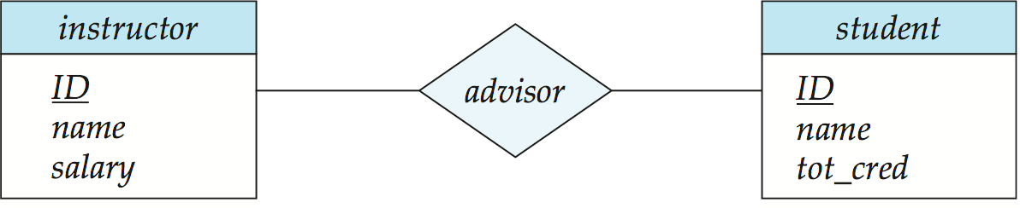
Relationship Sets
Diamonds represent relationship sets.
Notes:
‹#›

Slide 26
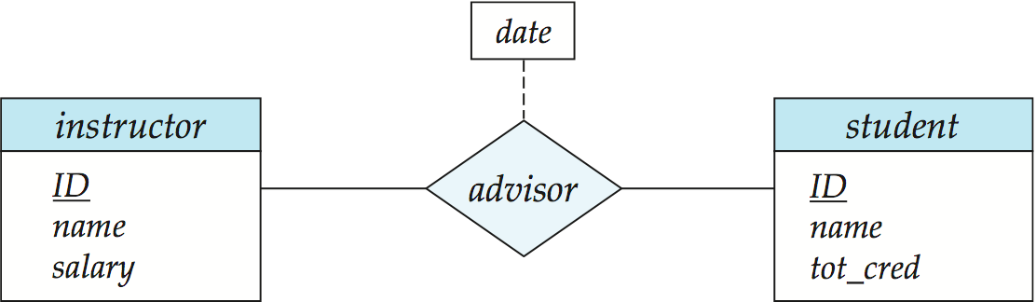
Relationship Sets with Attributes
Notes:
‹#›

Slide 27
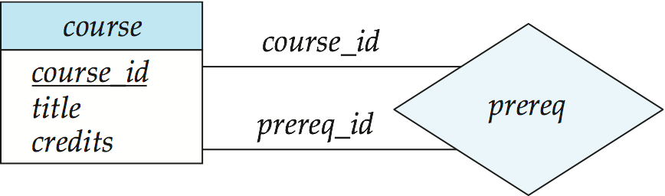
Roles
Entity sets of a relationship need not be distinct
Each occurrence of an entity set plays a “role” in the relationship
The labels “course_id” and “prereq_id” are called roles.
Notes:
‹#›

Slide 28
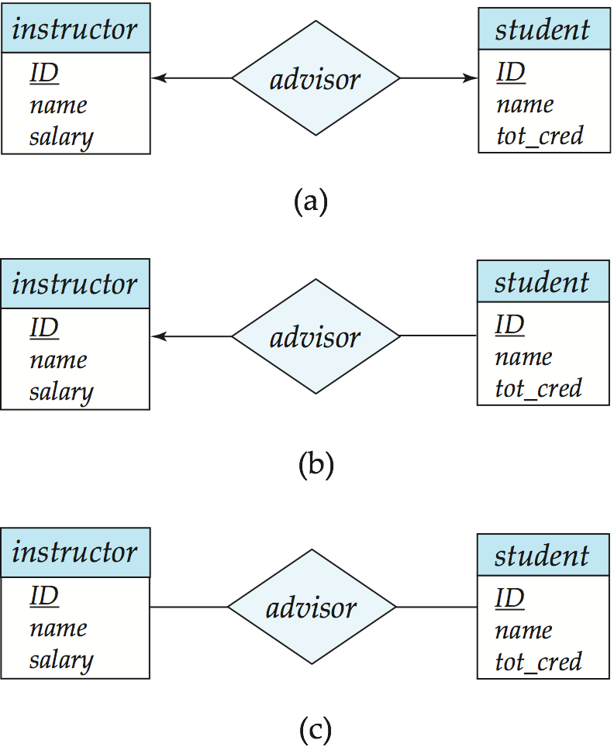
Cardinality Constraints
We express cardinality constraints by drawing either a directed line (→), signifying “one,” or an undirected line (—), signifying “many,” between the relationship set and the entity set.
One-to-one relationship between an instructor and a student :
A student is associated with at most one instructor via the relationship advisor
A student is associated with at most one department via stud_dept
Notes:
‹#›

Slide 29
One-to-Many Relationship
one-to-many relationship between an instructor and a student
an instructor is associated with several (including 0) students via advisor
a student is associated with at most one instructor via advisor,
Notes:
‹#›

Slide 30
Many-to-One Relationships
In a many-to-one relationship between an instructor and a student,
an instructor is associated with at most one student via advisor,
and a student is associated with several (including 0) instructors via advisor
Notes:
‹#›

Slide 31

Many-to-Many Relationship
An instructor is associated with several (possibly 0) students via advisor
A student is associated with several (possibly 0) instructors via advisor
Notes:
‹#›

Slide 32
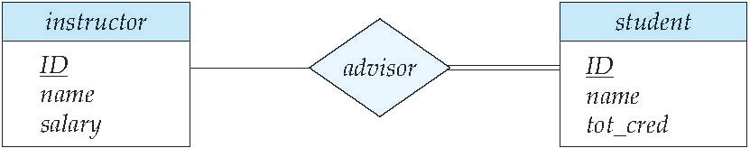
Total and Partial Participation
Total participation (indicated by double line): every entity in the entity set participates in at least one relationship in the relationship set
participation of student in advisor relation is total
every student must have an associated instructor
Partial participation: some entities may not participate in any relationship in the relationship set
Example: participation of instructor in advisor is partial
Notes:
‹#›

Slide 33
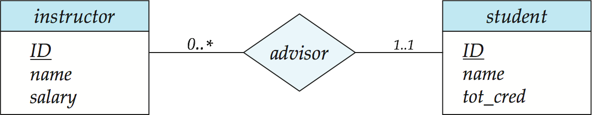
Notation for Expressing More Complex Constraints
A line may have an associated minimum and maximum cardinality, shown in the form l..h, where l is the minimum and h the maximum cardinality
A minimum value of 1 indicates total participation.
A maximum value of 1 indicates that the entity participates in at most one relationship
A maximum value of * indicates no limit.
Instructor can advise 0 or more students. A student must have 1 advisor; cannot have multiple advisors
Notes:
‹#›

Slide 34
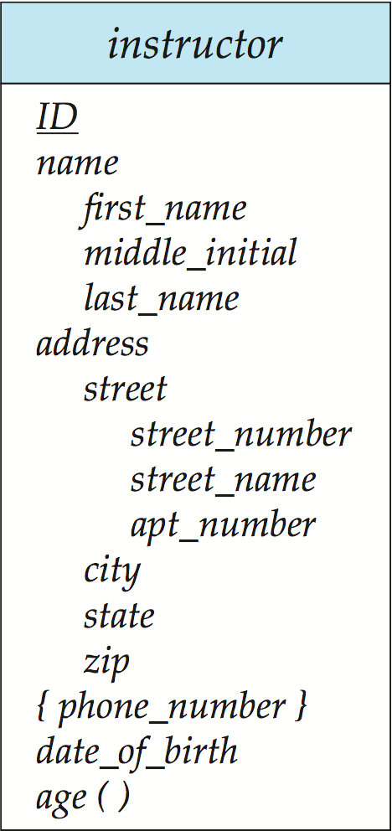
Notation to Express Entity with Complex Attributes
Notes:
‹#›

Slide 35
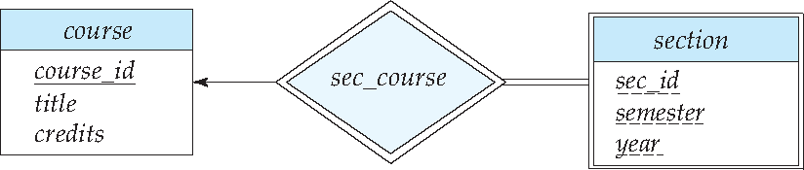
Expressing Weak Entity Sets
In E-R diagrams, a weak entity set is depicted via a double rectangle.
We underline the discriminator of a weak entity set with a dashed line.
The relationship set connecting the weak entity set to the identifying strong entity set is depicted by a double diamond.
Primary key for section – (course_id, sec_id, semester, year)
Notes:
‹#›

Slide 36
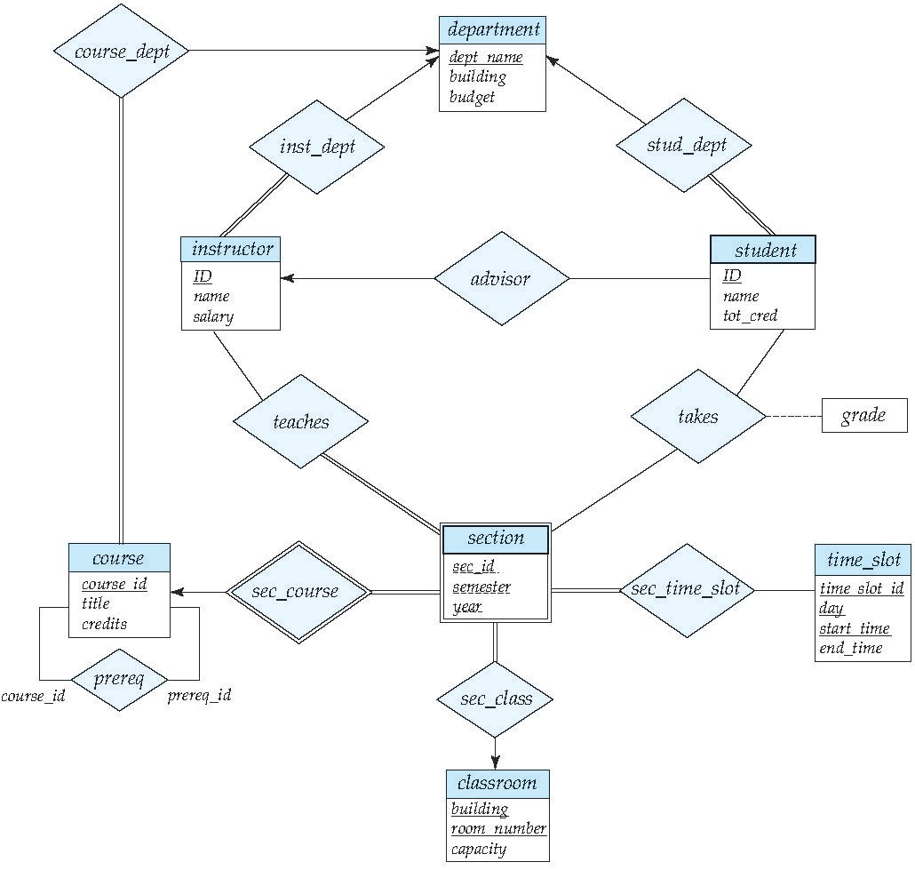
E-R Diagram for a University Enterprise
Notes:
‹#›

Slide 37
Reduction to Relation Schemas
Notes:
‹#›

Slide 38
Reduction to Relation Schemas
Entity sets and relationship sets can be expressed uniformly as relation schemas that represent the contents of the database.
A database which conforms to an E-R diagram can be represented by a collection of schemas.
For each entity set and relationship set there is a unique schema that is assigned the name of the corresponding entity set or relationship set.
Each schema has a number of columns (generally corresponding to attributes), which have unique names.
Notes:
‹#›

Slide 39
Representing Entity Sets
A strong entity set reduces to a schema with the same attributes
student(ID, name, tot_cred)
A weak entity set becomes a table that includes a column for the primary key of the identifying strong entity set
section ( course_id, sec_id, sem, year )
Notes:
‹#›

Slide 40

Representing Relationship Sets
A many-to-many relationship set is represented as a schema with attributes for the primary keys of the two participating entity sets, and any descriptive attributes of the relationship set.
Example: schema for relationship set advisor
advisor = (s_id, i_id)
Notes:
‹#›

Slide 41
Representation of Entity Sets with Composite Attributes
Composite attributes are flattened out by creating a separate attribute for each component attribute
Example: given entity set instructor with composite attribute name with component attributes first_name and last_name the schema corresponding to the entity set has two attributes name_first_name and name_last_name
Prefix omitted if there is no ambiguity (name_first_name could be first_name)
Ignoring multivalued attributes, extended instructor schema is
instructor(ID, first_name, middle_initial, last_name, street_number, street_name, apt_number, city, state, zip_code, date_of_birth)
Notes:
‹#›

Slide 42
Representation of Entity Sets with Multivalued Attributes
A multivalued attribute M of an entity E is represented by a separate schema EM
Schema EM has attributes corresponding to the primary key of E and an attribute corresponding to multivalued attribute M
Example: Multivalued attribute phone_number of instructor is represented by a schema: inst_phone= ( ID, phone_number)
Each value of the multivalued attribute maps to a separate tuple of the relation on schema EM
For example, an instructor entity with primary key 22222 and phone numbers 456-7890 and 123-4567 maps to two tuples: (22222, 456-7890) and (22222, 123-4567)
Notes:
‹#›

Slide 43
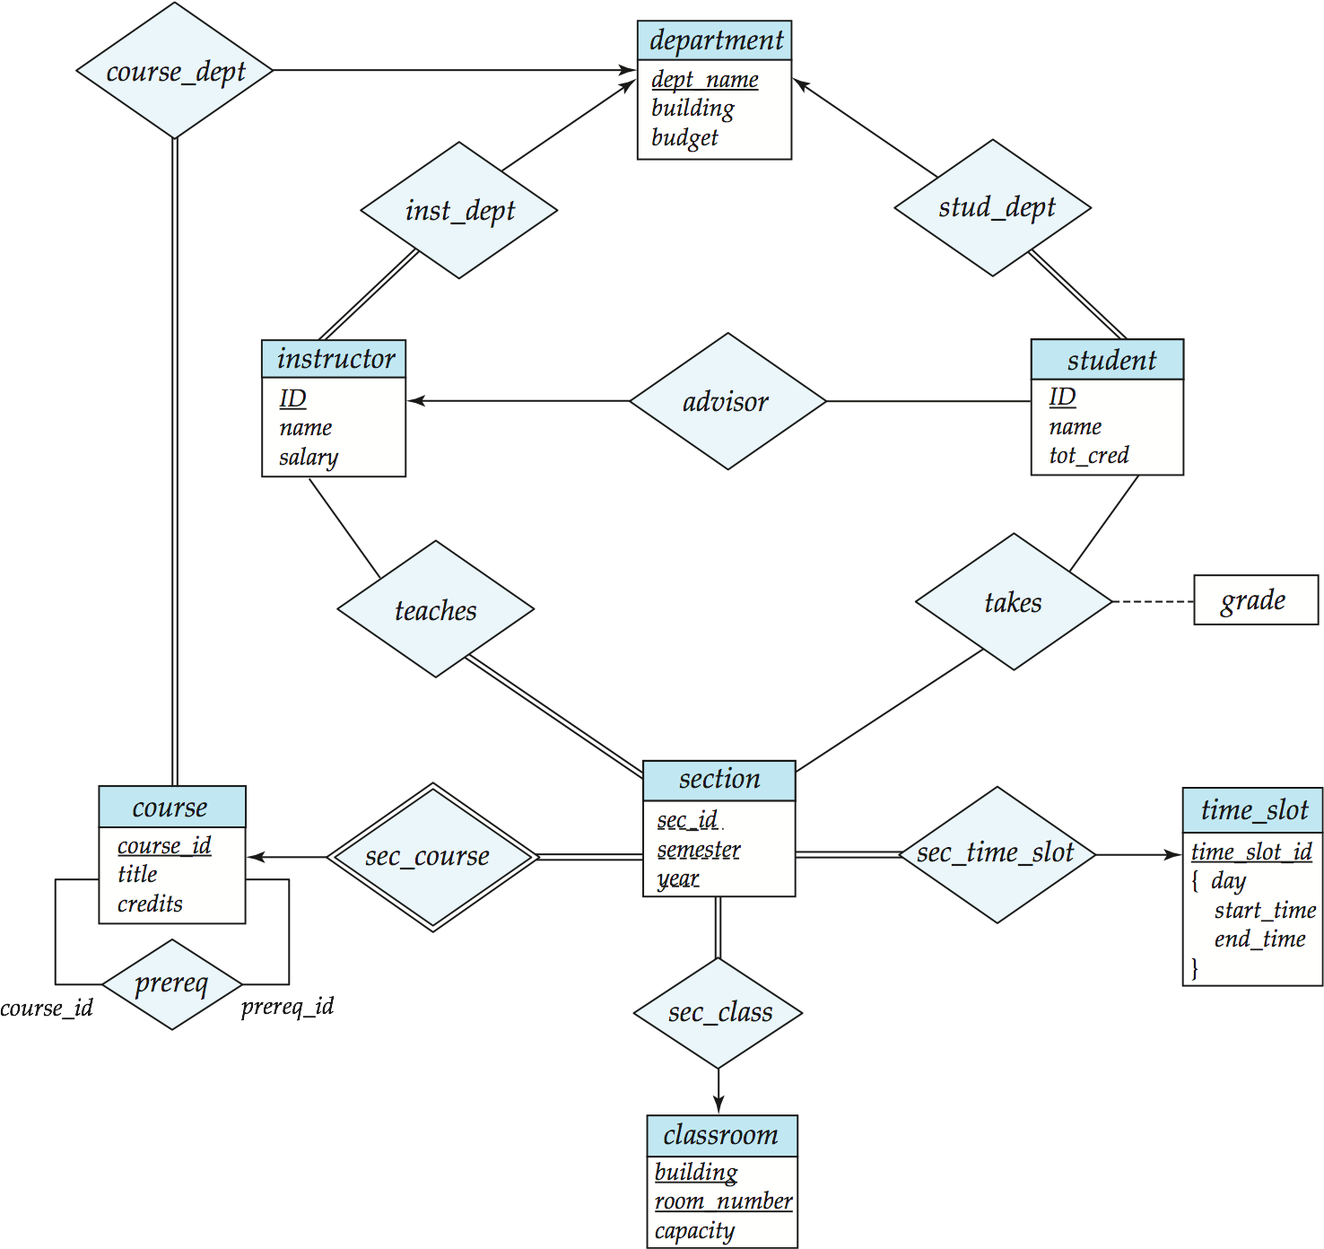
Redundancy of Schemas
Many-to-one and one-to-many relationship sets that are total on the many-side can be represented by adding an extra attribute to the “many” side, containing the primary key of the “one” side
Example: Instead of creating a schema for relationship set inst_dept, add an attribute dept_name to the schema arising from entity set instructor
Notes:
‹#›

Slide 44
Redundancy of Schemas (Cont.)
For one-to-one relationship sets, either side can be chosen to act as the “many” side
That is, an extra attribute can be added to either of the tables corresponding to the two entity sets
If participation is partial on the “many” side, replacing a schema by an extra attribute in the schema corresponding to the “many” side could result in null values
Notes:
‹#›

Slide 45
Redundancy of Schemas (Cont.)
The schema corresponding to a relationship set linking a weak entity set to its identifying strong entity set is redundant.
Example: The section schema already contains the attributes that would appear in the sec_course schema
Notes:
‹#›

Slide 46
Advanced Topics
Notes:
‹#›

Slide 47
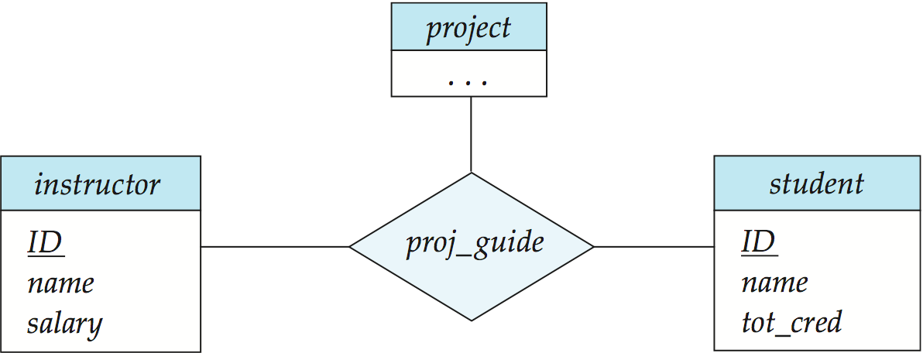
Non-binary Relationship Sets
Most relationship sets are binary
There are occasions when it is more convenient to represent relationships as non-binary.
E-R Diagram with a Ternary Relationship
Notes:
‹#›

Slide 48
Cardinality Constraints on Ternary Relationship
We allow at most one arrow out of a ternary (or greater degree) relationship to indicate a cardinality constraint
For exampe, an arrow from proj_guide to instructor indicates each student has at most one guide for a project
If there is more than one arrow, there are two ways of defining the meaning.
For example, a ternary relationship R between A, B and C with arrows to B and C could mean
1. Each A entity is associated with a unique entity from B and C or
2. Each pair of entities from (A, B) is associated with a unique C entity, and each pair (A, C) is associated with a unique B
Each alternative has been used in different formalisms
To avoid confusion we outlaw more than one arrow
Notes:
‹#›

Slide 49
Specialization
Top-down design process; we designate sub-groupings within an entity set that are distinctive from other entities in the set.
These sub-groupings become lower-level entity sets that have attributes or participate in relationships that do not apply to the higher-level entity set.
Depicted by a triangle component labeled ISA (e.g., instructor “is a” person).
Attribute inheritance – a lower-level entity set inherits all the attributes and relationship participation of the higher-level entity set to which it is linked.
Notes:
‹#›

Slide 50
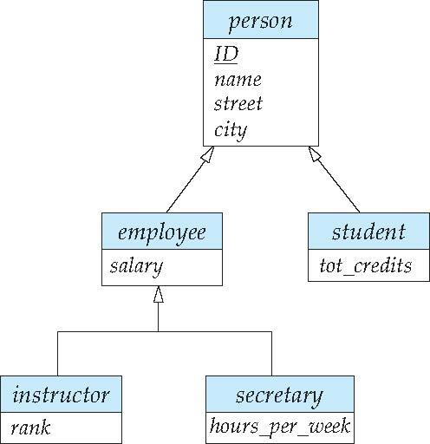
Specialization Example
Overlapping – employee and student
Disjoint – instructor and secretary
Total and partial
Notes:
‹#›

Slide 51
Representing Specialization via Schemas
Method 1:
Form a schema for the higher-level entity
Form a schema for each lower-level entity set, include primary key of higher-level entity set and local attributes
Drawback: getting information about, an employee requires accessing two relations, the one corresponding to the low-level schema and the one corresponding to the high-level schema
schema attributes
person ID, name, street, city
student ID, tot_cred
employee ID, salary
Notes:
‹#›

Slide 52
Representing Specialization as Schemas (Cont.)
Method 2:
Form a schema for each entity set with all local and inherited attributes
Drawback: name, street and city may be stored redundantly for people who are both students and employees
schema attributes
person ID, name, street, city
student ID, name, street, city, tot_cred
employee ID, name, street, city, salary
Notes:
‹#›

Slide 53
Generalization
A bottom-up design process – combine a number of entity sets that share the same features into a higher-level entity set.
Specialization and generalization are simple inversions of each other; they are represented in an E-R diagram in the same way.
The terms specialization and generalization are used interchangeably.
Notes:
‹#›

Slide 54
Design Constraints on a Specialization/Generalization
Completeness constraint -- specifies whether or not an entity in the higher-level entity set must belong to at least one of the lower-level entity sets within a generalization.
total: an entity must belong to one of the lower-level entity sets
partial: an entity need not belong to one of the lower-level entity sets
Partial generalization is the default. We can specify total generalization in an ER diagram by adding the keyword total in the diagram and drawing a dashed line from the keyword to the corresponding hollow arrow-head to which it applies (for a total generalization), or to the set of hollow arrow-heads to which it applies (for an overlapping generalization).
The student generalization is total: All student entities must be either graduate or undergraduate. Because the higher-level entity set arrived at through generalization is generally composed of only those entities in the lower-level entity sets, the completeness constraint for a generalized higher-level entity set is usually total
Notes:
‹#›

Slide 55
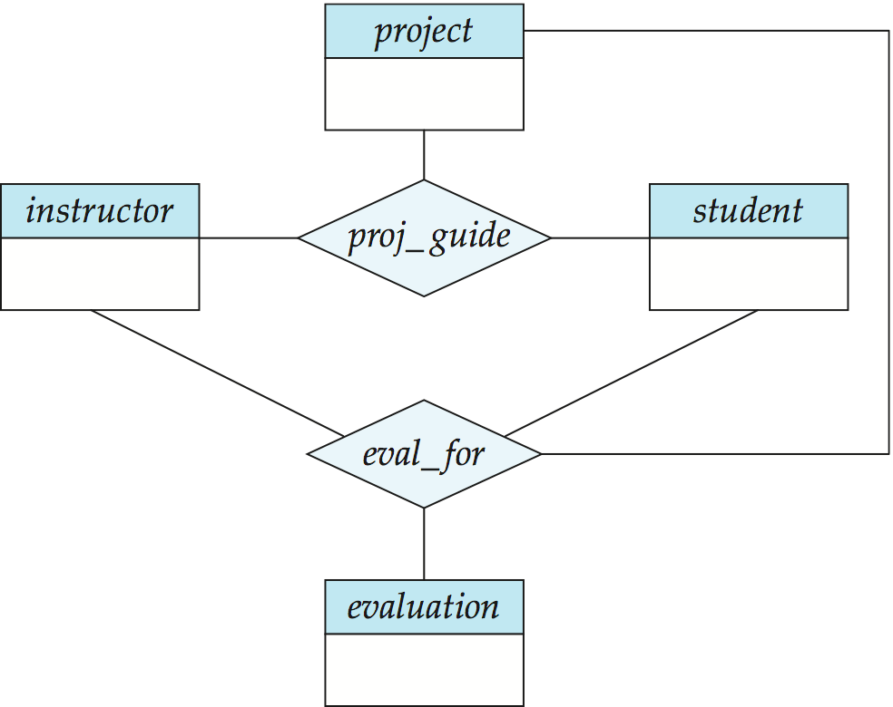
Aggregation
Consider the ternary relationship proj_guide, which we saw earlier
Suppose we want to record evaluations of a student by a guide on a project
Notes:
‹#›

Slide 56
Aggregation (Cont.)
Relationship sets eval_for and proj_guide represent overlapping information
Every eval_for relationship corresponds to a proj_guide relationship
However, some proj_guide relationships may not correspond to any eval_for relationships
So we can’t discard the proj_guide relationship
Eliminate this redundancy via aggregation
Treat relationship as an abstract entity
Allows relationships between relationships
Abstraction of relationship into new entity
Notes:
‹#›

Slide 57
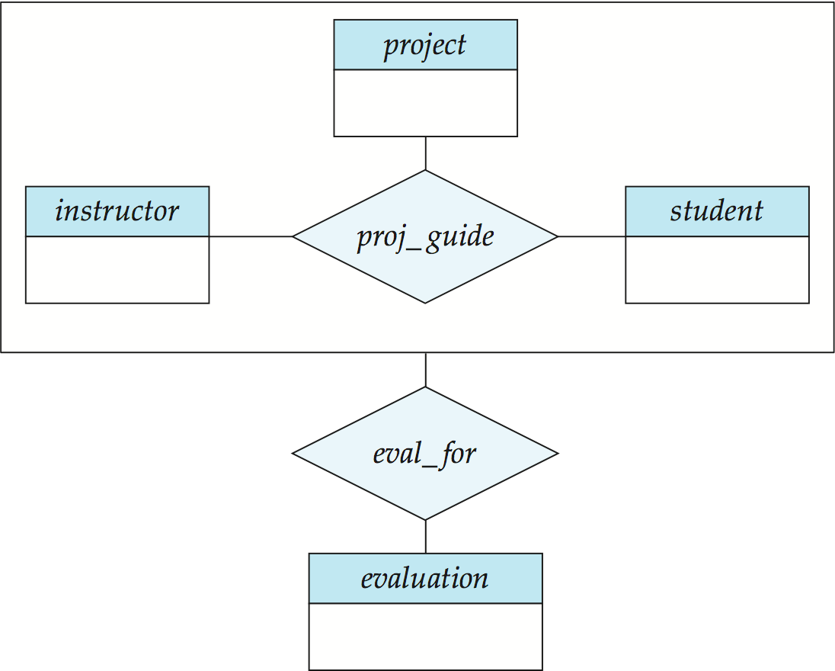
Aggregation (Cont.)
Eliminate this redundancy via aggregation without introducing redundancy, the following diagram represents:
A student is guided by a particular instructor on a particular project
A student, instructor, project combination may have an associated evaluation
Notes:
‹#›

Slide 58
Representing Aggregation via Schemas
To represent aggregation, create a schema containing
Primary key of the aggregated relationship,
The primary key of the associated entity set
Any descriptive attributes
In our example:
The schema eval_for is:
eval_for (s_ID, project_id, i_ID, evaluation_id)
The schema proj_guide is redundant.
Notes:
‹#›

Slide 59
Design Issues

Slide 60
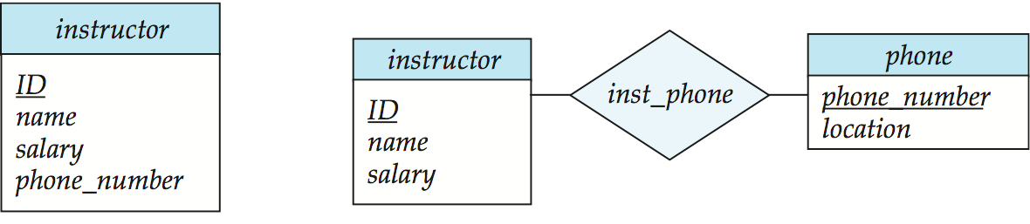
Entities vs. Attributes
Use of entity sets vs. attributes
Use of phone as an entity allows extra information about phone numbers (plus multiple phone numbers)
Notes:
‹#›

Slide 61
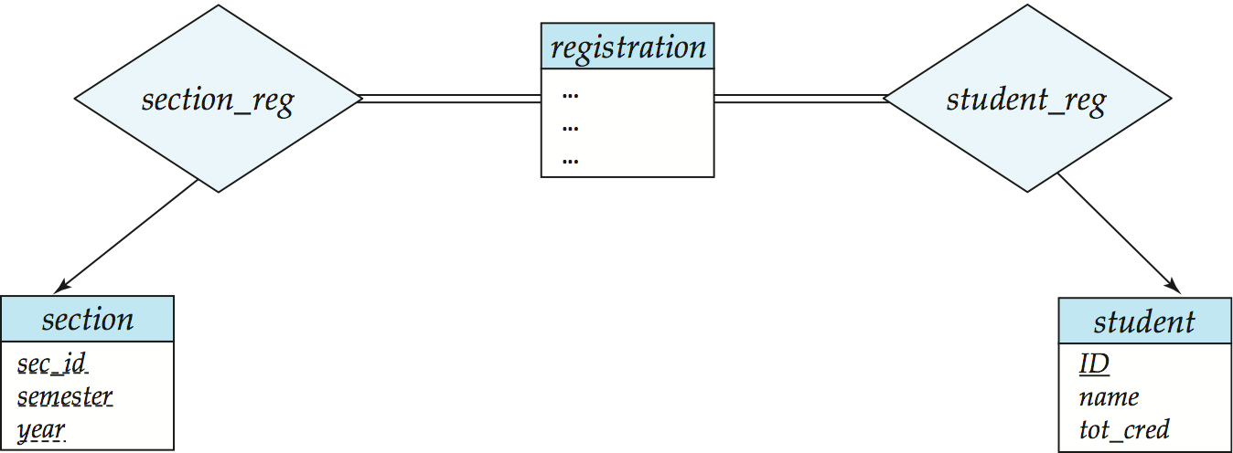
Entities vs. Relationship sets
Use of entity sets vs. relationship sets
Possible guideline is to designate a relationship set to describe an action that occurs between entities
Placement of relationship attributes
For example, attribute date as attribute of advisor or as attribute of student
Notes:
‹#›

Slide 62
Binary Vs. Non-Binary Relationships
Although it is possible to replace any non-binary (n-ary, for n > 2) relationship set by a number of distinct binary relationship sets, a n-ary relationship set shows more clearly that several entities participate in a single relationship.
Some relationships that appear to be non-binary may be better represented using binary relationships
For example, a ternary relationship parents, relating a child to his/her father and mother, is best replaced by two binary relationships, father and mother
Using two binary relationships allows partial information (e.g., only mother being known)
But there are some relationships that are naturally non-binary
Example: proj_guide
Notes:
‹#›

Slide 63
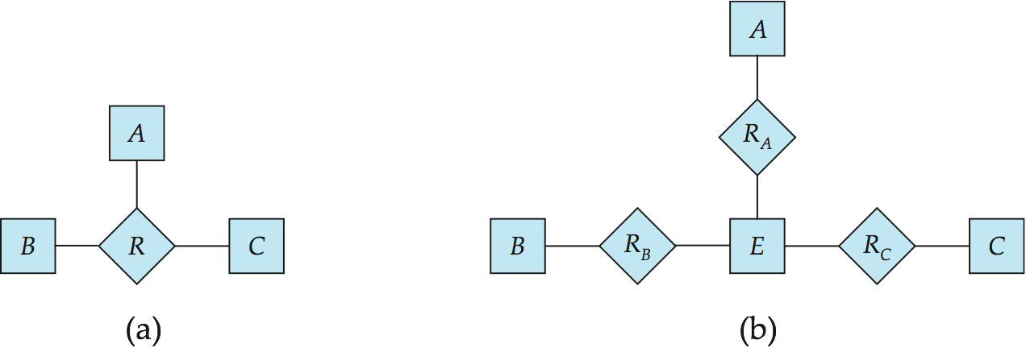
Converting Non-Binary Relationships to Binary Form
In general, any non-binary relationship can be represented using binary relationships by creating an artificial entity set.
Replace R between entity sets A, B and C by an entity set E, and three relationship sets:
1. R_{A}, relating E and A 2. R_{B}, relating E and B 3. R_{C}, relating E and C
Create an identifying attribute for E and add any attributes of R to E
For each relationship (a_{i} , b_{i} , c_{i}) in R, create
1. a new entity e_{i} in the entity set E 2. add (e_{i} , a_{i} ) to R_{A}
3. add (e_{i} , b_{i} ) to R_{B} 4. add (e_{i} , c_{i} ) to R_{C}
Notes:
‹#›

Slide 64
Converting Non-Binary Relationships (Cont.)
Also need to translate constraints
Translating all constraints may not be possible
There may be instances in the translated schema that cannot correspond to any instance of R
Exercise: add constraints to the relationships R_{A}, R_{B} and R_{C} to ensure that a newly created entity corresponds to exactly one entity in each of entity sets A, B and C
We can avoid creating an identifying attribute by making E a weak entity set (described shortly) identified by the three relationship sets
Notes:
‹#›

Slide 65
E-R Design Decisions
The use of an attribute or entity set to represent an object.
Whether a real-world concept is best expressed by an entity set or a relationship set.
The use of a ternary relationship versus a pair of binary relationships.
The use of a strong or weak entity set.
The use of specialization/generalization – contributes to modularity in the design.
The use of aggregation – can treat the aggregate entity set as a single unit without concern for the details of its internal structure.
Notes:
‹#›

Slide 66
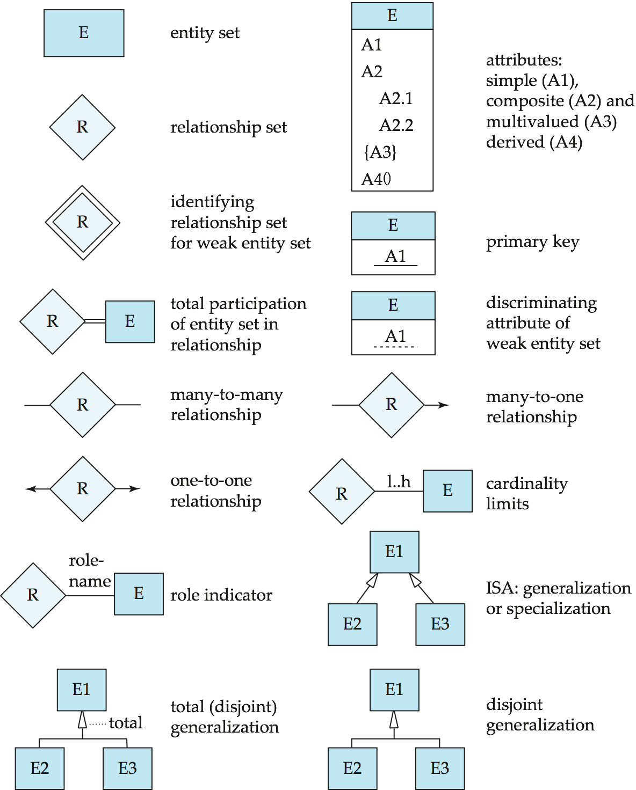
Summary of Symbols Used in E-R Notation
Notes:
‹#›

Slide 67
Symbols Used in E-R Notation (Cont.)
Notes:
‹#›

Slide 68
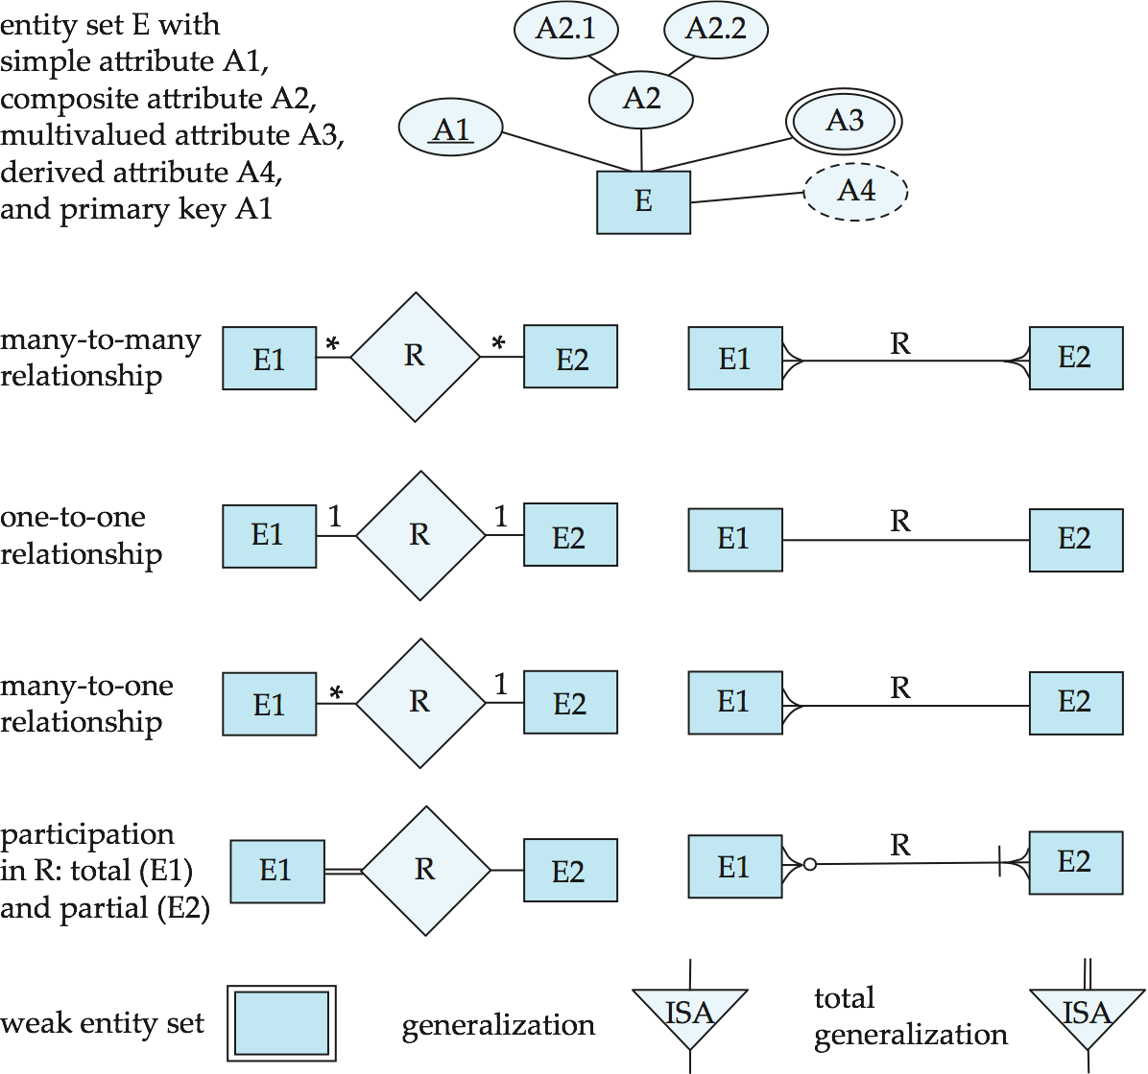
Alternative ER Notations
Chen, IDE1FX, …
Notes:
‹#›

Slide 69
Alternative ER Notations
Chen IDE1FX (Crows feet notation)
Notes:
‹#›

Slide 70
UML
UML: Unified Modeling Language
UML has many components to graphically model different aspects of an entire software system
UML Class Diagrams correspond to E-R Diagram, but several differences.
Notes:
‹#›

Slide 71
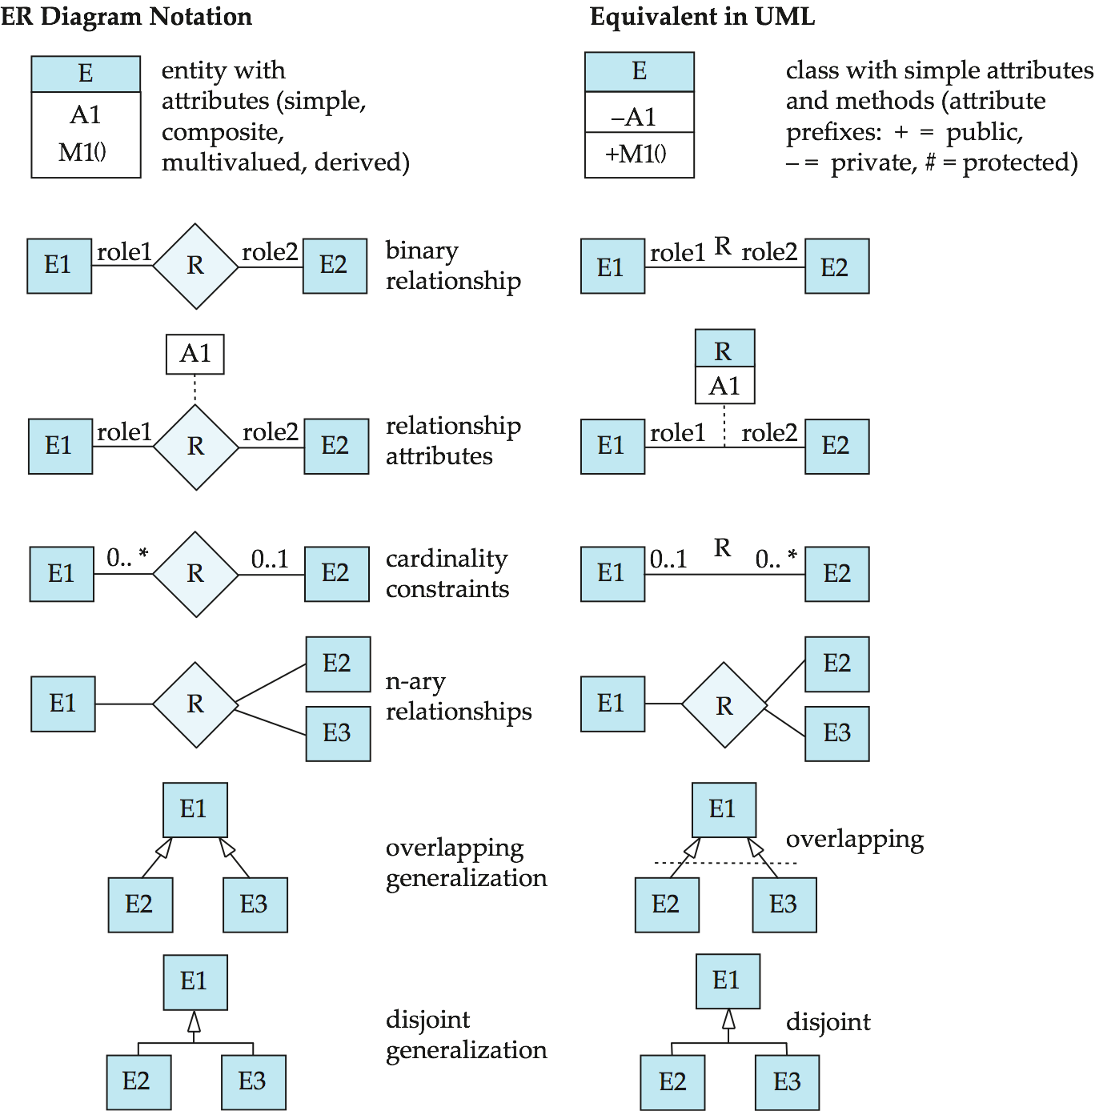
ER vs. UML Class Diagrams
*Note reversal of position in cardinality constraint depiction
Notes:
‹#›

Slide 72
ER vs. UML Class Diagrams
ER Diagram Notation
Equivalent in UML
*Generalization can use merged or separate arrows independent
of disjoint/overlapping
Notes:
‹#›

Slide 73
UML Class Diagrams (Cont.)
Binary relationship sets are represented in UML by just drawing a line connecting the entity sets. The relationship set name is written adjacent to the line.
The role played by an entity set in a relationship set may also be specified by writing the role name on the line, adjacent to the entity set.
The relationship set name may alternatively be written in a box, along with attributes of the relationship set, and the box is connected, using a dotted line, to the line depicting the relationship set.
Notes:
‹#›

Slide 74
End of Chapter 7
Notes:
‹#›

