Slide 1
CSE 3109
Microprocessors and Assembly Language
Microprocessors
Presented by
Mohiuddin Ahmed
Lecturer
Department of CSE
RUET

Slide 2
Evolution of
MICROPROCESSORS
4

Slide 3
4-BIT
MICROPROCESSORS
4

Slide 4
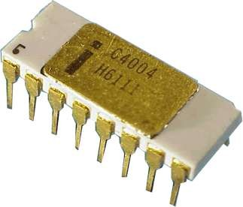
INTEL 4004
Introduced in 1971.
It was the first microprocessor by Intel.
It was a 4-bit µP.
Its clock speed was 740KHz.
It had 2,300 transistors.
It could execute around 60,000 instructions per second.
5

Slide 5
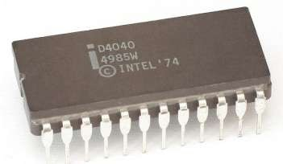
INTEL 4040
Introduced in 1974.
It was also 4-bit µP.
6

Slide 6
8-BIT MICROPROCESSORS
7

Slide 7
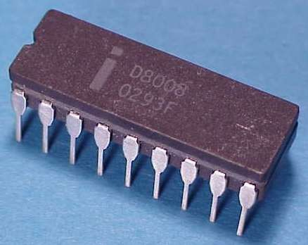
INTEL 8008
Introduced in 1972.
It was first 8-bit µP.
Its clock speed was 500 KHz.
Could execute 50,000 instructions per second.
8

Slide 8
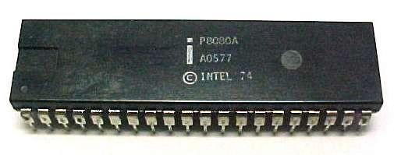

INTEL 8080
Introduced in 1974.
It was also 8-bit µP.
Its clock speed was 2 MHz.
It had 6,000 transistors.
Was 10 times faster than
8008.
Could execute 5,00,000 instructions per second.
9

Slide 9
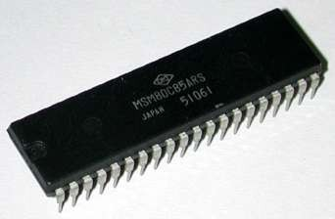
INTEL 8085
Introduced in 1976.
It was also 8-bit µP.
Its clock speed was 3 MHz.
Its data bus is 8-bit and address bus is 16-bit.
It had 6,500 transistors.
Could execute 7,69,230 instructions per second.
It could access 64 KB of
memory.
It had 246 instructions.
10

Slide 10
16-BIT
MICROPROCESSORS
11

Slide 11
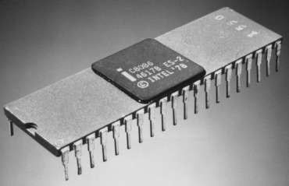
Introduced in 1978.
INTEL 8086
It was first 16-bit µP.
Its clock speed is 4.77 MHz, 8 MHz and 10 MHz, depending on the version.
Its data bus is 16-bit and address bus is 20-bit.
It had 29,000 transistors.
Could execute 2.5 million instructions per second.
It could access 1 MB of memory.
It had 22,000 instructions.
It had Multiply and Divide
instructions.
12

Slide 12
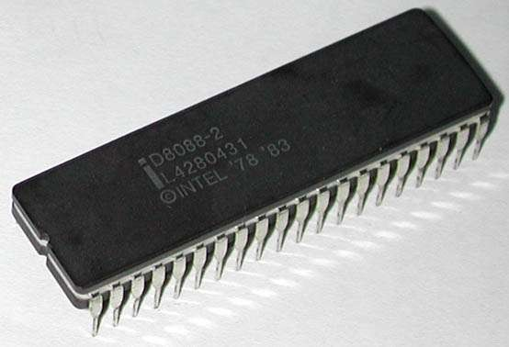
INTEL 8088
Introduced in 1979.
It was also 16-bit µP.
It was created as a cheaper
version of Intel’s 8086.
It was a 16-bit processor with an 8-bit external bus.
13

Slide 13
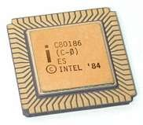
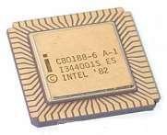
INTEL 80186 & 80188
Introduced in 1982.
They were 16-bit µPs.
Clock speed was 6 MHz.
14

Slide 14
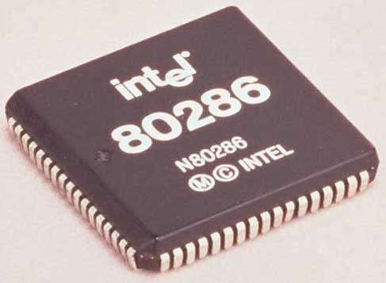
INTEL 80286
Introduced in 1982.
It was 16-bit µP.
Its clock speed was 8 MHz.
15

Slide 15
32-BIT MICROPROCESSORS
16

Slide 16
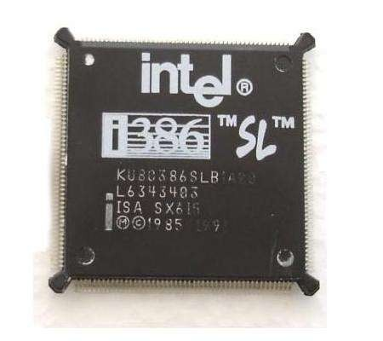
Introduced in 1986.
INTEL 80386
It was first 32-bit µP.
Its data bus is 32-bit and address bus is 32-bit.
It could address 4 GB of memory.
17

Slide 17
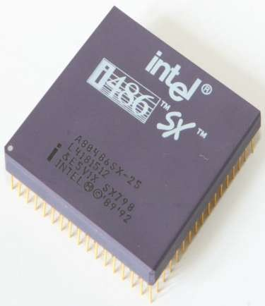
Introduced in 1989.
INTEL 80486
It was also 32-bit µP.
It had 1.2 million transistors.
Its clock speed varied from 16 MHz to 100 MHz depending upon the various versions.
18

Slide 18
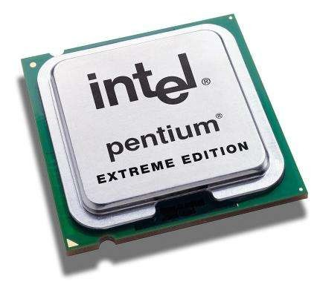
Introduced in 1993.
INTEL PENTIUM
It was also 32-bit µP.
It was originally named 80586.
Its clock speed was 66 MHz.
19

Slide 19
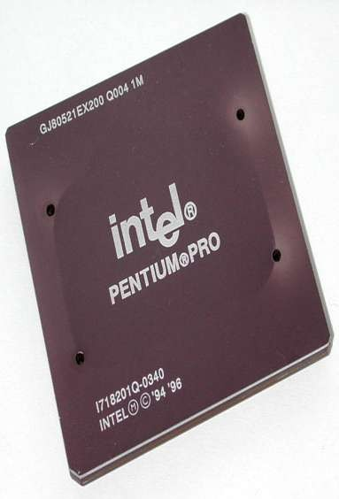
INTEL PENTIUM PRO
Introduced in 1995.
It was also 32-bit µP.

Slide 20
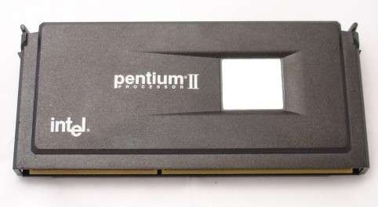
INTEL PENTIUM II
Introduced in 1997.
It was also 32-bit µP.
21

Slide 21
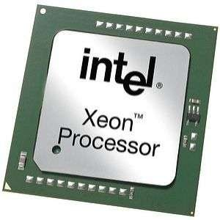
INTEL PENTIUM II XEON
Introduced in 1998.
It was also 32-bit µP.
22

Slide 22
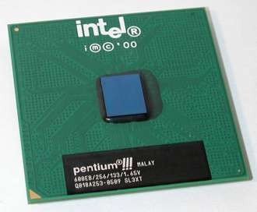
INTEL PENTIUM III
Introduced in 1999.
It was also 32-bit µP.
23

Slide 23
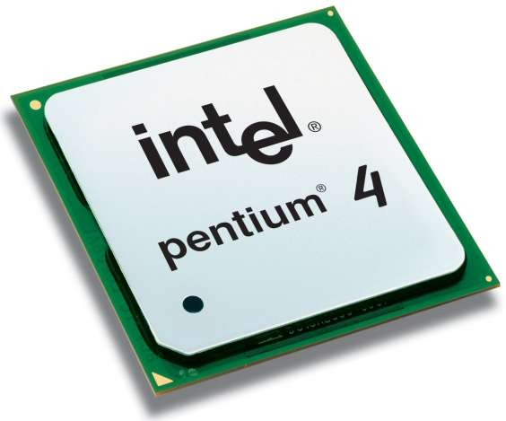
INTEL PENTIUM Iv
Introduced in 2000.
It was also 32-bit µP.
24

Slide 24
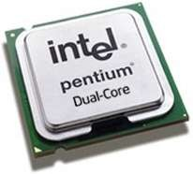
INTEL DUAL CORE
Introduced in 2006.
It is 32-bit or 64-bit µP.
It has two cores.
Both the cores have there own internal bus and L1 cache, but share the external bus and L2 cache
25

Slide 25
64-BIT MICROPROCESSORS
27

Slide 26
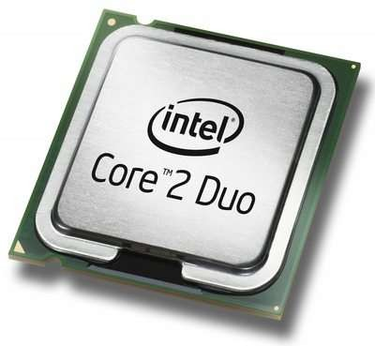
INTEL CORE 2 DUO
Introduced in 2006.
It is a 64-bit µP.
28

Slide 27
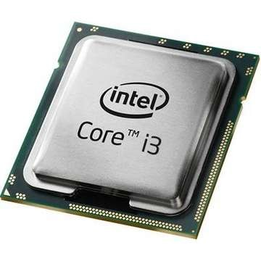
INTEL CORE i3
Introduced in 2008.
It is a 64-bit µP.
31

Slide 28
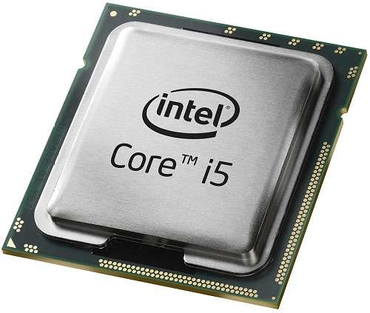
INTEL CORE i5
Introduced in 2009.
It is a 64-bit µP.
30

Slide 29
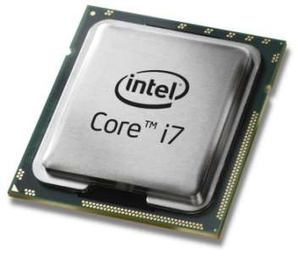
INTEL CORE i7
Introduced in 2010.
It is a 64-bit µP.
29

Slide 30
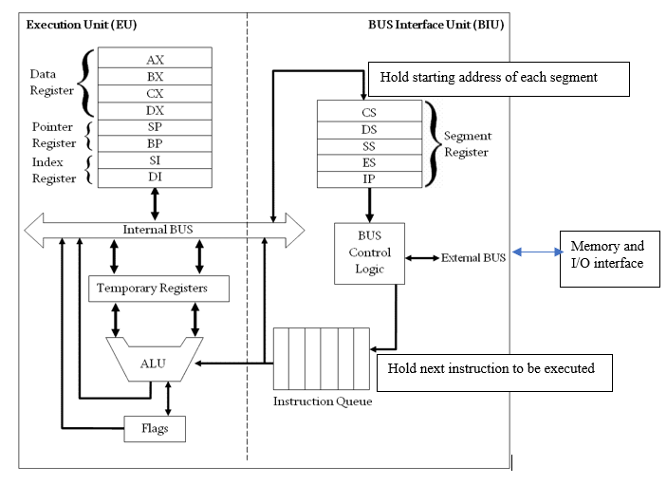
Internal Architecture of 8086 Microprocessor

Slide 31
Internal Architecture of 8086 Microprocessor
It has mainly two functional parts. Dividing the works between two units speeds up the processing.
Bus Interface Unit: Main function of BIU is divided into three sections.
Calculating the 20-bit physical address.
Provide the interface with memory and I/O devices.
Provide pipelining by pre-fetching instructions and stored in the instruction queue.
The BIU sends out addresses, fetches instructions from memory, reads data from ports and memory, and writes data to ports and memory.
BIU handles all transfers of data and addresses on the buses for the execution unit.

Slide 32
Internal Architecture of 8086 Microprocessor
Execution Unit: The execution unit of 8086 tells the BIU where to fetch instructions or data, decodes instructions, and executes instructions
Process the instructions or data provided by the BIU.
Stores the result in the internal registers.
Update the offset address of the registers and status flags.

Slide 33
Types of Registers in the 8086 Microprocessor
Data Registers – AX, BX, CX, DX
Segment Registers – CS, DS, SS, ES
Pointers and Index Registers – IP, BP, SP, SI, DI
Flags or Status Register

Slide 34
Data Registers
AX (Accumulator)
It is used in arithmetic, logic and data transfer instructions in 8086 microprocessors. In multiplication and division, one of the numbers involved must be in AX or AL.
BX (Base Register)
BX register is an address register. It usually contains a data pointer used for based, based indexed or register indirect addressing.
CX (Count register)
This serves as a loop counter. Program loop constructions are facilitated by it. Count register can also be used as a counter in string manipulation and shift/rotate instruction.
DX (Data Register)
DX is data register. The two parts are DH and DL. This register can be used in Multiplication, Input/output addressing etc.
15 7 0
AX | AH | AL
BX | BH | BL
CX | CH | CL
DX | DH | DL

Slide 35
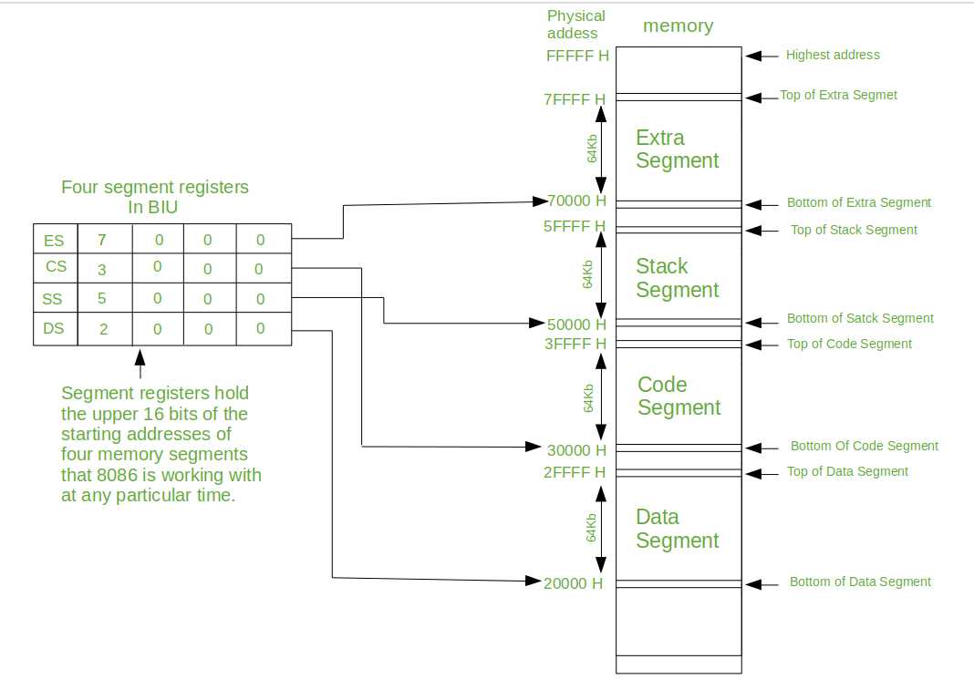
Segment Registers
Code Segment (CS) Register:
CS holds the base address for the Code Segment. All programs are stored in the Code Segment and accessed via the IP.
Data Segment (DS) Register:
DS holds the base address for the Data Segment.
Stack Segment (SS) Registers:
The SS is used to store the information about the memory segment. The operations of the SS are mainly Push and Pop.
Extra Segment (ES) Register:
By default, the control of the compiler remains in the DS where the user can add and modify the instructions. If there is less space in that segment, then ES is used. ES is also used for copying purpose.

Slide 36
Pointers and Index Registers
IP (Instruction Pointer)
It is a 16-bit register. It holds offset of the next instructions in the Code Segment.
SP (Stack Pointer)
This is stack pointer register pointing to program stack. It is used in conjunction with SS for accessing the stack segment. It is of 16 bits. It points to the topmost item of the stack.
BP (Base Pointer)
This is base pointer register pointing to data in stack segment. Unlike SP, we can use BP to access data in the other segments. It is of 16 bits. It is primarily used in accessing parameters passed by the stack. Its offset address is relative to the stack segment.
SI (Source Index)
This is source index register which is used to point to memory locations in the data segment addressed by DS. Thus, when we increment the contents of SI, we can easily access consecutive memory locations. It is of 16 bits. Its offset is relative to the data segment.
DI (Destination Index)
This is destination index register performs the same function as SI. There is a class of instructions called string operations, that use DI to access the memory locations addressed by ES

Slide 37
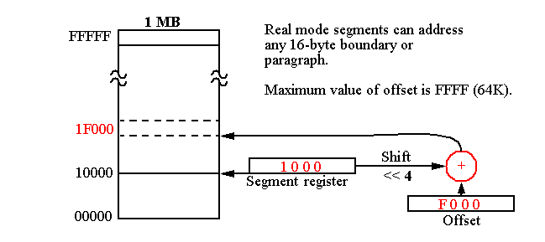
Segment and Offset Address
Segment Address:
The content of a segment register is called as segment address.
Offset Address:
The offset address is a location within a 64K-byte segment range.
It is also called the displacement from the base address

Slide 38
Physical and Logical Address
Physical Address:
The physical address is the 20-bit address that is actually put on the address pins of the 8086 microprocessor and decoded by the memory interfacing circuitry.
Logical Address:
The logical address consists of a segment value and an offset address.
Represented by Segment:Offset

Slide 39
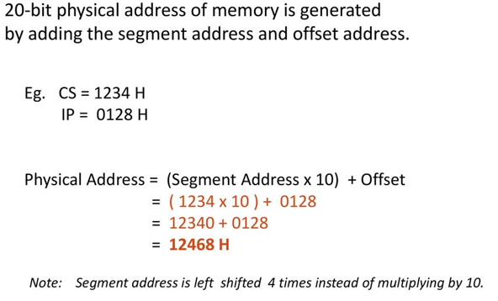
Physical Address Calculation
Physical Address = Segment ×10h+Offset

Slide 40
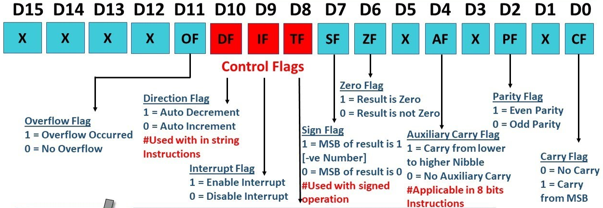
Flags Register
The Flag register is a Special Purpose Register. Depending upon the value of result after any arithmetic and logical operation the flag bits become set (1) or reset (0).

Slide 41
Thank You

