Slide 1
Probability

Slide 2
Uncertainty in the World
An person can often be uncertain about the state of the world/domain since there is often ambiguity and uncertainty
Plausible/probabilistic inference
I’ve got this evidence; what’s the chance that this conclusion is true?
I’ve got a sore neck; how likely am I to have meningitis?
A mammogram test is positive; what’s the probability that the patient has breast cancer?
Notes:
CLICK EACH SUB

Slide 3
Uncertainty
Say we have a rule:
if toothache then problem is cavity
But not all patients have toothaches due to cavities, so we could set up rules like:
if toothache and ¬gum-disease and ¬filling and ... then problem = cavity
This gets complicated; better method:
if toothache then problem is cavity with 0.8 probability
or P(cavity | toothache) = 0.8
the probability of cavity is 0.8 given toothache is observed
Notes:
CLICK EACH SUB

Slide 4
Example of Uncertainty
Assume a camera and vision system is used to estimate the curvature of the road ahead
There's uncertainty about which way it curves
limited pixel resolution, noise in image
algorithm for “road detection” is not perfect
This uncertainty can be represented with a simple probability model:
P(road curves to left | E) = 0.6 P(road goes straight | E) = 0.3 P(road curves to right | E) = 0.1
where the probability of an event is a measure of observer’s belief in the event given the evidence E
Notes:
CLICK EACH SUB

Slide 5
Uncertainty in the World and our Models
True uncertainty: rules are probabilistic in nature
quantum mechanics
rolling dice, flipping a coin
Laziness: too hard to determine exception-less rules
takes too much work to determine all of the relevant factors
too hard to use the enormous rules that result
Theoretical ignorance: don't know all the rules
problem domain has no complete, consistent theory (e.g., medical diagnosis)
Practical ignorance: do know all the rules BUT
haven't collected all relevant information for a particular case
Notes:
CLICK EACH

Slide 6
Logics
Logics are characterized by what they commit to as "primitives"
Logic | What Exists in World | Knowledge States
Propositional | facts | true/false/unknown
First-Order | facts, objects, relations | true/false/unknown
Temporal | facts, objects, relations, times | true/false/unknown
Probability Theory | facts | degree of belief 0..1
Fuzzy | degree of truth | degree of belief 0..1
Notes:
CLICK EACH SUB

Slide 7
Probability Theory
Probability theory serves as a formal means for
Representing and reasoning with uncertain knowledge
Modeling degrees of belief in a proposition (event, conclusion, diagnosis, etc.)
Probability is the “language” of uncertainty
A key modeling method in modern AI
Notes:
CLICK EACH SUB

Slide 8
Source of Probabilities
Frequentists
probabilities come from experiments
if 10 of 100 people tested have a cavity, P(cavity) = 0.1
probability means the fraction that would be observed in the limit of infinitely many samples
Objectivists
probabilities are real aspects of the world
objects have a propensity to behave in certain ways
coin has propensity to come up heads with probability 0.5
Subjectivists
probabilities characterize an agent's belief
have no external physical significance

Slide 9
Sample Space/Outcome Space
S is a outcome space: collection of all possible outcome
Let, A be a part of the collection of outcomes in S; that is, A ⊂ S. Then A is called an event.
Events can be binary, multi-valued, or continuous

Slide 10
Outcome and Event
Outcome and event are not synonymous.
Outcome is the result of a random experiment. Example: rolling a die has six possible outcomes.
Event is a set of outcomes to which a probability is assigned. Example: One possible event is "rolling a number less than 3".

Slide 11
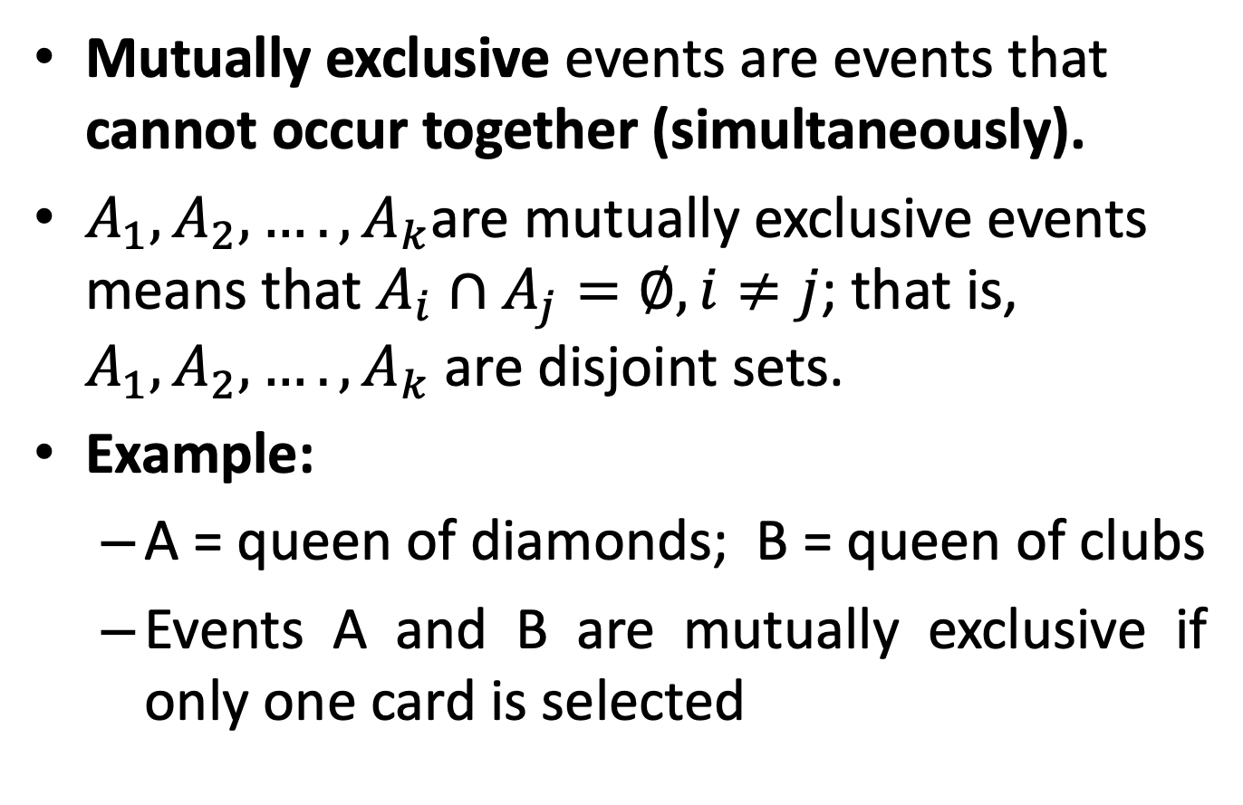
Mutually Exclusive Event
Mutually exclusive events are events that cannot occur together (simultaneously).
$A_{1}, A_{2},…., A_{k}$are mutually exclusive events means that $A_{i}∩A_{j}=∅, i≠j$; that is, $A_{1}, A_{2},…., A_{k}$ are disjoint sets.
Example:
A = queen of diamonds; B = queen of clubs
Events A and B are mutually exclusive if only one card is selected

Slide 12
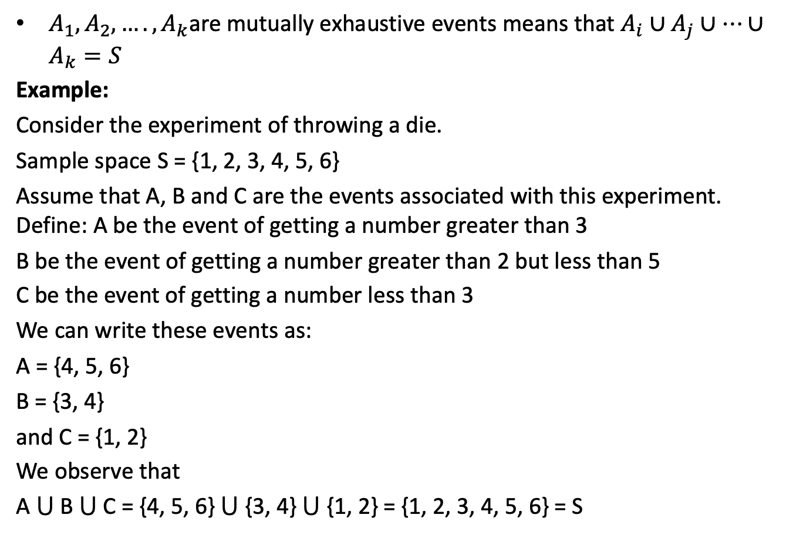
Mutually Exhaustive Event
$A_{1}, A_{2},…., A_{k}$are mutually exhaustive events means that $A_{i}∪A_{j}∪…∪A_{k}=S$
Example:
Consider the experiment of throwing a die.
Sample space S = {1, 2, 3, 4, 5, 6}
Assume that A, B and C are the events associated with this experiment. Define: A be the event of getting a number greater than 3
B be the event of getting a number greater than 2 but less than 5
C be the event of getting a number less than 3
We can write these events as:
A = {4, 5, 6}
B = {3, 4}
and C = {1, 2}
We observe that
A ⋃ B ⋃ C = {4, 5, 6} ⋃ {3, 4} ⋃ {1, 2} = {1, 2, 3, 4, 5, 6} = S

Slide 13
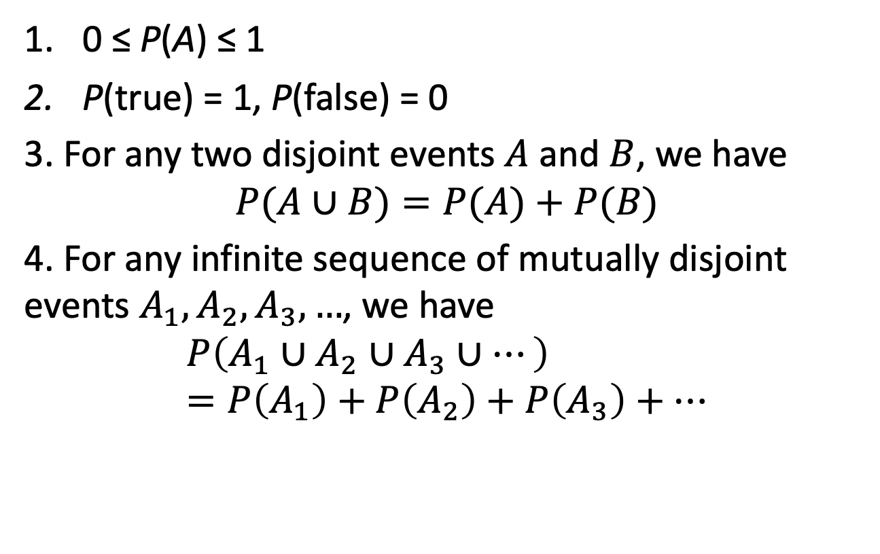
The Axioms of Probability
0 ≤ P(A) ≤ 1
P(true) = 1, P(false) = 0
3. For any two disjoint events $A$ and $B$, we have
$$P(A∪B)=P(A)+P(B)$$
4. For any infinite sequence of mutually disjoint events $A_{1},A_{2},A_{3},…$, we have
$$P\left(A_{1}∪A_{2}∪A_{3}∪⋯\right)=P\left(A_{1}\right)+P\left(A_{2}\right)+P\left(A_{3}\right)+⋯$$

Slide 14
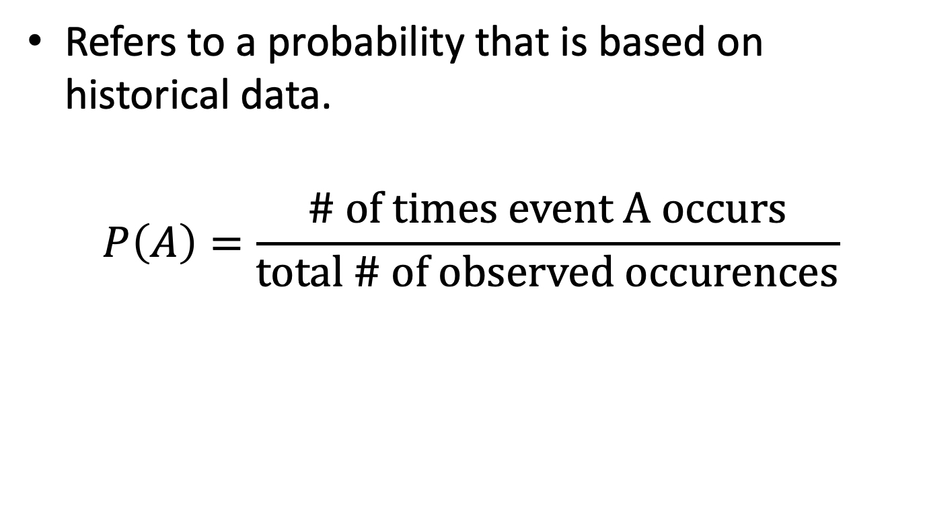
Empirical Probablity
Refers to a probability that is based on historical data.
$$P\left(A\right)=\frac{\text{\# }\text{of} \text{times} \text{event} \text{A} \text{occurs}}{\text{total}\text{ \# }\text{of} \text{observed} \text{occurences}}$$

Slide 15
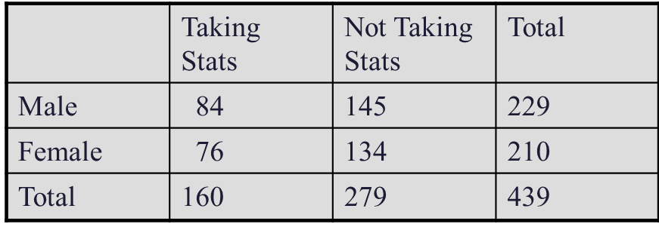
Empirical Probablity
Find the probability of selecting a male taking statistics from the population described in the following table:

Slide 16
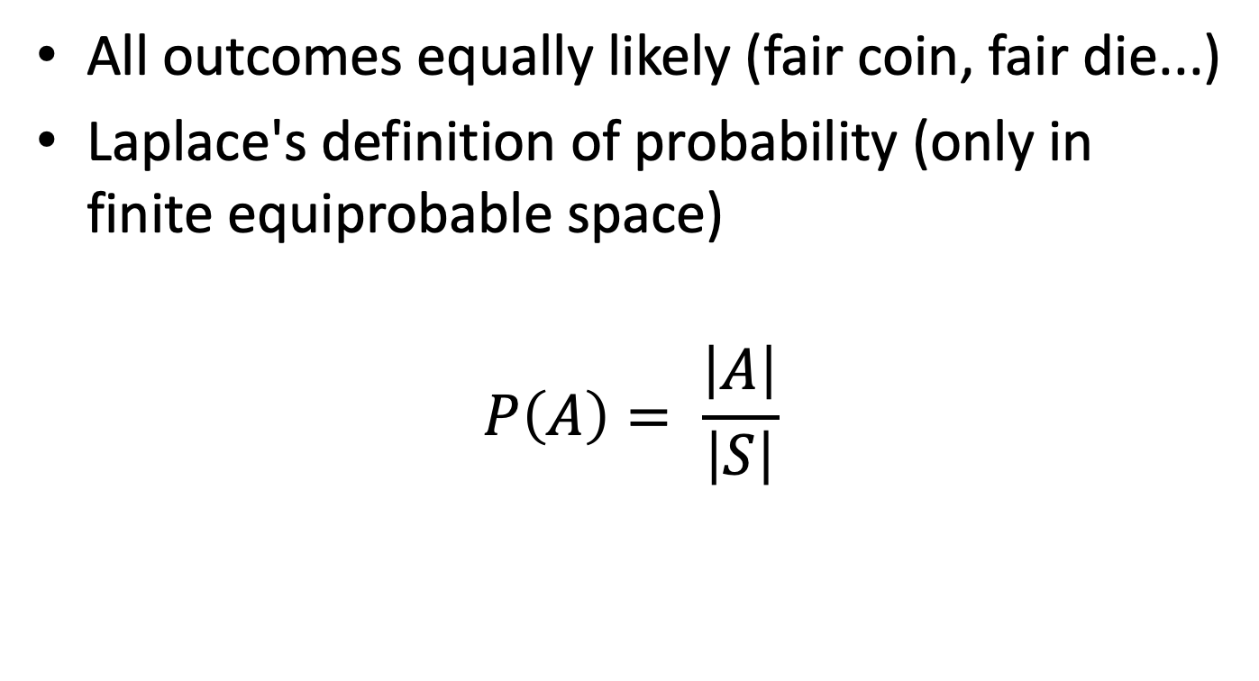
Equiprobable Probability Space
All outcomes equally likely (fair coin, fair die...)
Laplace's definition of probability (only in finite equiprobable space)
$$P\left(A\right)= \frac{\left|A\right|}{\left|S\right|}$$

Slide 17
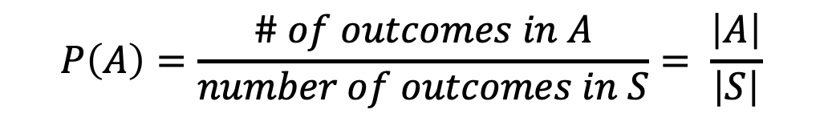
Theoritical Probablity
Theoretical probability is finding the probability of events that come from an equiprobable sample space.
$$P\left(A\right)=\frac{\# of outcomes in A}{number of outcomes in S}= \frac{\left|A\right|}{\left|S\right|}$$

Slide 18

Theoritical Probablity
Find the probability of selecting a face card (Jack, Queen, or King) from a standard deck of 52 cards.
$$P\left(Face Card\right)= \frac{\left|A\right|}{\left|S\right|}=\frac{12}{52}=\frac{3}{13}$$

Slide 19
Simple vs Joint Probability
Simple (Marginal) Probability refers to the probability of a simple event.
Example: P(King)
Joint Probability refers to the probability of an occurrence of two or more events.
Example: P(King and Spade)

Slide 20
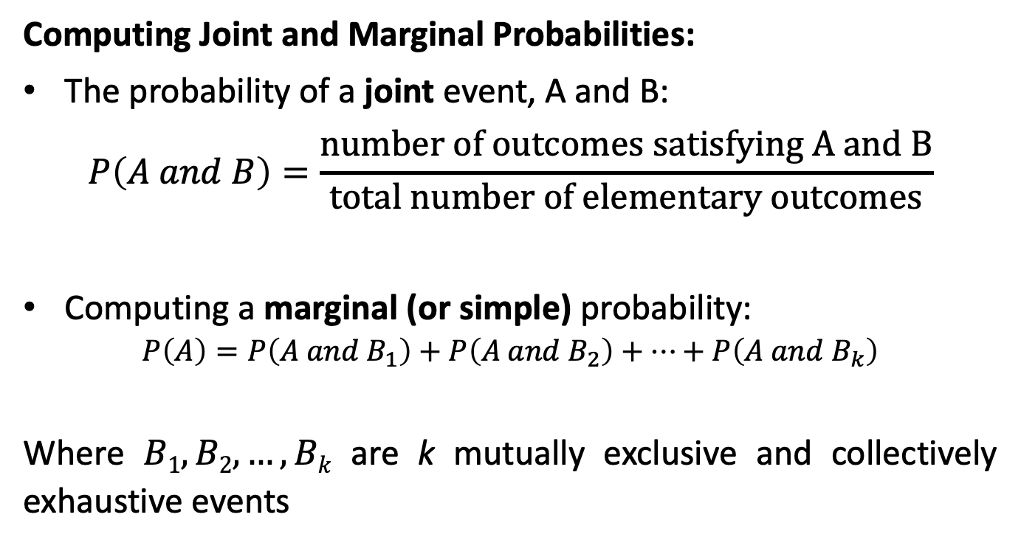
Simple vs Joint Probability
Computing Joint and Marginal Probabilities:
The probability of a joint event, A and B:
$$P\left(A and B\right)=\frac{\text{number} \text{of} \text{outcomes} \text{satisfying} \text{A} \text{and} \text{B}}{\text{total} \text{number} \text{of} \text{elementary} \text{outcomes}}$$
Computing a marginal (or simple) probability:
$$P\left(A\right)=P\left(A and B_{1}\right)+P\left(A and B_{2}\right)+…+P\left(A and B_{k}\right)$$
Where $B1, B2, …, Bk$ are k mutually exclusive and collectively exhaustive events

Slide 21
Example of Joint Probability
 | Ace | Not Ace | Total
Black | 2 | 24 | 26
Red | 2 | 24 | 26
Total | 4 | 48 | 52
P(Red and Ace)

Slide 22
Example of Marginal Probability
 | Ace | Not Ace | Total
Black | 2 | 24 | 26
Red | 2 | 24 | 26
Total | 4 | 48 | 52
P(Ace)

Slide 23
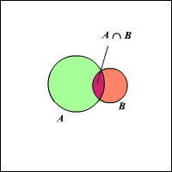
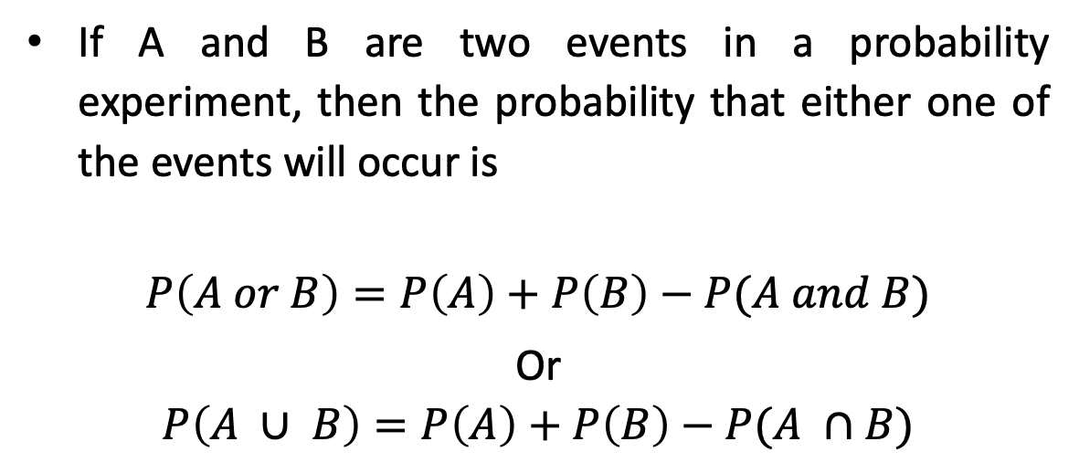
Laws of Probability: Additive Rule
If A and B are two events in a probability experiment, then the probability that either one of the events will occur is
$$P\left(A or B\right)=P\left(A\right)+P\left(B\right)−P(A and B)$$
Or $$P\left(A ∪ B\right)=P\left(A\right)+P\left(B\right)−P(A ∩B)$$

Slide 24
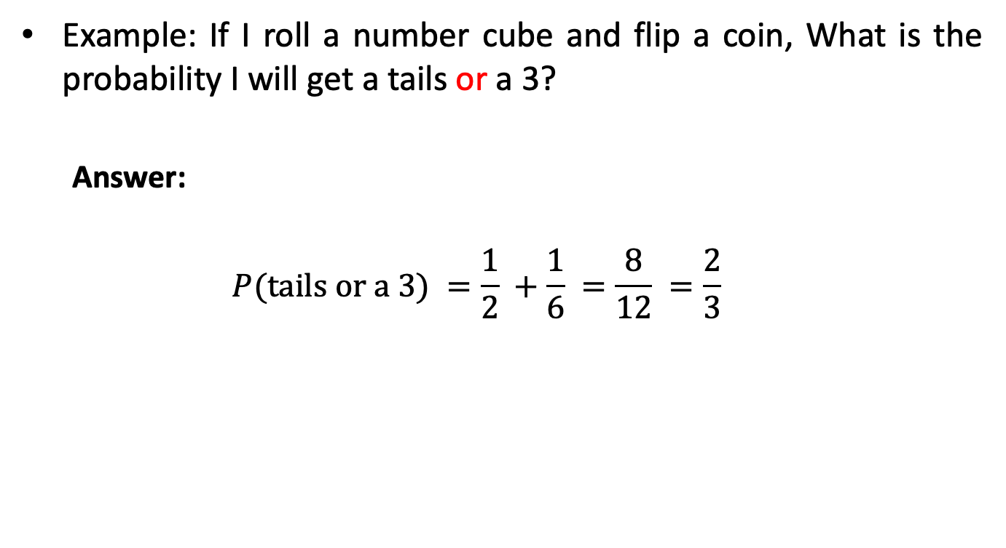
Laws of Probability: Additive Rule (Example)
Example: If I roll a number cube and flip a coin, What is the probability I will get a tails or a 3?
Answer:
$$P(\text{tails} \text{or} \text{a}\text{ 3}) =\frac{1}{2} +\frac{1}{6} =\frac{8}{12} =\frac{2}{3}$$

Slide 25
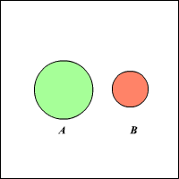
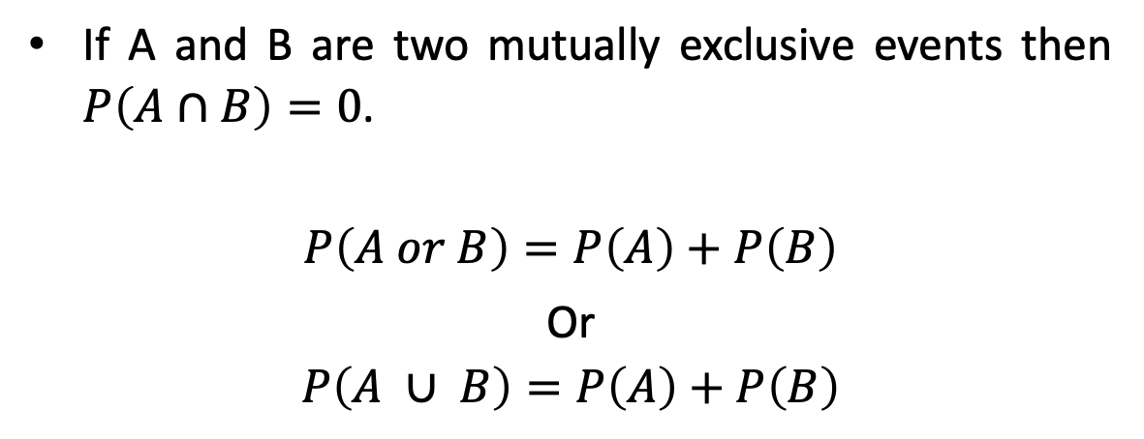
Laws of Probability: Additive Rule
If A and B are two mutually exclusive events then $P\left(A∩B\right)=0$.
$$P\left(A or B\right)=P\left(A\right)+P\left(B\right)$$
Or $$P\left(A ∪ B\right)=P\left(A\right)+P\left(B\right)$$

Slide 26
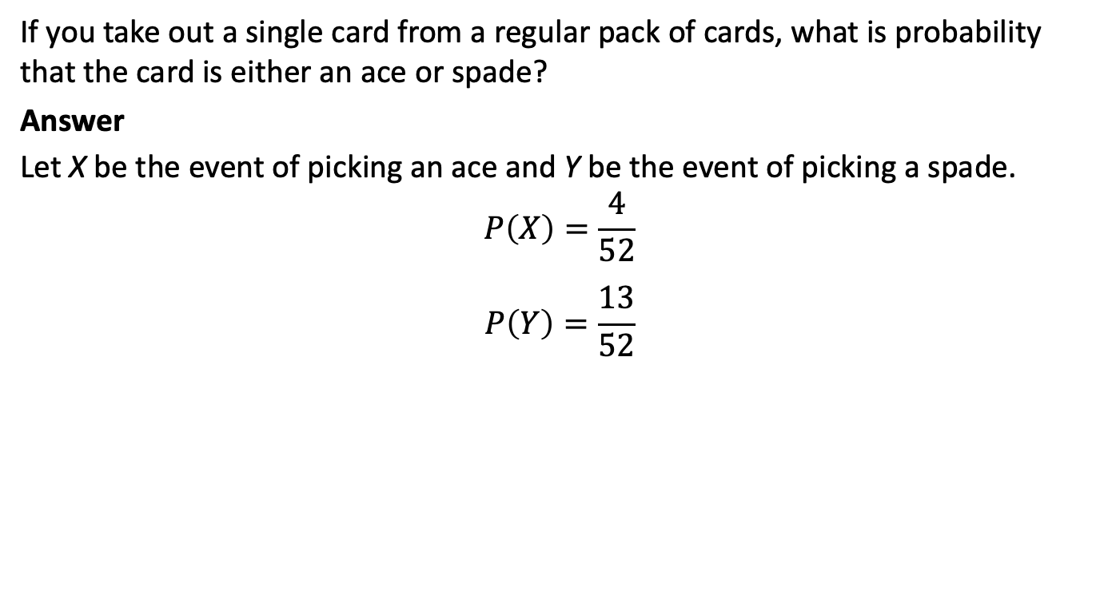
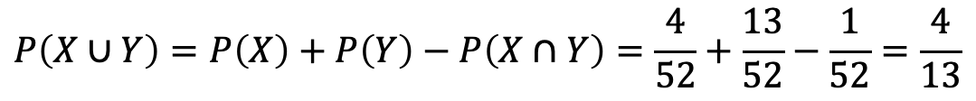
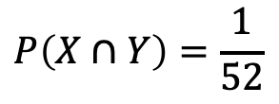
Laws of Probability: Additive Rule (Example)
If you take out a single card from a regular pack of cards, what is probability that the card is either an ace or spade?
Answer
Let X be the event of picking an ace and Y be the event of picking a spade.
$$P\left(X\right)=\frac{4}{52}$$
$$P\left(Y\right)=\frac{13}{52}$$
The two events are not mutually exclusive, as there is one favorable outcome in which the card can be both an ace and spade.
$$P\left(X∩Y\right)=\frac{1}{52}$$
$$P\left(X∪Y\right)=P\left(X\right)+P\left(Y\right)−P\left(X∩Y\right)=\frac{4}{52}+\frac{13}{52}−\frac{1}{52}=\frac{4}{13}$$

Slide 27

Complement Rule
For any event A, we have
$$P\left(A^{c}\right)=1−P(A)$$

Slide 28
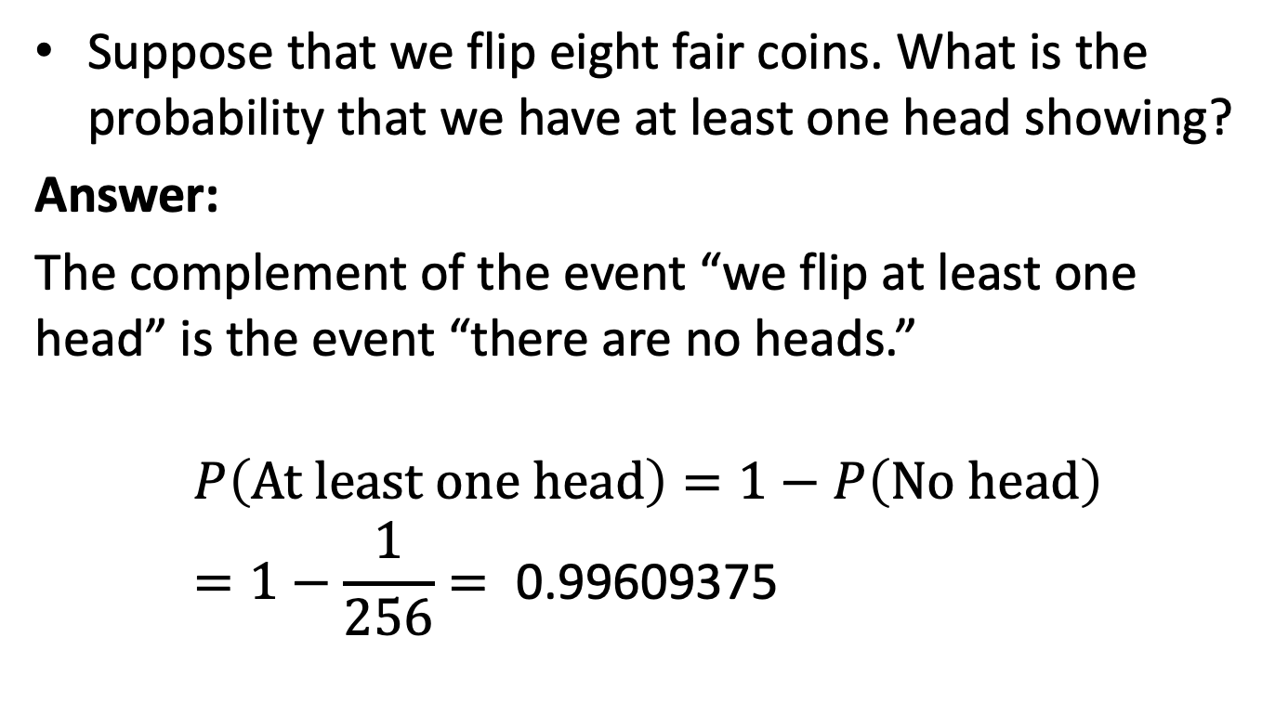
Complement Rule
Suppose that we flip eight fair coins. What is the probability that we have at least one head showing?
Answer:
The complement of the event “we flip at least one head” is the event “there are no heads.”
$$P\left(\text{At} \text{least} \text{one} \text{head}\right)=1−P\left(\text{No} \text{head}\right) \\ =1−\frac{1}{256}=\text{ 0.99609375}$$

Slide 29
Complement Rule
Suppose that we flip eight fair coins. What is the probability that we have at least one head showing?
Answer:
The complement of the event “we flip at least one head” is the event “there are no heads.”
$$P\left(\text{At} \text{least} \text{one} \text{head}\right)=1−P\left(\text{No} \text{head}\right) \\ =1−\frac{1}{256}=\text{ 0.99609375}$$

Slide 30
Random Variable
A variable, X, whose domain is a sample space, and whose value is (somewhat) uncertain
Examples:
X = coin flip outcome
X = first word in tomorrow’s NYT newspaper
X = tomorrow’s high temperature

Slide 31
Random Variable
Random Variables (RV):
are capitalized (usually) e.g., Sky, Weather, Temperature
refer to attributes of the world whose "status" is unknown
have one and only one value at a time
have a domain of values that are possible states of the world:
Boolean: domain = <true, false>
Cavity = true (often abbreviated as cavity ) Cavity = false (often abbreviated as ←cavity )
Discrete: domain is countable (includes Boolean) values are mutually exclusive and exhaustive
e.g. Sky domain = <clear, partly_cloudy, overcast> Sky = clear abbreviated as clear Sky ≠ clear also abbreviated as ¬clear
Continuous: domain is real numbers
Notes:
CLICK EACH SUB

Slide 32
Conditional Probability
Conditional probabilities
formalizes the process of accumulating evidence and updating probabilities based on new evidence
specifies the belief in a proposition (event, conclusion, diagnosis, etc.) that is conditioned on a proposition (evidence, feature, symptom, etc.) being true
P(a | e): conditional probability of A=a given E=e evidence is all that is known true
P(a | e) = P(a ∧ e) / P(e) = P(a, e) / P(e)
conditional probability can viewed as the joint probability P(a, e) normalized by the prior probability, P(e)
Notes:
CLICK EACH SUB

Slide 33
Conditional Probability
Conditional probabilities behave exactly like standard probabilities; for example:
0 ≤ P(a | e) ≤ 1
conditional probabilities are between 0 and 1 inclusive
P(a₁ | e) + P(a₂ | e) + ... + P(a_{k} | e) = 1
conditional probabilities sum to 1 where a₁, …, a_{k} are all values in the domain of random variable A
P(¬a | e) = 1 − P(a | e)
negation for conditional probabilities
Notes:
CLICK EACH

Slide 34
Conditional Probability
P(conjunction of events | e)
P(a ∧ b ∧ c | e) or as P(a, b, c | e) is the agent’s belief in the sentence a ∧ b ∧ c conditioned on e being true
P(a | conjunction of evidence)
P(a | e ∧ f ∧ g) or as P(a | e, f, g) is the agent’s belief in the sentence a conditioned on e ∧ f ∧ g being true
Notes:
CLICK EACH

Slide 35
Conditional Probability
The conditional probability P(A=a | B=b) is the fraction of time A=a, within the region where B=b
P(A=a), e.g. P(1st word on a random page = “San”) = 0.001
A
P(B=b), e.g. P(2nd word = “Francisco”) = 0.0008
P(A=a | B=b), e.g. P(1st=“San” | 2nd =“Francisco”) = ?
(possibly: San, Don, Pablo …)

Slide 36
Conditional Probability
P(san | francisco)
= #(1st=s and 2nd=f) / #(2nd=f)
= P(san ∧ francisco) / P(francisco)
= 0.0007 / 0.0008
= 0.875
P(s)=0.001
P(f)=0.0008
P(s,f)=0.0007
A
P(B=b), e.g. P(2nd word = “Francisco”) = 0.0008
P(A=a | B=b), e.g. P(1st=“San” | 2nd =“Francisco”) = 0.875
(possibly: San, Don, Pablo …)‏
Although “San” is rare and “Francisco” is rare,
given “Francisco” then “San” is quite likely!

Slide 37
Conditional Probability
In general, the conditional probability is
We can have everything conditioned on some other event(s), C, to get a conditionalized version of conditional probability:
‘|’ has low precedence.
This should read: P(A | (B,C))

Slide 38
The Chain Rule
From the definition of conditional probability we have
P(A, B) = P(B) * P(A | B) = P(A | B) * P(B)
It also works the other way around:
P(A, B) = P(A) * P(B | A) = P(B | A) P(A)
It works with more than 2 events too:
P(A₁, A₂, …, A_{n}) =
P(A₁) * P(A₂ | A₁) * P(A₃| A₁, A₂) * …
* P(A_{n} | A₁, A₂, …, A_{n-1})
Called “Product Rule”
Called “Chain Rule”

Slide 39
Probabilistic Reasoning
How do we use probabilities in AI?
You wake up with a headache
Do you have the flu?
H = headache, F = flu
Logical Inference: if H then F
(but the world is usually not this simple)
Statistical Inference: compute the probability of a query/diagnosis/decision given (i.e., conditioned on) evidence/symptom/observation, i.e., P(F | H)
[Example from Andrew Moore]

Slide 40
Example
Statistical Inference: Compute the probability of a diagnosis, F, given symptom, H, where H = “has a headache” and F = “has flu”
That is, compute P(F | H)
You know that
P(H) = 0.1 “one in ten people has a headache”
P(F) = 0.01 “one in 100 people has flu”
P(H | F) = 0.9 “90% of people who have flu have a headache”
[Example from Andrew Moore]

Slide 41
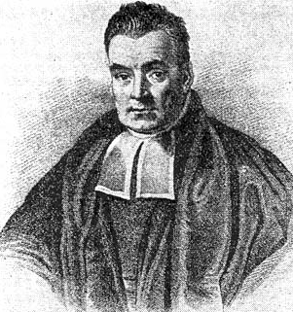
Inference with Bayes’s Rule
Thomas Bayes, “Essay Towards Solving a Problem in the Doctrine of Chances,” 1764
P(H) = 0.1 “one in ten people has a headache”
P(F) = 0.01 “one in 100 people has flu”
P(H|F) = 0.9 “90% of people who have flu have a headache”
P(F|H) = 0.9 * 0.01 / 0.1 = 0.09
So, there’s a 9% chance you have flu – much less than 90%
But it’s higher than P(F) = 1%, since you have a headache
Def of cond. prob.
Product rule

Slide 42
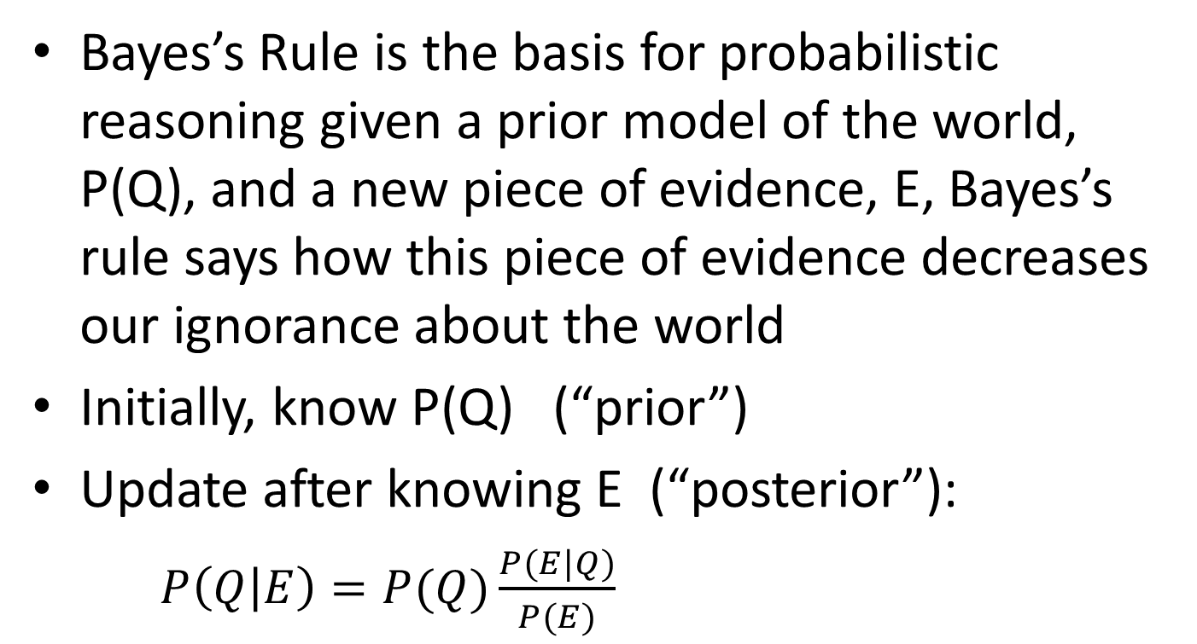
Bayes’s Rule

Slide 43
Inference with Bayes’s Rule
P(A|B) = P(B | A)P(A) / P(B) Bayes’s rule
Why do we make things this complicated?
Often P(B|A), P(A), P(B) are easier to get
Some names:
Prior P(A): probability of A before any evidence
Likelihood P(B|A): assuming A, how likely is the evidence
Posterior P(A|B): probability of A after knowing evidence B
(Deductive) Inference: deriving an unknown probability from known ones
If we have the full joint probability table, we can simply compute P(A|B) = P(A, B) / P(B)

Slide 44
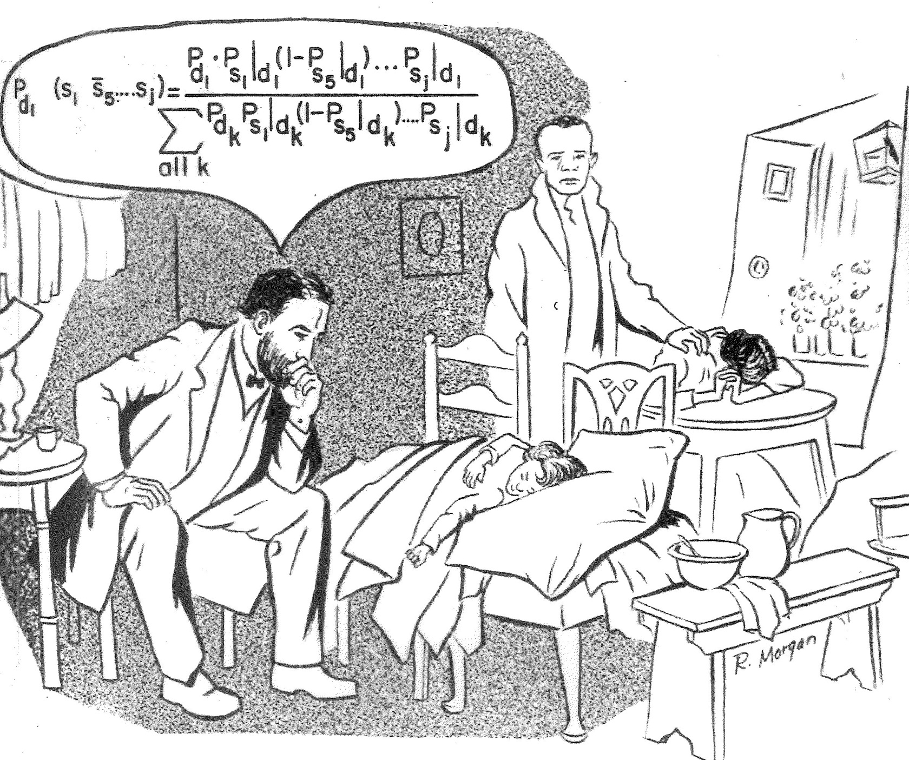
Bayes’s Rule in Practice

Slide 45
Summary of Important Rules
Conditional Probability: P(A|B) = P(A,B)/P(B)
Product rule: P(A,B) = P(A|B)P(B)
Chain rule: P(A,B,C,D) = P(A|B,C,D)P(B|C,D)P(C|D)P(D)
Conditionalized version of Chain rule:
P(A,B|C) = P(A|B,C)P(B|C)
Bayes’s rule: P(A|B) = P(B|A)P(A)/P(B)
Conditionalized version of Bayes’s rule:
P(A|B,C) = P(B|A,C)P(A|C)/P(B|C)
Addition / Conditioning rule: P(A) = P(A,B) + P(A,¬B)
P(A) = P(A|B)P(B) + P(A|¬B)P(¬B)

Slide 46
Common Mistake
P(A) = 0.3 so P(¬A) = 1 – P(A) = 0.7
P(A|B) = 0.4 so P(¬A|B) = 1 – P(A|B) = 0.6
because P(A|B) + P(¬A|B) = 1
but P(A|¬B) ≠ 0.6 (in general)
because P(A|B) + P(A|¬B) ≠ 1 in general

Slide 47
Quiz
A doctor performs a test that has 99% reliability, i.e., 99% of people who are sick test positive, and 99% of people who are healthy test negative. The doctor estimates that 1% of the population is sick.
Question: A patient tests positive. What is the chance that the patient is sick?
0-25%, 25-75%, 75-95%, or 95-100%?

Slide 48
Quiz
A doctor performs a test that has 99% reliability, i.e., 99% of people who are sick test positive, and 99% of people who are healthy test negative. The doctor estimates that 1% of the population is sick.
Question: A patient tests positive. What is the chance that the patient is sick?
0-25%, 25-75%, 75-95%, or 95-100%?
Common answer: 99%; Correct answer: 50%
Notes:
P(TP | S) = 0.99
P(~TP | ~S) = 0.99
P(S) = 0.01
P(S | TP) =

Slide 49
Given:
P(TP | S) = 0.99
P(¬TP | ¬S) = 0.99
P(S) = 0.01
Query:
P(S | TP) = ?
TP = “tests positive”
S = “is sick”

Slide 50
P(TP | S) = 0.99
P(¬TP | ¬S) = 0.99
P(S) = 0.01
P(S | TP) =
P(TP | S) P(S) / P(TP)
= (0.99)(0.01) / P(TP) = 0.0099/P(TP)
P(¬S | TP) = P(TP | ¬S)P(¬S) / P(TP)
= (1 – 0.99)(1 – 0.01) / P(TP) = 0.0099/P(TP)
0.0099/P(TP) + 0.0099/P(TP) = 1, so P(TP) = 0.0198
So, P(S | TP) = 0.0099 / 0.0198 = 0.5

Slide 51
Inference with Bayes’s Rule
In a bag there are two envelopes
one has a red ball (worth $100) and a black ball
one has two black balls. Black balls are worth nothing
You randomly grab an envelope, and randomly take out one ball – it’s black
At this point you’re given the option to switch envelopes. Should you switch or not?
Similar to the “Monty Hall Problem”

