Slide 1

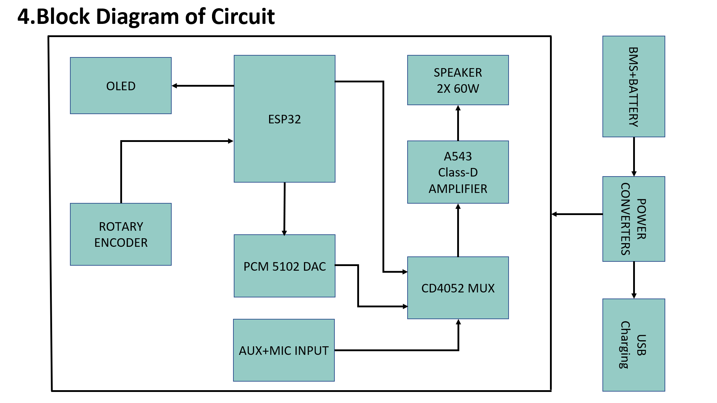
Portable Smart Bluetooth Audio System
Name: Md.Tanvirul Islam, ID: 2101097
Name: Md Intisar Ahmed, ID: 2101104
Name: Md.Shehab Babu, ID: 2101105
Dept. of Electrical & Electronic Engineering, RUET
Introduction
In an era of portable electronics, consumers demand devices that are not only powerful but also versatile and intelligent. This project details the design, construction, and implementation of a high-fidelity portable audio system built from the ground up to meet these demands. The system integrates a powerful 60-watt stereo amplifier with a multi-source audio input system, featuring high-quality Bluetooth, AUX, and microphone compatibility. At its core, an ESP32 microcontroller manages all logic, from audio source switching and digital volume control to status updates on an OLED display. A dedicated mobile application provides advanced control over the audio equalization (treble and bass). The entire system is powered by a custom high-capacity 3S2P Li-ion battery pack with modern USB-C charging and power bank functionality, all housed on a custom-designed motherboard, making it a truly portable and future-proof audio solution.
4. Key Features
🔊 High-Power 60W Stereo Output: Driven by a TPA3116D2 Class-D amplifier for loud, clear, and efficient audio reproduction.
🔋 Extended 10+ Hour Battery Life: A custom 3S2P Li-ion battery pack with a dedicated BMS ensures long, reliable, and safe portable operation.
🎛️ Multi-Source Audio Input: Seamlessly switch between high-fidelity Bluetooth, a universal 3.5mm TRRS jack for AUX, and an external microphone input.
📱 Mobile App Integration: A dedicated mobile app allows for remote control of volume and fine-tuning of Treble and Bass through a software equalizer.
💡 OLED Status Display: A crisp OLED screen provides real-time information on the current audio mode (Bluetooth/AUX/Mic) and volume level.
🔌 Dual-Port Power Bank: Integrated USB-A ports allow the speaker to function as a power bank, charging two mobile devices simultaneously.
⚡ Modern USB-C Charging (Future): Utilizes a USB-C PD Decoy module to enable fast and convenient charging of the 3S battery pack from modern power adapters.
2. System Architecture & Logic
Component | Model | Function
Microcontroller | ESP32 (30-pin) | Main processor, Bluetooth, Wi-Fi, control logic.
DAC | PCM5102A | Converts digital Bluetooth audio to high-quality analog.
Amplifier | A543 (TPA3116D2) | Powers the 10W speakers with up to 150 W total output.
Audio Switch | CD4052 MUX | Electronically selects between Bluetooth, AUX, and Mic inputs.
Power System | 3S2P Li-ion + BMS | Provides high-capacity, safe, and portable power.
Power Converters | Boost & Buck Modules | Provide stable 24V, 5V, and 3.3V rails for all components.
User Interface | OLED & Rotary Encoder | Provides physical control and visual feedback.
5. Block Diagram of Circuit
6. Result & Conclusion and Future Work
Result & Conclusion:
This project successfully demonstrates the creation of a feature-complete, high-power portable smart speaker. By integrating a powerful ESP32 with carefully selected audio and power components on a custom-designed PCB, the final product achieves all its primary objectives, including multi-source playback, smart controls, and power bank functionality.
Future Work:
Finalizing the software for the mobile app's Treble and Bass controls.
Designing and 3D printing a custom enclosure for the final assembly.
Implementing functional Type C charging support with 3.5mm Audio Jack.
Processing the audio of AUX input using DSP techniques.
3. Methodology
The project was executed through a systematic, four-stage methodology encompassing system design, hardware implementation, software development, and iterative testing.
System Design: A centralized architecture was adopted, utilizing an ESP32 microcontroller as the core processing unit. This "smart" design was chosen over a simpler analog-only path to enable universal digital control over all audio sources
Hardware Implementation: Key components, including a PCM5102A DAC and a TPA3116D2 amplifier, were selected for high-fidelity audio. The power system was engineered for stability and isolation, employing three separate DC-DC converters: a boost converter for the high-power amplifier, and two dedicated buck converters for the USB power bank and the ESP32 logic, respectively. A custom 2-layer Printed Circuit Board (PCB) was designed in Autodesk EAGLE, to eliminate signal noise and ensure stability.
Software Development: The firmware was developed in the Arduino IDE, leveraging the AudioTools and BluetoothA2DPSink libraries for the core audio pipeline. A state machine logic was implemented to manage the user-selected mode (Bluetooth, AUX, Mic). This logic interprets input from the user interface (joystick/encoder) and commands the CD4052 MUX to switch the appropriate analog audio source to the amplifier. All volume and EQ adjustments for the Bluetooth source are handled digitally on the ESP32 before the signal is sent to the DAC.
Integration & Testing: Each hardware module was tested independently before full system integration. An oscilloscope was used to verify the analog output integrity of the DAC, and the Serial Monitor was used extensively for debugging software logic. Iterative testing was crucial for resolving hardware-software conflicts, such as interrupt clashes between libraries and identifying faulty components (e.g., the half-step rotary encoder), leading to the robust and fully functional final design.
7. Unique Features & Innovations
Integrated Power Bank Functionality: Dual USB-A ports allow the speaker to double as a power bank, providing convenience for charging other devices on the go.
Modular Design for Future Expansion: The custom PCB and ESP32 core allow for easy integration of future functionalities like DSP, ensuring the system can evolve.
Emphasis on Audio Fidelity: Careful component selection and PCB design (dual ground planes) demonstrate a strong commitment to delivering high-quality audio.
Comprehensive Control Suite: Combines physical controls (Rotary Encoder, OLED) with a dedicated mobile app for a versatile and user-friendly experience.
8. Relevance to National Development
Fostering Local Innovation: Demonstrates the capability to design and build complex consumer electronics within Bangladesh, reducing reliance on imported goods.
Building High-Value Skills: Develops critical skills in PCB design, embedded systems programming, and IoT, which are essential for the "Digital Bangladesh" initiative.
Promoting Entrepreneurship: Serves as a viable prototype for a local, small-scale manufacturing enterprise, creating a cost-effective and high-performance alternative for the domestic market.
Referrence:
1.Schatzmann, P. (2024). Arduino Audio Tools [Software]. GitHub. Retrieved from https://github.com/pschatzmann/arduino-audio-tools
2.Schatzmann, P. (2024). ESP32-A2DP [Software]. GitHub. Retrieved from https://github.com/pschatzmann/ESP32-A2DP

