Slide 1
ALANKAN 2020
TEAM ZENITH
LADY SHRI RAM COLLEGE FOR WOMEN
TANVI SAINI
NARAYANAM JAYANI ISHWINDER KAUR
Notes:
https://unsplash.com/photos/PhYq704ffdA

Slide 2

https://docs.google.com/spreadsheets/d/1jKwdm2nwDVkK7EXvtIbXPmEzxwn53bsTHEKZ3HcmsBE/edit?usp=drivesdk
Problem Statement:
In this scenario, Investico Airlines wants to know whether their customers are satisfied with the services. Based on the ratings provided by the customers, we build a model to classify customer satisfaction level. and find out the factors affecting customer satisfaction.
Target Variable
Satisfaction (Customer Satisfaction Level) - satisfaction/dissatisfaction
EXECUTIVE SUMMARY
Data Cleaning
Data Visualization
Data Modelling
Model Comparison
1
2
3
4

Slide 3
DATA CLEANING:
PROCEDURE:
1
We observe that our dataset has 129880 observations of 23 variables. We replace the 0 values of columns 3-21 by n/a’s and check the whole data for n/a values. We observe that are comparatively more n/a’s under arrival delay in minutes i.e 393 n/a’s. We replace all the other n/a’s by the median of the respective columns.
'data.frame': 129880 obs. of 22 variables:
$ satisfaction : Factor w/ 2 levels "dissatisfied",..: 2 2 2 2 2 2 2 2 2 2 ...
$ Gender : Factor w/ 2 levels "Female","Male": 1 2 1 1 1 2 1 2 1 2 ...
$ Customer.Type : Factor w/ 2 levels "disloyal Customer",..: 2 2 2 2 2 2 2 2 2 2 ...
$ Age : int 65 47 15 60 70 30 66 10 56 22 ...
$ Type.of.Travel : Factor w/ 2 levels "Business travel",..: 2 2 2 2 2 2 2 2 2 2 ...
$ Class : Factor w/ 3 levels "Business","Eco",..: 2 1 2 2 2 2 2 2 1 2 ...
$ Flight.Distance : int 265 2464 2138 623 354 1894 227 1812 73 1556 ...
$ Seat.comfort : int 3 3 3 3 3 3 3 3 3 3 ...
$ Departure.Arrival.time.convenient: num 3 3 3 3 3 3 3 3 3 3 ...
$ Food.and.drink : int 3 3 3 3 3 3 3 3 3 3 ...
$ Gate.location : num 2 3 3 3 3 3 3 3 3 3 ...
$ Inflight.wifi.service : num 2 3 2 3 4 2 2 2 5 2 ...
$ Inflight.entertainment : num 4 2 4 4 3 4 5 4 3 4 ...
$ Online.support : int 2 2 2 3 4 2 5 2 5 2 ...
$ Ease.of.Online.booking : num 3 3 2 1 2 2 5 2 4 2 ...
$ On.board.service : int 3 4 3 1 2 5 5 3 4 2 ...
$ Leg.room.service : num 4 4 3 4 4 4 4 3 4 4 ...
$ Baggage.handling : int 3 4 4 1 2 5 5 4 1 5 ...
$ Checkin.service : int 5 2 4 4 4 5 5 5 5 3 ...
$ Cleanliness : int 3 3 4 1 2 4 5 4 4 4 ...
$ Online.boarding : num 2 2 2 3 5 2 3 2 4 2 ...
$ Departure.Delay.in.Minutes : int 0 310 0 0 0 0 17 0 0 30 ...
2
Since arrival delay in minutes has maximum n/a’s so we analyse its correlation with other variables. We observe that the correlation between arrival delay in minutes and departure delay in minutes is very high i.e 0.965291184. Hence we omit the entire variable as we have a similar variable with no n/a’s.

Slide 4

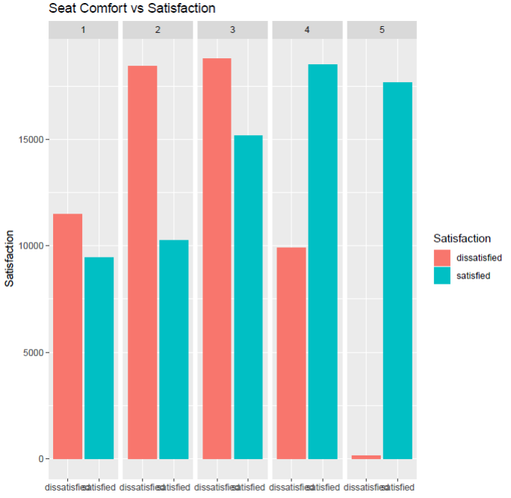
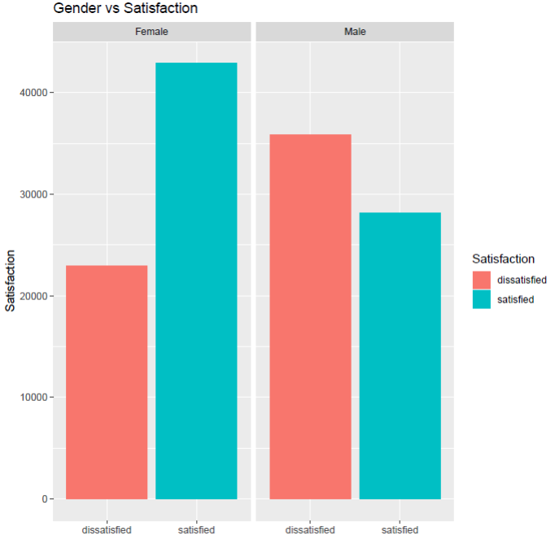
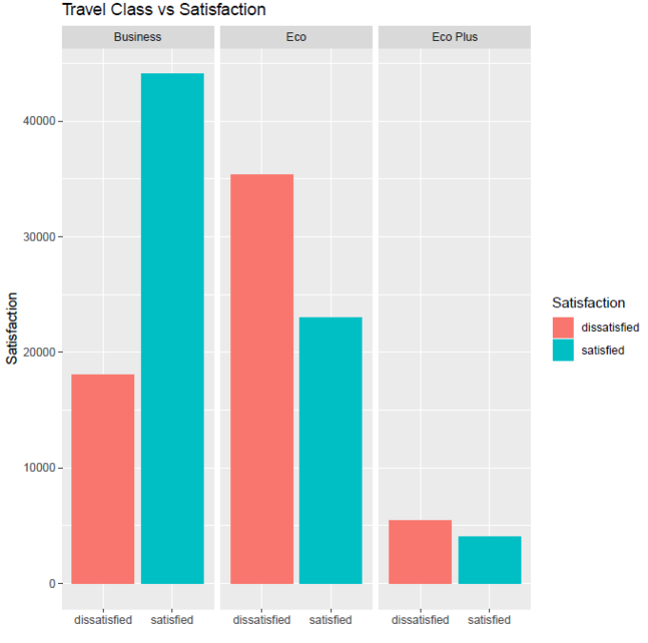
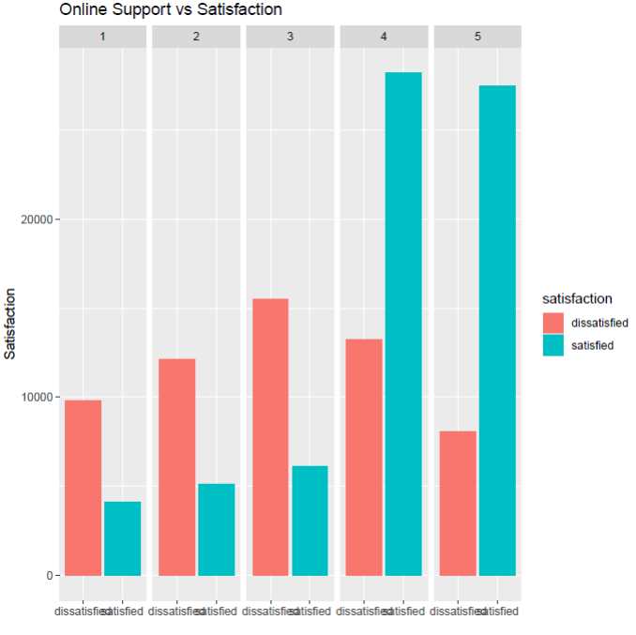
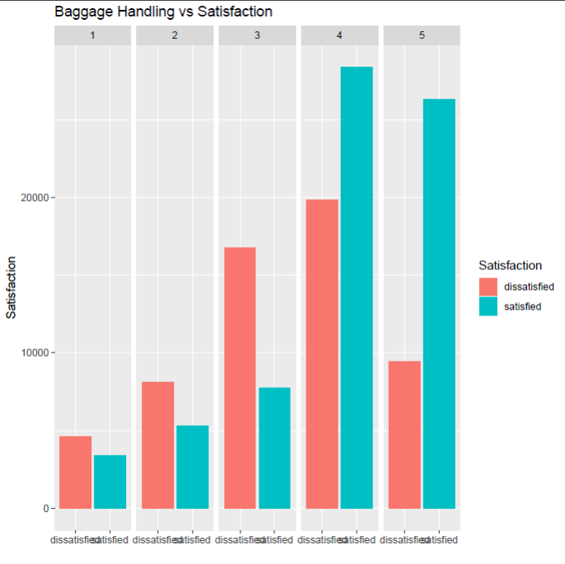
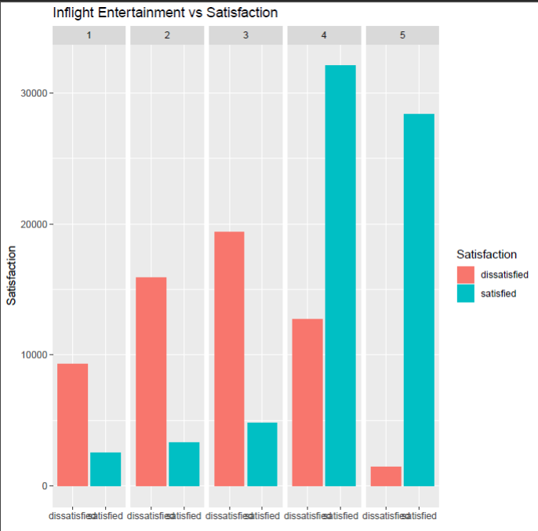
DATA VISUALISATION

Slide 5
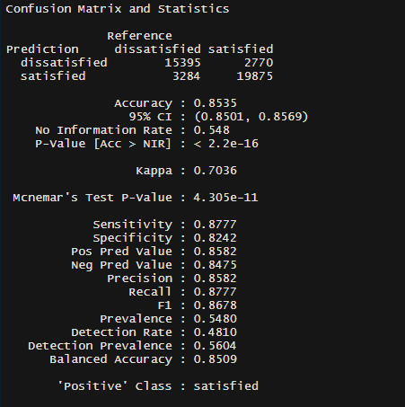
DATA MODELLING
We check the data for biasing since the cases are approximately equally distributed. So, there is no class bias.
dissatisfied satisfied
45.26717 54.73283
Now we split the data into training and testing dataset in the ratio of 70:30.
Logistic Regression Model
We use the glm package in R to predict the Satisfaction from independent variables available.
We observe from the coefficient weights that all independent variables are significantly important in predicting the satisfaction.
We predict the test dataset using the model and converting the prediction probabilities by considering a cutoff of 0.5 into “Yes” and “No” for satisfaction.
We build the confusion matrix to check accuracy, kappa value, sensitivity and specificity of the model

Slide 6
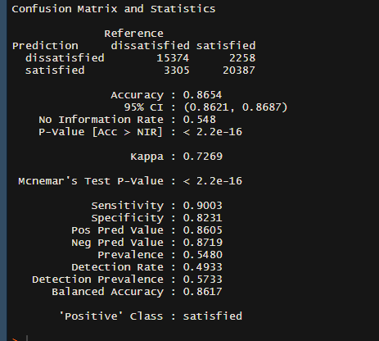
Decision Tree
We use the Decision Tree algorithm to classify the dependent variable on the basis of independent variable
The algorithm built a classification tree with several leaf nodes.
We use this model to predict the satisfaction level of the test data set and converting the prediction probabilities by considering a cutoff of 0.5 into “Yes” and “No” for satisfaction.
We build the confusion matrix to check accuracy, kappa value, sensitivity and specificity of the model

Slide 7

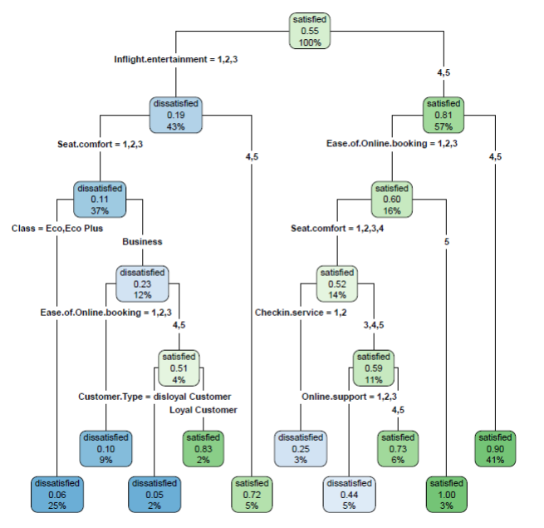
DECISION TREE

Slide 8
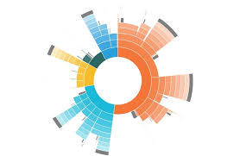
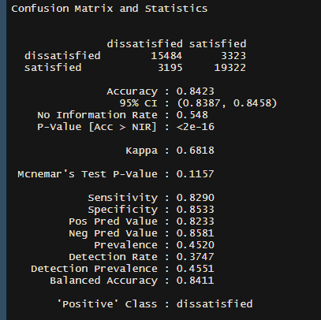
Confusion Matrix and Statistics
dissatisfied satisfied
dissatisfied 15484 3323
satisfied 3195 19322
Accuracy : 0.8423
95% CI : (0.8387, 0.8458)
No Information Rate : 0.548
P-Value [Acc > NIR] : <2e-16
Kappa : 0.6818
Mcnemar's Test P-Value : 0.1157
Sensitivity : 0.8290
Specificity : 0.8533
Pos Pred Value : 0.8233
Neg Pred Value : 0.8581
Prevalence : 0.4520
Detection Rate : 0.3747
Detection Prevalence : 0.4551
Balanced Accuracy : 0.8411
'Positive' Class : dissatisfied
Naive Bayes
We use the Naive Bayes model based on Bayes theorem to predict the satisfaction by using a probabilistic approach.
The algorithm built a Bayesian classifier-lift chart.
We use this model to predict the satisfaction level of the test data set and converting the prediction probabilities by considering a cutoff of 0.5 into “Yes” and “No” for satisfaction.
We build the confusion matrix to check accuracy, kappa value, sensitivity and specificity of the model

Slide 9

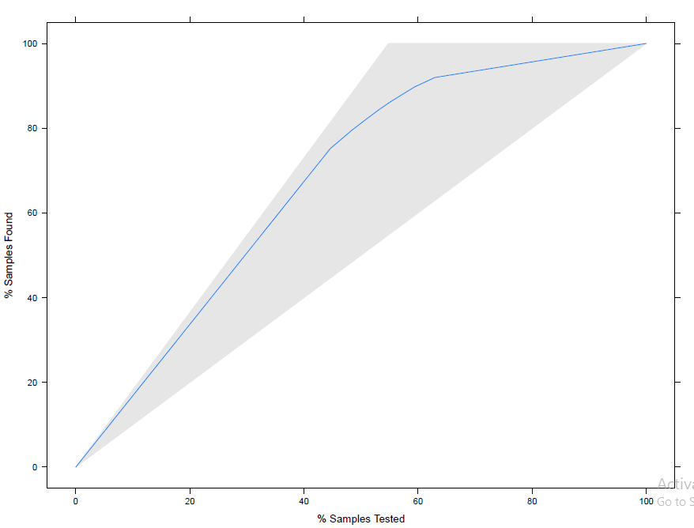
BAYESIAN CLASSIFIER - LIFT CHART

Slide 10
MODEL COMPARISON
We observe from the summary that the Decision tree provides better performance metrics over other models since it has an accuracy of -- and kaapa value of --.
Sensitivity value of -- indicates that the model has correctly identified -- of the satisfied customers correctly.
Specificity value of-- % indicates that the model has correctly identified --% of the dissatisfied customers correctly.
 | Logistic Regression | Decision Tree | Naive Bayes
Accuracy | 0.8534992 | 0.8653809 | 0.8422708
Kappa | 0.7035601 | 0.7269184 | 0.6818000
Sensitivity | 0.8776772 | 0.9002870 | 0.8289523
Specificity | 0.8241876 | 0.8230633 | 0.8532568
Notes:
https://unsplash.com/photos/AvhMrjYC8L8

Slide 11
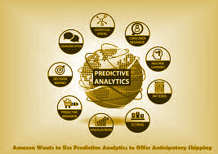
THANK
YOU
Contact us
Tanvi Saini 9958826407
Narayanam Jayani 9550226264
Ishwinder Kaur 9560056249
Email ID - 18jayani@gmail.com
Notes:
https://unsplash.com/photos/PhYq704ffdA

