Slide 1

Tata Imagination Challenge
Cliqing The Glamour Industry!
Submission Of Case Study For Tata Cliq
By: Tanvi Shahani
Indian Institute Of Technology Guwahati
tanvi.shahani2432@gmail.com
tshahani@iitg.ac.in

Slide 2
01
02
03
Index
Sneak Peek
A breif analysis of the industry
The route and App
Breif description of strategy to be used and latest features in the app.
Marketing and Uniqueness
Explaining the online methodoligies to be used and what makes Cliq unique.

Slide 3
A Sneak peek into the Industry
1. High Repeat Rate
2. Low Returns
3. Higher Units Per Transaction
Consumer
behaviour
1. Personalization
2. Loyalty Issues
3. Improper Product Description
Common Issues Faced
1. Highly Disorganized(only 2% organised sector)
2. Expected increase at 100% CAGR:
The Market

Slide 4
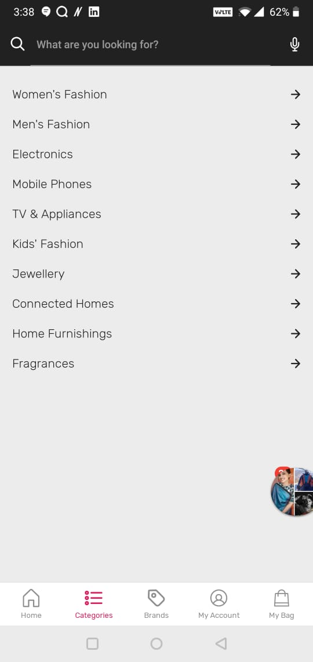
Route to Cliqing
Categories
Phase 1: Dealing with brands
Using an inventory led model due to low margins in the industry and highly regular product demands.
Phase 2: The app
Special features in the app to enhance personalisation features and realistic feel of makeup application.
Phase 3: Make It famous
Using various online methods to increase
the popularity among millennials.
Phase 4: Bring it on store
Establishing offline beauty segments in existing tata stores with the bestseller products and skin consultants.
Offers …
Bestsellers …
New …
Brands …
Makeup …
Subdivided into face parts like lips , eyes ,etc.
Skincare …
Hair …
Fragrance …
Minis …
By Skin Type …
I know my skin type! …
Request a free video call consultation …
Beautician at Home …
MINIS
For commitment phobic millennials, providing smaller portions of few products .
Skin Consultation
SKIN CONSULTATION
The correct identification of skin type, pigment using various online and offline options for the first time identification to get perfect shade.

Slide 5
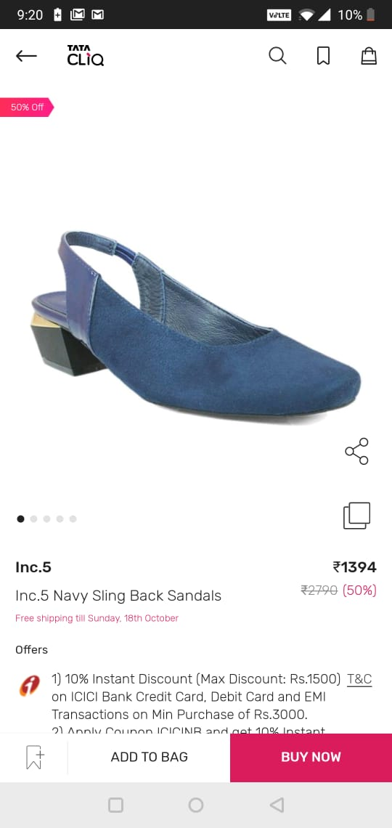
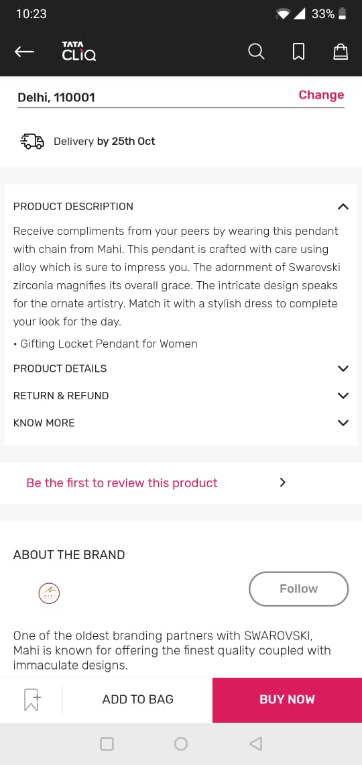
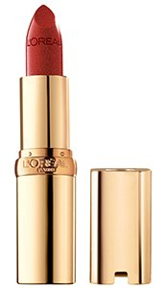
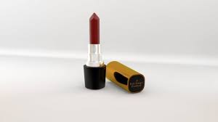
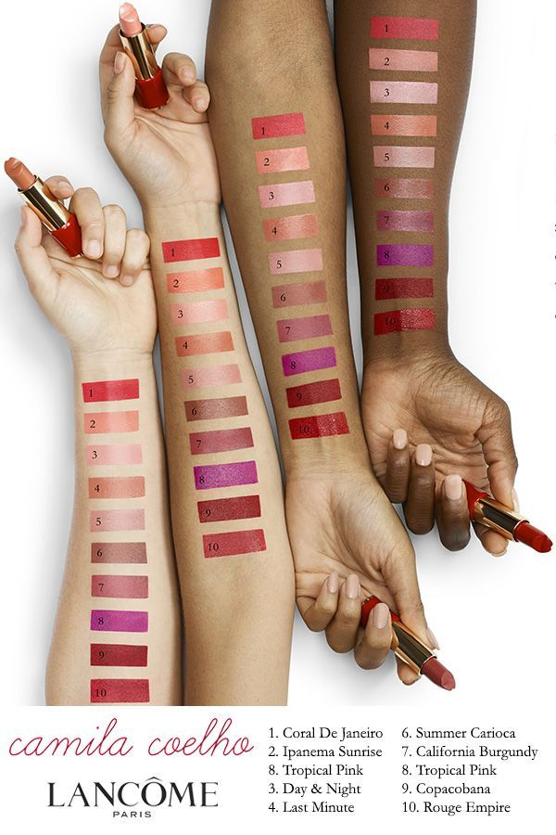
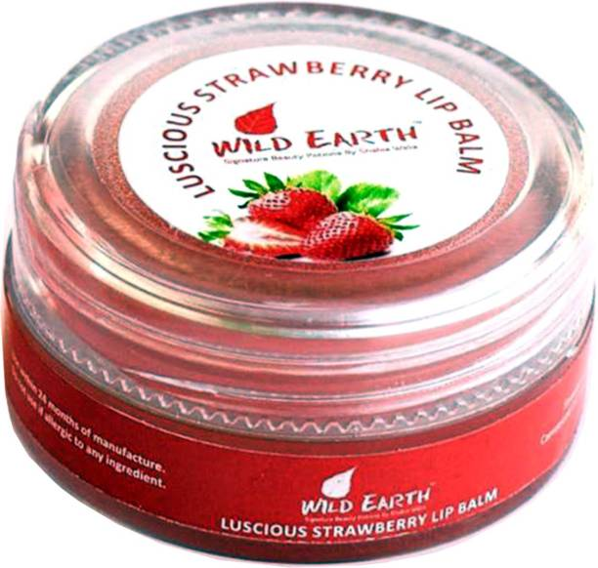
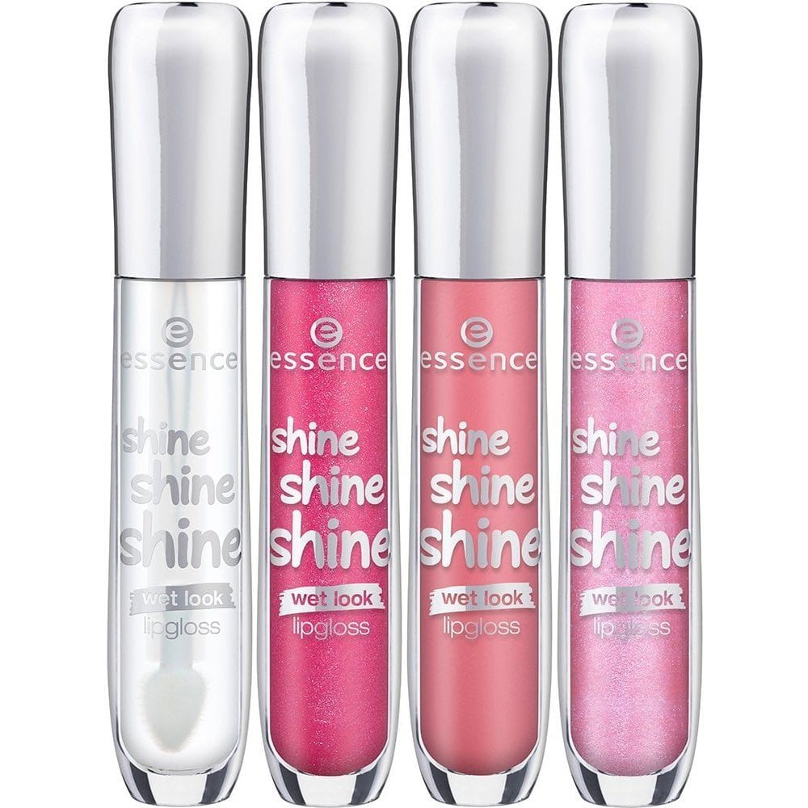
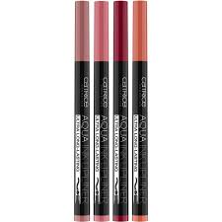
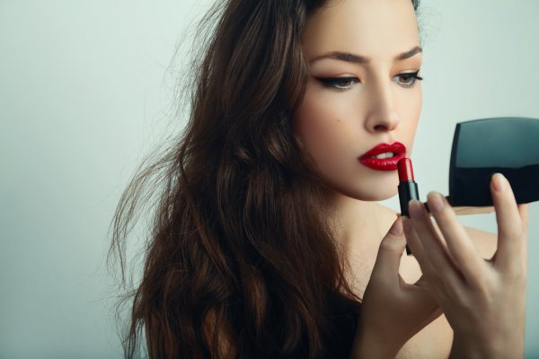
Application
Accurate product descriptions explaining dimensions, texture, ideal skin types etc.
Product Images
Product Description
A very detailed product description describing the texture ,shade and pigmentation of product.
Product Details
A table of product details regarding its size etc.
Ideal Skin Shades
Reviews
Product Questions
Beautify It
Products that enhance the given lipstick like lipliner, lip balm etc.
Similar by other brands
Similar by Loreal
The TRY IT On feature uses the latest AR/AI technologies to provide a realistic makeup applying experience with adjustable shades, tools and other makeup in live face.
A highly zoomable picture with 3d modelling.
A picture showing inclusivity and shade on different skin types.
Try it on!
Loreal Lipstick $239
Loreal Italy Matte $479 |50%
Further product recommendations using latest ML and DL algorithms to find suitable shade matches etc.
A video with model to show exact size and texture.
Product Description

Slide 6
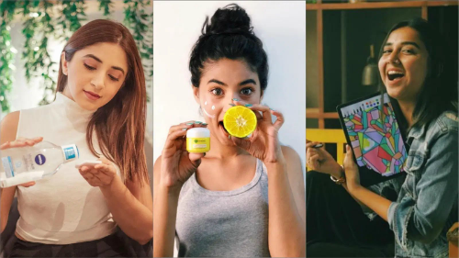
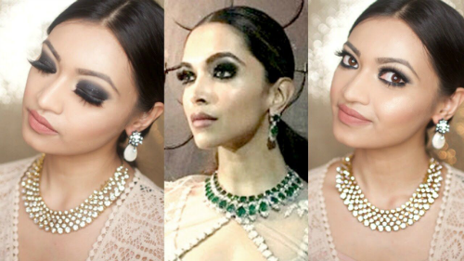


Making it famous online
Influencer
Marketing
Beauty
Contests
Loyalty
Rewards
Digital
Marketing
A creative buzz in the beginning from handles of all influencer partners.
Beauty Influencers post their selfies using the try on feature and review services on their handles!
Various beauty contests on social media handles for normal people.
Asking them to upload on their pics on social media handles hence online word of mouth.
Providing Loyalty Rewards for referrals, contest wins, the more you buy the more you get.
Using regular popups for loyal users timed with their last purchases.
Using social media to brand the platform to target audience.
Utilizing the consumer base to best by introducing unique ideas, where they themselves post about the app on their handles.

Slide 7

What makes us stand out!
“Tata Cliq provides a realistic experience of makeup to it’s customers with appropriate in-depth product information along with personalised touch to help everyone find their perfect shade!”
 | Tata Cliq | Nykaa, Purplle & others
Try It On Feature | Highly improved AR and AI used to give real time how the product looks on skin. | Nykaa uses it for some products but provides a very unrealistic look.
Virtual Consulting | Various methods based on AR based technology find the nearest shade to skin. | The chat feature given for consultation fails to identify the issue and perfect skin type correctly .
Intricate product images | Sufficient Product images for maximum clarity on dimensions and texture. | Constant trust issues with consumers because of huge differences in size, color etc.

Slide 8
Appendix
https://yourstory.com/2020/10/indian-ecommerce-festive-season-sale-2020?utm_pageloadtype=scroll
https://fashionista.com/2019/07/india-beauty-cosmetics-market-growth
https://www.alliedmarketresearch.com/cosmetics-market
https://economictimes.indiatimes.com/industry/cons-products/fashion-/-cosmetics-/-jewellery/indian-cosmetics-industry-mini-on-mind-for-beauty-conscious/articleshow/71769273.cms?from=mdr
https://medium.com/latitude-elevates/trust-issues-why-customers-avoid-buying-cosmetics-online-how-brands-can-win-trust-back-f3d1f27662f4
https://zoovu.com/blog/solve-the-5-biggest-problems-of-online-shoppers/
https://luxe.digital/business/digital-luxury-reports/luxury-wellness-beauty/
https://www.franchiseindia.com/wellness/7-Beauty-Trends-with-a-Business-Scope-of-their-Own.9994
https://www.statista.com/
https://www.tatacliq.com/

