Slide 1
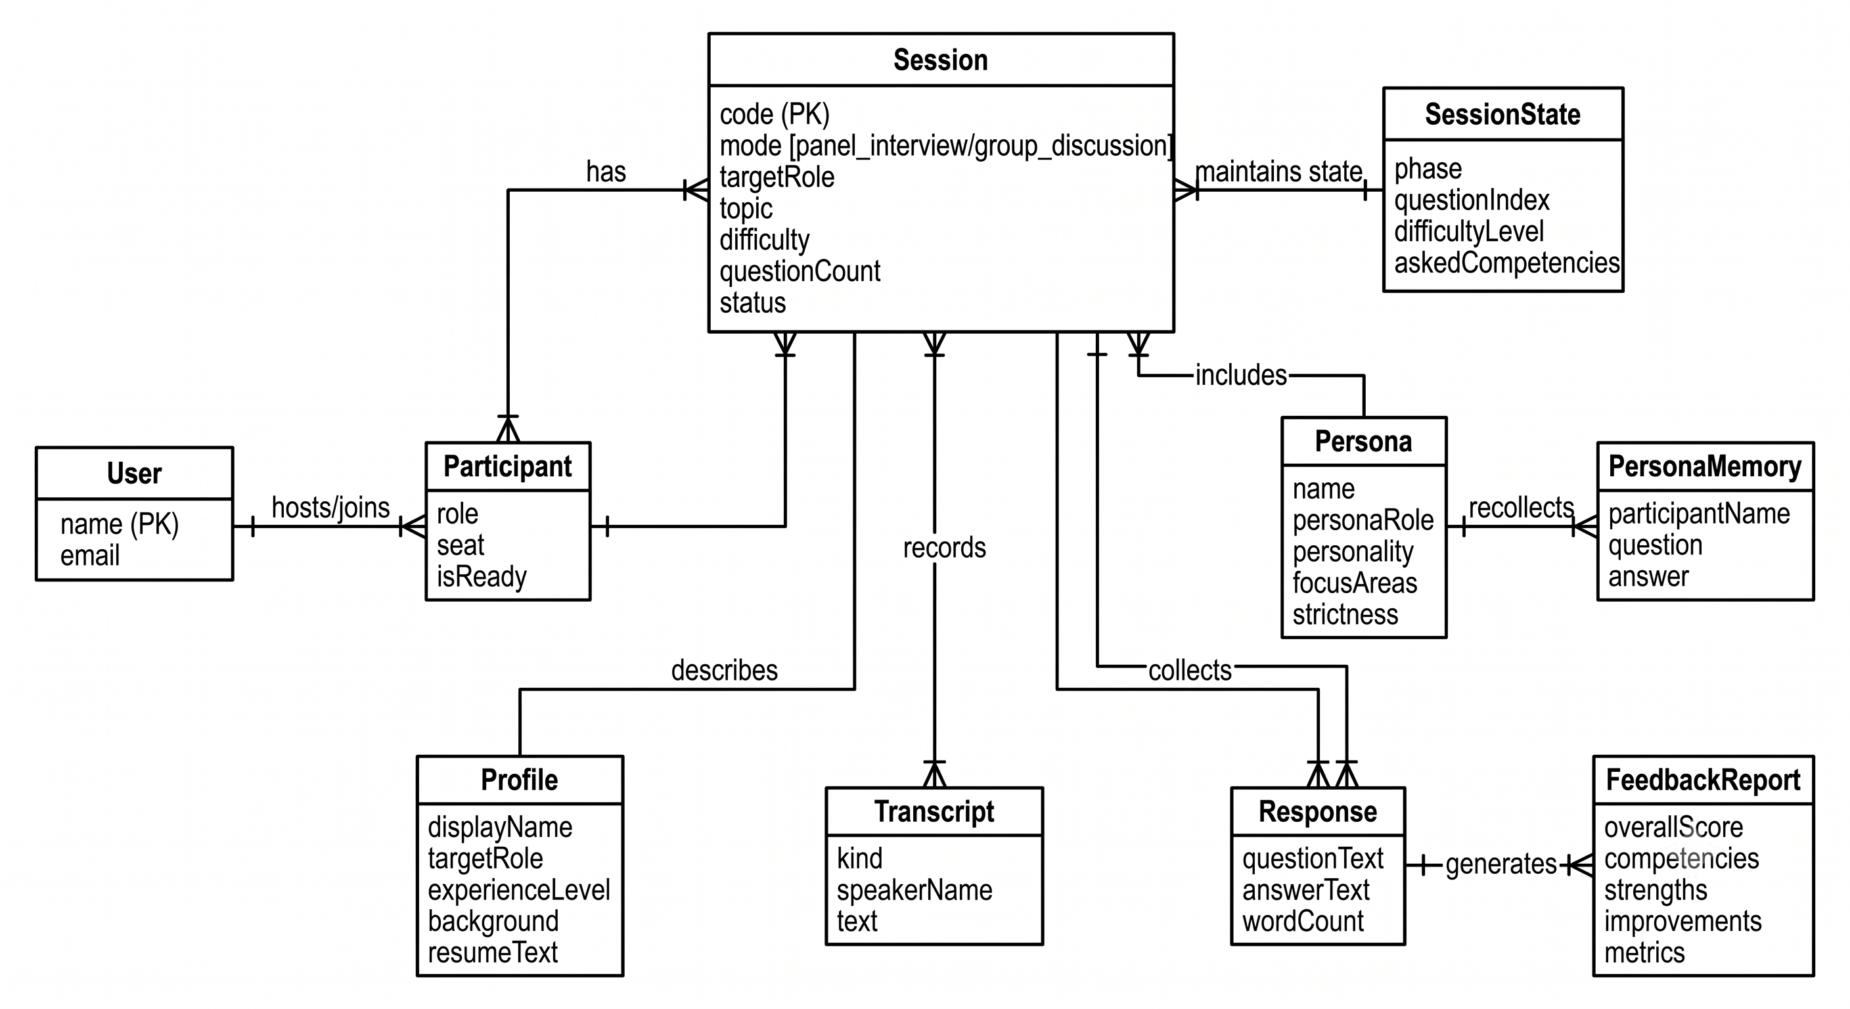
Abhyaas
AI Placement Practice Simulator
Realistic AI-driven practice for campus placement panel interviews & group discussions
Capstone Project | LDRP-ITR — Information Technology Department
Author: [Student Name] | Guide: [Guide Name]

Slide 2
PROBLEM & MOTIVATION
The two rounds students can't rehearse
Panel interviews and group discussions decide most placement offers — yet they are the hardest rounds to practise, because each one needs several people in the room.
Practice can't scale
Faculty hours are finite, so individual mock panels are rare and handed out unevenly across a batch.
Decisive rounds are multi-person
A panel needs a panel and a discussion needs a group — a student alone the night before a drive has neither.
Why existing AI tools fall short
Single-player by design (Yoodli, Google Interview Warmup, Final Round AI) — they can't stage a panel or a discussion.
No memory — disconnected questions, none of the follow-up pressure where a real interview turns uncomfortable.
A pure-LLM system has no reliable sense of turn, stage or score, so behaviour drifts and can't be audited.
Feedback is a vague impression, not a per-competency read a student can act on.

Slide 3
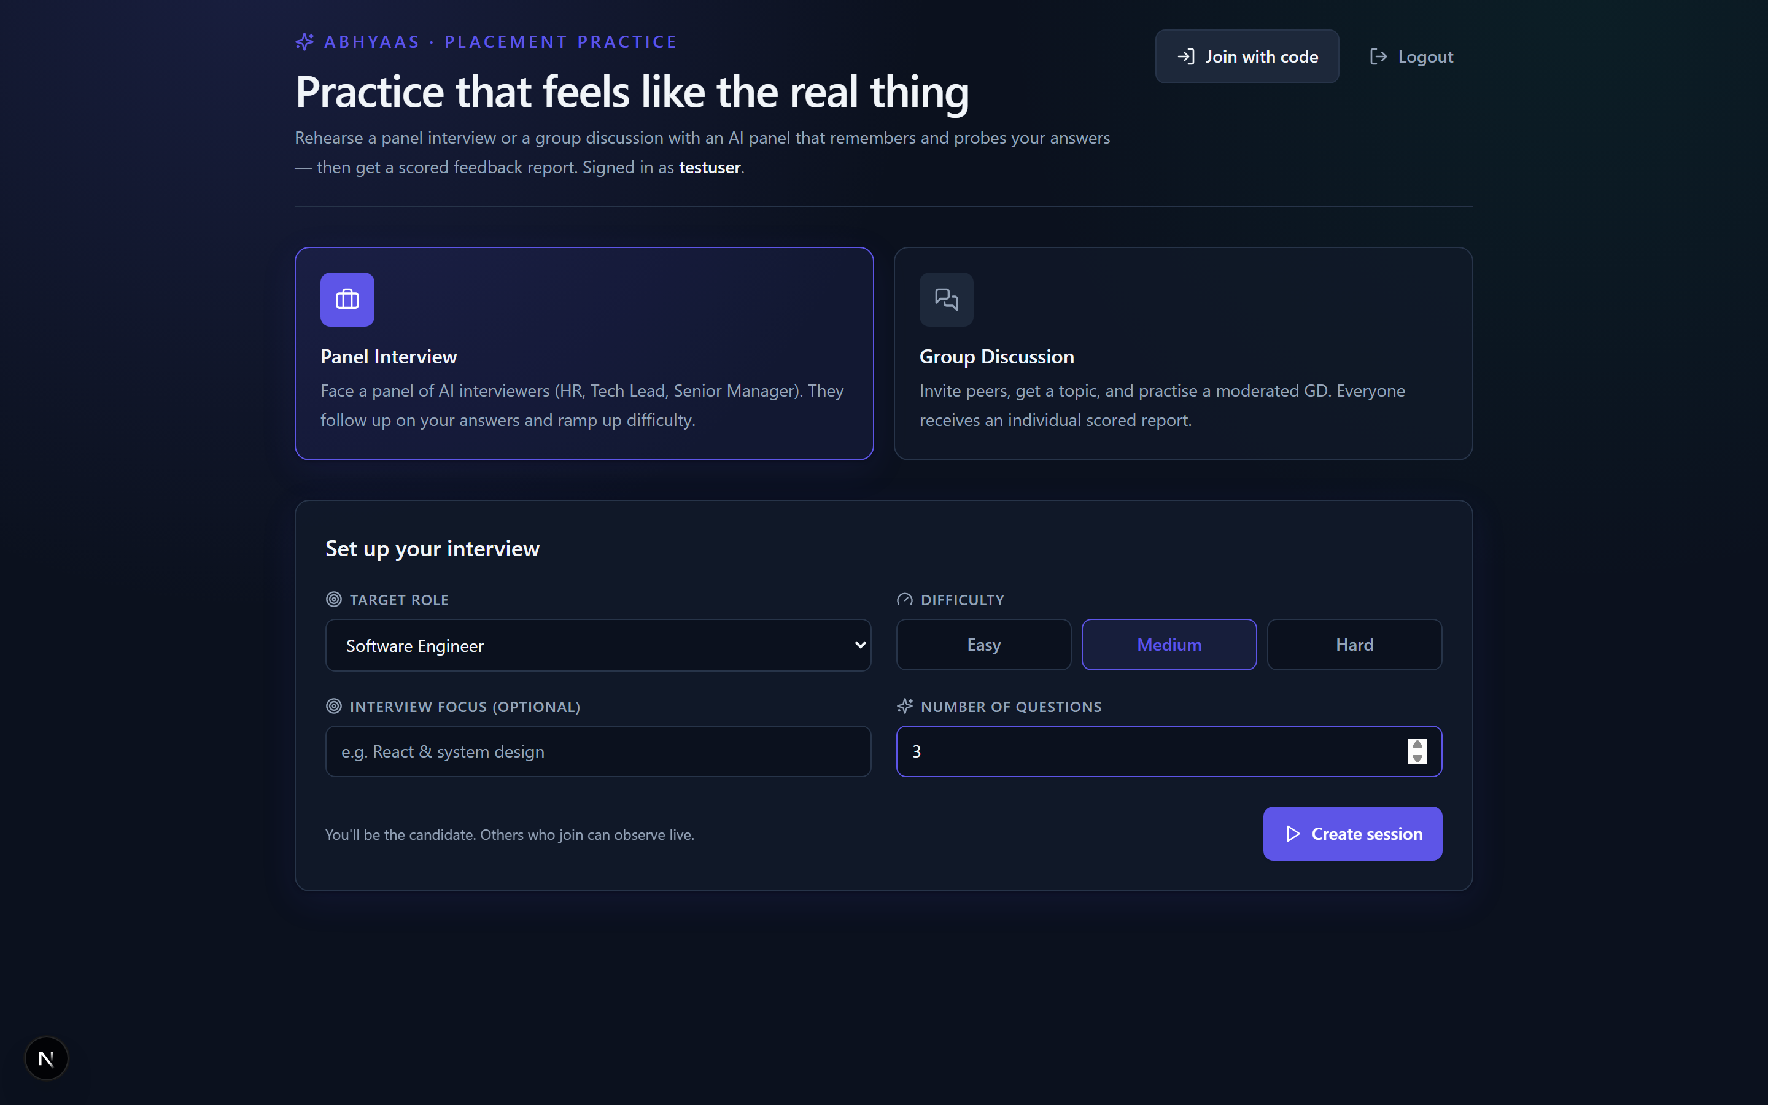
THE SOLUTION
Two real rounds, on demand — measured
Panel Interview mode — Rotating panel of three AI personas — HR Manager, Technical Lead, Senior Manager.
Group Discussion mode — Participants argue a topic under an AI moderator that keeps it fair and scores each person.
Memory-aware follow-ups — Each persona remembers earlier answers and probes them for real interview pressure.
Escalating difficulty — Questions get harder as the session goes on, just like the real thing.
Scored feedback reports — Per-competency scores (1–5) with justifications + objective engine-computed metrics.
Real-time multiplayer — Live for everyone connected via Convex reactive queries — no separate socket layer.
Dashboard — session setup

Slide 4
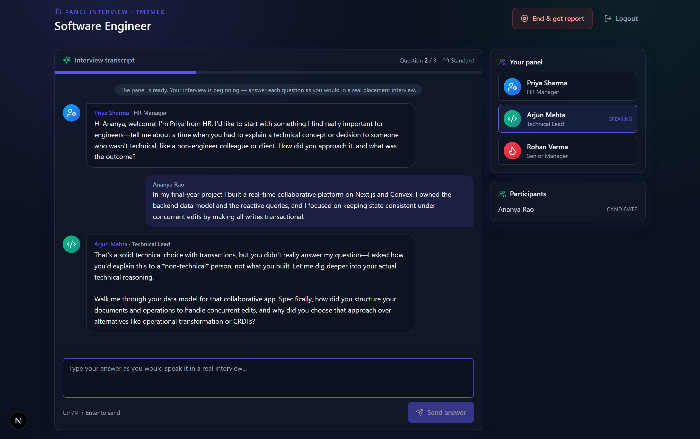
ARCHITECTURE
Engine owns state — the LLM only writes
A deterministic session engine owns all canonical state and flow (turns, stages, difficulty, scoring). The LLM is confined to writing questions, prompts and feedback prose — it never mutates canonical state.
Frontend
Next.js (App Router) + TypeScript
Tailwind CSS · reactive UI
Session Engine (Convex)
Deterministic: turns, stages,
difficulty, scoring, wrap-up
LLM — writes prose only
Gemini (Groq / NVIDIA fallback)
questions · prompts · feedback
Owns canonical state — the LLM never touches it
Stack
Frontend: Next.js (App Router), TypeScript, Tailwind CSS
Backend: Convex — schema, queries, mutations, actions, scheduling
Auth: @convex-dev/auth (email + password)
AI: Google Gemini with Groq / NVIDIA fallbacks
Live panel interview session

Slide 5
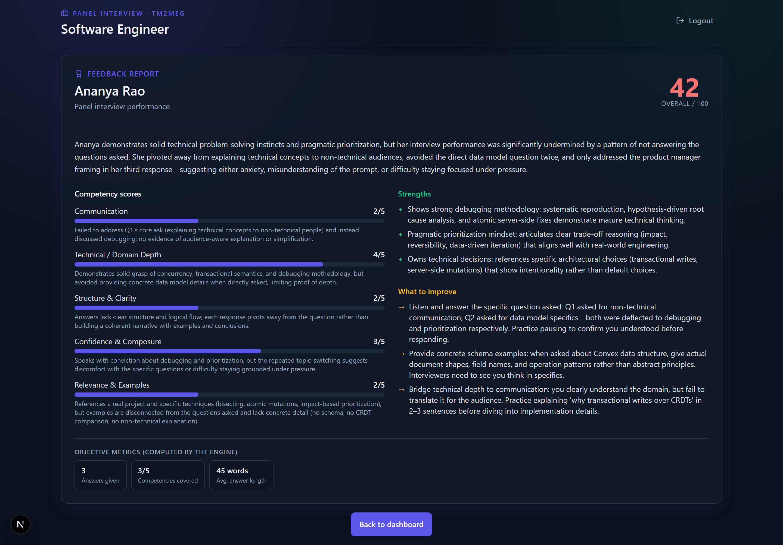
RESULTS
Objective, rubric-scored feedback
At session end each candidate gets a report a plain chatbot cannot produce:
Per-competency scores (1–5) each with a written justification
Highlighted strengths and concrete areas to improve
Overall score (0–100) and a narrative summary
Objective engine-computed metrics
Questions answered
Competencies covered / total
Average answer length (words)
Scored feedback report

Slide 6
CONCLUSION & FUTURE WORK
What we built, and what's next
Summary
The two hardest rounds to rehearse — panel interview & group discussion — simulated realistically.
A deterministic engine paired with an LLM kept to prose keeps sessions consistent and auditable.
Multi-person practice, interviewers that remember, optional résumé grounding, live for all.
Objective, per-competency feedback plus hard metrics — evidence, not just a transcript.
Future Work
Voice & video analysis to judge delivery and body language
Richer analytics and a cohort-readiness dashboard for the placement cell
More interview domains and target roles
Mobile experience
A larger before-and-after study to quantify improvement over repeated practice

