Slide 1
MINI PROJECT I · GROUP 20
EcoMesh
Distributed Peer-to-Peer Disaster
Relief Communication Mesh
PHASE III & IV — MODULE-WISE CODING TO A TESTED, INTEGRATED SYSTEM
TEAM
Miti Shah · Twissha Shah · Tanvi Sheth
Prof. Anuj Tawari
GUIDE

Slide 2
02 · AGENDA
Two phases, six deliverables
PHASE III
PHASE IV
P1
Module-wise coding
P1
Integration of front-end and back-end
P2
Git repository setup
P2
Functional and non-functional testing
P3
Git branching strategy and commit conventions
P3
Report
ECOMESH / GROUP 20
02 / 19

Slide 3
03 · PHASE III · P1 MODULE-WISE CODING
Eleven modules, each with its own tests
One module per concern in mesh/core/, written and tested in isolation before being wired together.
MODULE | LINES | WHAT IT DOES | TESTS
packet.py | 362 | 52-byte binary header, path, payload, signature | 47
transport · udp · sim | 327 | One interface; real sockets or an in-memory radio | 21
discovery.py | 292 | HELLO beacons, neighbour table, death detection | 15
relay.py | 153 | Forward, deliver, TTL, loop check, priority queue | 18
routing.py | 546 | Link-state gossip, weighted cost, Dijkstra | 61
reliability.py | 240 | Dedup, priority queue, ACK + retry, store-and-forward | 38
crypto.py | 131 | AES-256-GCM payloads, Ed25519 signatures | 19
store.py | 258 | SQLite (WAL) message, event and peer log | 23
node.py | 513 | Wires every layer into one asyncio node | 27
2,822 lines of engine code · 4,547 lines of tests · a test file for every module
ECOMESH / GROUP 20
03 / 19

Slide 4
04 · PHASE III · P1 MODULE-WISE CODING
One message, six modules
How the modules cooperate when someone sends an SOS.
01
PACKET
02
ROUTING
03
SECURITY
Builds the 52-byte header: priority 0 (SOS), ttl 10, a random msg_id.
Dijkstra over the link-state graph picks the cheapest next hop. RESCUE__ means any gateway.
Payload sealed with AES-256-GCM; identity fields signed with Ed25519.
04
RELAY
05
RELIABILITY
06
STORE
Each hop decrements ttl, appends itself to the path and sends SOS before routine traffic.
Destination ACKs. A missed ACK retries on a recomputed route; no route means it is held.
Every send, forward, retry and drop is logged in SQLite. Metrics are queries over it.
ECOMESH / GROUP 20
04 / 19

Slide 5
05 · PHASE III · P1 MODULE-WISE CODING
Four bugs that would have failed silently
Found by writing the tests, not by guessing. Each one is now a regression test.
GRAPH STUCK AT TWO HOPS
FAILURES NEVER PENALISED
Link-state reports weren't re-flooded past the first neighbour, so no node could learn a route beyond 2 hops. Fixed with origin + sequence numbers.
Retry logic never told routing about a timed-out link, so the cost function's failure term was always zero. Now every ACK timeout updates the cost at once.
RETENTION QUEUE UNBOUNDED
SIGNATURES BREAK AT HOP 1
Store-and-forward had no limit. It now holds 500 messages for 30 minutes and evicts the lowest-priority first, so an SOS is never displaced.
ttl, hop_count and path change at every relay, so signing them invalidates the signature after one hop. Now only fields that never change are signed.
ECOMESH / GROUP 20
05 / 19

Slide 6
06 · PHASE III · P2 GIT REPOSITORY SETUP
One repository, laid out so each concern has a home
REPOSITORY LAYOUT
WHAT WAS SET UP
mesh/core/
the engine: 11 modules
Hosted on GitHub as a public repository, with all three members as contributors.
README, CONTRIBUTING.md (branches and commit style) and a .gitignore from the first day.
requirements.txt and pytest.ini so a fresh clone installs and tests in two commands.
docs/ holds the master project plan, SRS, algorithm design, contribution log and the report.
Tag v0.3-phase3 marks the end of Phase III.
api/
FastAPI + WebSocket server, mesh lab
sim/
simulator runner and scenarios
story/
real-socket multi-device demo
ui/
React website (PWA)
tests/
18 test files, 312 test cases
docs/
plan, SRS, algorithms, report
Phase-2/
UML diagrams
config/
node configuration
ECOMESH / GROUP 20
06 / 19

Slide 7
07 · PHASE III · P3 BRANCHING STRATEGY
One branch per phase, each inheriting the last
A phase branch is a snapshot a reviewer can open, run and grade on its own.
PHASE 1
PHASE 2
PHASE 3
PHASE 4
PHASE 5
develop
develop_2
develop_3
develop_4
develop_5
14
16
39
48
49
commits · packet, transport
commits · discovery, relay, simulator
commits · routing, reliability, crypto, store
commits · API, website, tests, devices
commits · report and evaluation
RULES WE AGREED
MAIN AND TAGS
Never merge between phase branches.
Each member runs their own git commands.
No force-pushes (one agreed exception, below).
main is reserved for tagged releases and holds one README commit today. Once, the history of develop_2 to develop_5 was rewritten to correct author names; file contents were identical.
ECOMESH / GROUP 20
07 / 19

Slide 8
08 · PHASE III · P3 COMMIT CONVENTIONS
Conventional Commits, small and often
FORMAT
COMMITS BY TYPE (49 ON develop_5)
type(scope): short description
REAL EXAMPLES FROM THE LOG
feat(api): FastAPI + WebSocket server, mesh lab and virtual-time simulator
fix(reliability): make multi-hop ACK and retry actually work
test: configure pytest import path
docs: add Phase III presentation deck
chore: initialize mesh packages
WHO COMMITTED
Tanvi 19 · Twissha 18 · Miti 12
All 5 "other" commits are from Phases 1 and 2; every commit since follows the convention.
ECOMESH / GROUP 20
08 / 19

Slide 9
09 · PHASE IV · P1 FRONT-END + BACK-END
The website is a window onto the real engine
No mock data anywhere: every number on screen is read from a running Node and its SQLite log.
WEBSITE
API
MESH LAB
TRANSPORT
React PWA, 9 pages
FastAPI: REST + WebSocket
Real Node objects, one process
Simulated radio or real TCP
ui/
api/server.py
api/lab.py
transport_sim.py · story/
REST
WEBSOCKET
SIMULATOR
Send a message or SOS, list peers, route and path costs, message history, statistics, switch nodes on and off.
Every engine event is pushed as it is logged: sent, forwarded, received, retried, held. The screen animates from it.
The same engine runs headless on a virtual clock, so 50 simulated mesh lifetimes take seconds.
ECOMESH / GROUP 20
09 / 19

Slide 10
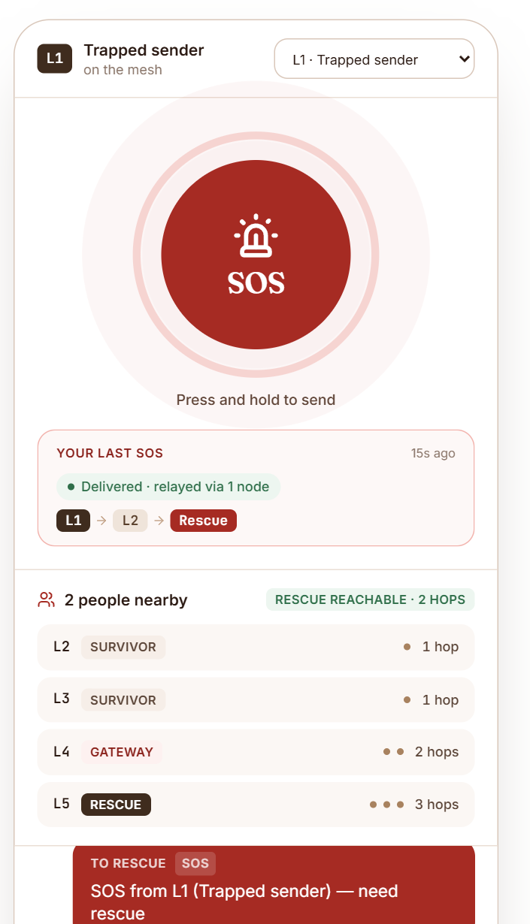
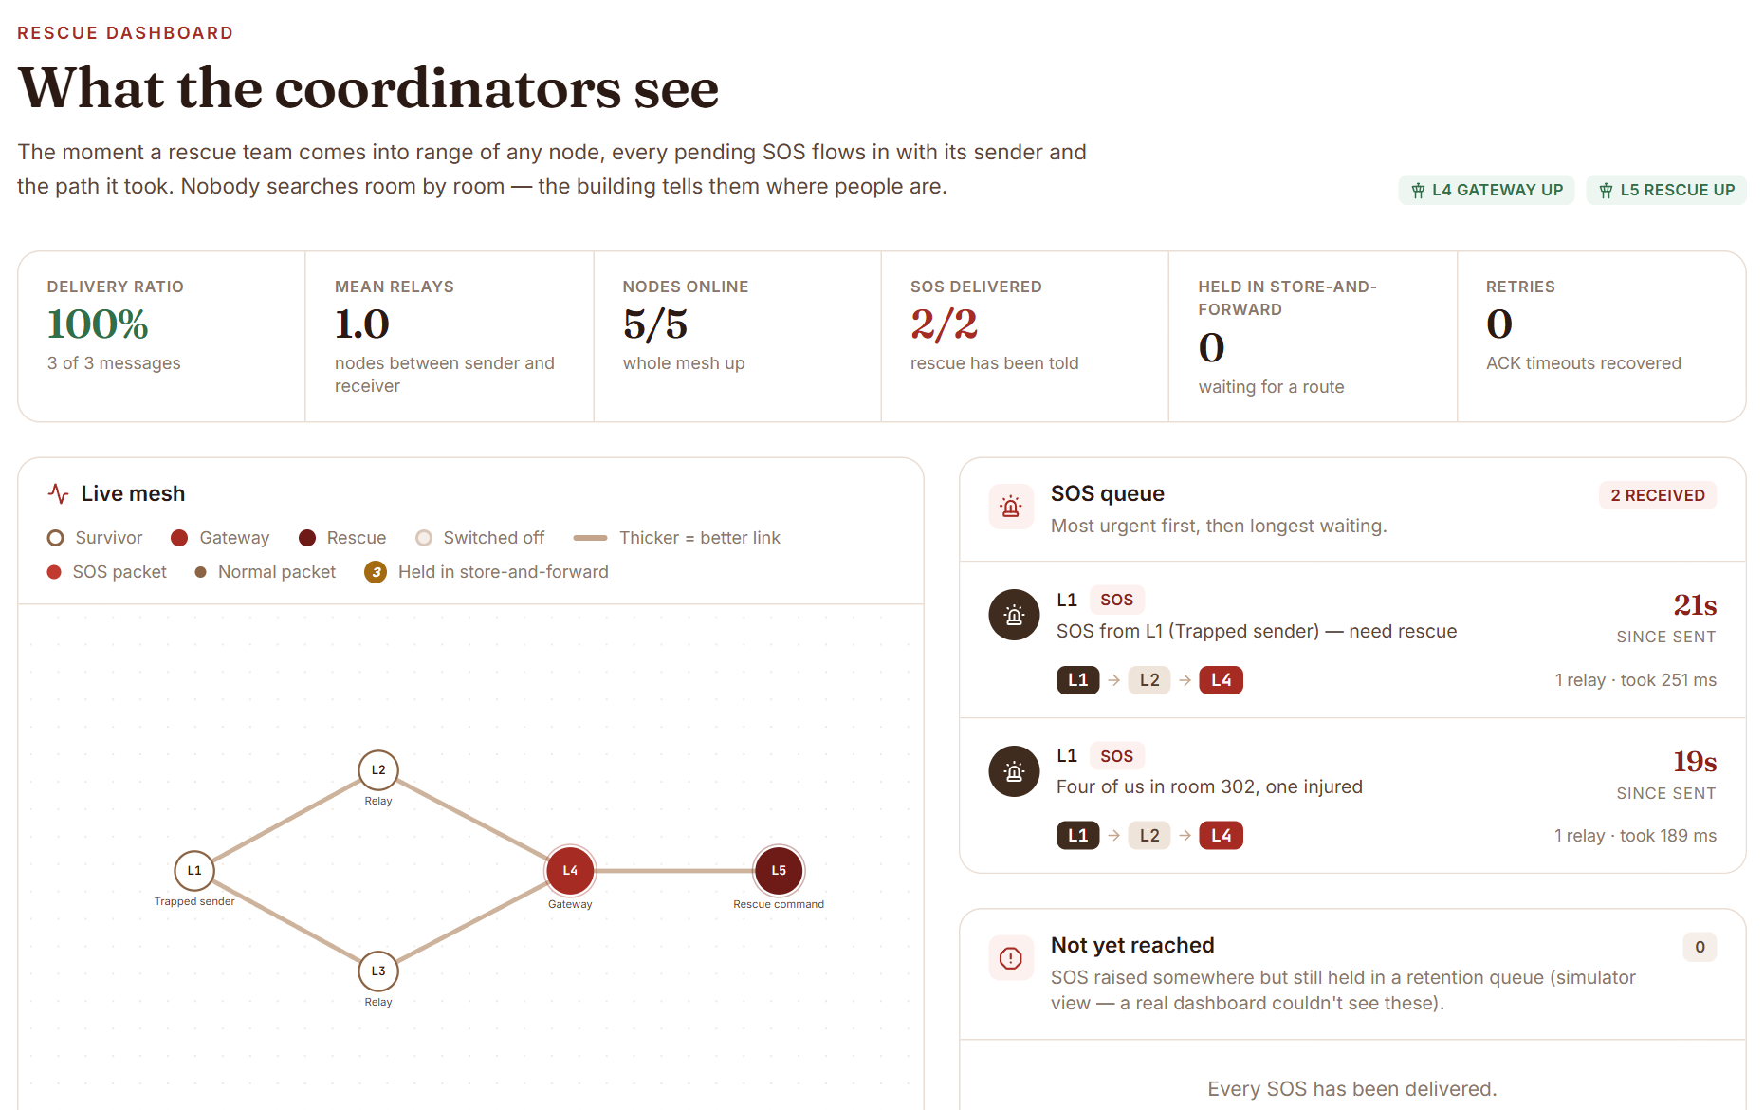
10 · PHASE IV · P1 FRONT-END + BACK-END
Two views, built for two kinds of user
NODE VIEW
Long-press to arm the SOS button.
Who is reachable and how many hops.
Each message: sending, relayed via N nodes, delivered.
RESCUE DASHBOARD
Live mesh graph.
SOS queue with sender, route and time since sent.
Delivery log and live statistics.
RESCUE DASHBOARD
Both read the same running mesh. Send an SOS on the left and it appears in the queue on the right with the route it took.
NODE VIEW
ECOMESH / GROUP 20
10 / 19

Slide 11
11 · PHASE IV · P1 FRONT-END + BACK-END
Integration found what unit tests could not
Wiring the screens to the engine exposed four defects. Each is fixed and has a regression test.
MULTI-HOP ACKS WERE DROPPED
LINK QUALITY WAS NEVER MEASURED
Duplicate filtering keyed on msg_id alone dropped an ACK at the first relay its DATA had crossed, and swallowed retries. Fixed with a (type, msg_id, attempt) key and a retry counter in the header.
Nothing fed the cost function, so every link looked perfect. It is now measured from HELLO reception, which is what makes weighted routing win.
DEAD NODES STAYED ROUTABLE
FUZZING AND SHUTDOWN
A newer link-state report added edges but never removed them, so distant nodes kept routing through a dead one. A report now replaces the old one.
Random bytes showed a parser raising the wrong exception on non-ASCII node ids, and Node.stop() could hang on Windows. Both fixed.
ECOMESH / GROUP 20
11 / 19

Slide 12
12 · PHASE IV · P1 FRONT-END + BACK-END
From the simulator to real sockets
story/ runs each device as its own process with its own TCP port and web page.
47 ms
~4 s
4.2 s
3.8 s
median SOS latency to the rescue node (p95 102 ms, 30 of 30 acknowledged)
average reroute after a relay is killed; all 8 trials still delivered
average to flush 5 held SOS messages once the gateway returns (4 of 4 trials)
from starting 5 processes to every node knowing the whole mesh
HOW IT RUNS
python -m story.local starts all five devices on one machine; python -m story.node --id L1 starts one per laptop.
A topology file decides who can hear whom, which emulates radio range on a flat Wi-Fi network.
The two-laptop split worked over a phone hotspot with three devices on one laptop and two on the other.
ECOMESH / GROUP 20
12 / 19

Slide 13
13 · PHASE IV · P2 FUNCTIONAL AND NON-FUNCTIONAL TESTING
Two questions: does it work, and how well
312
68
20-50
9
automated test cases across 18 files; all pass on the latest run
functional requirements, each traced to the test or check that verifies it
seeded simulation runs per scenario, with packet loss and injected failures
website pages walked through in a real browser, with no console errors
FUNCTIONAL: DOES IT DO WHAT THE SRS SAYS
NON-FUNCTIONAL: HOW WELL
Unit tests for each module.
Integration tests across modules and over the API.
A scripted browser run through every page and all six demo beats.
Performance, delivery and recovery against 10 targets (KPIs).
Scalability to 65 simulated nodes.
Security attacks, fuzzing and real-socket tests.
Re-run everything with one command: python -m pytest -q
ECOMESH / GROUP 20
13 / 19

Slide 14
14 · PHASE IV · P2 FUNCTIONAL TESTING
Every requirement traced to evidence
68 functional requirements: 52 by automated tests alone, 10 by tests plus a manual look at the screen.
AREA | TESTS | WHAT IS PROVEN
Discovery and neighbours | 15 | HELLO, neighbour table, death after 10 s
Routing | 61 | gossip, Dijkstra, weighted path beats shorter path
Reliability | 38 | priority, dedup, ACK, retry, bounded store-and-forward
Security | 19 | relay cannot decrypt; forged and tampered rejected
Storage | 23 | message, event and peer log queries
API and website | 12 + browser | REST, WebSocket, 9 pages, six demo beats
Not fully met: 2 requirements are partial (immediate flush when a new neighbour appears; a history filter on the screens), 2 are verified by code inspection and 2 by a manual check only.
ECOMESH / GROUP 20
14 / 19

Slide 15
15 · PHASE IV · P2 NON-FUNCTIONAL TESTING
Ten targets, measured, and honest about the misses
KPI | TARGET | MEASURED | VERDICT
Delivery ratio | >= 90% | 92.6% over 50 runs (40 nodes, 20% loss, failures) | MET
Convergence | <= 15 s | 9.6 s mean; 47 of 50 runs within target | MET
Recovery after relay death | <= 10 s | 8.1 s mean, but 27 of 50 runs took 10.2 s | PARTLY
SOS latency advantage | >= 3x | 4.4x faster than routine traffic | MET
Store-and-forward flush | 100% | 201 of 201 flushed | MET
Weighted vs hop-count | weighted wins | 99.2% against 57.4% | MET
Scale | 50 nodes | 100% at 5% loss; 88.2% at 20% loss | PARTLY
Screen freshness | <= 2 s | API median 16 ms; screens poll every 0.7 s | MET
Correctness | all pass | 311 of 312 in all 3 runs; 1 timing-sensitive test failed once | PARTLY
Security | all hold | no decrypt at relays; forged and tampered rejected | MET
ECOMESH / GROUP 20
15 / 19

Slide 16
16 · PHASE IV · P2 NON-FUNCTIONAL TESTING
The two results that carry the design
WEIGHTED ROUTING VS HOP COUNT
DELIVERY AS THE MESH GROWS
delivery % on identical seeds, 20 runs
delivery % against number of nodes
ECOMESH / GROUP 20
16 / 19

Slide 17
17 · PHASE IV · P3 REPORT
A 55-page report whose numbers come from the code
ELEVEN CHAPTERS, AS THE GUIDELINES REQUIRE
EVIDENCE PIPELINE
1 Introduction
2 Literature survey
3 Requirements (SRS)
4 Design
5 Algorithms
6 Subjects applied
7 Implementation
8 Performance
9 Testing
10 Results
11 Conclusion
Measurements are saved as JSON, scripts turn them into LaTeX tables and number macros, and the report includes them. Every number in Chapters 8 to 10 comes from those measurements, so a code change can be re-measured and the tables rebuilt.
BUILT FROM
The department Overleaf template and the Mini Project Report Preparation Guidelines.
12 pages of front matter, 11 chapters and references.
Source in docs/report/latex; PDF in docs/report.
ECOMESH / GROUP 20
17 / 19

Slide 18
18 · STATUS
What is done, what is left, what we are honest about
DONE
STILL TO DO
KNOWN LIMITS
Engine, API, website, simulator with seven scenarios, real-socket demo, 312 tests, the report and this deck.
Poster or paper for the end-semester evaluation.
Plagiarism report.
Photo of the two-laptop run for Chapter 10.
Printed, bound copy and the guide's review.
Optional usability test with 5 people.
No radio hardware: the radio is a neighbour-restricted LAN.
One shared key for the whole mesh.
Recovery is bounded by the 10 s heartbeat.
Delivery drops below 90% past about 43 nodes at 20% loss.
No automated browser tests.
What remains is documentation and evaluation material, not engine code.
ECOMESH / GROUP 20
18 / 19

Slide 19
Thank you
Questions?
github.com/tanvisheth1234-wq/miniproject · branch develop_5
Miti Shah · Twissha Shah · Tanvi Sheth Guide: Prof. Anuj Tawari

