Slide 1
MINI PROJECT I · T.E. SEMESTER V · SPIT
EcoMesh
Distributed peer-to-peer
disaster-relief communication mesh
Phase III and Phase IV · Group 20
SOS
Rescue
Twissha Shah · Miti Shah · Tanvi Sheth
Guide: Prof. Anuj Tawari
Notes:
Good morning. We are Group 20: Twissha Shah, Miti Shah and Tanvi Sheth, guided by Prof. Anuj Tawari. EcoMesh is a disaster-relief communication mesh: when towers and internet are gone, every phone becomes a relay so that an SOS can hop from device to device until it reaches a rescue team. In the next twenty minutes we cover Phase III, the engine and how we managed the code, and Phase IV, the integrated app, the testing and the report.

Slide 2
THE PROBLEM AND THE IDEA
When towers fail, phones can still reach each other
THE PROBLEM
An SOS crosses the mesh
After an earthquake, fire or building collapse, cell towers fail or are jammed.
Messaging apps need a server far away, so they stop even for people in the same room.
Trapped people cannot tell anyone where they are; rescuers search room by room.
The route is chosen by the network, not typed in
Phone 2
THE IDEA
Phones still have battery and can still reach devices near them. Make every device a relay, so an SOS hops device to device until it reaches a rescue team or a gateway. No tower, no internet, no central server.
Trapped
person
Gateway
Rescue
team
Phone 3
EcoMesh · Group 20 · Phase III and IV
2 / 14
Notes:
The problem. In a disaster the towers fail or are overloaded, and apps like WhatsApp need a far-away server, so they fail even between two people in the same building. The insight is that connectivity is never fully zero: phones still have battery and can still reach nearby devices. EcoMesh turns every device into both an endpoint and a relay. The picture shows the idea: a trapped person's SOS hops through another phone and a gateway to the rescue team, with no server involved.

Slide 3
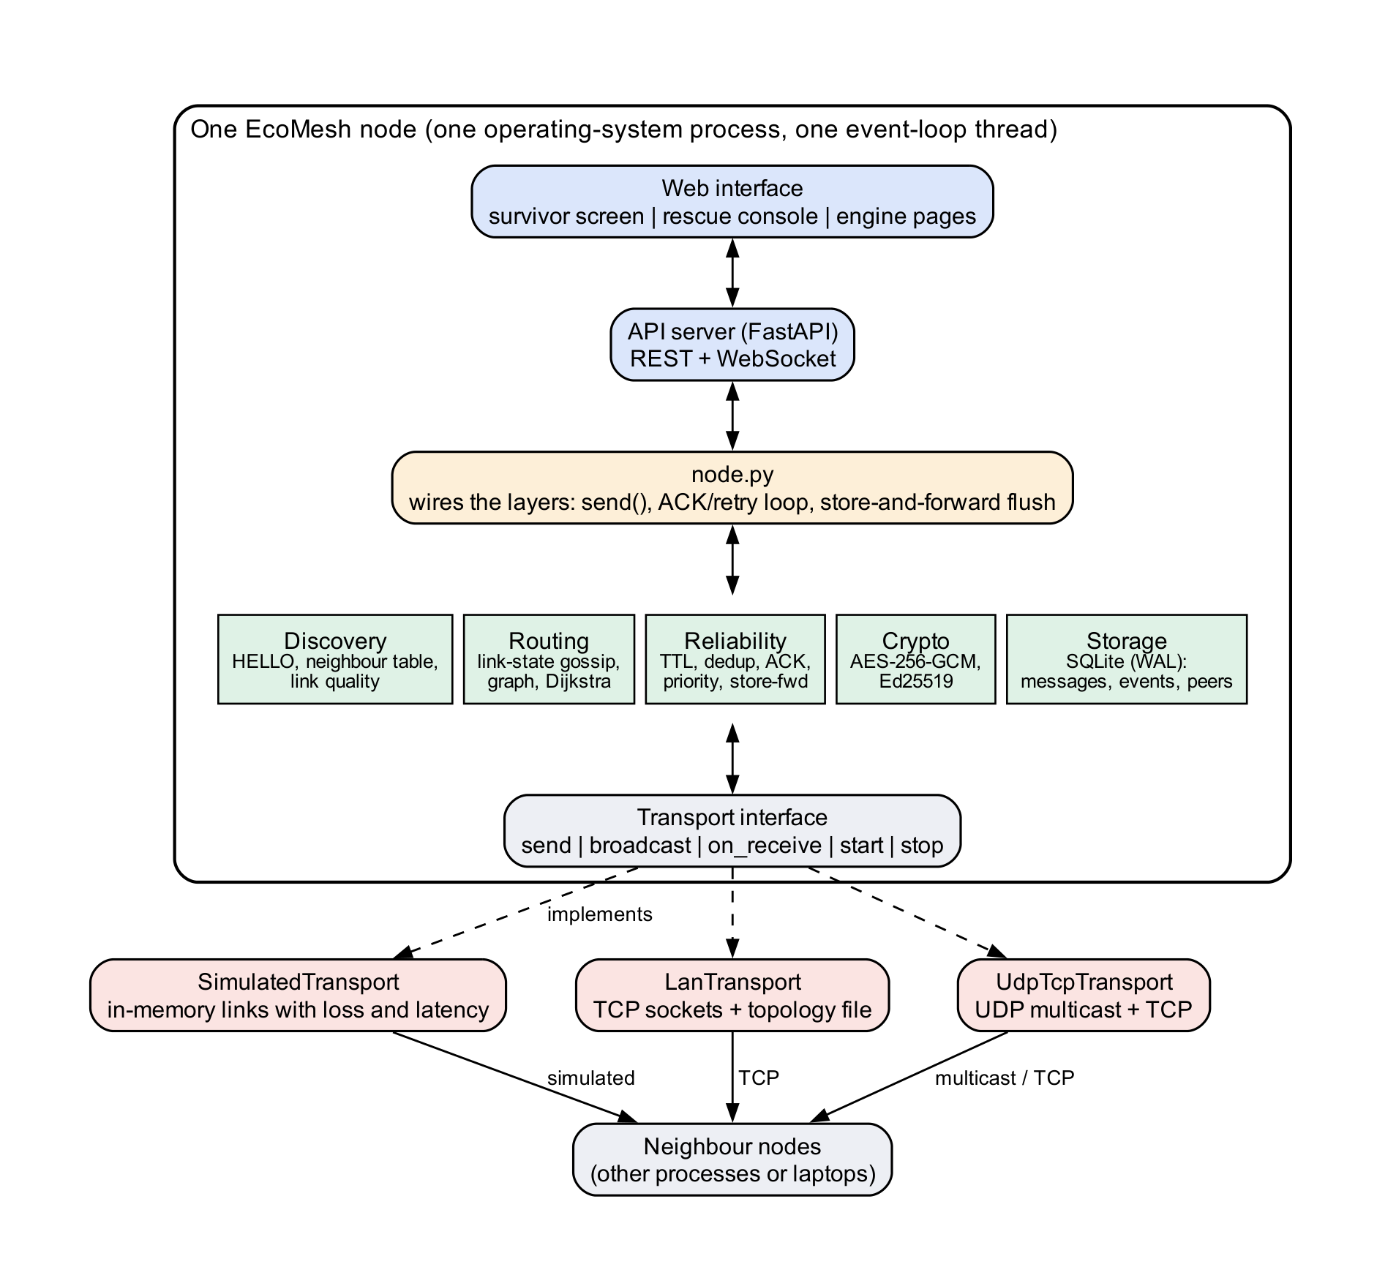
WHAT WE BUILT
An engine, an API and one device app
Engine (mesh/core)
11 modules, 2,849 lines: discovery, link-state routing, reliability, security and a SQLite log per device.
API and simulation lab
FastAPI and WebSocket server, a React lab and a simulator that runs 7 scenarios up to 65 nodes. It produced the experiment results.
The device app (story/)
One web page per device. It becomes the survivor phone, the gateway view or the rescue console, depending on the device's role.
The radio is emulated. Devices exchange real packets over TCP, but only with the neighbours a config file allows.
EcoMesh · Group 20 · Phase III and IV
3 / 14
Notes:
This is the architecture. At the bottom is the engine: discovery, routing, reliability, security and the log, about 2,849 lines in eleven modules. Above it, an API and a simulation lab, which we used to run the experiments. And the single app: one web page that each device serves, which turns into a survivor phone, a gateway view or the rescue console. We want to be clear about one thing now rather than be asked later: the radio is emulated. Real packets cross real TCP connections, but a configuration file decides who can hear whom. A real phone app would swap that transport for Bluetooth or Wi-Fi Direct.

Slide 4
PHASE III · P1 MODULE-WISE CODING
Eleven modules, built by three people
Who built what, as recorded in the contribution log.
PHASE | WHAT WAS BUILT | BUILT BY
1 | Packet format (52-byte header), transport interface, UDP transport | Tanvi
2 | Discovery (HELLO, neighbour table), relay, simulated transport | Miti
3 | Link-state gossip and the weighted cost function; wiring into the node | Twissha
3 | Dijkstra pathfinding, dedup and priority queue, ACK and retry, store-and-forward | Miti
3 | AES-256-GCM and Ed25519 security; SQLite message and event log | Miti
4 | API, simulation lab, scenarios; engine fixes found by integration | Tanvi
4 | Device app, multi-device demo, packet-parser hardening, report evidence | Twissha
4 | Device server: send, history, safe, structured SOS, CSV export, immediate flush | Miti
Every module has its own test file. The suite has 331 tests in total.
EcoMesh · Group 20 · Phase III and IV
4 / 14
Notes:
Phase III was module-wise coding, and each module has its own tests. Tanvi built the packet format and transport in Phase 1. Miti built discovery and the relay in Phase 2. In Phase 3, Twissha wrote the link-state gossip and the cost function and wired everything into the node; Miti wrote Dijkstra, the reliability layer, the cryptography and the SQLite log. In Phase 4, Tanvi built the API and the simulation lab and the fixes that integration forced; Twissha built the device app and the multi-device demo; Miti built the device server endpoints. This table is taken from our contribution log.

Slide 5
PHASE III · THE ALGORITHMS
How an SOS travels
1
Route
2
Seal
3
Relay
4
Confirm
5
Hold
Dijkstra over the link-state graph picks the cheapest path
AES-256-GCM encrypts the payload; Ed25519 signs the identity
Every hop sends SOS before routine traffic
The receiver acknowledges; a missed ACK retries on a recomputed route
No route? The message is kept and sent when a path appears
THE COST OF ONE LINK
WHAT THAT MEANS
cost = 1 + 5 (1 − q) + 3 f
A perfect link costs 1.00. A link that loses 45% of beacons (q = 0.55) costs 3.25.
A longer path over clean links can beat a shorter path over a bad one.
SOS packets jump the queue at every hop, not only at the source.
q is the share of the last 20 HELLO beacons heard. f is the number of recent ACK timeouts. Weak or failing links cost more, so the router prefers reliable links over merely short ones.
EcoMesh · Group 20 · Phase III and IV
5 / 14
Notes:
Here is how one SOS travels. The router runs Dijkstra over a graph that every node builds from its neighbours' reports. The cost of a link is one, plus five times one minus the link quality, plus three times the recent failures. So a link that loses 45 percent of beacons costs 3.25 instead of one, and the router will happily take a longer clean path. The payload is encrypted with AES-256-GCM and the identity is signed with Ed25519, so relays cannot read or forge it. At every hop the priority queue sends SOS first. The receiver acknowledges; if the acknowledgement does not come back, the sender retries on a recomputed route. And if there is no route at all, the message is held, not dropped, and sent when a path appears.

Slide 6
PHASE III · P2 REPOSITORY · P3 BRANCHING
One branch per phase, never merged back
Each phase branch is a snapshot a reviewer can open, run and grade on its own.
PHASE 1
PHASE 2
PHASE 3
PHASE 4
PHASE 5
FINAL
develop
develop_2
develop_3
develop_4
develop_5
develop_6
14
16
39
48
56
84
commits
commits
commits
commits
commits
commits
Cumulative commit count on each branch, read from git. main holds one README commit and is reserved for tagged releases.
Conventional Commits
Three contributors
78 of 84 commits (93%) follow type(scope): description. The 6 that do not are five early commits from Phases 1 and 2 and one merge commit.
Commits by member: Twissha 31 Miti 31 Tanvi 22. Commit messages carry the type (feat, fix, test, docs, chore) so the history can be read as a changelog.
EcoMesh · Group 20 · Phase III and IV
6 / 14
Notes:
Repository and branching. Phase 2 of the college plan asked us to set up the repository and a branching strategy. We use one branch per phase, and each branch inherits everything before it, so a reviewer can check out the branch for Phase 3 and see exactly what existed then. We never merge between phase branches, and main is reserved for tagged releases. The counts on screen are cumulative commits read from git: develop 14, develop_2 16, develop_3 39, develop_4 48, develop_5 56, develop_6 84. We use Conventional Commits; 78 of 84 commits follow the format, and the exceptions are from the first weeks. The commit counts by member are Twissha 31 Miti 31 Tanvi 22.

Slide 7
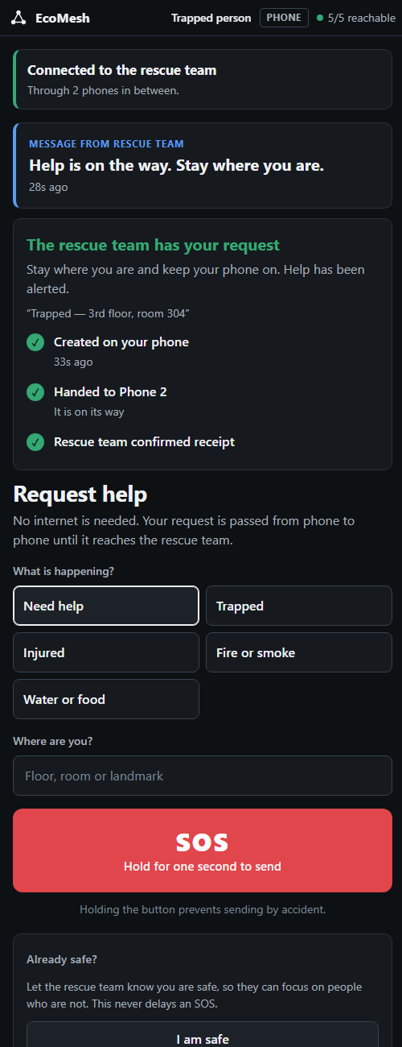
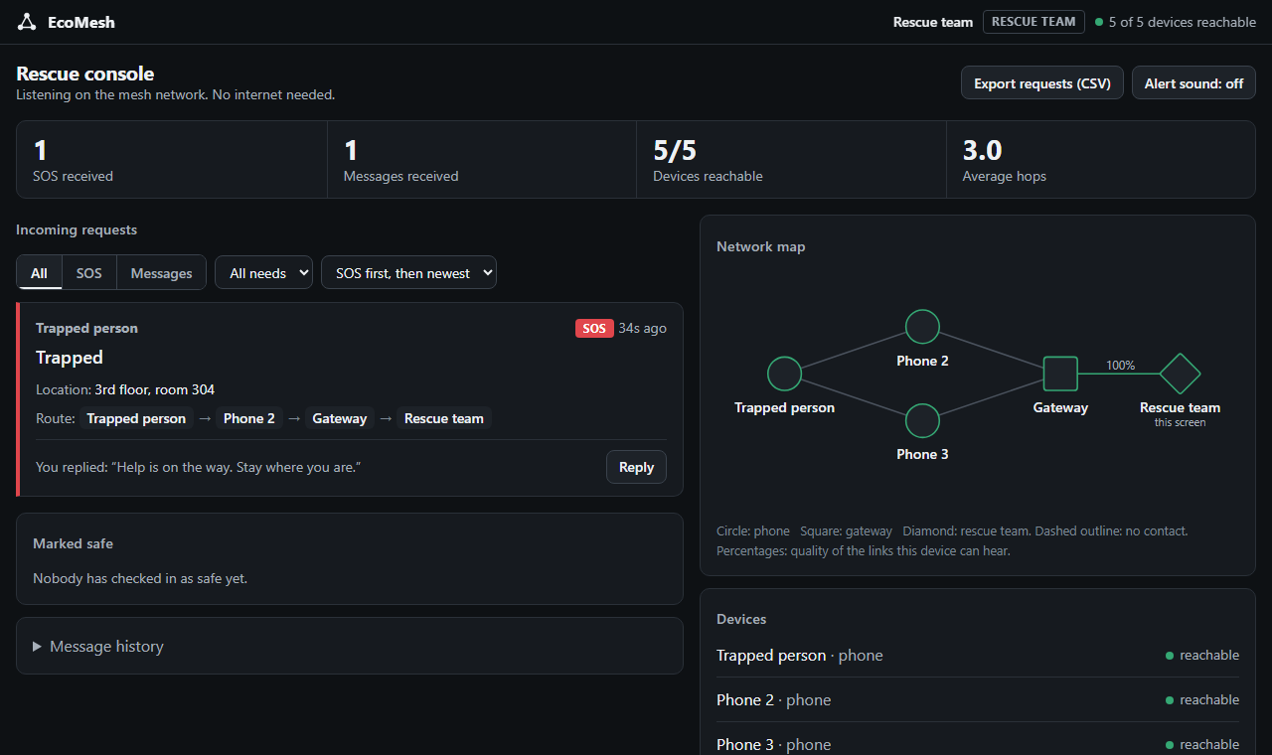
PHASE IV · P1 INTEGRATION
One app: the device screen
Served by each device. Its role decides what it shows.
Survivor: hold to send SOS with need and location, I am safe, send a message, see the rescue team's reply.
Gateway: messages passed on, live activity.
Rescue console: requests with route, reply, filters, history, CSV export, network map.
A phone is only a screen. The engine runs on the laptop.
Rescue console
Survivor phone
EcoMesh · Group 20 · Phase III and IV
7 / 14
Notes:
Phase IV, integration of front end and back end. We started with a React website and a Python API, and ended with something simpler and more honest: one app. Each device runs the full engine and serves one web page. Depending on the device's role the page becomes the survivor phone, the gateway view or the rescue console. On the left is the survivor's screen after delivery. On the right is the rescue console, showing the request, its need and location, and the route it took. A phone is only a screen here: the engine runs on a laptop and the phone opens its page over the same Wi-Fi. The React website stays in the repository as the simulation lab that produced our measurements.

Slide 8
PHASE IV · P1 INTEGRATION
Integration found real defects
Seven defects in the engine and tests. Six are closed with a regression test; one is open.
ID | DEFECT | FIX | STATUS
D1 | Discovery and relay shared one receive callback; the last registered won | Single dispatcher registered last | Closed
D2 | Multi-hop ACK and retry failed: duplicate filter dropped ACKs and retries | Key on type, id and attempt; retry counter in the header | Closed
D3 | Dead nodes stayed routable: new link-state reports merged with old ones | A newer report replaces the old one | Closed
D4 | A non-ASCII byte made the parser raise the wrong exception (found by fuzzing) | Raise the packet error; both fuzz tests pass | Closed
D5 | Node.stop() hung on Windows: a cancellation was swallowed | Helper built on asyncio.wait; 40 of 40 clean | Closed
D6 | Two timing-sensitive tests failed under load | Polling helper instead of fixed sleeps | Closed
D7 | History-order test fails now and then: same-millisecond messages have no order | Add a second sort key; with the test's owner | Open
EcoMesh · Group 20 · Phase III and IV
8 / 14
Notes:
Integration is where bugs hide that unit tests cannot see. These seven defects were found by wiring things together or by hammering them. D2 is the most important: multi-hop acknowledgements did not work at all, because the duplicate filter dropped every ACK at the first relay its data had crossed, and swallowed retries. D4 was found by fuzzing: random bytes made the parser raise the wrong exception. D6, the two flaky tests, is closed. D7 is open, and we want to be transparent about it: a history test fails occasionally because two messages created in the same millisecond have no defined order. It is open and reported to its owner.

Slide 9
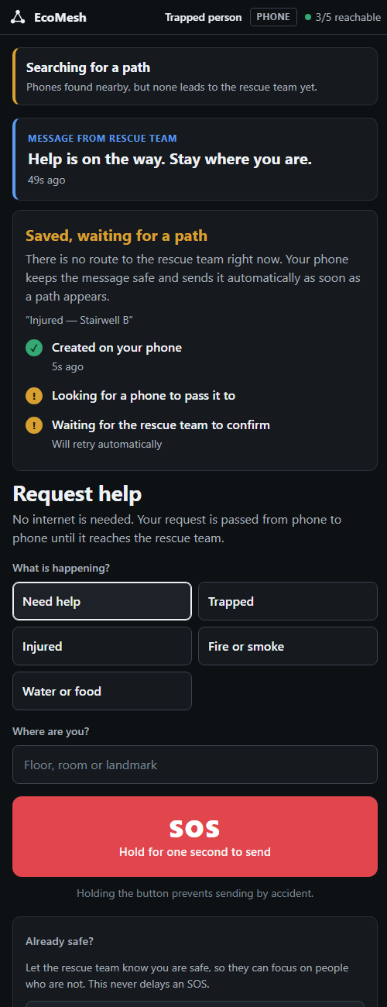

PHASE IV · P1 INTEGRATION
The demo: an SOS that survives failures
Five minutes, five devices, one app. The script is in docs/DEMO_SCRIPT.md.
1
SOS delivered
2
A relay fails
3
The gateway fails
4
The gateway returns
off
Hold the button. The request reaches the rescue console by way of Phone 2 and the gateway.
Switch off the relay. The activity panel shows the lost contact; the next SOS takes the other path.
No route. The phone says “Saved, waiting for a path” and keeps the message safe.
Within seconds the held message is sent and the screen confirms the rescue team has it.
EcoMesh · Group 20 · Phase III and IV
9 / 14
Notes:
This is the story we tell in the live demo. One: the survivor holds the SOS button; it reaches the rescue console through Phone 2 and the gateway. Two: we switch off the relay; the live activity panel shows the lost contact, and the next SOS still arrives by the other path. Three: we switch off the gateway. There is no route, so the survivor's phone says Saved, waiting for a path, and keeps the message. Four: the gateway comes back, and within seconds the held message is sent and the screen confirms it. The whole script, with set-up and likely questions, is in docs/DEMO_SCRIPT.md.

Slide 10
PHASE IV · P2 TESTING
Functional testing: does it do what the SRS says
331
68
64
automated tests pass in a fresh run
functional requirements, each traced to evidence
fully verified by tests (12 with a manual look at the screen)
Device screens: 18 of 18 browser checks pass: SOS with need and location, I am safe, send a message, rescue reply, filters, history, CSV export, activity panel, gateway off and on.
Simulation lab website: 16 of 16 browser checks pass.
Other methods: 0 partly implemented, 2 by code inspection, 2 by manual check only. Nothing is hidden.
Test levels: unit, integration, API, browser, simulation, five real processes over TCP, fuzzing and stress.
EcoMesh · Group 20 · Phase III and IV
10 / 14
Notes:
Functional testing asks whether each feature does what the specification says. A fresh run of the suite just now passed 331 tests in 27 seconds. Our SRS has 68 numbered functional requirements and every one is traced to the test or check that verifies it: 64 are fully verified by automated tests, 12 of them with a manual look at the screen. The remaining 4 are marked partly implemented, verified by inspection or by a manual check, and the testing document says which. We also drive the real device screens in a browser, pressing the buttons a user would press, and record the results.

Slide 11
PHASE IV · P2 TESTING
Non-functional results: 7 of 10 targets fully met
Ten targets were fixed in the project plan before any measurement.
Delivery against packet loss
Weighted vs hop-count routing
Median latency under load (ms)
SOS arrives 4.4 times faster
Fully met: K1, K4, K5, K6, K7, K8, K10. Partly met: K2 convergence; K3 recovery after relay death; K9 correctness.
Delivery was 92.6% on a 40-node mesh at 20% loss with failures injected (target 90%). Recovery after a relay dies is quantised by the 10 s heartbeat; at 20% loss delivery is 92.9% at 50 nodes and 83.1% at 65.
EcoMesh · Group 20 · Phase III and IV
11 / 14
Notes:
Non-functional testing asks how well. We fixed ten targets in the project plan before measuring, and 7 of them are fully met. The left chart shows delivery staying at 100 percent up to 10 percent loss on every link and degrading gracefully after that. The middle chart is the central claim of the routing design: on identical seeds, weighted routing delivered 99.2 percent against 57.4 percent for hop-count routing. The right chart shows that under congestion the median SOS arrives 4.4 times faster than routine traffic. And here are the misses, because we would rather you hear them from us: K2 convergence; K3 recovery after relay death; K9 correctness. Delivery was 92.6% on a 40-node mesh with 20 percent loss and failures; recovery time is limited by the ten-second heartbeat; and at 20 percent loss delivery is 92.9 percent at 50 nodes but 83.1 percent at 65.

Slide 12
PHASE IV · P3 REPORT
A report whose numbers come from the code
40
68
10
pages in the final PDF, 11 chapters
requirements traced in the report's tables
target metrics, each validated against stored data
Follows the department template and the Mini Project report guidelines: introduction, literature survey, SRS, design, algorithms, implementation, performance, testing, results, conclusion.
Every number in the chapters on performance, testing and results is generated from stored measurements by scripts in docs/report/evidence, so a change can be re-measured and the tables rebuilt.
A separate testing document covers the functional and non-functional tests in detail, with every test case listed.
A one-page poster summarises the problem, the architecture, the key results and the limits, with a QR code to the repository.
EcoMesh · Group 20 · Phase III and IV
12 / 14
Notes:
Phase IV also asked for a report. Ours is 40 pages in eleven chapters, following the department template and the report guidelines. What we are proud of is that the numbers are not typed in: the measurements are saved as data, scripts turn them into tables, and the report includes those tables, so any change to the code can be re-measured and the report rebuilt. There is also a separate, detailed testing document, and a one-page poster for the evaluation.

Slide 13
HONEST LIMITS
What this is, and what it is not
A measured prototype
Not built
We built and measured the routing and reliability layer; it is not a finished product. The radio is emulated over TCP. A real build needs a Bluetooth or Wi-Fi Direct transport, and the transport interface is built for that swap.
There is no real phone app: a phone only shows a web page served by a laptop. One shared key protects the whole mesh, so any key holder could read forwarded messages. Per-pair keys are future work.
Tried and dropped
Measured, not assumed
A faster failure detector (neighbour timeout of about 7 s instead of 10 s) was tried to improve recovery time. It lowered delivery at 20% loss, so we kept 10 s and report recovery time as partly met.
All timings come from one machine, and scale was tested to 65 simulated nodes. No timed usability study with participants has been done.
EcoMesh · Group 20 · Phase III and IV
13 / 14
Notes:
We want to finish with honesty. This is a measured prototype of the routing and reliability layer. The radio is emulated: real packets over TCP, but a config file decides who can hear whom. There is no real phone app; a phone shows a web page served by a laptop. One shared key protects the mesh, which is a real limitation, and per-pair keys are future work. We also tried a faster failure detector, shortening the neighbour timeout from ten seconds to seven, hoping to improve recovery time. It lowered delivery at 20 percent loss, so we dropped it and report recovery time honestly as partly met. Finally, our timings come from one machine and we have not done a timed usability study.

Slide 14

TEAM AND QUESTIONS
Thank you
Twissha Shah
Link-state gossip and cost function, node integration, the device app and multi-device demo, parser hardening, report evidence
Miti Shah
Discovery, relay, Dijkstra, reliability, security, SQLite log, and the device server endpoints
Tanvi Sheth
Packet format and transport, API, simulation lab, testing documents, deck and poster
Scan for the repository
https://github.com/tanvisheth1234-wq/miniproject
Guide: Prof. Anuj Tawari
Notes:
To summarise who built what: Twissha built the link-state gossip and cost function, the node integration, the device app and the multi-device demo; Miti built discovery, the relay, Dijkstra, the reliability layer, the security and the log, and the device server; Tanvi built the packet format and transport, the API and simulation lab, and the testing documents, deck and poster. The code, the report and the testing document are all in the repository; the QR code opens it. Thank you; we are happy to take questions, and to show any part of the demo again.

