Slide 1
Pancreatic cancer prognosis with Cox survival models
Risk stratification, hazard ratios and a live risk calculator
UE24CS352A Machine Learning mini-project · Tanvi B. Shetty · Y. V. Bhavana
Notes:
Intro (20s): we predict overall survival in pancreatic cancer with Cox models. Tanvi built the models; I'll show what the models say and let you try one.

Slide 2
Data: TCGA-PAAD, 183 patients, 99 deaths
183
99
12 + 500
patients (TCGA-PAAD PanCancer Atlas)
observed deaths (the rest are censored)
clinical features + top-variance genes
Public data replaces the paper's Stanford cohort, which is under NDA.
Gene expression stands in for radiomic features: many features, few patients.
Outcome: overall survival in months, with right-censoring handled by the Cox model.
Notes:
Public TCGA-PAAD stands in for the Stanford data in the reference paper, which is under NDA. Gene expression plays the role of the radiomic features: high-dimensional, few patients.

Slide 3
Method: penalised Cox, scored by cross-validation
1
2
3
4
Cox PH + L2
10-fold CV
Tune
Interpret
Hazard depends on a weighted sum of features; ridge penalty tames 100+ genes
Concordance index on held-out patients, features scaled per training fold
Penalty 0.1–50 and 25–500 genes; best: 100 genes, penalty 1
Out-of-fold risk scores → KM curves, log-rank, hazard ratios
Notes:
Features are standardised inside each training fold so nothing leaks from the test fold. Penalty and gene count were tuned by a sweep on the same CV, so tuned scores are slightly optimistic.

Slide 4
Combining clinical and gene data gives the best C-index
Model | Untuned | Tuned
Clinical (12 features) | 0.63 | 0.63
Expression | 0.57 | 0.64 (100 genes, penalty 1)
Combined | 0.58 | 0.67 (100 genes, penalty 1)
10-fold CV concordance index (0.5 = coin flip, 1.0 = perfect ranking). Tuned scores are the best of a sweep chosen on the same CV, so slightly optimistic.
Notes:
Clinical alone is about 0.63. Expression alone is poor untuned but reaches 0.64 once regularised properly. Combined is best at 0.67. Tuned numbers are the best of a sweep on the same CV, so slightly optimistic.

Slide 5
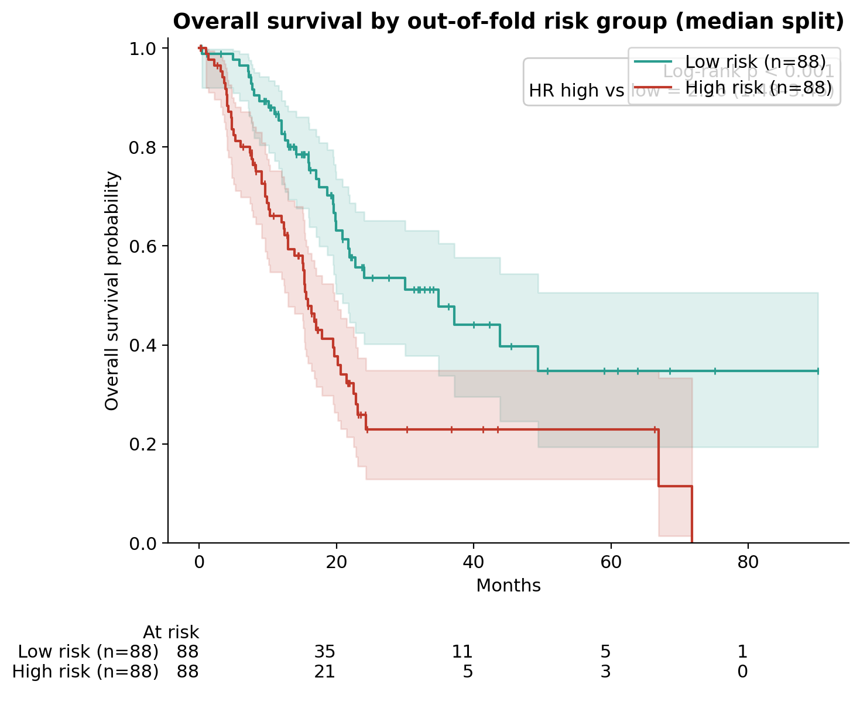
High-risk patients die sooner
p < 0.001
log-rank test, high vs low risk
2.26×
hazard of death, high vs low (95% CI 1.48–3.45)
35 vs 16 mo
median survival, low vs high risk
Notes:
Each patient is scored by a model that never saw them (out-of-fold), then split at the median. The log-rank test asks whether the two curves could plausibly be the same. Point at the at-risk table: the tail is thin, so late-time estimates are noisy.

Slide 6
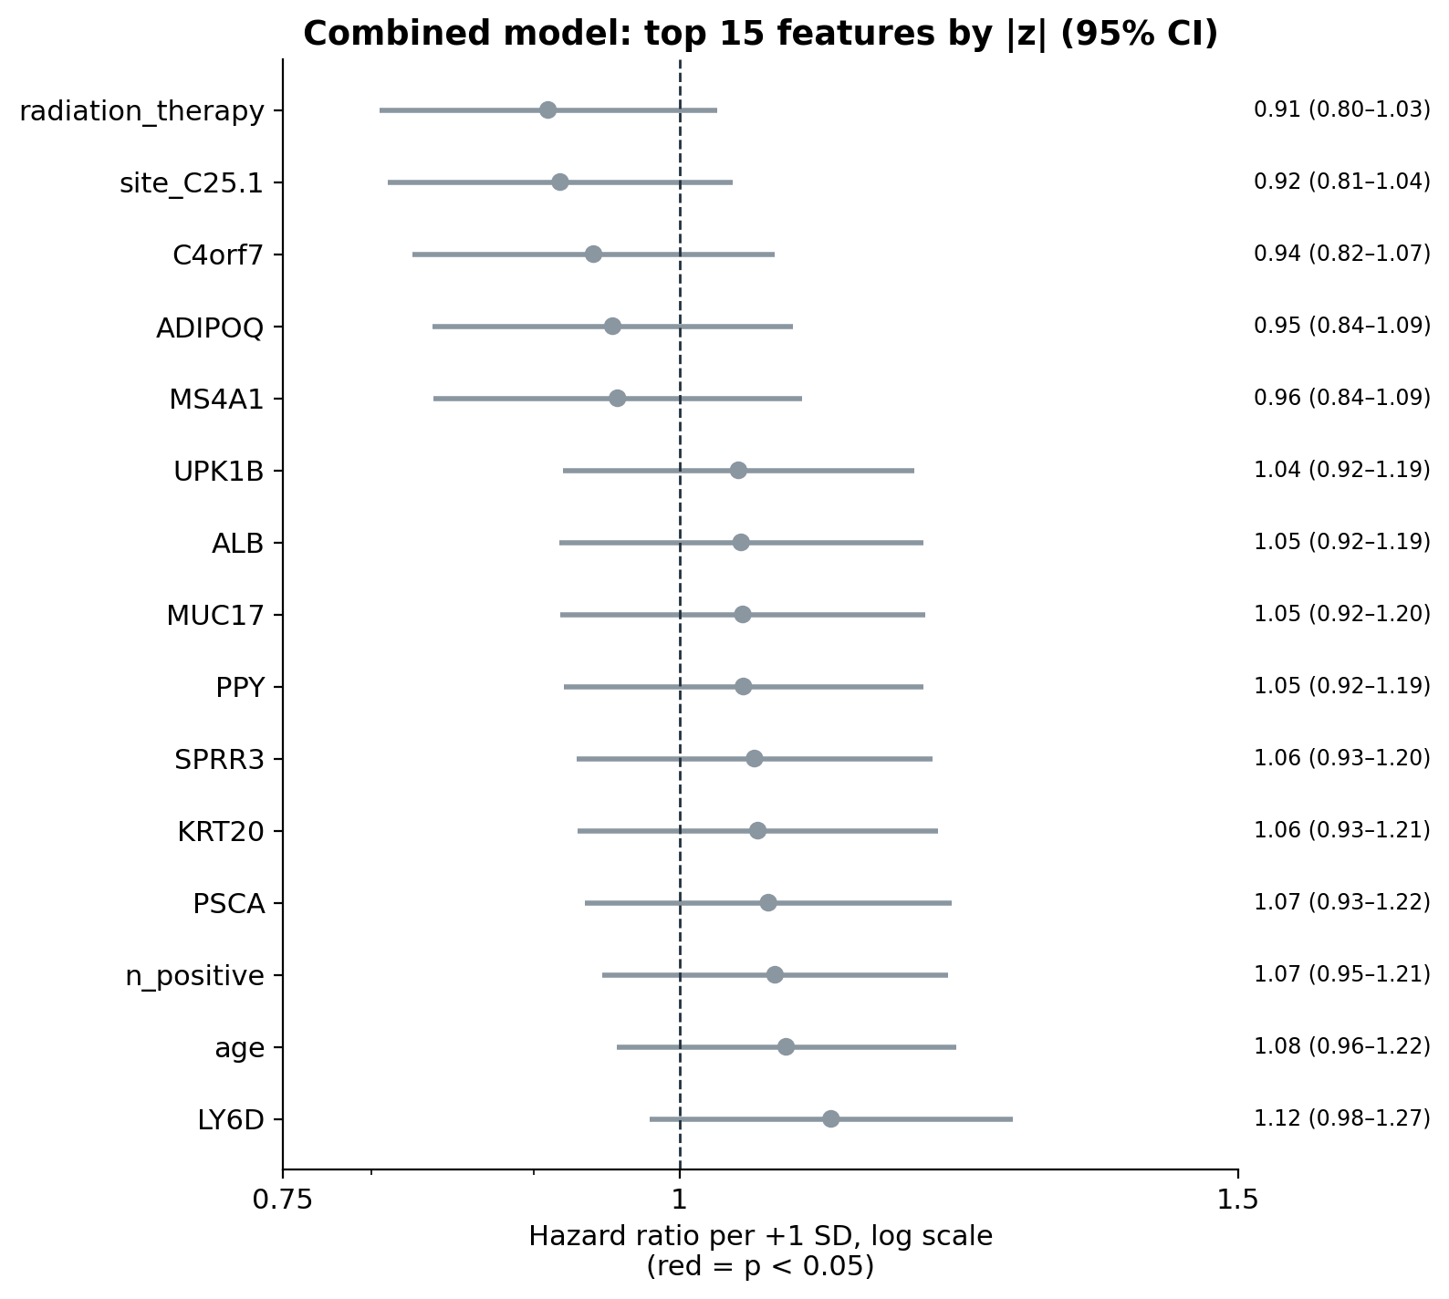
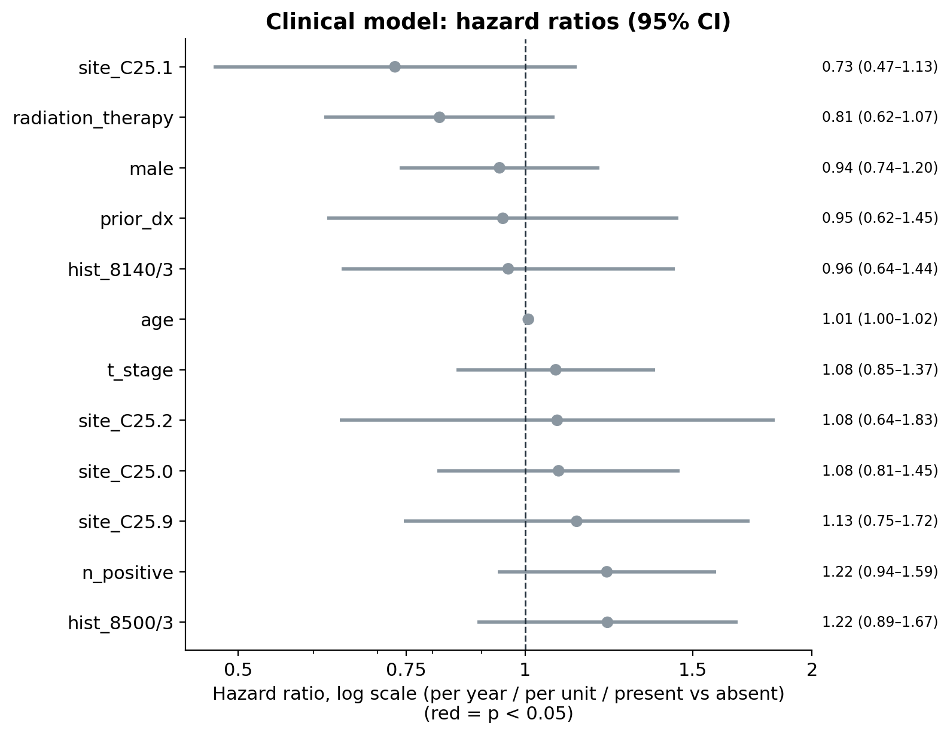
Which features move the hazard?
Notes:
Hazard ratio above 1 means shorter survival. Red intervals exclude 1. With 183 patients most intervals are wide and cross 1; that width is the honest message. Clinical model in natural units, combined model per one standard deviation.

Slide 7
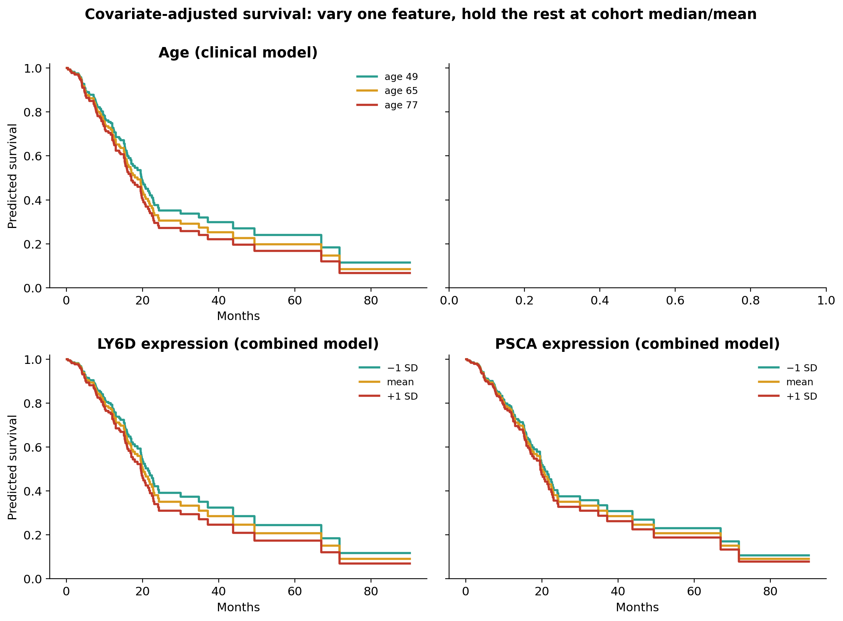
Covariate effects on predicted survival
One feature changes per panel; all others stay at the cohort median or mean.
Curves are model predictions, not raw data.
Wider gaps between curves mean a larger effect.
Notes:
Each panel changes one feature and holds everything else at the cohort median. This is the model's prediction, not raw data, so it shows direction and size of effect, not a new finding.

Slide 8
Live demo: risk calculator
Enter
Score
Explain
Clinical features and top gene levels, or start from a real cohort patient
Relative hazard vs the average patient, percentile, high/low group
Predicted survival curve and the features driving the score
streamlit run demo_app.py
Notes:
Switch to the browser: streamlit run demo_app.py. Follow demo_script.md.

Slide 9
Takeaways and limitations
What we found
Clinical + expression beats either alone (C-index 0.67 vs 0.63 / 0.64).
Out-of-fold risk groups separate clearly (p < 0.001).
Regularisation matters: untuned expression models barely beat chance.
Limitations
183 patients: wide intervals, one cohort, no external validation.
Tuned scores are slightly optimistic (sweep on same CV).
Median imputation of missing clinical values.
Research prototype, not for clinical use.
Notes:
Close: three takeaways, then limitations.

