Slide 1
Face Recognition Attendance System
Project Presentation
Tanvi

Slide 2
Abstract
Automated attendance using face recognition.
Saves time and improves accuracy.

Slide 3
Objectives
• Automate attendance
• Reduce errors
• Save time
• Secure system

Slide 4
Technologies Used
Python, Django, OpenCV, NumPy, SQLite

Slide 5
System Working
1. Register face
2. Train model
3. Detect face
4. Mark attendance

Slide 6
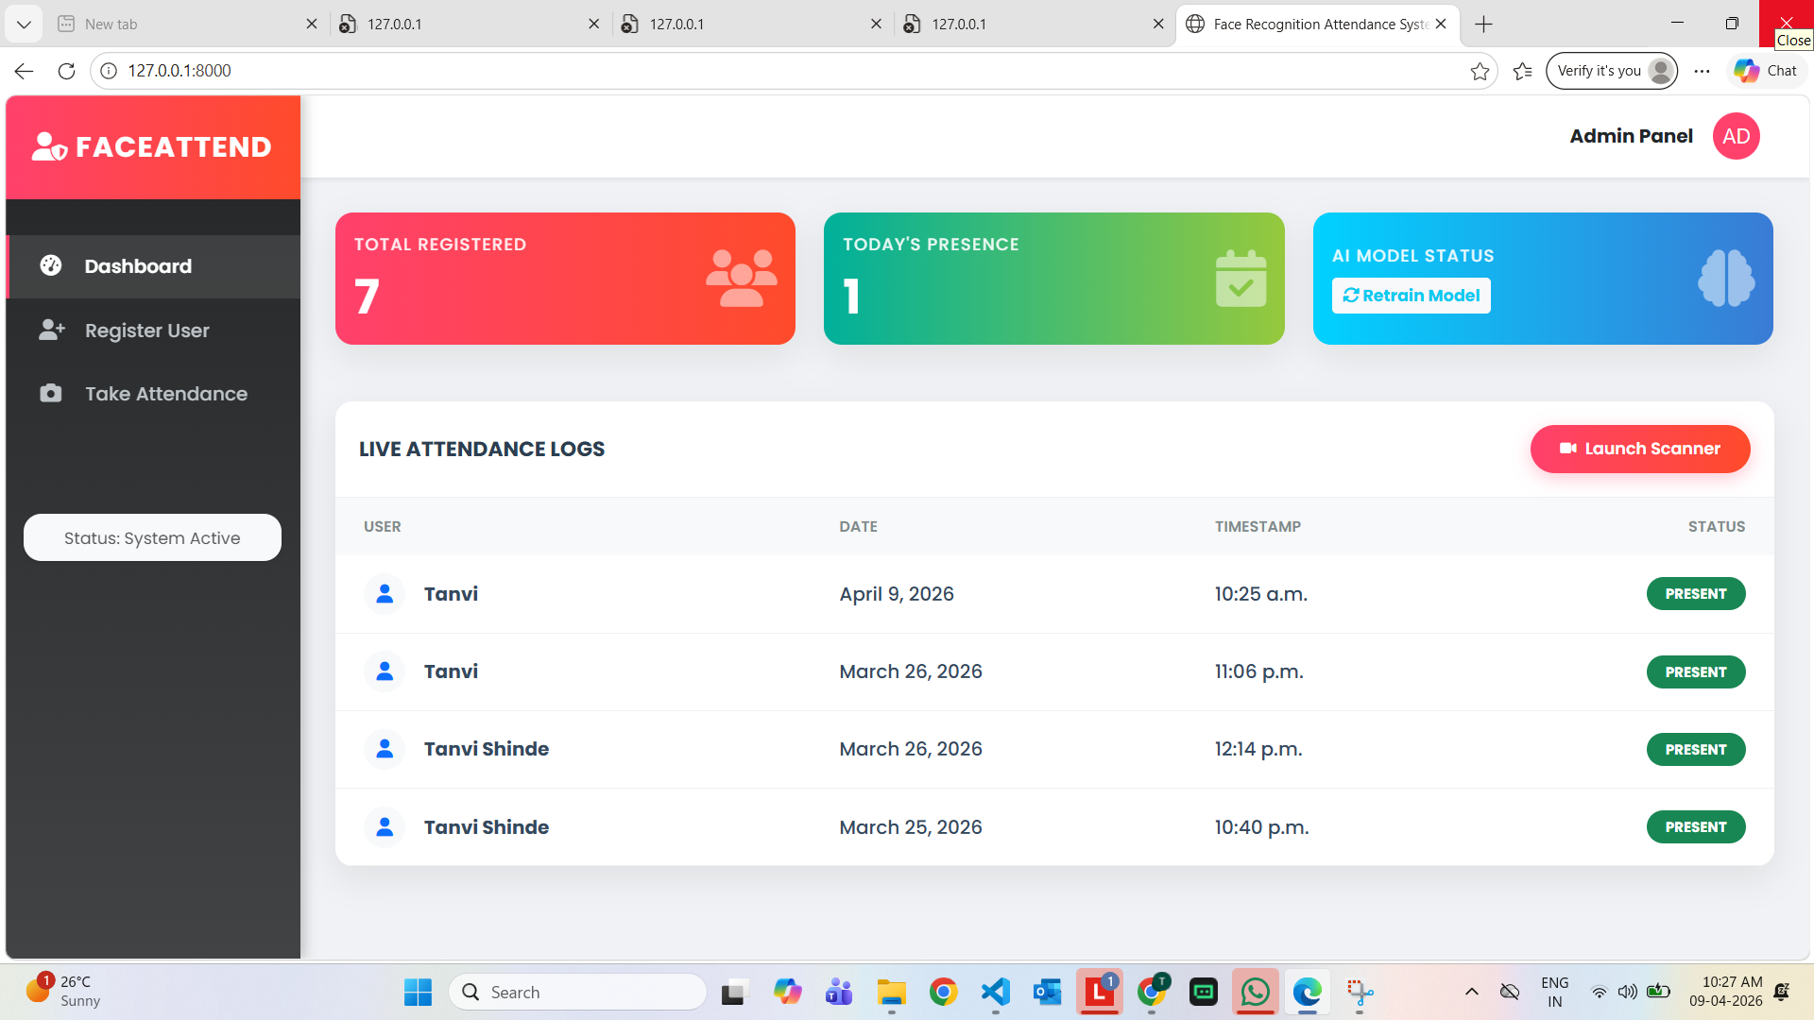
Dashboard

Slide 7
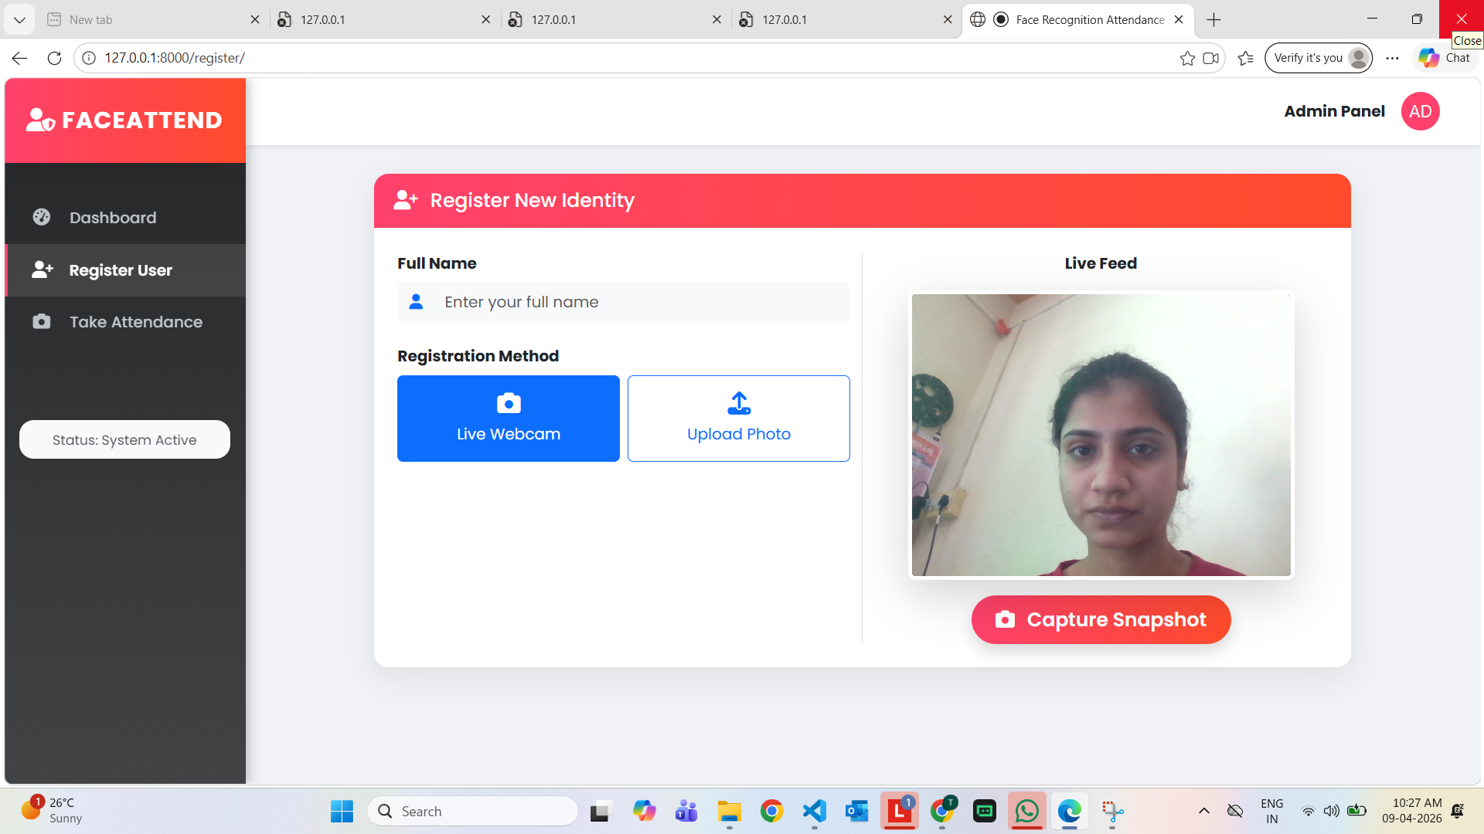
User Registration

Slide 8
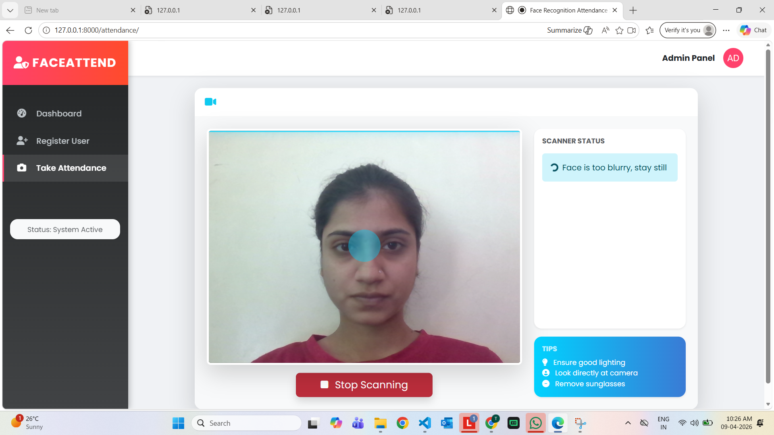
Attendance Logs

Slide 9
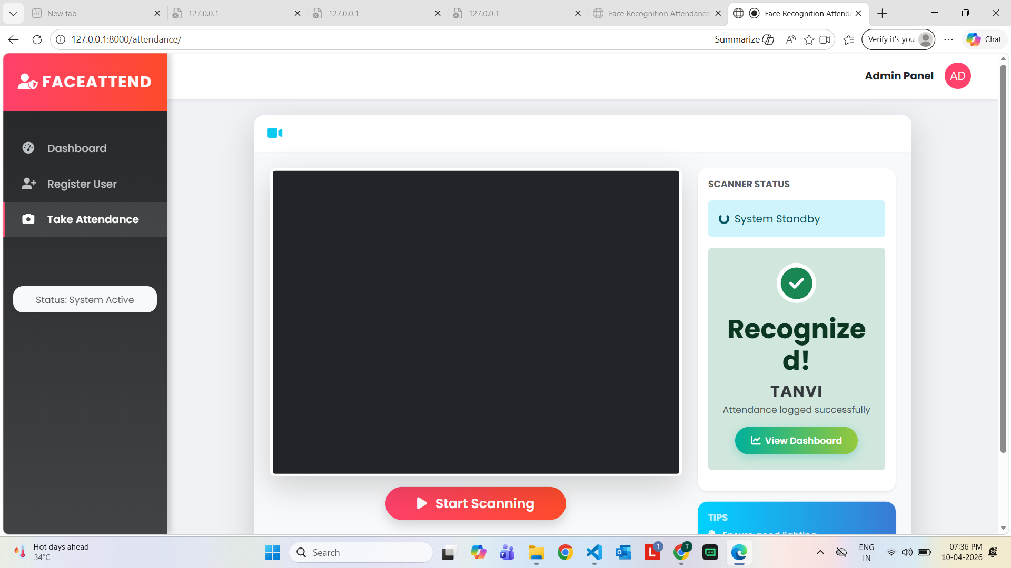
Face Scanning

Slide 10
Conclusion
Efficient and secure attendance system using AI.

