Slide 1
Automated Stuttering Detection Using BERT Model
D.Varsha – 21251A05D6
Sheema Mateen – 21251A05F9
Aneesha Fatima – 21251A05G5
Tanvi Tanniru – 21251A05K0

Slide 2

Introduction
80 million of the total population stutter, which is 1% of the population.
The stuttering affects different areas in the lives of the people who suffer from this problem.
Our goal is to detect stuttering and provide feedback on the stuttering so that the person can practice speaking and improve.

Slide 3

Summary
Developing an automatic stuttering detection system using BERT to improve diagnosis and therapy for speech disorders.
The system collects and preprocesses speech data, fine-tune the BERT model on this data, and evaluate its performance using standard metrics.
The BERT model achieves effective accuracy in detecting stuttering, outperforming traditional methods.
The project demonstrates the effectiveness of BERT in identifying stuttering, with potential future applications in real-time analysis and more diverse datasets.
The technology can assist speech therapists with objective assessments and contribute to advancements in NLP applications for speech disorders.

Slide 4
EXISTING SYSTEM
The current approach to stuttering detection involves a combination of manual assessment by trained speech-language pathologists (SLPs) and automated analysis using computational techniques.
Manual assessment: clinical assessment and subjective rating scales.
Automatic analysis: software for speech analysis, acoustic analysis, machine learning approaches and multimodal approaches.

Slide 5
Previous works
Model | purpose | Algorithm used | Accuracy | Drawbacks
Surya and Varghese | Converts audio clip to audio array and obtains frequency to train machine | SVM(Support Vector Machine) | 76% | The problem with the model is that only trained words can be predicted
Automatic detection of prolongations and repetitions | To identify the stutter samples | LPCC(Linear predictive Cepstral Coefficient), KNN(K-Nearest Neighbors), LDA(Linear Discriminant Analysis) | 88.05% | Main drawback is that it only identifies and classifies known stutterers and do not deal with general problems like poor pronunciation

Slide 6
Dataset (SEP-28K and Real-Time)
Our dataset came from SEP-28k .
Containing about 385 different podcasts of peoples who stutter in English.
Each recording was cut to no more than 5 seconds.
The number of audio samples that are taken per second is 16,000 Hz.
The data consists of an equal number of men and women.
50% of the data is of people who stutter and 50% who do not stutter.
The data is divided into 80 percent train and 20 percent test.

Slide 7
PROPOSED SYSTEM
The system employs advanced models for automated stuttering detection. It utilizes Wav2vec to convert audio recordings into matrix representations and Agnostic BERT to generate vector representations from transcripts. These representations are combined into a single vector, incorporating both auditory and linguistic information. A binary classifier is then used to differentiate between individuals identified as "stutterers" and "non-stutterers" based on this combined information.

Slide 8
OBJECTIVES
To collect Real-Time dataset.
To convert audio files into transcripts using wav2vec model.
To classify audio files using Agnostic BERT.
To analyze and evaluate the model using suitable metrics.

Slide 9
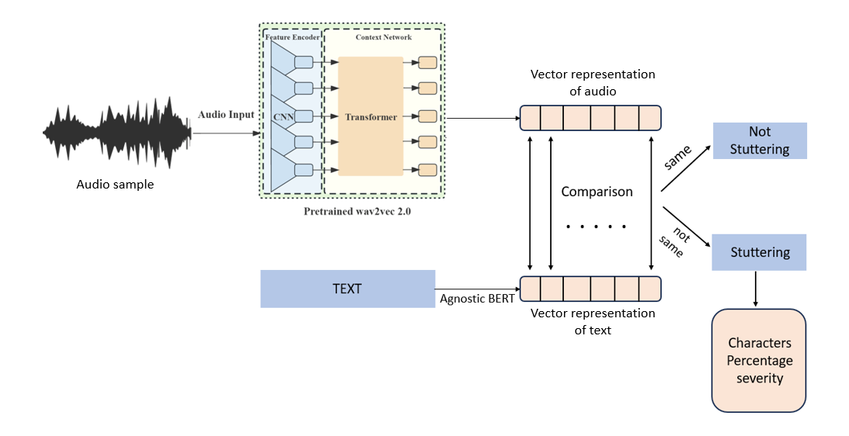
METHODOLOGY
Figure : The steps through which the audio passes through the model for training

Slide 10
MODULES
Collection of Real-Time dataset
Transcription of the audio files
Sound to Matrix Representation
Transcript to Vector Embedding
Binary Classification
Evaluation of Stuttering

Slide 11
ALGORITHMS
Wav2Vec: Sound to Matrix Representation
Matrix For One Vector
Agnostic BERT: Transcript to vector embedding
Vector Concatenation
Binary Classifier Training
CTC loss: Audio-Detected Stuttering Segments

Slide 12
Results
The table of the results:
Accuracy | Precision | Recall | F1-score
0.68 | 0.83 | 0.45 | 0.59

Slide 13
DEGREES OF SEVERITY
Range of stuttering percentages | Severity level
Less than 5% | Trivial
5 – 10% | Trivial to Intermediate
10-15% | Intermediate
15-20% | Intermediate to Acute
Above 20% | Acute
Reference: https://stamurai.com/blog/understanding-degrees-of-stuttering-severity/

Slide 14
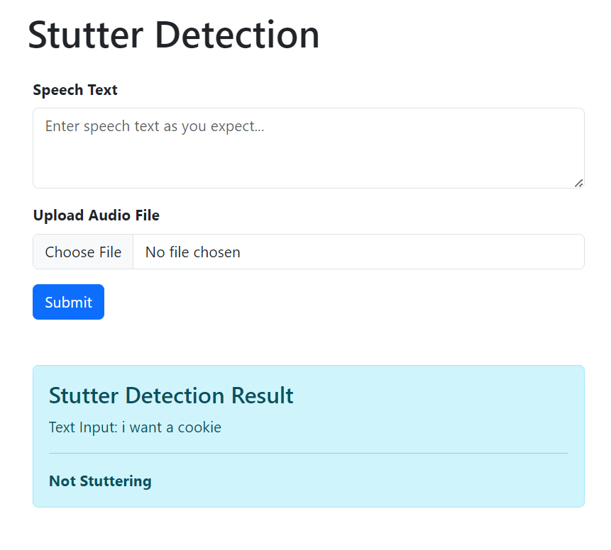
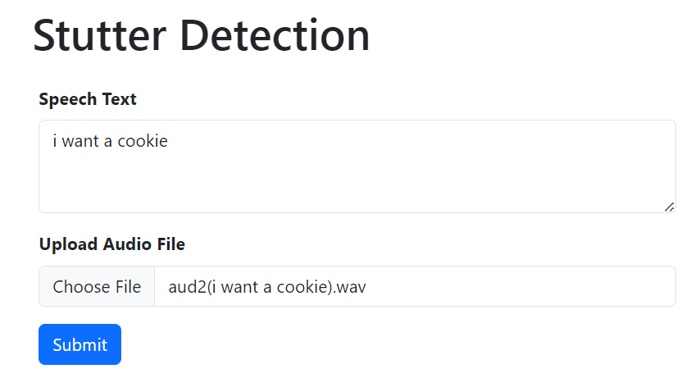
Results

Slide 15
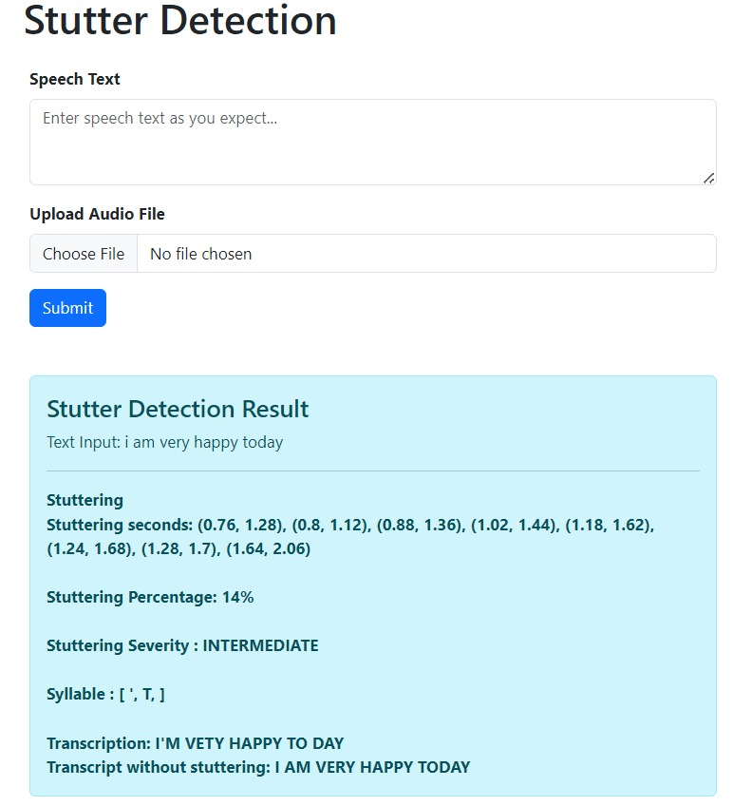
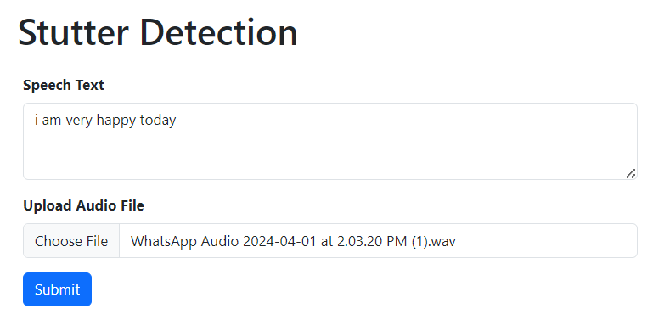
Results

Slide 16
FUTURE SCOPE
Real-Time Audio Recording on User-Interface
Improving accuracy of the model
Improvising User-Interface
Multilingual Models

Slide 17

CONCLUSION
The results of the study emphasize the effectiveness of the approach in the article for classifying stuttering cases.
The approach combined audio and text representations and effectively captured features related to stuttering. The concatenated vector provided a representation that improves classification performance.

Slide 18


