Slide 1

Exploring Physiological and Environmental Factors: Predicting Engagement Levels
MET CS-555
Foundations Of Machine Learning
Tanvi Thopte
U35489362

Slide 2

GOAL
This project aims to evaluate how some physiological and environmental factors influence an individual’s engagement level.
Addressing Questions
Do Cognitive/Emotional states impact engagement levels, and if so, how?
What factors, such as heart rate and environmental conditions, are the most significant predictors of a person’s engagement level?
• Does engagement level change with physiological responses like heart rate or skin conductance?
• How does the surrounding environment (ambient noise or lighting) influence a person’s engagement?

Slide 3
INTRODUCTION TO THE DATASET
Physiological Data
Environmental Factors
Engagement Levels
The dataset includes real-time measurements of heart rate, skin conductance, and other physiological signals.
HeartRate
SkinConductance
EEG
Temperature
PupilDiameter
Smile Intensity
Emotional State
Cognitive State
Environmental variables such as lighting, noise levels, and temperature were also recorded to understand their impact.
ActivityLevel
AmbientNoiseLevel
LightingLevel
Engagement levels were collected at regular intervals to serve as the target variable.
Engagement Level
3
Emotional Monitoring dataset

Slide 4
Statistical Methods
Hypothesis Testing
Correlation Tests
Simple Linear Regression
Multiple Linear Regression
Analysis of Variance
Correlation Analysis
Visualizations
4

Slide 5
Statistical Methods
Hypothesis Testing
Correlation Tests
Simple Linear Regression
Multiple Linear Regression
Analysis of Variance
Correlation Analysis
Visualizations
5

Slide 6
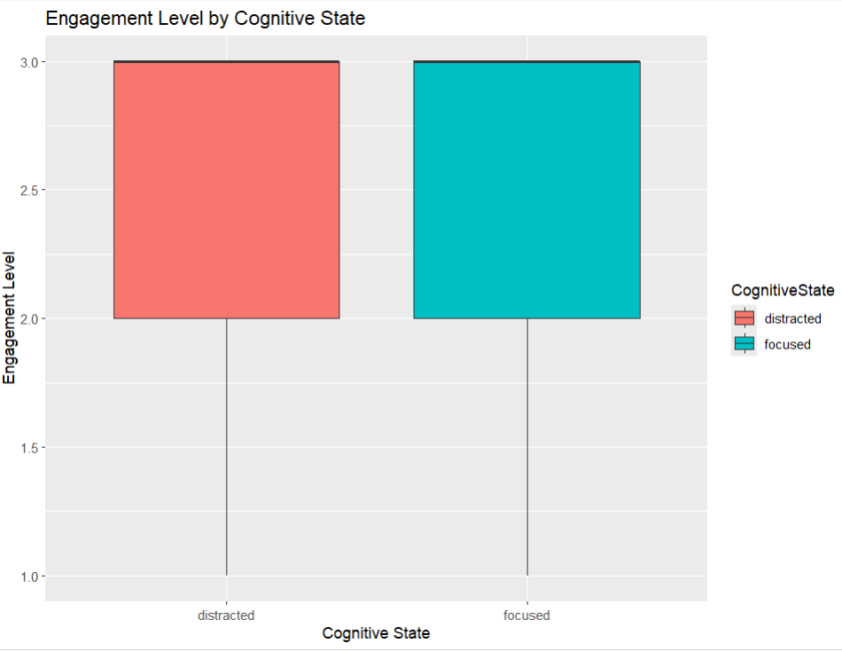
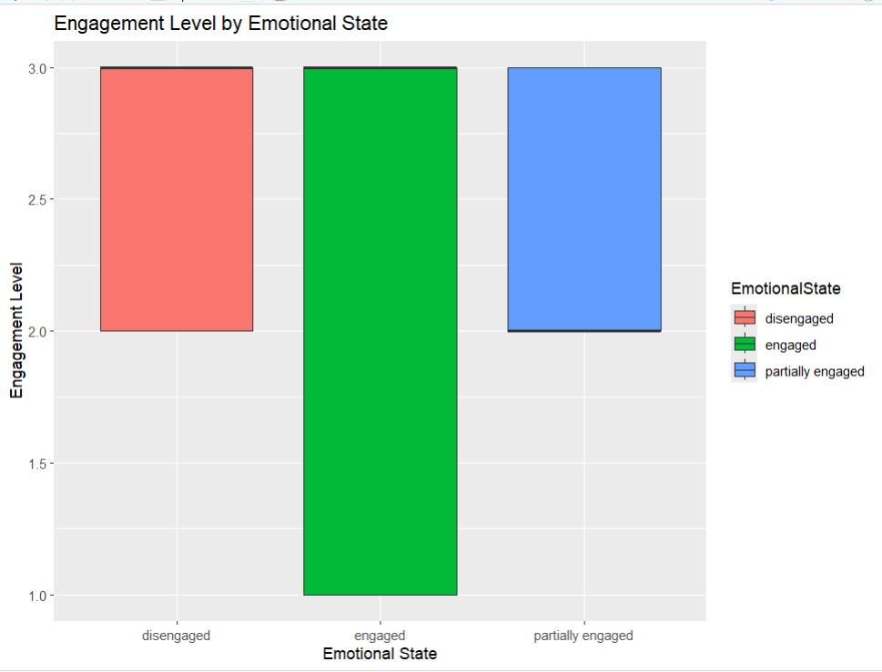
Comparing engagement levels across cognitive and emotional state
Do Cognitive/Emotional states impact engagement levels?
Both cognitive states ("distracted" and "focused") have similar ranges for engagement level. The medians also appear close, suggesting little difference in central tendency.
Statistical testing (like ANOVA) is required to confirm whether the apparent similarity is statistically significant or not.
The "engaged" group seems to exhibit higher median and a wider range of engagement levels than the other emotional states.
Differences among emotional states are visually evident. Further statistical testing (e.g., ANOVA and post-hoc Tukey HSD) is needed to determine if these differences are significant.

Slide 7
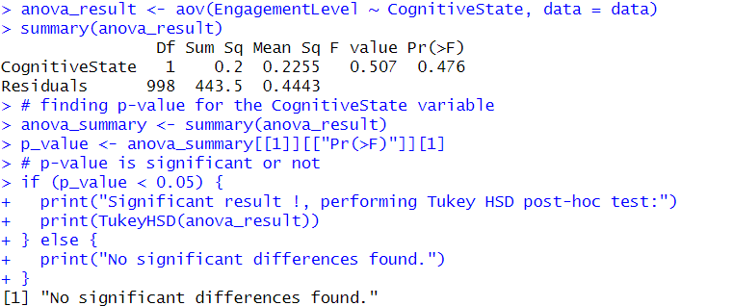
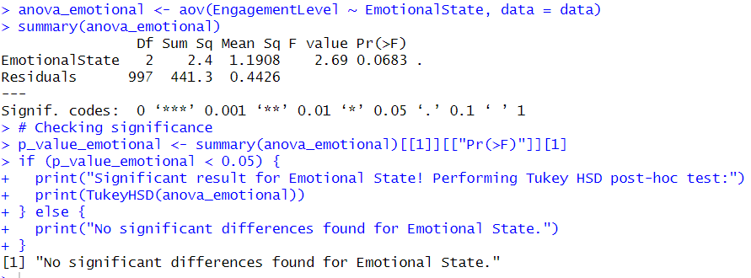
HYPOTHESIS TESTING and ANOVA
H0: Mean engagement levels across Cognitive/Emotional State groups are equal.
H1: Mean engagement levels differ across Cognitive/Emotional State groups.
P-value is not significant, we fail to reject the null hypothesis.
Tukeys Test was supposed to be conducted but no significant differences were found thus it didn’t perform.
Cognitive State and Emotional State both do not significantly affect the EngagementLevel

Slide 8
Simple Linear Regression
“Does engagement level change with physiological responses like heart rate or skin conductance?”
“How does the surrounding environment (ambient noise or lighting) influence a person’s engagement?”
Predictor | Intercept | R squared | P value | Conclusion
Heart Rate | 2.35 | 0.0014 | 0.237 | Not a significant predictor
Skin Conductance | 2.66 | 0.053 | 1.76e-13 | Significant Negative Relationship
Ambient Noise | 2.38 | 0.0009 | 0.352 | Not a significant predictor
Lighting Level | 2.37 | 0.0026 | 0.105 | Not a significant predictor
SkinConductance is the only significant predictor of Engagement Level
Other predictors (HeartRate, AmbientNoiseLevel, and LightingLevel) are not significant.

Slide 9
Multiple Linear Regression
"What factors, such as heart rate and environmental conditions, are the most significant predictors of a person’s engagement level?"
Predictor | P value | Conclusion
Heart Rate | <2e-16 | Significant Negative Relationship
Skin Conductance | <2e-16 | Significant Negative Relationship
Ambient Noise | 0.697 | Not a significant predictor
Lighting Level | 0.135 | Not a significant predictor
HeartRate and SkinConductance are significant predictors of Engagement Level, both showing negative relationships.
AmbientNoiseLevel and LightingLevel are not significant.

Slide 10
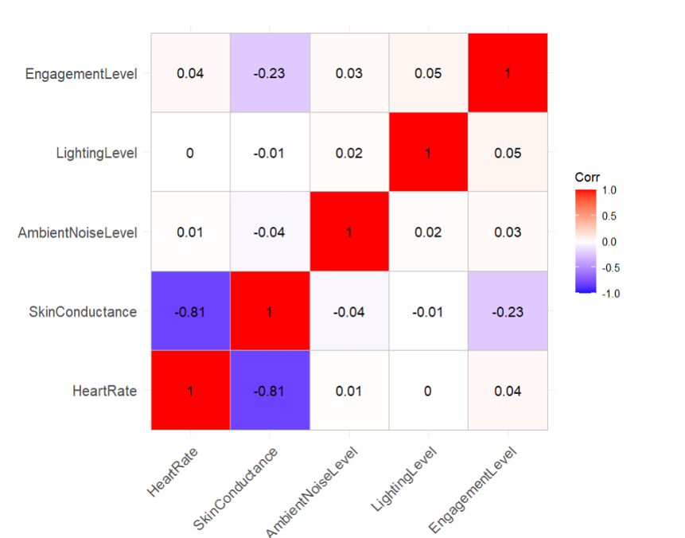
Correlation Matrix
Assessing the relationship between multiple continuous variables.
Variable | Engagement Level | HeartRate | SkinConductance | LightingLevel
Engagement Level | 1.00 | 0.04 | -0.23 | 0.00
HeartRate | 0.04 | 1.00 | -0.81 | 0.05
SkinConductance | -0.23 | -0.81 | 1.00 | -0.01
LightingLevel | 0.00 | 0.05 | -0.01 | 1.00
Weak correlation between Engagement Level and other variables.
Strong negative correlation between HeartRate and SkinConductance (-0.81).

Slide 11
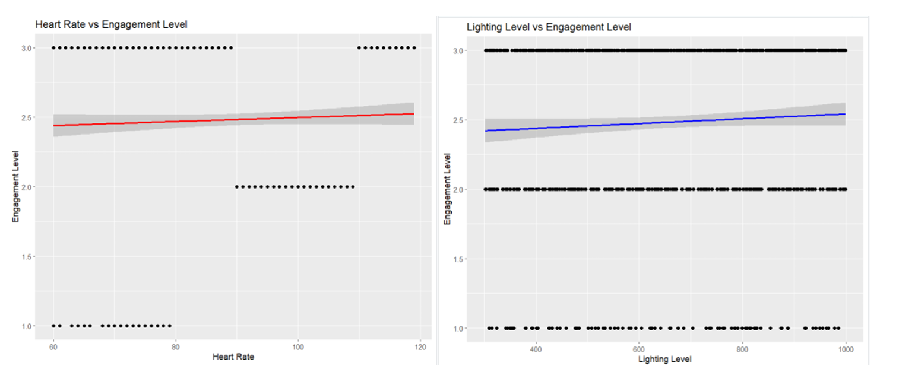
Correlation Matrix
To check whether these are significant predictors of EngagementLevel.
Heart Rate vs. Engagement Level: Shows a slight positive relationship, but the spread of data indicates a weak correlation.
Lighting Level vs. Engagement Level: The regression line shows minimal influence of lighting on engagement

Slide 12

Skin Conductance
CONCLUSION:
Most significant Predictor
Significant Predictor in MLR
Heart Rate
Environmental factors
Negligible impact
Emotional State
Significantly influences
Cognitive state
Does not significantly influence
12

Slide 13

THANK YOU
13

