Slide 1
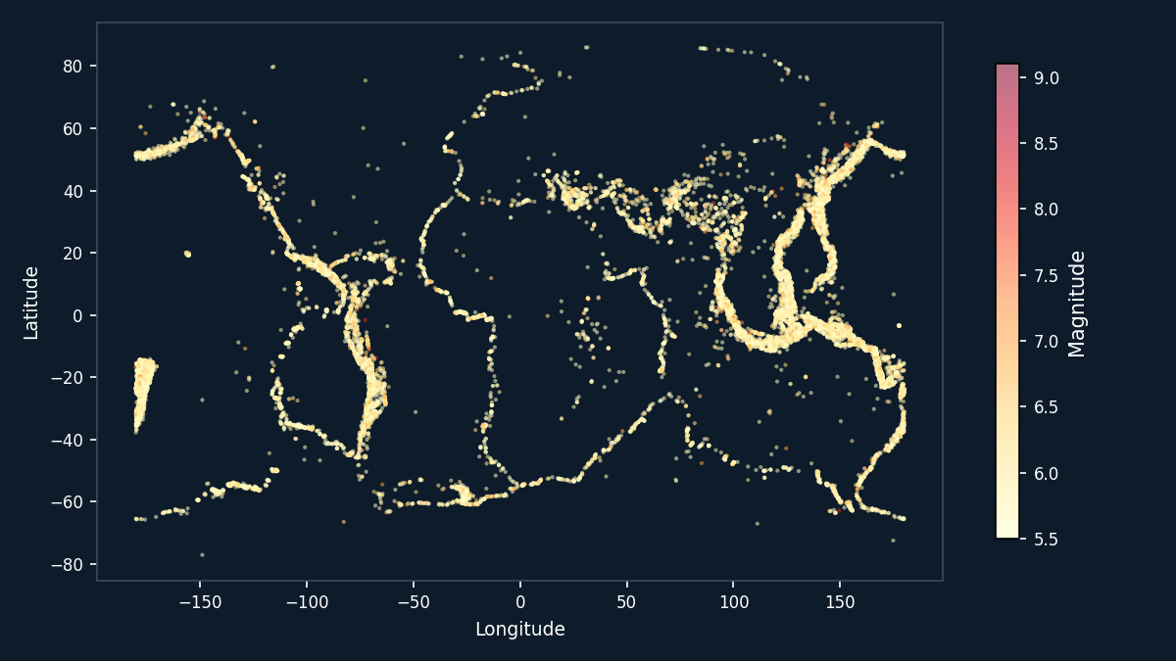
PROJECT REVIEW 1
AI Earthquake
Alert System
An AIoT-driven system for real-time seismic event classification and role-based alert delivery
Data source: USGS National Earthquake Information Center · Significant Earthquakes 1965–2016
Presented by: Tanvi Jain RA2311003010560
Akshit Sharma RA2311003011096
Institution: SRM Institute of Science and Technology, Chennai

Slide 2

PROBLEM STATEMENT
Seconds decide outcomes - and current alerting is too slow
Narrow warning window
Strong shaking often arrives only seconds after initial detection, leaving little time for manual response chains to act.
WHY THIS MATTERS
A society-oriented system
Earthquakes remain one of the deadliest natural hazards globally, with damage severity closely tied to how quickly warnings reach the public and responders. An AI-driven, role-based alert system directly reduces response delay for citizens, field operators, and disaster-management administrators alike — not a purely commercial or software-only exercise.
No centralized severity classification
Most regions rely on manual review or raw magnitude alone, without a structured, automated severity-tiering process.
Depth and location are under-used
Threshold-based (magnitude-only) alerts ignore depth and geographic context, both of which strongly affect real surface impact.
Disconnected stakeholders
Planned as an AIoT product: seismic event classification (AI) feeding a role-based web alert platform (software), extensible to sensor-fed ingestion (IoT).
Citizens, field operators, and administrators lack a shared, auditable system for tracking alerts from detection to resolution.
2

Slide 3

LITERATURE SURVEY
What prior research establishes
Author(s) & Year | Method | Dataset | Key Finding
Mousavi & Beroza (2020) | ML-based magnitude estimation | Regional seismic waveform stations | Shows ML can estimate magnitude reliably from early waveform features, ahead of full event resolution.
Apriani, Wijaya & Daryono (2021) | Deep Neural Net + Random Forest | Single-station raw seismograms (BMKG, Indonesia) | Using only 1s before / 3s after the P-wave was sufficient for fast magnitude estimation for early warning.
Wang, Li, Wang & Liu — EEWNet (2022) | 1D Convolutional Neural Network | KiK-net: 30,756 accelerograms, M4–9 | Outperformed the traditional Pd method using just the initial 0.5–3s of recorded data.
Survey: ML for Magnitude Prediction (2024) | Review of RF, SVM, CNN, LSTM | Multiple public seismic catalogs | Flags scarce data and class imbalance as open challenges — directly relevant to this project's Alert_Level distribution.
Research gap this project addresses
Existing work concentrates on magnitude/intensity regression from raw waveforms at research-grade seismic networks. Few systems carry that output through to an end-to-end alert-tiering and role-based notification workflow for public and administrative use — the gap this project targets.
3

Slide 4
Author(s) & Year | Method | Dataset | Key Finding
K. Jaiswal and D. Wald[2013] | ML-based magnitude estimation | USGS PAGER: Prompt Assessment of Global Earthquakes for Response | The USGS system that estimates an earthquake's likely human and economic impact within roughly 30 minutes of the event, by combining shaking-intensity modeling (ShakeMap), population exposure, and regional building-vulnerability data
Machine learning for earthquake damage classification (Nepal, 2015) | ML-based magnitude estimation | Study from RNS Institute of Technology, Bengaluru-data from Kathmandu Living Labs | Random Forest and Gradient Boosting classifiers to predict building damage-grade severity after the 2015 Gorkha earthquake, using survey data from Kathmandu Living Labs
E. R. Burkett, D. D. Given, and L. M. Jones[2014]- [ShakeAlert] | Distinguishing the two clarifies exactly what category of “alert system” this project belongs to. | U.S. Geological Survey Fact Sheet 2014-3083, 2014. | Weaker seismic waves and issues a warning before the more damaging shaking arrives, giving people seconds to minutes of advance notice.
USGS “Did You Feel It?” (DYFI) V. Quitoriano and D. J. Wald [2020] | felt (DYFI report count) and cdi (community-determined intensity) | Science and Lessons From 20 Years of Citizen Science-Based Macroseismology | system for collecting citizen-submitted shaking reports over the internet, which has amassed over five million individual reports used to build near-real-time community intensity maps.

Slide 5
OBJECTIVES
Four objectives, each with an identified technique
01
Acquire a real, verified dataset
02
Engineer discriminative features
Source the USGS NEIC significant-earthquake catalog (1965–2016, M5.5+) rather than a synthetic stand-in.
Build temporal, depth-based, and magnitude-based features that separate alert-severity classes.
Technique: FDSN/USGS catalog retrieval + data-quality filtering
Technique: Feature engineering + USGS magnitude-band labeling
03
Classify alert severity
04
Evaluate under class imbalance
Train a model to assign incoming events to an alert tier for downstream notification.
Assess the model with metrics suited to rare, high-severity events — not raw accuracy alone.
Technique: Supervised multi-class classification (planned: RF / gradient boosting baseline)
Technique: Precision/recall/F1 per class, stratified evaluation
4

Slide 6
DATASET
Real USGS catalog, not synthetic data
10,994
Before preprocessing earthquake records, 1965–2016
10,787
cleaned earthquake records, 1965–2016
Alert_Level bands — derived from USGS magnitude classes
Level | Magnitude
Moderate | 5.5 – 6.0
Strong | 6.1 – 6.9
Major | 7.0 – 7.9
Great | 8.0+
Global distribution of catalog events — the pattern traces real tectonic plate boundaries (the “Ring of Fire” and mid-ocean ridges), confirming the data reflects genuine seismic activity.
Source: USGS NEIC · Earthquake Magnitude, Energy Release & Shaking Intensity
5

Slide 7


DATASET PREPROCESSING
From raw catalog to a model-ready, leakage-free split
1
2
3
4
5
Filter
Clean
Engineer
Label
Split & Scale
Keep only true earthquakes — remove nuclear tests & rock bursts
Drop columns >70% missing; fill remaining with mode/median
Add time-based + depth-category features
Derive Alert_Level from USGS magnitude bands
Stratified 70/15/15 split, then StandardScaler (train-fit only)
Alert_Level distribution — full dataset (23,232 records)
Imbalance is real, not a data flaw
“Great” earthquakes (M8+) are genuinely rare — just 0.2% of catalog events. This will be handled at modeling time via class weighting and per-class precision/recall, evaluated in Review 2, rather than by discarding real events.
6

