Slide 1
Tap n Track
Flow of App - Idea

Slide 2
Open app: First look
Welcome to Tap n Track (Only First Time)
Then it goes into the next phase

Slide 3
Phase 2
tabs in the app:-
Basic in Overview:
Red and green buttons + - and pop ups (choose categ)
Overview Without Budget mode:
3 Numbers - Income, Exp, Balance
Pie chart
Bars indicating the exp in each categ
Overview With Budget Mode:
Budget toggle
If chosen, will pop up and can choose to set budget for each categ or to have a main budget
3 Numbers - Sum of budgets, Sum of exp, Balance
Bars indicating the breakdown - with different highlights
Pie chart - Just the expenditure

Slide 4
History
Sorted by date
Income - Divisions under it (different accounts like cash, cards etc)
Sorted by category initially
Go into it can see sorted by date
Expenditure
Sorted by date initially.
Has the options to sort by category.
Report/Analysis - Extensions

Slide 5
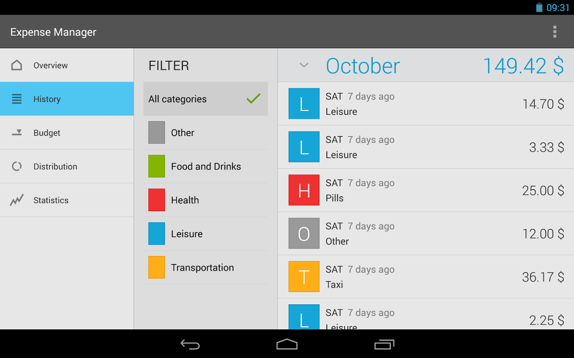
Examples of tabs

Slide 6
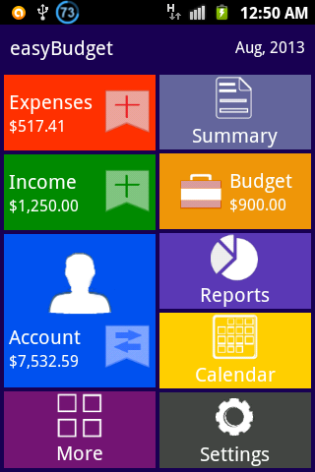
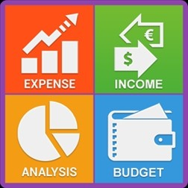

Slide 7
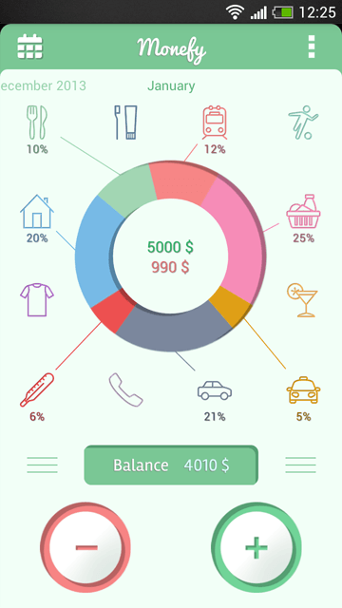
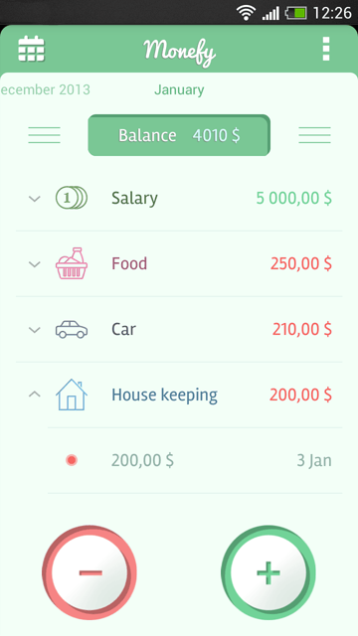
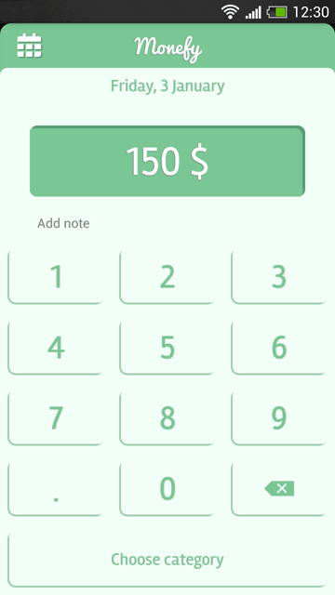
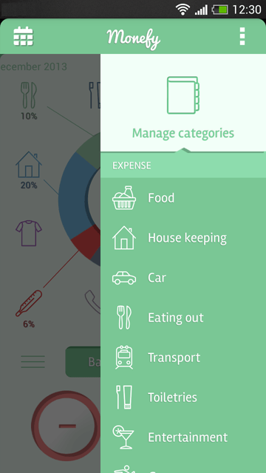
Monefy
Main interface
Breakdown by category
After pressing “-” / “+”

Slide 8
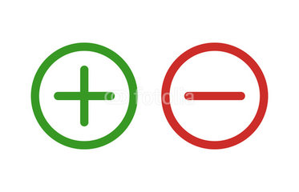
What happens if they press +
The app will either pop a rectangle window or will take the user to a new phase
In that, they will be asked to enter their income and the “name” (and maybe a tickbox to indicate if this is a recurring income so that they don’t have to input every month). Press ok. Once they do this, this will be shown under the history tab. They can go to history, and edit the income if they want. It should automatically note the date when this was entered
What happens if they press -
Same as above, probably the colour what is seen in the exp tab will be red and income tab is green
One extra is that, we will have the common types of expenditure and will ask them to tick their type (and they can modify the types eg. change names/icons). This will help us analyse and break down the expenditure

Slide 9
Budget tab
Here, I think we can ask them to set a budget- how much they plan on spending on the different types we have..like food, entertainment, stationery, etc
If the expenditure exceeds, we will show it in the analysis, and will notify them
Maybe don’t have to be a tab, just a mode. So if the mode is enabled, users will be asked to key in an amount that is the budget. If expenditure > budget, the balance will be in red and a negative number: (budget - expenditure); else in normal mode, the balance would be (income-expenditure)

Slide 10
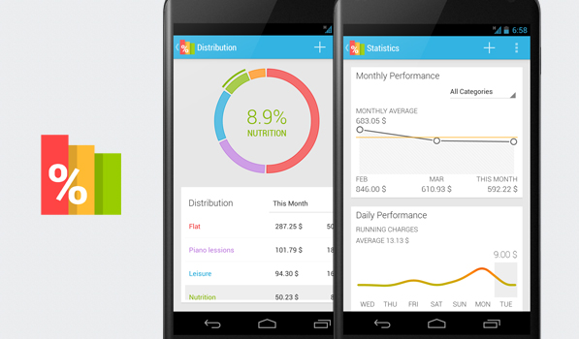
Report analysis tab
We will show the breakdown of their expenses..and will show them through graphs and charts (easier by pie charts like the other apps)

Slide 11
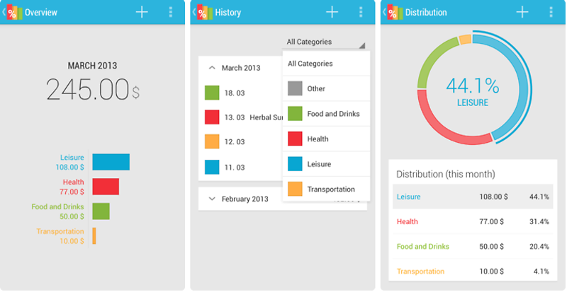

Slide 12
History tab
Will basically have all the stuff we have entered..in order of the date..they can edit their inputs here.
We can give them another view to arrange the income on one side and expenditure on the other
-- Here i wonder whether we should have income and expend tabs separately..tht might be a repeat of stuff..thats y i thought that just history would do and we can give them a separate view if we want
I’m thinking we can do by categories to have a more categorised breakdown. So when we come into this tab, we will see all the stuff we have entered. Then we can press on somewhere and the history will be categorised regardless of + or -, then we can view the details by pressing on the categories.

Slide 13
Settings
Notifications
Change colour
If we have sign in somewhere..then some settings related to that (we should have sign in if possible so that users can still access their data on other devices)
Etc

Slide 14
Extensions , possible other features
Ez Link card history integration
Feature to export the information to excel sheet
Allow users to take photo of their receipts as inputs of expenditures
Sync with other users (eg. for groups, enable read-only mode for viewers and editable mode for collaborators)
An option to carry forward the balance of previous month(s) to the current month
A calendar for users to choose a date to check income/expenditure of that certain date
Allow users to cancel the change they have just made (eg. a bar that lasts for 3 seconds)
a web page for introduction of the app (If really have time - i doubt so haha)
etc

Slide 15
(Are we asking them to sign in using fb..google..?) - or they can create a new account just for our app, or connect using their fb/google account

Slide 16
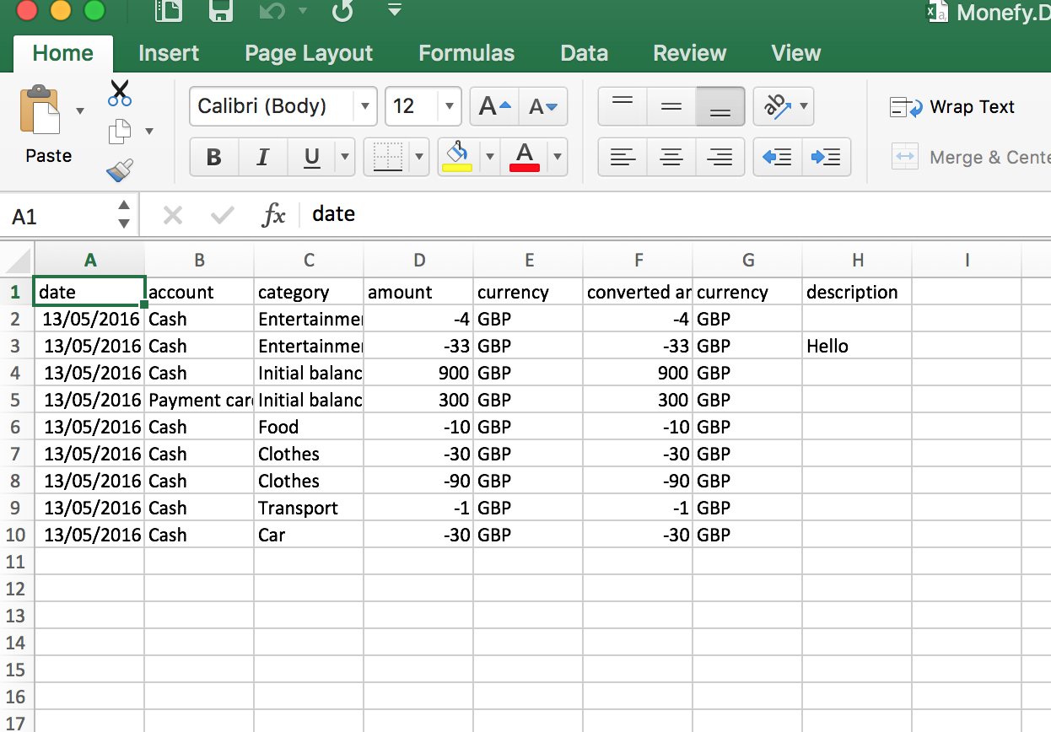
Example of an exported file (from monefy)

Slide 17
Other notes
I am planning to read the comments of the apps and see what other users have to say of the existing expense manager apps.
Some do provide good suggestions for improvement :)

