Slide 1
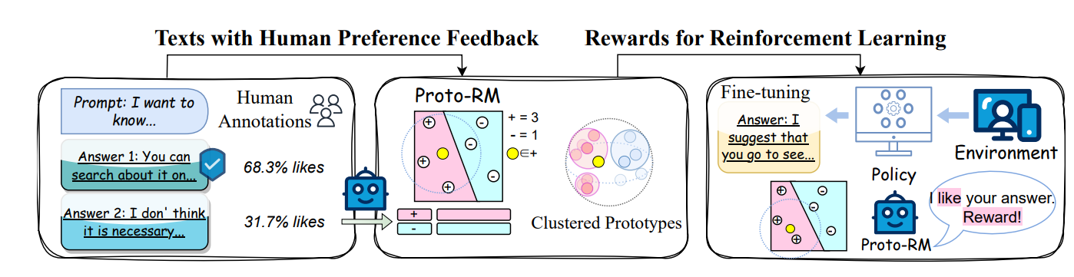
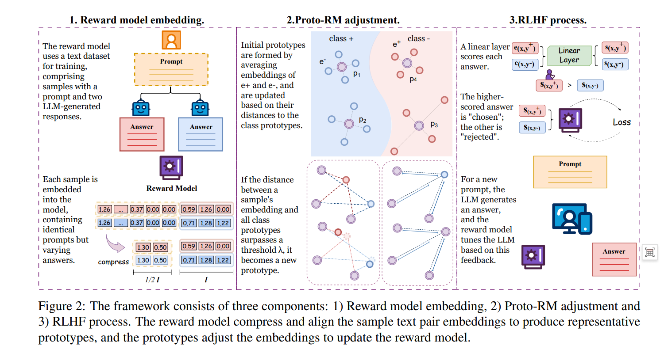
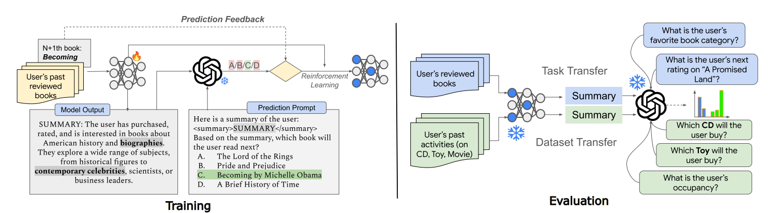

Slide 2


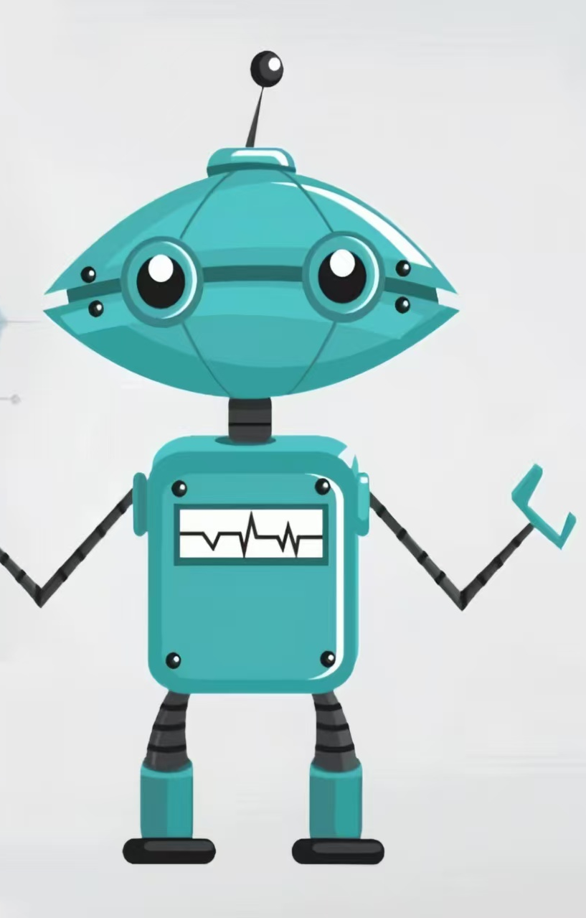
Environment
Prototypical Reward Model
Prompt: What is the definition of cat?
Human Feedback
User
Helpful
Answer 1: A cat is a small, domesticated mammal scientifically known as Felis catus. They belong to the family Felidae and are characterized by their sharp claws, keen senses …..
p3
Helpful
p1
or
p4
Helpless
p2
p5
Answer 2: A cat is a cute animal. Their independent nature allows them to enjoy spending time alone, exploring their surroundings or relaxing without needing constant attention. …..
p7
p6
Helpful
or
Helpless
Agent
Helpless
Prototypical-based Human Reward

