Slide 1
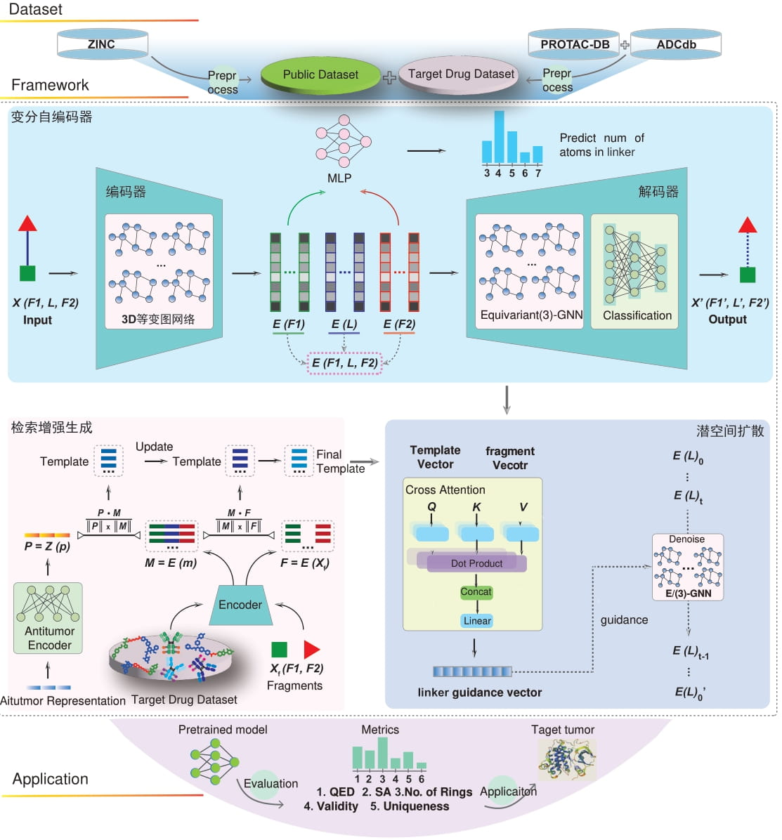
VAE
Encoder
Equivariant(3)-GNN
RAG Enhanced Generation
Latent Diffusion

