Slide 1
CS 383 ALGORITHM
DESIGN AND ANALYSIS
Welcome. Whatever you build next, this is how it runs well.
Tanwistha Saha
Week 1 · August 31

Slide 2
BEFORE WE DIVE IN
Who are we? And, who are you?
WHO ARE WE
WHO ARE YOU
Tanwistha Saha · Instructor
Lewis & Clark students — from all over the map:
Lectures, course design, and office hours (MW 10-11, F by appointment, Olin 230)
Computer Science
Mathematics
Biology
Chemistry
Eden Straitiff · Teaching Assistant
Physics
Arts
Lab sessions, assignment help, and your first stop for questions (M 3-5 PM, W 6-7 PM, F 3-4 @ SQRC)
… other majors not on this list, and also, students who are still deciding on their majors
No matter your major, you already think algorithmically — this course puts a structure to that thought process.
Design & Analysis of Algorithms · Course Introduction · Aug 31
2

Slide 3
LET'S GET STARTED
Welcome to the class!
Hope you have satisfied the perquisites for this class (CS 172) – just bring in your curiosity and a willingness to get stuck on a problem for a while.
CLASS WEBSITE
(please refresh while revisiting): https://github.com/tanwistha/cs383_fall26/blob/main/README.md
TEXT BOOK
Algorithms Illuminated Omnibus Edition. By Tim Roughgarden
LECTURE SLIDES
https://github.com/tanwistha/cs383_fall26/blob/main/schedule.md

Slide 4
WHERE WE'RE HEADED
The roadmap — one semester, six phases
MIDTERM
Foundations
Sorting &
Priority Structures
Trees &
Hashing
Graph
Algorithms
Greedy & Dynamic
Programming
Final
Project
Data structures,
recursion, Big-O
Sorting algorithms,
heaps
BST, Red-Black
Trees, hashing
BFS/DFS, shortest
paths, MST
When greedy fails,
DP takes over
TO BE ANNOUNCED by end of October
THE THROUGH-LINE
Weeks 1–7 build your toolbox. The midterm checks it. Weeks 8–13 add graphs, greedy, and DP — the exact tools your final project needs. Week 14 onwards, you build it.
4 programming assignments (3 before midterm, 1 after midterm)
Design & Analysis of Algorithms · Course Introduction · Aug 31
11

Slide 5
LET'S START HERE
What is an algorithm?
A recipe
GPS directions
Preheat, mix, fold, bake — in that order, or it doesn't work.
Turn-by-turn steps that get you from A to B, recalculated on the fly.
Doing laundry
Alphabetizing a bookshelf
Sort, wash, dry, fold — skip a step and you regret it.
A repeatable process, not a one-time trick.
What do all four of these have in common?
Design & Analysis of Algorithms · Course Introduction · Aug 31
3

Slide 6
MAKING IT PRECISE
An algorithm, defined
A finite, well-defined sequence of steps that transforms an input into an output.
Finite
Well-defined
Input → Output
It has to end. "Repeat forever" isn't an algorithm.
Every step is unambiguous — no guessing what "some" or "a little" means.
It does something to something. No input, no transformation, no algorithm.
Design & Analysis of Algorithms · Course Introduction · Aug 31
4

Slide 7
IT'S BIGGER THAN CS
Algorithms are already running your life
Maps & rideshare apps
Netflix / Spotify
Protein folding
finding the fastest route, in real time
deciding what to recommend next
predicting 3D shape from a sequence
Drug discovery
MRI reconstruction
Financial markets
screening molecules for the best fit
turning raw signals into an image
pricing and trading in microseconds
Design & Analysis of Algorithms · Course Introduction · Aug 31
5

Slide 8
THE OBVIOUS QUESTION
So... why are YOU here?
Whatever field you're in, you'll eventually run into the same three walls:
"This works, but it's too slow."
"This works for small cases, but breaks at scale."
"There are 10 ways to solve this — which one is actually right?"
This course is where you learn to answer those questions — with evidence, not guesswork.
Algorithmic thinking isn't a CS-only skill. It's what separates "I tried something" from "I know this is the right approach, and here's why.”
A good algorithm designer should never stop asking this question: “Can we do better?”
Can we quantify “better”?
Design & Analysis of Algorithms · Course Introduction · Aug 31
6

Slide 9
THE REAL QUESTION
Why are you really here taking this course?
It is required. But, why is it required?
It is fundamental for any computer science practitioner.
It is useful.
It is fun!
CS 369 Artificial Intelligence and Machine Learning
CS 411 Advanced Cybersecurity
CS 469 Neural Networks for AI
CS 488 Software development
And many other cross disciplinary courses!
Design & Analysis of Algorithms · Course Introduction · Aug 31
7

Slide 10
MADE RELEVANT TO YOU
Your major, your algorithm
Computer Science
Mathematics
Physics
Biology / Biochem / Mol Bio
Build the systems everyone else on this list depends on.
Proof-writing meets real, running computation.
Simulate particles, fields, and galaxies — efficiently enough to finish.
Sequence alignment, protein structure prediction.
Chemistry
Data Science
Entrepreneurship / Leadership
Still undecided
Molecular docking and reaction-network optimization.
Every model you'll ever train sits on top of an algorithm and a data structure.
Resource allocation, scheduling, and scaling decisions — with a real framework.
A great place to find out what kind of problem-solving excites you.
Design & Analysis of Algorithms · Course Introduction · Aug 31
8

Slide 11
WHY THIS IS EXCITING
A taste of what you can build in the future..
The routing behind Google Maps
A Nobel Prize... for novel algorithm
Real-time shortest-path algorithms — you’ll learn about it around week 10
Kidney-exchange matching (graph algorithms) has helped thousands of patients find compatible donors — and won a Nobel Prize in Economics.
DNA sequence alignment
Your final project
The dynamic programming you'll learn in week 12 is the same idea behind comparing genetic sequences.
<project details to be disclosed on a specific date> — you will be using your choice of the tools you'll have by then.
Design & Analysis of Algorithms · Course Introduction · Aug 31
9

Slide 12
COURSE OBJECTIVES
What you'll walk away with
1
Read and choose among core data structures instead of defaulting to whatever's familiar.
2
Reason about whether a solution will hold up at scale, before you find out the hard way.
3
Recognize when a problem calls for greedy, dynamic programming, or a graph algorithm — and explain why.
4
Communicate trade-offs clearly — a skill that matters in every field of study in this room, not just CS – and for any profession you will choose in the future.
Design & Analysis of Algorithms · Course Introduction · Aug 31
12

Slide 13
HOW WE'LL ATTACK PROBLEMS THROUGHOUT THE SEMESTER
Five ways to design algorithms (that we will explore)
1
2
3
4
5
Brute Force
Divide & Conquer
Transform
Greedy
Dynamic Programming
EXAMPLES
EXAMPLES
EXAMPLES
EXAMPLES
EXAMPLES
Try every possibility — linear search, or checking all routes between cities.
Split, solve, combine — merge sort, quicksort, binary search.
Reshape the problem first — sort before searching, or model a dataset as a tree.
Take the best step available now — finding shortest path.
Solve each subproblem once and reuse it — Fibonacci sequence.
Same problem, five angles of attack — the real skill is choosing the right one.
Design & Analysis of Algorithms · Course Introduction · Aug 31
10

Slide 14
A PROBLEM YOU ALL KNOW HOW TO SOLVE
Revisiting – how to define one approach is “better” than the other? Integer Multiplication
12
34
x
408
Design & Analysis of Algorithms · Course Introduction · Aug 31
12
Notes:
Slide reference from Stanford lectures https://web.stanford.edu/class/archive/cs/cs161/cs161.1176/

Slide 15
A PROBLEM YOU ALL KNOW HOW TO SOLVE
Integer Multiplication
1234567895931413
4563823520395533
x
Design & Analysis of Algorithms · Course Introduction · Aug 31
13
Notes:
Slide reference Stanford Lectures https://web.stanford.edu/class/archive/cs/cs161/cs161.1176/

Slide 16
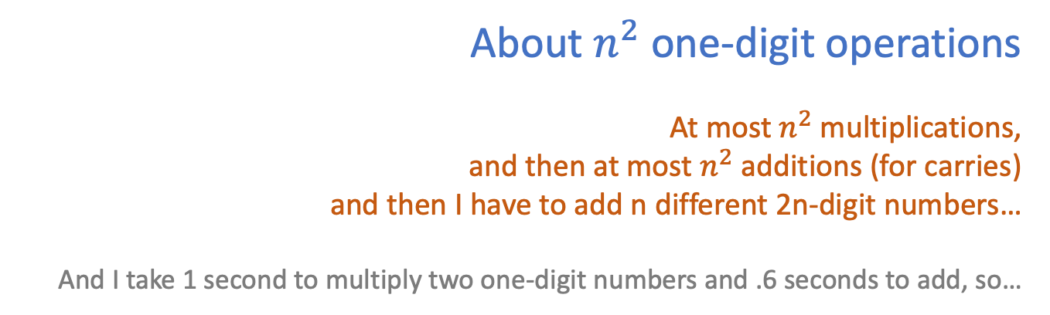
A PROBLEM YOU ALL KNOW HOW TO SOLVE
Integer Multiplication
n
1233925720752752384623764283568364918374523856298
4562323582342395285623467235019130750135350013753
x
Can we do better than n² one-digit operations?
???
How would you solve this problem?
How long would it take you?
About $n^{2}$one-digit operations
At most $n^{2}$multiplications,
and then at most $n^{2}$ additions (for carries)
and then I have to add n different 2n-digit numbers…
And I take 1 second to multiply two one-digit numbers and .6 seconds to add, so…
Design & Analysis of Algorithms · Course Introduction · Aug 31
14
Notes:
Slide reference Stanford Lectures https://web.stanford.edu/class/archive/cs/cs161/cs161.1176/

Slide 17
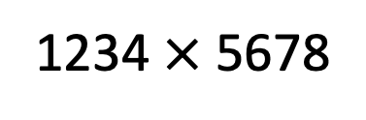
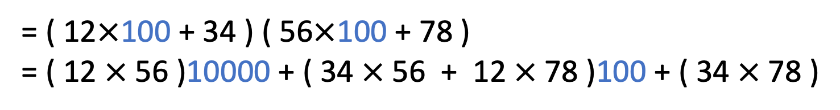
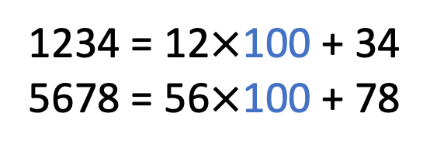
DIVIDE AND CONQUER
Divide and conquer for multiplication
Break up an integer:
1234 = 12$×$100 + 34
5678 = 56$×$100 + 78
1234$×$5678
= ( 12$×$100 + 34 ) ( 56$×$100 + 78 )
= ( 12$×$56 )10000 + ( 34$×$56 + 12$×$78 )100 + ( 34$×$78 )
1
2
3
4
One 4-digit multiply
Four 2-digit multiplies
Design & Analysis of Algorithms · Course Introduction · Aug 31
15
Notes:
Slide reference: https://web.stanford.edu/class/archive/cs/cs161/cs161.1176/
Text book ref: pp. 4 – 7

Slide 18
NEXT LECTURES
Week 1 and 2
SURVEY POSTED (DUE END OF WEEK 1 – SEP 4)
(please refresh while revisiting): https://github.com/tanwistha/cs383_fall26/tree/main
Check email for invitation to Google classroom – CS 383 Fall 2026
Assignment 0 (survey) posted. Due on Sep 4. 5 points - towards Class participation category.
COMING UP
Sep 2
Course Setup/Structure
Sep 4
Data Structures Recap: Arrays, Linked List, Stacks & queues (survey due!)
Sep 9
Recursion foundations · Programming Assignment (PA) 1 released
Questions? This is exactly what the first week is for.

