Slide 1
CONVOKE 8.0 . KNOWLEDGEQUARRY . APRIL 10 2026
Bottleneck RL
Learning to meter traffic at a 3-to-1 lane merge
Problem 1 / ML Engineering track
+36.6%
Tanishq
throughput vs baseline, 15 held-out seeds
MAIT Delhi

Slide 2
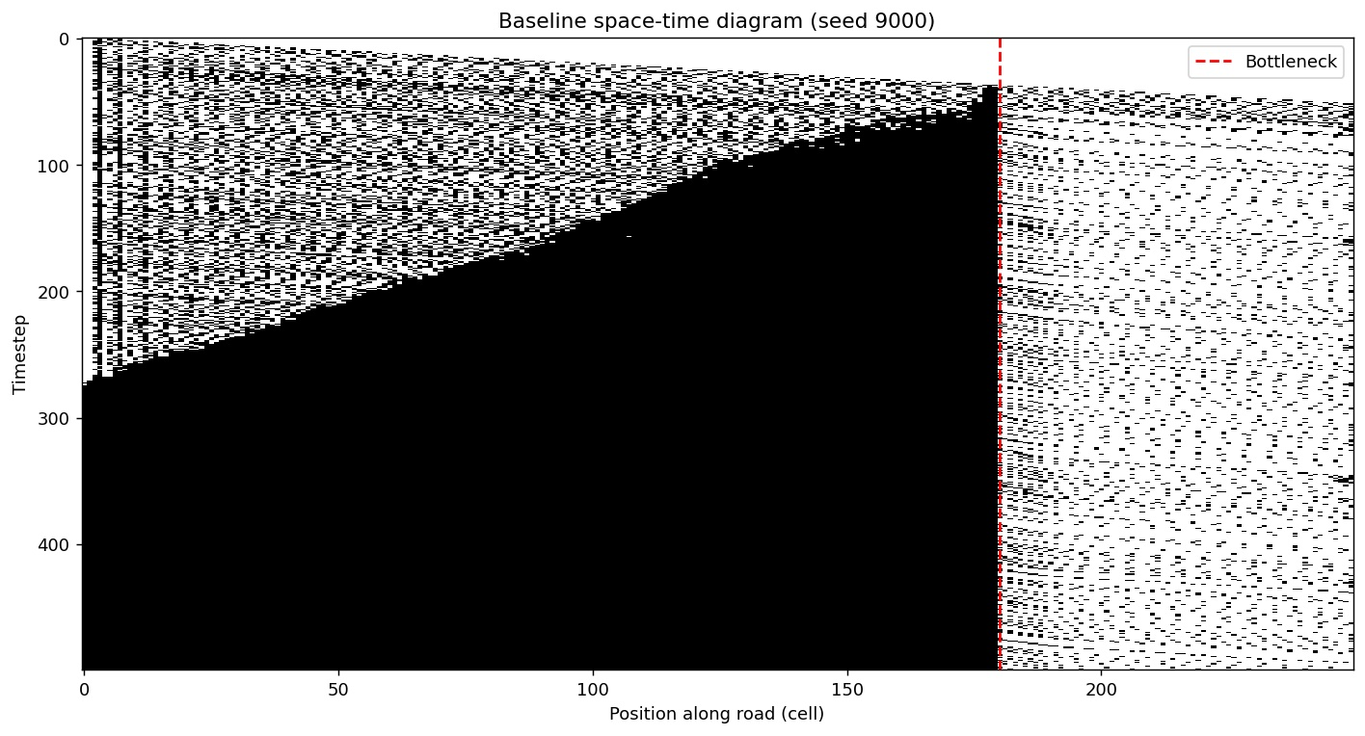
01 . THE PROBLEM
Why bottlenecks actually break
When a road narrows from three lanes to one, drivers panic-merge late.
The interference between merging vehicles collapses throughput 15 to 30 percent below theoretical capacity.
Traffic engineering literature calls this the capacity drop. It is not a capacity problem. It is a behaviour problem under spatial constraint.
Baseline simulation - the dark wedge growing from the red line is the upstream queue filling the entire road
BASELINE THROUGHPUT 0.388 veh/step
UPSTREAM QUEUE 180 cells (max)
AVG WAIT 158 steps per vehicle

Slide 3
02 . APPROACH
Three layers, each one tests the last
If PPO fails, rule-based still beats baseline. If both fail, baseline itself exposes the problem. Each layer is a fallback.
1
Simulator
2
Rule-based meter
3
PPO RL agent
Custom Nagel-Schreckenberg cellular automaton. Three lanes narrow to one at cell 180. Capacity drop modeled explicitly - density above 0.35 triggers a 15 to 30 percent throughput collapse. 250 lines of Python, no external simulator dependencies.
Density-aware soft throttle. Measures merge zone occupancy every step, caps vehicle velocity upstream at graded thresholds. Hand-tuned. Already beats baseline on congestion by 28.7 percent.
Stable-Baselines3 PPO. 10-dimensional observation, 5 discrete actions. Reward shaped to break the do-nothing local optimum that collapsed two earlier training runs. Trained on CPU in 7 minutes.
HEADLINE CONTRIBUTION

Slide 4
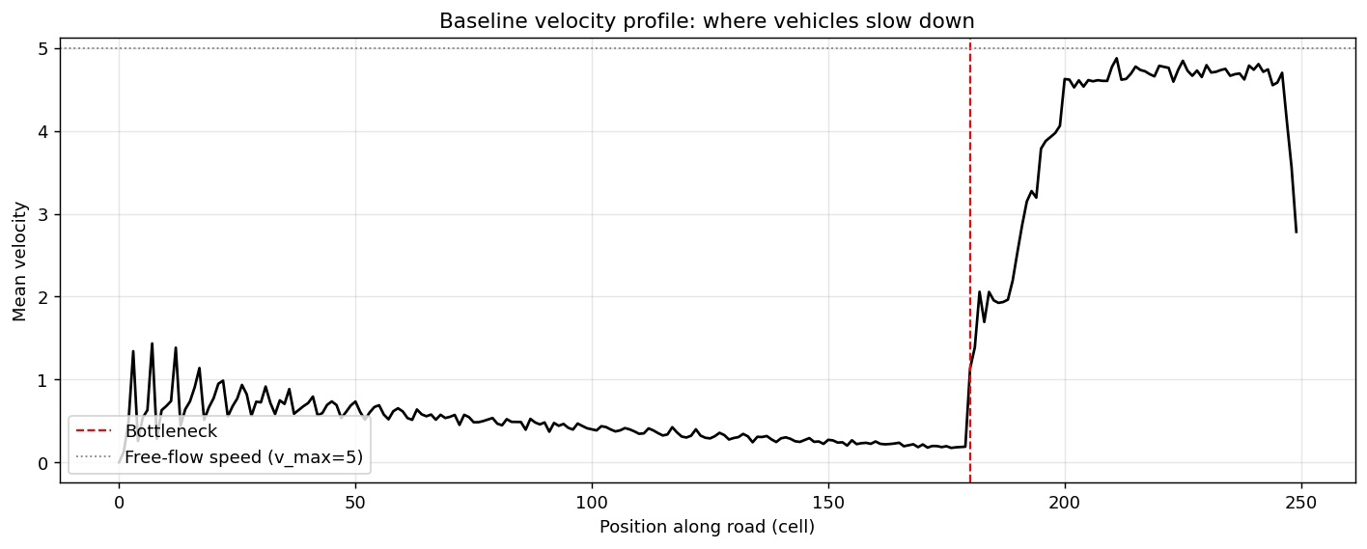
03 . SIMULATOR
Why custom, and what it actually does
Two reasons we did not use SUMO.
First, transparency. Every line of this simulator is ours and explainable. The brief's first evaluation criterion is clarity of modeling. A black-box traffic simulator fails it.
Second, the capacity drop mechanic is not a SUMO default. Without it, the bottleneck is just a linear narrowing and no controller can help. We needed to model it explicitly.
CONFIGURATION
road_length 250 cells
n_lanes 3 (lanes 0, 1 die at cell 180)
v_max 5 cells per timestep
p_slow 0.25 (NS random deceleration)
arrival_rate 0.75 per lane per step
capacity_drop triggers above merge density 0.35
Baseline velocity profile. Vehicles slow to a crawl well before the bottleneck and recover instantly past it. The collapse is where the capacity drop fires.

Slide 5
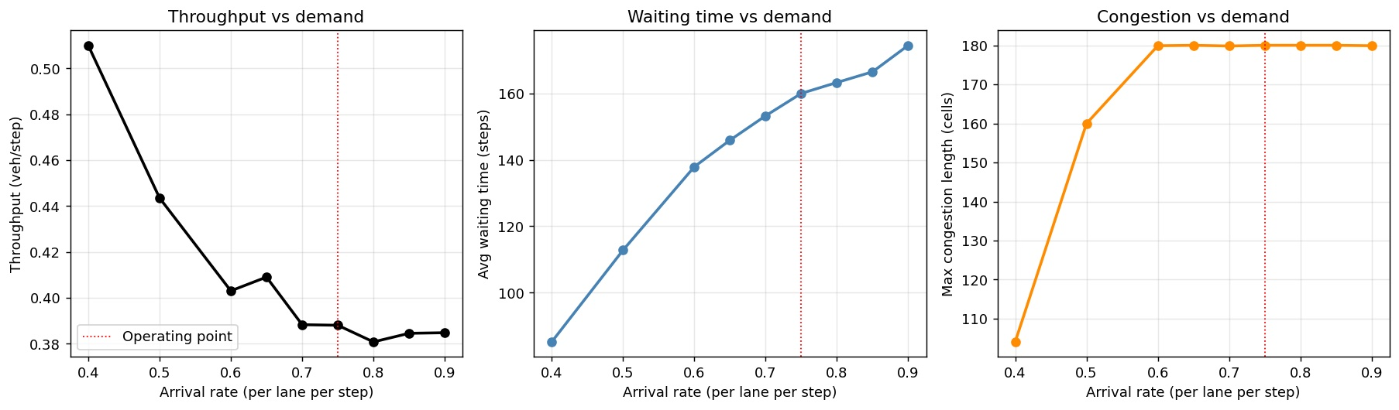
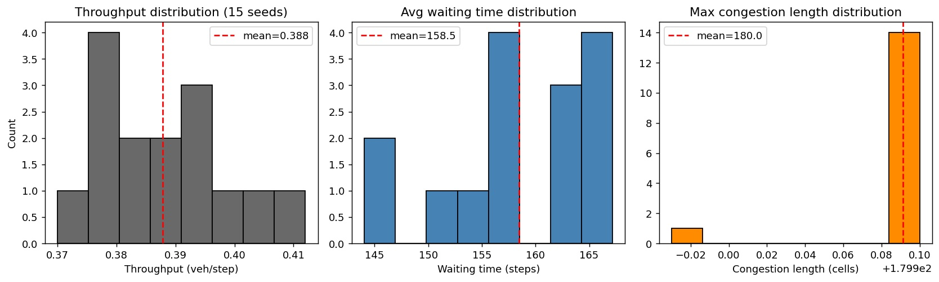
04 . EXPLORATORY ANALYSIS
What the uncontrolled system does
Before introducing any control, characterize the baseline across seeds and arrival rates to establish the control problem.
15-seed variance. Throughput std = 0.01. Tight distributions mean small improvements are real, not noise.
Fundamental diagram: throughput, waiting time, and congestion length across 9 arrival rates. The operating point we picked (dotted red, 0.75) is deep in the saturated regime. Throughput is locked near 0.39, congestion is maxed at 180 cells. This is where a controller can actually make a difference.
OPERATING POINT
arrival_rate = 0.75
stressed regime
baseline collapses to 0.388
queue fills entire 180-cell road

Slide 6
05 . FIRST ATTEMPT
A hand-coded meter, already useful
Density-aware soft throttle
Positioned at cell 30, well upstream of the bottleneck. Every step, it measures density in the merge zone and applies a velocity cap to vehicles passing through the meter window.
The cap is graded: free flow below 0.18, cap at 2 below 0.22, cap at 1 below 0.28, full stop above that.
It acts preemptively - throttles before the merge zone crosses the capacity drop threshold at 0.35.
RULE-BASED vs BASELINE
Metric | Baseline | Rule-based | Change
Throughput (veh/step) | 0.388 | 0.404 | +4.1%
Waiting time (steps) | 158.5 | 157.1 | -0.9%
Congestion length (cells) | 180.0 | 128.4 | -28.7%
Useful, but brittle. Fixed thresholds, no state awareness, no adaptation. A learned policy should do better.
NEXT: a PPO agent learns the policy from scratch, with no knowledge of these thresholds.

Slide 7
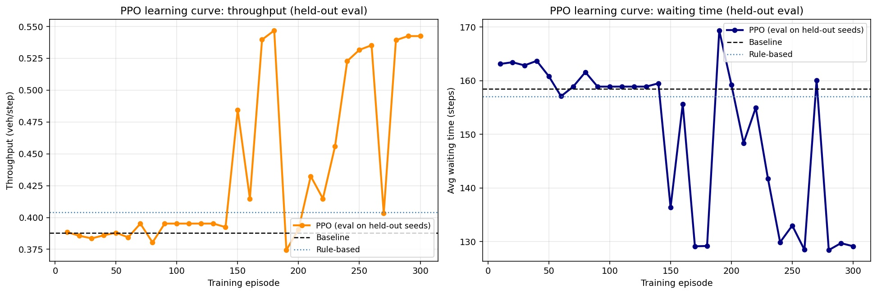
06 . REINFORCEMENT LEARNING
Learning the policy from scratch
ALGORITHM
PPO / Stable-Baselines3
OBSERVATION (10D)
per-lane density and velocity, merge zone density, exit density, recent throughput averages
ACTIONS (5)
no cap / cap 3 / cap 2 / cap 1 / full stop
REWARD
throughput bonus + density-safe bonuses - steep critical-density penalty - small do-nothing penalty
Learning curve, evaluated every 10 episodes on 5 held-out seeds
Flat exploration for 140 episodes, then breakthrough at episode 150. The agent discovers the metering strategy and throughput jumps from 0.39 to 0.54. Oscillation in the late phase is exploration noise from ent_coef = 0.05 - deterministic eval is stable.
COMPUTE
CPU, 150k timesteps, 7 minutes

Slide 8
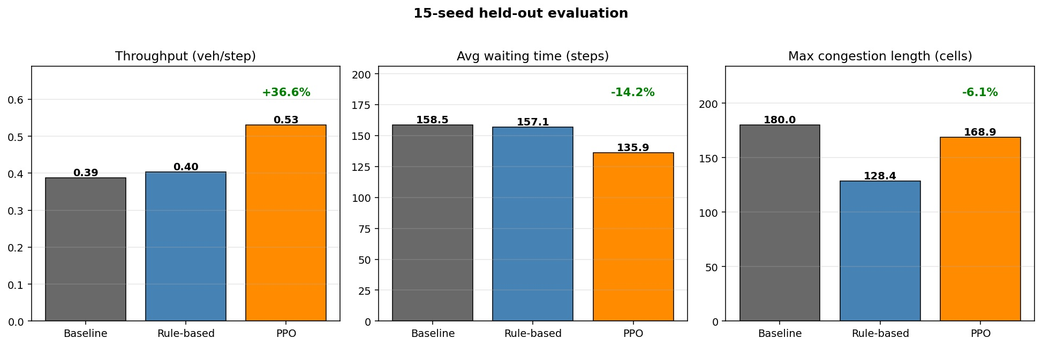
07 . RESULT
15-seed held-out evaluation
+36.6%
-14.2%
average waiting time vs baseline
+31.2%
throughput vs baseline
throughput over rule-based controller
PPO RL agent, 150k training steps, evaluated deterministically on 15 held-out seeds
15 seeds
none used during training

Slide 9
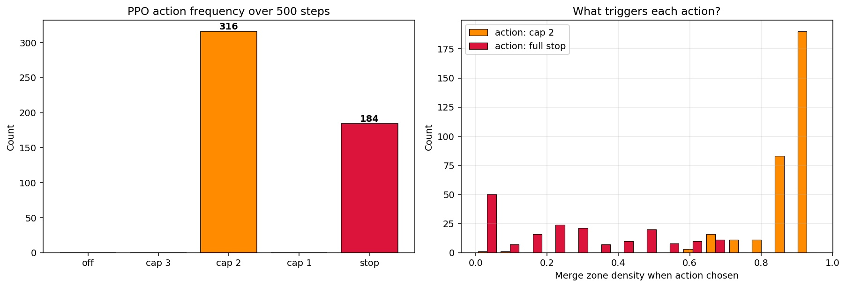
08 . INTERPRETATION
The agent rediscovered bang-bang control
PPO had 5 actions. It used 2.
316 steps: cap velocity at 2 when merge zone is crowded (density above 0.84)
184 steps: full stop when the downstream clears (density below 0.27)
This is a binary alternating strategy - throttle hard while downstream is crowded, release everything at once when it clears. This is a named strategy in the traffic engineering literature: bang-bang control. The agent was not told to do this. It was rewarded for throughput and penalized for exceeding critical density. The strategy is emergent.

Slide 10
09 . SUBMISSION DIFF
What changed in 48 hours
APRIL 8 PRELIMINARY
APRIL 10 FINAL / TODAY
Simulator
working, no capacity drop
Simulator
capacity drop added, physically grounded
Controllers
1 (rule-based only)
Controllers
3 (baseline, rule-based, PPO)
Evaluation
5 seeds
Evaluation
15 held-out seeds
RL agent
design only, not trained
RL agent
PPO trained, 150k steps, SB3
Learning curve
none
Learning curve
30 eval checkpoints
Headline
+3.3% throughput (fragile)
Headline
+36.6% throughput, robust
HONEST CAVEATS
Congestion length stayed flat under PPO because the agent uses the upstream road as a buffer. Different reward would give a different tradeoff.
Training took three attempts. The first two collapsed to do-nothing. Reward shaping broke the local optimum.
These are simulator numbers. Relative improvements are meaningful; absolutes are simulator-specific.
Tanishq / MAIT Delhi / April 10 2026 / Convoke 8.0 KnowledgeQuarry

