Slide 1



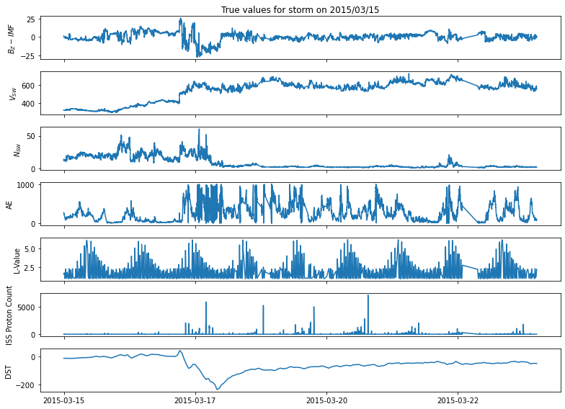
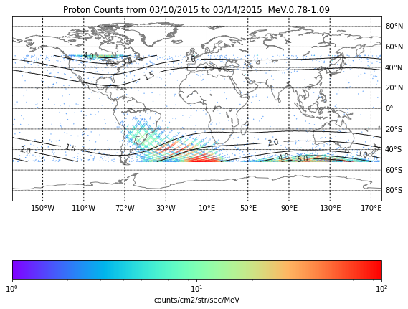
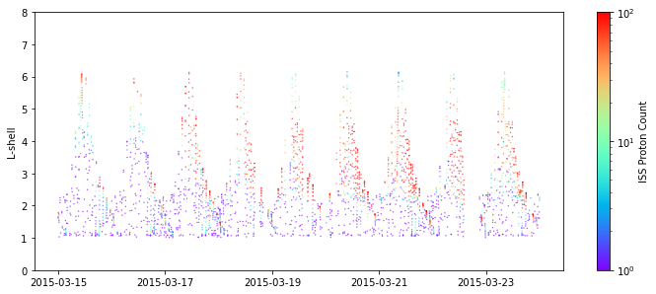
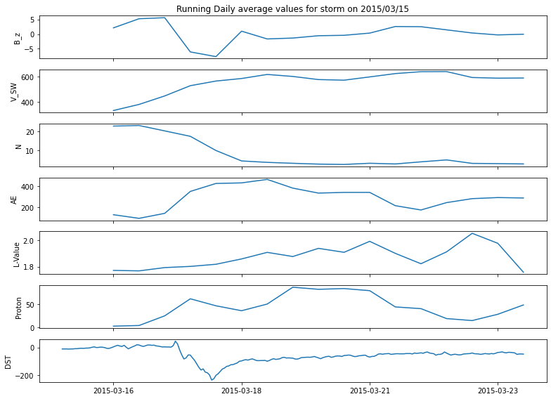
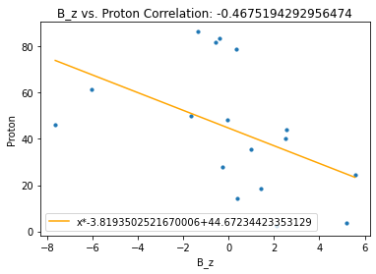
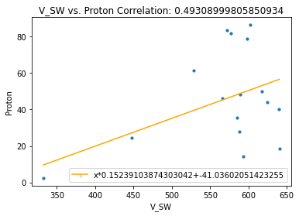
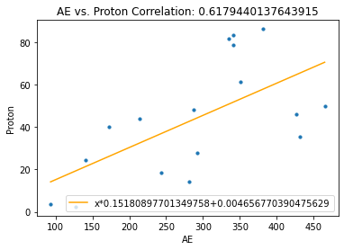
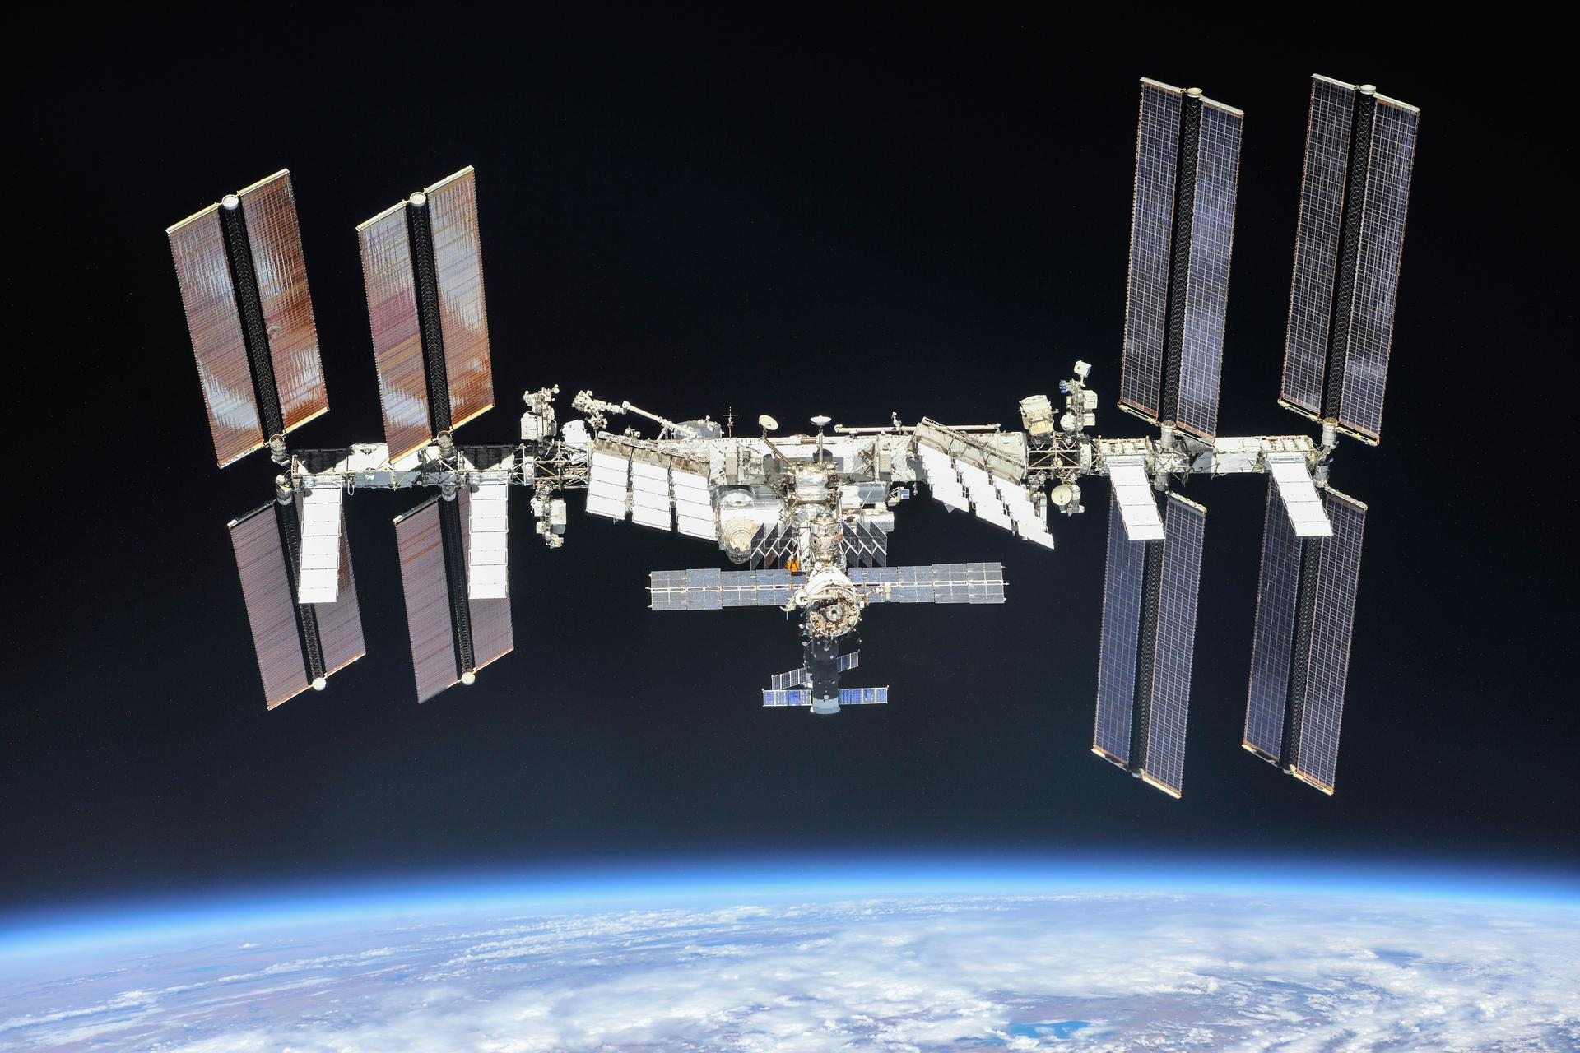
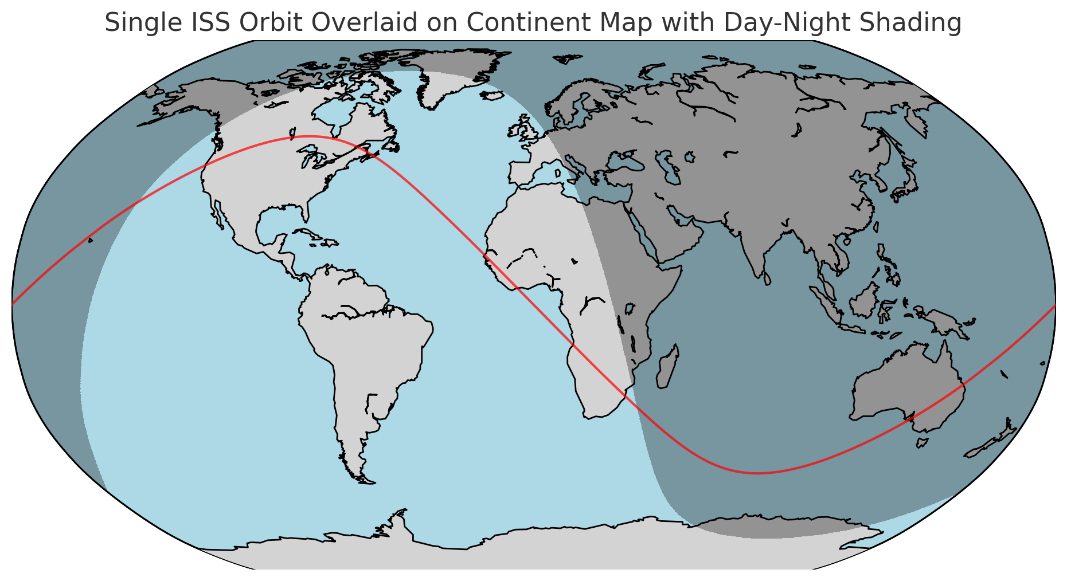
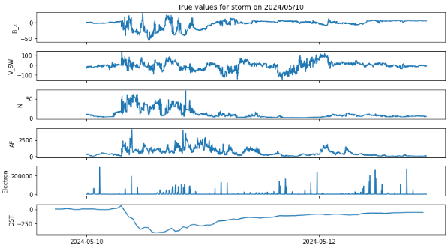
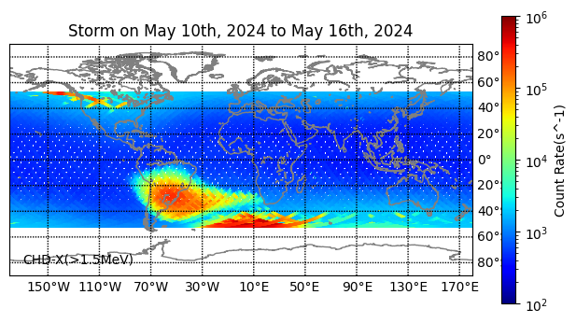
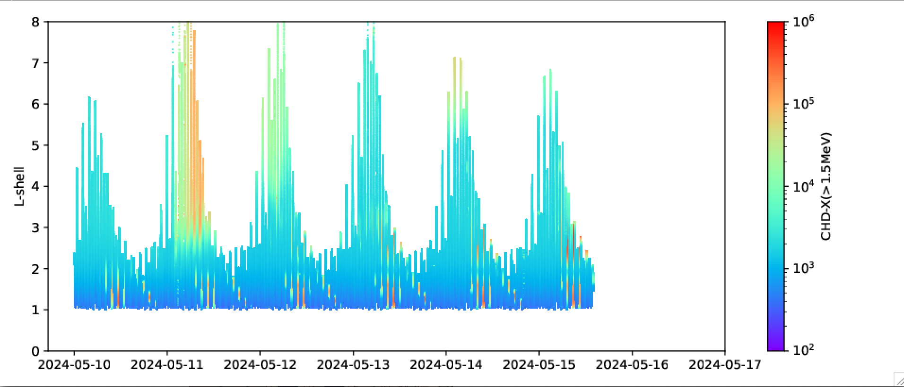
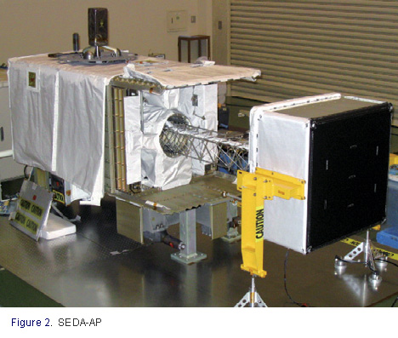
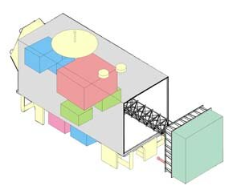
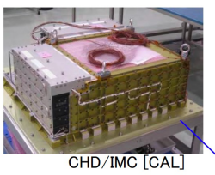
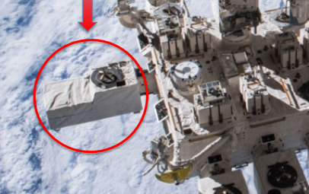
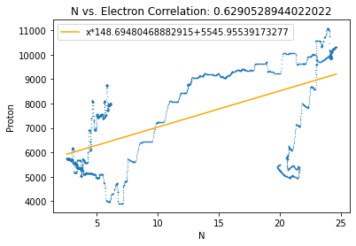
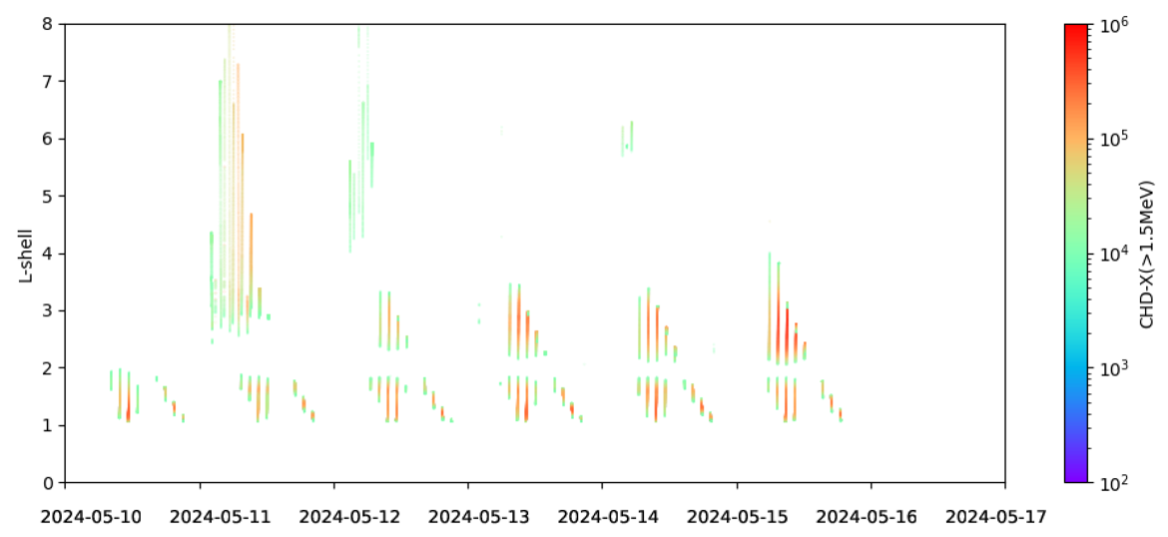
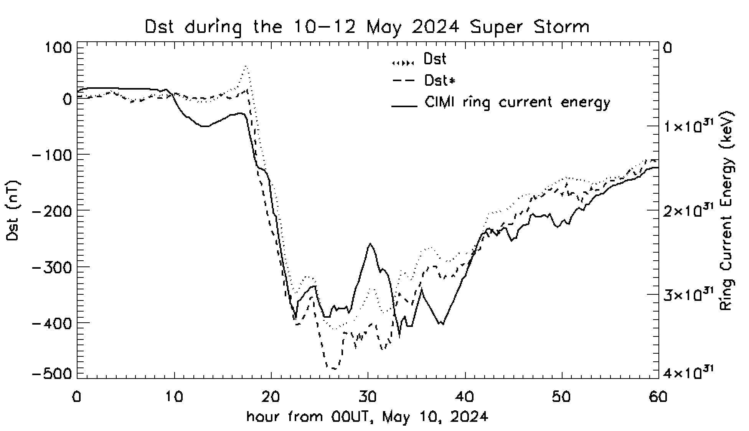
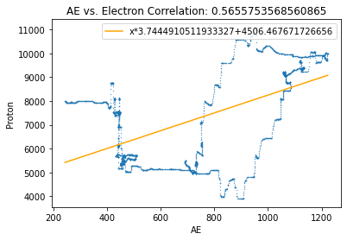
Characterization of Space Radiation Environment of the International Space Station (ISS) during Recent Solar Storms
Tiancheng S. Shao¹, Mei-Ching Fok², Cristian Ferradas³
1. Montgomery Blair High School, Silver spring, MD, USA; 2. NASA Goddard Space Flight Center, USA; 3. Catholic University of America, USA
Introduction
Analysis of SEDA-SDOM Proton Flux Variation During the 2015 Mar. 17 St. Patrick Day Storm Event
Solar storms can lead to an increase in energetic particles, which can penetrate the International Space Station (ISS), potentially causing harm to the astronauts and damaging onboard electronics.
Understanding and characterizing the variations of energetic particles on ISS during solar storms are crucial for developing protective measures and ensuring the safety of astronauts on ISS during such events.
In this study, the spatial and temporal variations of energetic proton and electron fluxes observed on ISS during recent solar storms are analyzed.
Two severe to extreme geomagnetic storms with a Disturbance Storm-Time (Dst) index minimum of less than -200 nT during the 24th and 25th solar cycles are selected: 2015 St. Patrick's Day Storm and the recent 2024 May 10-16 extreme storm (Kp = 9).
The proton flux measurements by the Standard Dose Monitor (SDOM) of the Space Environment Data Acquisition Equipment (SEDA) on the ISS are available until 2018 and are used to study the St. Patrick's Day Storm event.
The energetic electron flux data observed by CALET/CHD for the May 2024 storm were analyzed.
The penetration of energetic particles into the L shell during the two storm events observed at the ISS are characterized.
The correlations between energetic proton and electron flux variations at the ISS and upstream solar wind drivers and geomagnetic indices are studied.
For the recent May 10-16 storm event, the growth of the ring current, monitored by the Dst index, was compared with simulated Dst from ring current model simulations to understand the physical processes during the sudden commencement, main, and recovery phases of the storm.
Characterizing energetic particle variations on the ISS aids in mission planning, risk mitigation, and the implementation of protective measures.
Solar Wind, AE, Dst and Proton Flux During the Storm
Accumulated Proton Flux Map with L Shel during the St. Patrick Storm
Time Variation of Proton Flux vs. L Shell
IMF Bz
Enhanced Proton Flux during Storm
Vsw
From WIND Satellite
Nsw
Nsw
L-Shell
AE
Enhanced Proton Flux at ~ L = 3
L-Shell
P Flux
Diffused-in proton flux to L < 2
Dst
St. Patrick Day storm event is one of the strongest G4 sever storm in Solar Cycle #24
Maximum magnetic field (IMF Bz): -30 nT (-20 nT sustained); Solar winr speed Vsw > 600 km/s
Duration: ~18 hours (G3/G4 conditions sustained for 12 hours)
Max. Kp = 8+; Min. Dst = -237 nT
Reconstruction of proton flux variation in the L Shell-Time map shows
Enhanced energetic proton flux over L = 2 to 6 on Mar. 17
Increased proton flux at L < 2 after Mar. 20, possibly due to the diffusion of proton across L shell
Half Day-Averaged Solar Wind, AE and Proton Flux
Correlation between Proton Flux and SW Bz/V and AE
IMF Bz
IMF Bz vs. ISS Proton
Vsw vs. ISS Proton
AE vs. ISS Proton
Vsw
Nsw
Nsw
ISS and Onboard Particle Instruments
AE
Correlation analysis reveals that proton flux enhancement is positively correlated with solar wind velocity and negatively correlated with the Bz component of the interplanetary magnetic field (IMF).
Increases in energetic proton flux during geomagnetic storms are driven by high-speed solar wind and southward IMF which facilitates day side and tail side magnetic reconnection.
The strong correlation between proton flux enhancement and the auroral electrojet (AE) index growth during geomagnetic storms suggests that both phenomena are influenced by elevated electromagnetic field levels in different regions of Earth’s magnetosphere, resulting from the impact of a coronal mass ejection (CME) on the magnetosphere.
International Space Station (ISS)
Example Orbit of ISS
L-Shell
P Flux.
Dst
Analysis of ISS CALET/CHD Electron (> 1.5 MeV) Flux Variation during the May 10-12, 2024 Extreme Strom Event
Solar Wind, AE, Dst and CHD Electron Flux During the Storm
Accumulated CHD (> 1.5 MeV) Electron Flux Map from May 10 to 16, 2024
CHD (> 1.5 MeV) Electron Flux vs. L Shell
IMF Bz
Inward Penetration of Energetic Electron
All Data
Vsw
From WIND Satellite
Penetration of Energetic Electron to Low L
https://www.nasa.gov/international-space-station/
Nsw
SAA
Signature of trapped electron enhancement
The International Space Station, with its altitude of ~400 km, passes through both the inner and outer radiation belt.
The ISS allows scientists and researchers to conduct long-term experiments in microgravity, studying areas such as biology, physics, astronomy, and materials science.
Understanding and characterizing the variations of energetic particles that can penetrate the ISS during solar storms is crucial for developing protective measures to ensure the safety of astronauts and prevent damage to onboard electronics.
AE
L-Shell
e flux
Space Environment Data Acquisition (SEDA) System
Calorimetric Electron Telescope (CALET) on ISS
Dst
Standard Dose Monitor (SDOM)
Charge Detector (CHD) Imaging Calorimeter (IMC)
Extreme storm event; Max. Kp = 9; Min. Dst = -412.
L Shell derived from Ring Current Simulation
Correlation between e Flux and SW N and AE
Time Variation of CHD (> 1.5 MeV) Electron Flux vs. L Shell
CHD Electron flux on L-Time map reveals
Initial inward penetration energetic electrons from L = 8 to L =3 on May 11.
the formation new electron belt near L = 2-3 after the May 10-12 storm
The energetic electron flux increase has relatively high correction with solar wind velocity and AE index.
Ring current model simulation reproduces Dst sudden commencement, main, and recovery phases of the storm well.
Characterizing variations in energetic particles on the ISS supports mission planning and risk mitigation.
Future work will focus on analyzing the CHD electron flux variation over longer period after May and studying more recent October storm event to monitor the new electron belt evolution.
Nsw vs. ISS electron
Initial Penetration of Energetic Electron to Low L
After Filtering
Modeled vs. Observed Dst During the Storm
Electron Flux
Possible New Trapped Electron Belt Formation (at L 2-3)
Obara, Takahiro, et al. "Space environment data acquisition with the kibo exposed facility on the international space station (ISS)." Data Science Journal 8 (2010): IGY76-IGY84.
https://ndico.in2p3.fr/event/28466/contributions/120685/attachments/76870/111608/ICPT-Kyoto_Torii-final.pdf
L-Shell
Both SEDA SDOM and CALET CHD instruments onboard ISS were intended to support space weather monitoring.
The CHD data was recorded every second, whereas the SDOM data was recorded either every 10, 20, 30 or 40 seconds.
From 2009 to 2018, the JAXA SEDA/SDOM instrument observed and recorded proton and electron flux data. The SEDA instrument was deorbited in 2018.
The proton flux measurements by the SEDA /SDOM on the ISS are used to study the 2015 St. Patrick's Day Storm event.
The recent 2024 May 10th storm was analyzed using the CALET CHD data. Due to the limited availability of proton flux data, only electron data was analyzed for the this storm event.
The particle instruments on the ISS, with altitudes ranging between 370 and 450 km, is suitable for studying the penetration of energetic particles into the lower L shell during the storms.
AE vs. ISS electron
Slot Region
Electron Flux
Inner Belt
Acknowledgements: T. S. Shao’s work was supported by 2024 National Space Club scholarship. T. S. Shao wants to thank for the summer internship opportunity at NASA Goddard Space Flight Center.

