Slide 1
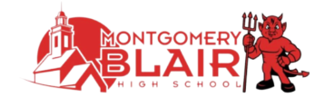

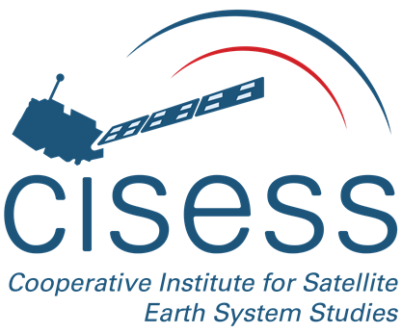
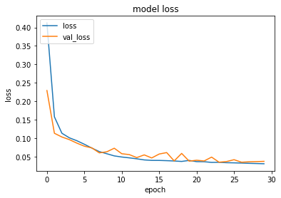
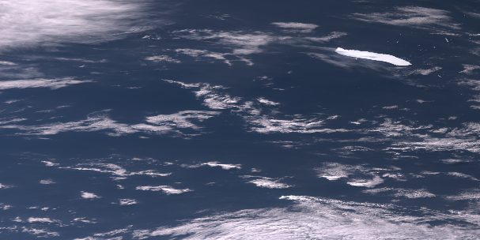
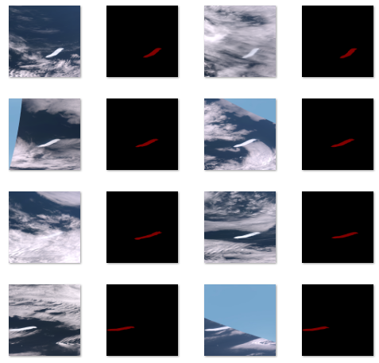
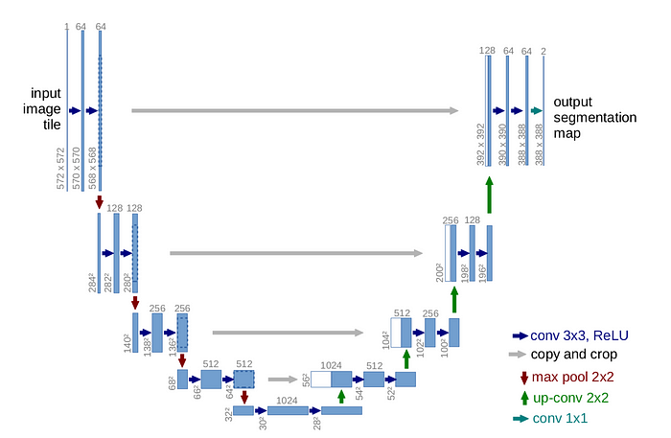
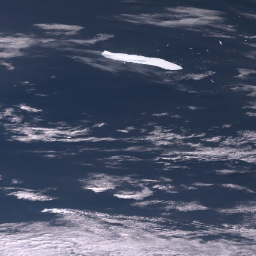
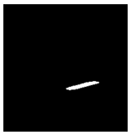
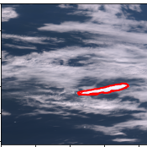
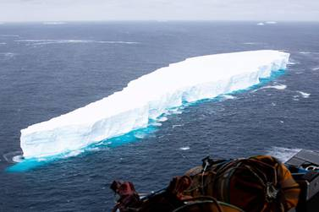
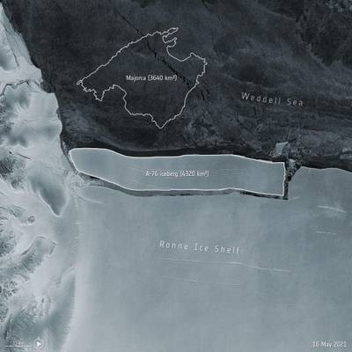
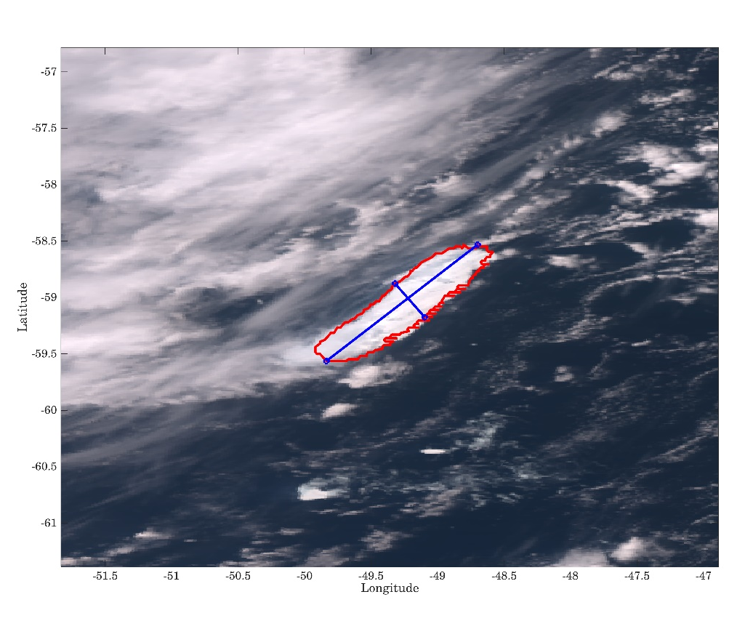
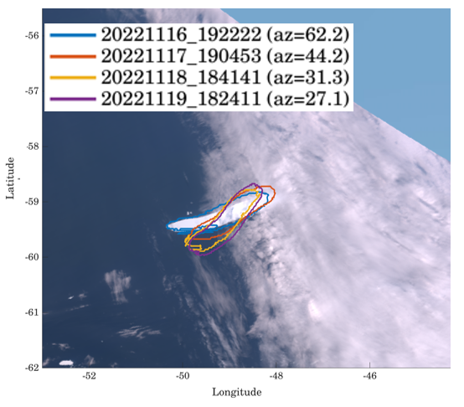
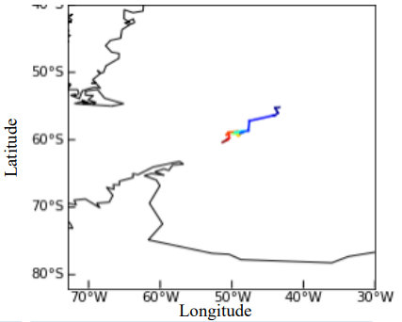
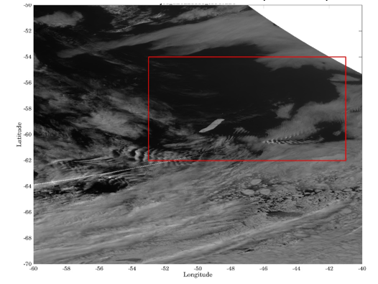
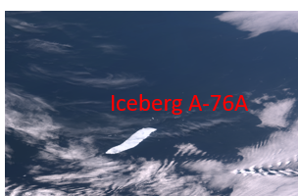
Detecting and Tracking Iceberg A-76A from VIIRS Observations with U-Net Deep Learning Model
Tiancheng S. Shao¹, Bin Zhang², Sirish Uprety², and Jun Dong²
1. Montgomery Blair High School, Silver spring, MD, USA
2.Cooperative Institute for Satellite Earth System Studies (CISESS), Earth System Science Interdisciplinary Center, University of Maryland, College Park, USA
Introduction
U-Net Deep Learning Model Setup for Iceberg Detection
Tracking iceberg movement aids in assessing potential threats to maritime safety, societal infrastructure and ecosystems, contributing to climate and environmental monitoring efforts.
In this study, A U-Net based deep learning model was developed to process images from Suomi-NPP (SNPP) and NOAA-20 Visible Infrared Imaging Radiometer Suite (VIIRS) observations for detecting and tracking Iceberg A-76A.
The detected boundaries of the Iceberg A-76A from U-Net were further analyzed to estimate its size, location, and track the drift of the iceberg from October, 2022 to April, 2023.
Furthermore, the multiple daily observations of Iceberg A-76A from both VIIRS sensors provides the opportunity to quantitatively monitor the daily rotation and drift of the iceberg in a short time scale.
Utilizing the U-Net deep learning architecture in conjunction with VIIRS observations for accurate iceberg detection and tracking provides an invaluable tool in understanding and mitigating the impacts of these icebergs on navigation, climate, and ecosystems.
Tracking the iceberg movements with observations from constellation satellites can also help understanding the complex structure of the Antarctic Circumpolar Current with multiple frontal jets in different time scales..
SNPP/NOAA-20 VIIRS Image (2048x1024) 2022-10 to 2023-04
Label selected training images using Labelme
Loss Curve
U-Net image segmentation
Crop to 1024x1024
Prediction and Extraction of Iceberg boundary for further analysis
Iceberg A-76A
Ronneberger et al. 2015
A subset of the VIIRS imagery dataset was extracted for iceberg boundary tagging to form the training and testing datasets.
U-Net deep learning architecture is a deep convolutional neural network (CNN) and has a unique design consisting of a contracting path that captures context and a symmetric expanding path that enables precise localization. Able to localize and distinguish borders by doing classification on every pixel.
Once trained, the U-Net model processes unlabeled VIIRS images and generates segmentation maps of the icebergs, enabling the identification of the boundaries of icebergs.
Several challenges
Trade-off between image size and processing time; Model still had trouble differentiating between clouds and the iceberg; Model got progressively worse at differentiating in later months
European Space Agency
Source: https://www.thenationalnews.com/world/world-s-largest-iceberg-breaks-off-from-antarctica-ice-shelf-1.1226359
In May 2021, Iceberg A-76, the largest iceberg at the time, broke from the Ronne Ice Shelf in Antarctica. Within a month, it fractured into three pieces, with the largest fragment being named as A-76A.
Over the course of its journey, A-76A traversed nearly 2000 kilometers. It was eventually dragged by coastal currents along the western Weddell sea, ending up in the Drake Passage/Scotia Sea by October 2022.
In the warmer waters of Antarctic Circumpolar Current, during March, 2023, Iceberg A-76A broke apart into multiple pieces near South Georgia Island.
Applications of U-Net Iceberg Detection Model for
Iceberg A76A Size Estimation
Iceberg A76A Rotation Estimation
Iceberg A76A Centroid Drift Tracking
SNPP/NOAA-20 VIIRS M3, M4, M5 Data
NOAA-20 VIIRS M3 (488 nm)
VIIRS M5,4,3 (RGB True Color)
Estimated Iceberg A76 Length: ~115 km; Width: ~35 km on Nov. 18, 202
Iceberg A76 can rotate 35.1 degree over ~four days
Iceberg A76 traveled from 51.3 west, 60.4 south to 43.4 west, 55.2 south, a total distance of 724.2048 kilometers, from October 3rd, 2022 to April 24th, 2023
The VIIRS instruments onboard SNPP and NOAA-20 missions are designed to provide moderate-resolution, radiometrically accurate global images in 22 spectral bands ranging from 0.41 to 12.5 μm.
SNPP and NOAA-20 VIIRS observations in three moderate-resolution visible bands (M3: 0.488 μm; M4 0.555 μm; M5: 0.672 μm) are resampled onto uniformly spaced pixels to assemble RGB true color images (See example right image above).
VIIRS data analyzed in this study span from October, 2022 to April, 2023
Future improvements: Provide more varied training images; the present ones were mostly clear sky; Increase resolution.
Acknowledgements: This project is supported by 2023 CISESS summer internship program at University of Maryland, College Park.
References:
NASA Earth Observatory, 10-31-2022, "Iceberg A-76A in the Drake Passage," https://earthobservatory.nasa.gov/images/150559/iceberg-a-76a-in -the-drake-passage
Ronneberger, O., Fischer, P., Brox, T. (2015). U-Net: Convolutional Networks for Biomedical Image Segmentation. In: Navab, N., Hornegger, J., Wells, W., Frangi, A. (eds) Medical Image Computing and Computer-Assisted Intervention – MICCAI 2015. MICCAI 2015. Lecture Notes in Computer Science(), vol 9351. Springer, Cham. https://doi.org/10.1007/978-3-319-24574-4_2

