Slide 1
INTERNAL REVIEW · IMD MAPPING
Impervious surface density from Sentinel-2
composites and AlphaEarth embeddings
Milan · Hanoi · Ho Chi Minh City · 2018 · 10 m
Companion to the AlphaEarth study by Matej Žgela
Xiao Tan , Keerthana Kirubakaran · Politecnico di Milano
Notes:
The through-line for the whole session: most of the same-source advantage was
agreement with CLMS rather than accuracy. Same-source validation is the right
instrument for model selection and the wrong one for claiming accuracy.
This extends Žgela's AlphaEarth study, which is assumed read. Three changes:
Sentinel-2 composites as an alternative predictor set, two Vietnamese cities so
transfer can be tested, and a second validation against plots no model saw.

Slide 2
OUTLINE
Where this goes
1
Design and data
What the study adds, what it borrows, and the two constraints that shape every result after
2
Method
The split, the cross-validation and the metrics the results lean on
3
Milan · same-source validation
The wide margin against CLMS, and the mechanism behind it
4
Vietnam · transfer
Zero-shot fails; local retraining repairs it, but not everywhere
5
Independent validation
Change the reference and most of that margin turns out to be agreement
6
Why transfer fails
Level matching, and the low tail that no level correction could repair
7
Conclusions and limitations
What the study supports, and the five constraints that bound it

Slide 3
SECTION 1 OF 7
Design and data
What the study adds, what it borrows, and the two constraints that shape every result after
1. Design and data · 2. Method · 3. Milan · same-source validation · 4. Vietnam · transfer · 5. Independent validation · 6. Why transfer fails · 7. Conclusions and limitations

Slide 4
SCOPE
Three additions to an established study, on a baseline verified to reproduce
The AlphaEarth method and the shared Milan sample set are Žgela's and are used as supplied.
Added by this project
Taken from Žgela
Verified, not claimed
Explicit Sentinel-2 composites as an alternative predictor set.
Two Vietnamese cities, turning a single-city study into a test of whether a model transfers.
A second validation against photo-interpreted plots no model saw.
The 3 500-point stratified sample, the 1 km spatial blocking and the 250 m buffer.
The treatment of the 64-dimensional embedding, used whole.
Three results reproduced here are labelled as his where they appear.
The embeddings pipeline was independently re-run and reproduces his published holdout figures exactly.
RF 14.123 / 10.675 / 0.837 / +0.624 against his 14.12 / 10.68 / 0.837 / +0.62.
The reproduction is a check that the shared baseline has not drifted, not a new result.
Notes:
Why the reproduction is reported at all: every comparison in the Milan and
discussion sections measures a new predictor set against that baseline, so a
baseline that had drifted would move those comparisons without announcing
itself. Both estimators reproduce: SVR gives 14.756 / 11.400 / 0.822 / +0.274
against his 14.76 / 11.40 / 0.822 / +0.27.
On using the embeddings whole: Žgela tested every band against the IMD groups
by Kruskal-Wallis and found 60 of 64 differ significantly across classes, and a
separate feature-selection experiment found the full set to outperform any
reduced subset. So the obvious question — would a smaller subset do as well —
has already been answered in the negative on this same data.
The three reproduced results are the CV-versus-holdout reversal, the per-class
pattern of local retraining, and the qualitative observation behind the bias
recovery.

Slide 5
METHOD · THE HINGE
Every map is scored twice, against two references that are never merged
This distinction is the methodological hinge of the study, and everything that follows depends on keeping the two apart.
Same-source validation
Independent validation
Scores each map against the product it was trained on: CLMS in Milan, GHS-BUILT-S in Hanoi and HCMC.
Runs on the spatial holdout — 1 014 points in Milan, 895 in Hanoi, 887 in HCMC.
Measures agreement with the training target. It cannot distinguish a good map from one that merely resembles its labels.
Scores every map against 450 photo-interpreted plots per city, 1 350 in total, on 2018 imagery.
No model saw them at any stage.
Measures accuracy against an independent reference, at the cost of a smaller and stratified sample.
Bias is observed minus predicted: positive means the map under-predicts. Identical in both validations.
Notes:
Both are necessary and neither substitutes for the other. Same-source is
available for every candidate model, uses the full spatial holdout, and is the
natural instrument for choosing among models. What it cannot do is separate a
good map from one that has learned to resemble its labels: a model scored
against the product it was fitted to is rewarded for reproducing that product,
including wherever the product is wrong.
That is not hypothetical here — the independent validation finds both training
products score no better than the models fitted to them.
The two are never merged and their numbers are never compared directly. They
are scored against different references, on different samples, at different
sizes, so a difference between a same-source number and an independent one
would measure the change of reference rather than anything about a map. The one
place they are set side by side is the compression slide, which has that
relationship as its subject.
On the sign convention: the two validations produce biases of opposite sign and
both are correct. In Vietnam the models read higher than GHS-BUILT-S, giving
negative biases; against photo-interpretation GHS-BUILT-S reads lower than the
reference, giving positive ones. Different comparisons — do not read the signs
across them.

Slide 6
DATA · TARGETS
The two training targets do not measure the same quantity
Both are 10 m and both report a percentage per pixel, so they enter the modelling identically. What they measure differs, and the difference is not noise.
CLMS — Milan
GHS-BUILT-S — Hanoi, HCMC
Why it was still the right choice
Imperviousness density for 2018. Measures sealed surface: the fraction of a pixel water cannot pass through.
Includes roads, pavements, car parks and rooftops alike.
Built-up surface for 2018. A narrower quantity: buildings and a limited set of other roofed infrastructure.
Does not include roads. Žgela calls this an inherent limitation of the chosen reference.
No other suitable 2018 reference product existed for the two Vietnamese cities.
Matching the label year to the imagery year was the binding constraint.
This returns later as a number: GHS-BUILT-S under-marks the interpreted reference by close to 20 pp in both cities.
Notes:
Flag this early. A definitional mismatch met without this slide reads as a
measurement error, and the +19.68 / +19.80 pp result later is exactly that
mismatch appearing as a number.
Žgela states the road exclusion twice in his report and it is taken from him
rather than asserted here: the product accounts only for built-up surfaces,
namely buildings and a limited set of other roofed infrastructure.
On the choice being deliberate rather than by default: a target with a known
definitional gap was preferred to a target from the wrong year, or to no
Vietnamese experiment at all.

Slide 7
DATA · THE INDEPENDENT REFERENCE
How the reference was built, and what may be claimed from it
450 plots per city, 1 350 in total, produced by Keerthana Kirubakaran in Google Earth Pro on 2018 imagery.
Plot geometry
The three coding rules
The metrics
A plot is a 10 m unit area — exactly one Sentinel-2 pixel and one pixel of every map under test.
Each is subdivided into nine sub-cells, each interpreted individually. Plot IMD is the percentage of sub-cells that are impervious.
Sub-cells are collapsed to one value per plot before anything is scored, so every metric runs on 450 observations per city.
strict — the primary rule: parking, pavement, road, roof, railroad, airport, pool.
B — adds permeable pavement, matching the sealed-surface definition CLMS works to.
C — adds unpaved dirt road and heavily compacted bare soil.
Paved roads are impervious under all three, so no choice of rule removes the GHS-BUILT-S mismatch.
RMSE and MAE in IMD percentage points. MAE weights every plot by how wrong it is; RMSE squares first and is driven by the largest errors, so the two can disagree about which map is better.
RMSE_corr removes a binomial estimate of the reference's own noise. It is an upper bound on map error, never a point estimate.
Notes:
On RMSE_corr, which is the one metric that invites misuse. A plot's IMD is a
proportion estimated from nine sub-cells, so the reference carries sampling
error of its own. The correction subtracts a binomial estimate of that error
and is floored at zero.
The independence assumption behind it does not hold: nine sub-cells within a
single 10 m pixel share land cover and are spatially correlated, so the binomial
calculation understates the true reference noise and the correction removes less
error than it should. The true map error is therefore at or below RMSE_corr. The
correct use is to say a map's error is at most some value, never that it equals
it. Saying the four Milan maps lie between 21.559 and 22.917 corrected is a
statement about bounds; claiming any of them achieves 21.559 is not supported.
R-squared: the proportion of reference variance the map accounts for. At or
below zero it is no more informative than predicting the mean everywhere — which
is what three of the four zero-shot combinations do.
One code, Rock/material, is ambiguous between sealed and unsealed and is dropped
wherever it occurs, with the denominator renormalised so a plot with one dropped
sub-cell scores out of eight. It occurs once, in Milan.
The rare codes bound how much the rule choice can matter: in Milan permeable
pavement occurs in 23 sub-cells across 6 plots, dirt road in 112 across 18. In
both Vietnamese cities permeable pavement does not occur at all, so rule B is
identical to strict there by construction.

Slide 8
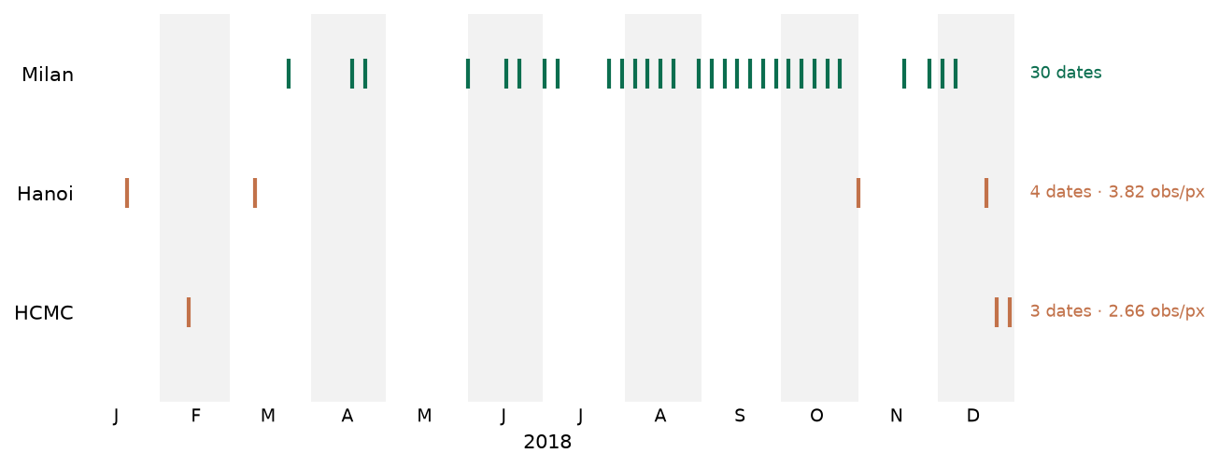
DATA · SENTINEL-2
Milan retains 30 usable dates; Hanoi retains 4 and HCMC 3
Both Vietnamese cities are screened one rung looser than Milan and still yield almost nothing.
Only the median composite is computable in Vietnam — an archive limit, not a modelling preference.
Notes:
Screening is per acquisition date on three criteria over the city's area of
interest: cloud cover, share of valid pixels, and at least 95 % scene coverage.
Milan passes at the strict setting, cloud below 20 % and valid above 90 %.
Neither Vietnamese city yields a workable set there, so both are screened one
rung looser at cloud below 35 % and valid above 80 %.
Three composite methods are defined: median (10 bands), stack (four dates one
per season, 40 bands), percentile (p10/p25/p50/p75/p90, 50 bands).
Why only median survives in Vietnam. A percentile needs enough observations on
either side of it; the guard scales with the number requested, so five
percentiles require at least 17 dates. This was tested rather than assumed: the
scene search evaluates a ceiling case with every threshold disabled and every
candidate accepted regardless of cloud. Even then HCMC reaches 16 against the 17
required — it fails by one. Hanoi reaches 10 and fails by seven.
The narrowness of HCMC's margin does not weaken the conclusion. The ceiling set
is not a usable alternative that was passed over: it includes every acquisition
rejected for cloud, which is how 16 becomes a screened count of 3. A percentile
composite computed from it would be a percentile of largely cloudy observations.
Stack fails for the same reason at a smaller count: it needs four dates one per
season and HCMC's three fall in two months.
Two properties that matter later. Milan's composite is near-annual rather than
annual — January, February and May are absent from all 30 dates. And HCMC's is
thinner than a count of three suggests: its dates are 12 February, 24 December
and 29 December, and the two December acquisitions are five days apart, so it is
effectively one February look plus one late-December look.
Do not read median's use in Vietnam as a finding that median is the better
choice — it is the weakest of the three in Milan, where all three could be
computed.

Slide 9
SECTION 2 OF 7
Method
The split, the cross-validation and the metrics the results lean on
1. Design and data · 2. Method · 3. Milan · same-source validation · 4. Vietnam · transfer · 5. Independent validation · 6. Why transfer fails · 7. Conclusions and limitations

Slide 10
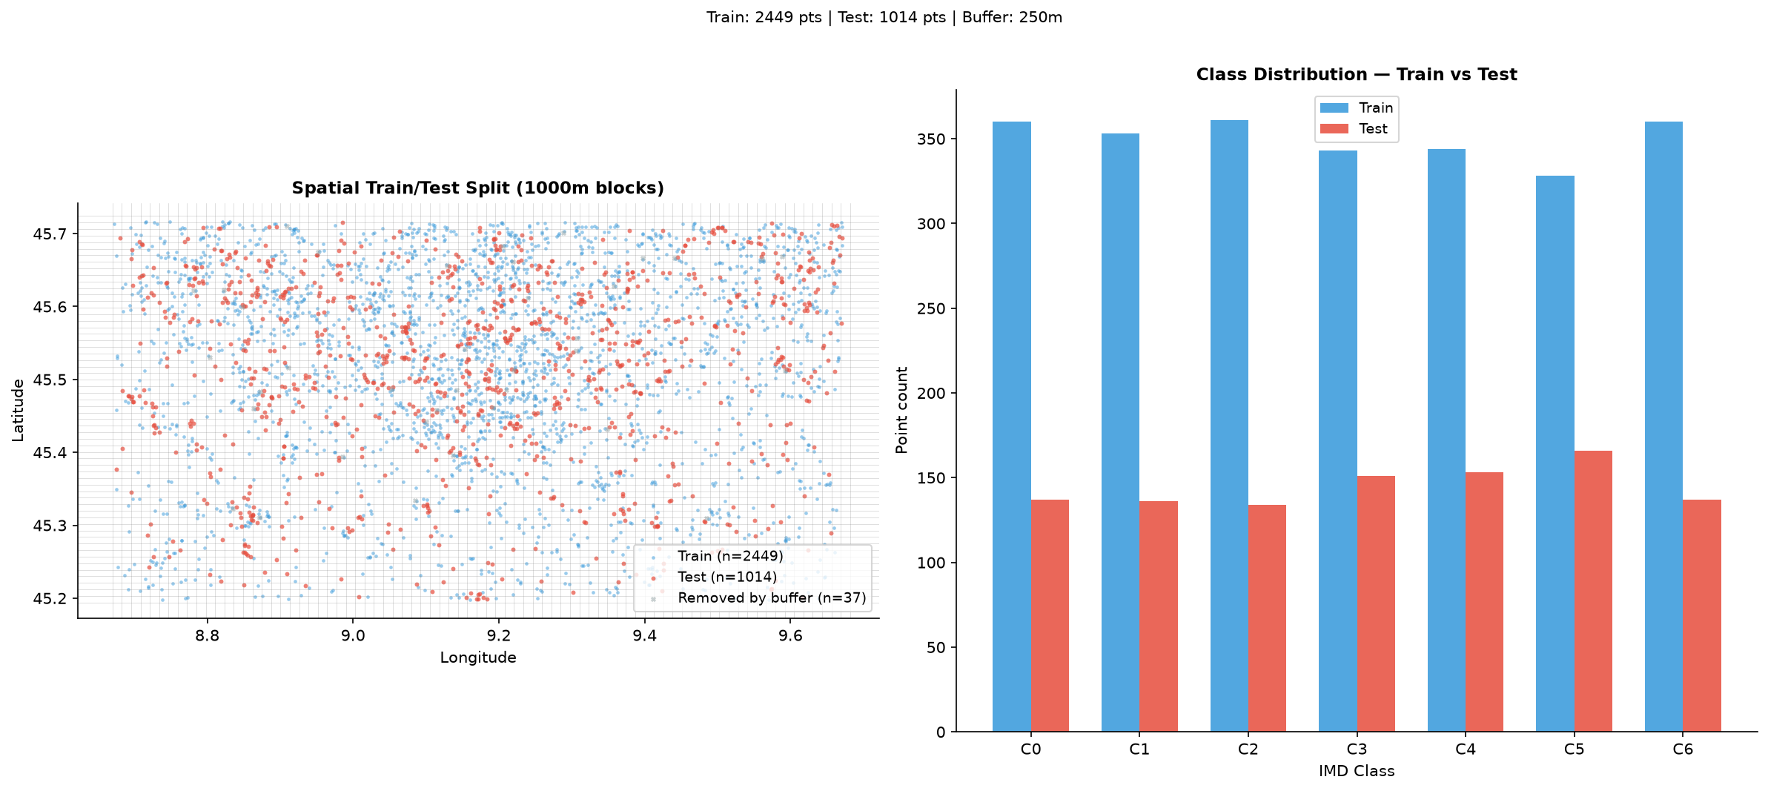
METHOD · SAMPLING
Train and test are separated spatially, not at random
Milan: 1 km blocks assigned whole to training or testing, plus a 250 m buffer removing test points near any training point.
2 449 training and 1 014 test points, roughly 70/30. The design is Žgela's and is used unchanged.
Notes:
The CLMS reference was classified into seven IMD groups and 500 points drawn at
random within each, giving 3 500. Stratifying this way rather than sampling
uniformly is what puts enough points in the sparse middle of the range, which an
unstratified draw over a city would leave nearly empty.
Why spatial rather than random splitting: random splitting would place training
and test points metres apart in the same neighbourhood, where they share land
cover and often the same rooftops, and would return an accuracy figure measuring
interpolation between neighbouring pixels rather than prediction.
Two consequences for this deck. First, the 1 014-point holdout is the same
holdout throughout the Milan section — notebook 01b imports the split from the
embeddings run rather than recomputing it, so all four predictor sets are scored
on exactly the same held-out points. That is what makes it a comparison of
predictors. Second, the 1 014 figure matches Žgela's, which is one of the checks
that the shared baseline was correctly reconstructed.
Žgela checked the design's own spatial randomness with an average nearest
neighbour index, running from 1.02 for the 0 % class down to 0.75 for the 100 %
class. The lower value records that fully impervious pixels cluster in the city
centre; he acknowledges it as a sampling limitation rather than correcting for
it, and it is repeated here on the same terms.
Vietnam is sampled and split on the same design against GHS-BUILT-S, giving 895
test points in Hanoi and 887 in HCMC.

Slide 11
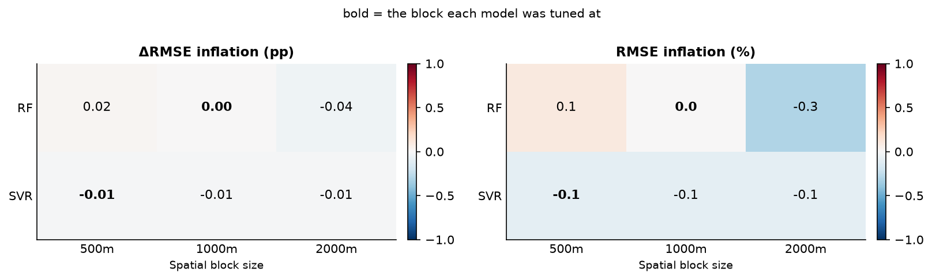
METHOD · CROSS-VALIDATION
Spatial and random cross-validation agree to within about one per cent
CV RMSE under spatial blocking against random folds, Milan training set, by estimator and block size. Bold marks the block each estimator was tuned at.
The largest absolute inflation is 0.3 %. This does not say spatial blocking was unnecessary.
Notes:
The agreement says the buffering and blocking have already removed what leakage
there was to remove, and that the tuning scores are not inflated by proximity
between folds. It does not say the blocking was pointless: the reason the two
agree is that the split was built to make them agree.
Cross-validation is spatial throughout, using the same block structure as the
train/test split, so a fold boundary is a spatial boundary.
Important: CV scores are used for tuning and are never quoted as holdout
performance. They score scikit-learn models on training-set folds, whereas every
accuracy figure in this deck is scored on data held out from training.
Estimator scope, fixed once. Three estimators were tuned; two are carried
forward, random forest and SVR. SVR is evaluated in Milan only. Every model
outside the Milan section is a random forest, for two reasons: the transfer
experiment requires a random forest by construction, and the comparison across
predictor sets, scenarios and cities is only a comparison of those things if the
estimator is held fixed. Only estimators whose trained form can be applied to a
raster through the Earth Engine Python API were considered, since every map is
produced by predicting over the full scene rather than scoring a table of
points.

Slide 12
SECTION 3 OF 7
Milan · same-source validation
The wide margin against CLMS, and the mechanism behind it
1. Design and data · 2. Method · 3. Milan · same-source validation · 4. Vietnam · transfer · 5. Independent validation · 6. Why transfer fails · 7. Conclusions and limitations

Slide 13
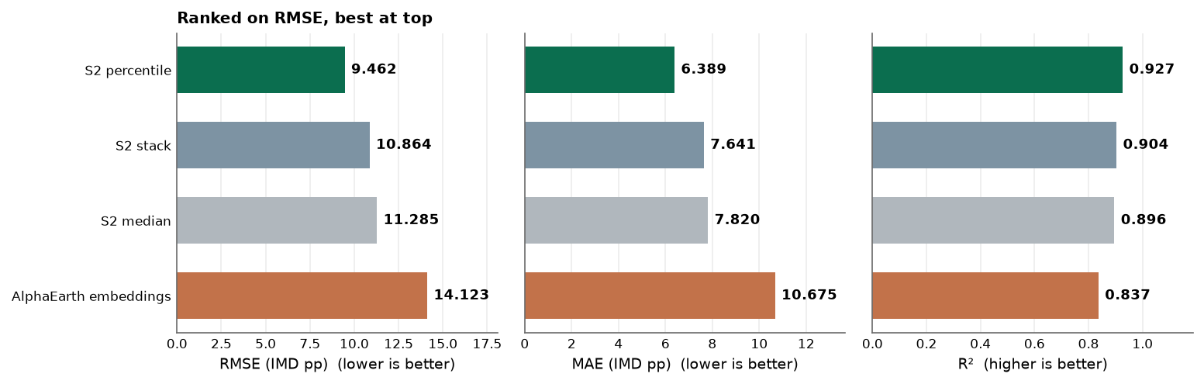
MILAN · SAME-SOURCE
Against CLMS, all three Sentinel-2 composites beat the embeddings
Percentile reaches RMSE 9.462 against the embeddings' 14.123, a reduction of 33 %. The ordering is the same on RMSE, MAE and R², so it is not an artefact of one metric.
Predictor set | RMSE | MAE | R² | Bias
S2 percentile (50 bands) | 9.462 | 6.389 | 0.927 | −0.104
S2 stack (40 bands) | 10.864 | 7.641 | 0.904 | −0.169
S2 median (10 bands) | 11.285 | 7.820 | 0.896 | 0.046
AlphaEarth embeddings (64 bands) | 14.123 | 10.675 | 0.837 | 0.624
GEE random forest, 1 014-point spatial holdout. The SVR rows run in the same order: 9.051 / 10.219 / 10.939 / 14.756.
Notes:
These are agreement with CLMS, not accuracy. Say so here — the independent
validation later compresses this spread about 6.4-fold.
The ordering holds on RMSE, MAE and R-squared, so it is not an artefact of a
single metric, and the bars in all three panels start at zero so bar length is
proportional and the spread is not exaggerated by a truncated axis.
The gap between the best composite and the embeddings, 4.661 RMSE, is larger
than the gap between the best and worst composite, 1.823.
All four maps are close to unbiased on this validation, between −0.169 and
+0.624, which is exactly what you expect of a model fitted to the product it is
then scored against.
Because the SVR ordering is identical, the advantage does not depend on the
estimator. SVR appears in Milan only, for the reasons on the cross-validation
slide.
If asked about the CV-versus-holdout reversal: SVR wins cross-validation and
loses the holdout, reproducing Žgela's result. On the embeddings run SVR tunes
to CV RMSE 11.711 at its selected 500 m block against RF's 13.162 at 1 000 m,
then loses all three holdout metrics. The reversal carries a confound — holdout
rows are scored on Earth Engine rasters while CV numbers come from tuned
scikit-learn models, and the parameter translation is lossy in both directions,
so overfitting to the folds and estimator translation cannot be separated from
these runs. RF is carried forward because the transfer design requires it, not
because SVR could not be rastered: the Milan SVR raster was produced and
retained.

Slide 14
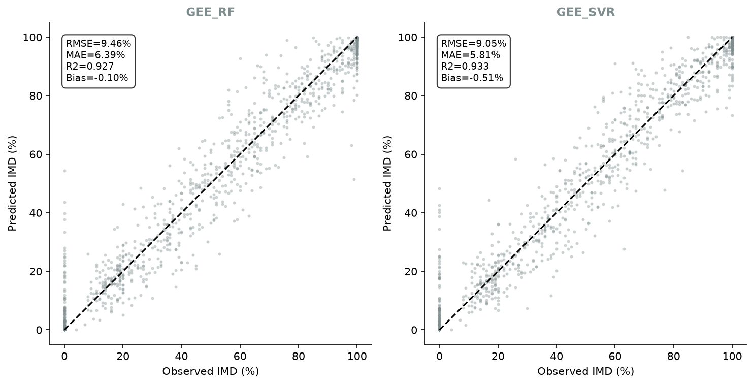
MILAN · SAME-SOURCE
Observed against predicted on the holdout, both estimators
S2 percentile composite, 1 014-point spatial holdout, scored against CLMS.
Notes:
This is the plot-level view behind the ranking table. Both estimator panels
carry their own RMSE, MAE, R-squared and bias.
Useful for the reversal question: the SVR panel is the map that won
cross-validation and lost here.

Slide 15
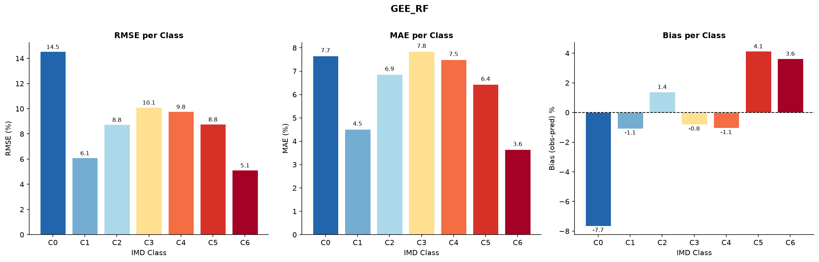
MILAN · SAME-SOURCE
RMSE, MAE and bias per IMD class, percentile composite
GEE random forest, scored against CLMS on the 1 014-point holdout.
Notes:
Breaking the holdout down by class, for anyone who wants to know where the
Milan error sits rather than only its total.
Note the contrast with Vietnam later: here there is no zero-shot/retrain
comparison to make, because the Milan model is trained on Milan.

Slide 16
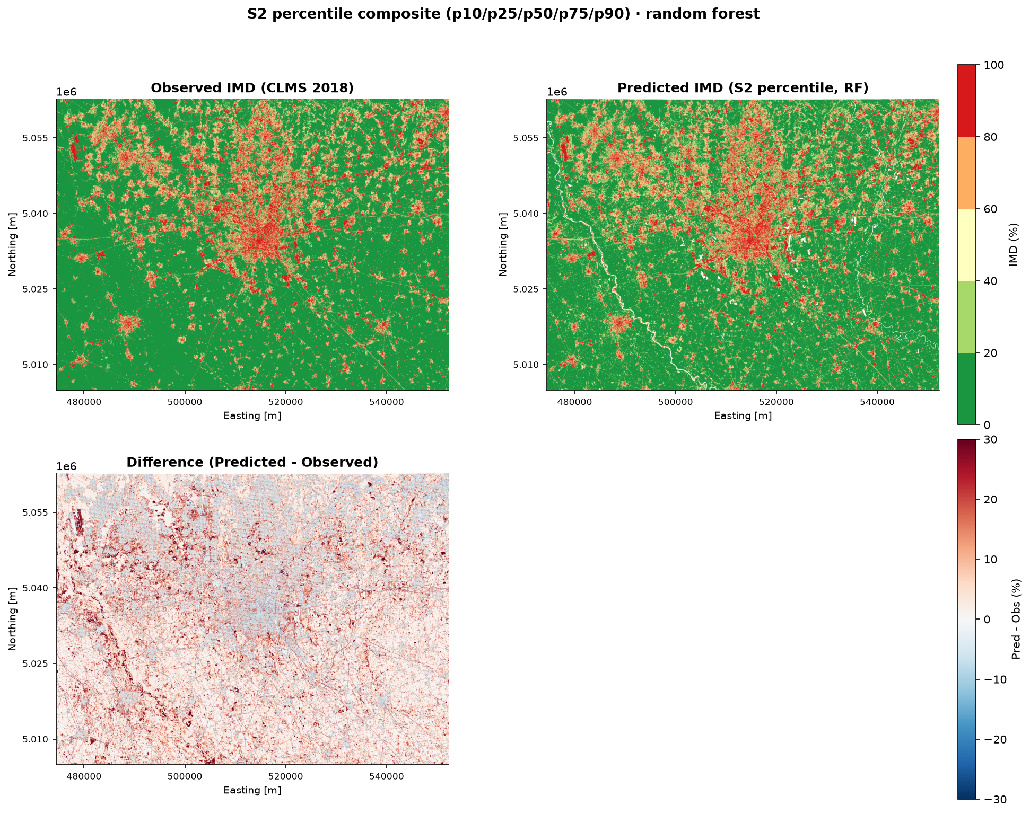
MILAN · SAME-SOURCE
The disagreement with CLMS is structured and two-sided
Observed CLMS, the predicted map and their difference, percentile composite. Positive difference means the model reads more impervious than CLMS.
Qualitative support only: this whole-scene view is not the 1 014-point holdout, and no number is quoted from it.
Notes:
The two upper panels agree on the structure of the conurbation: the dense core,
the satellite towns to the north, the largely agricultural south.
The difference panel is where the disagreement is legible. It is close to zero
over most of the rural area and over the interior of the built-up core, and
departs from CLMS in two places.
First, a fine network of positive lines threading the countryside, following the
road and canal network: the model reads these narrow sealed features as more
impervious than CLMS does. Second, a mild negative cast over the densest part of
the city centre, where the model sits below CLMS. The predicted panel also
carries small unmapped gaps along the watercourses that CLMS fills.
Be careful with the road reading here. CLMS measures sealed surface and includes
roads by design, so this is not the road-exclusion story that applies to
GHS-BUILT-S in Vietnam. What this shows is a disagreement about how narrow
sealed features are resolved, in both directions, not a definitional gap.

Slide 17
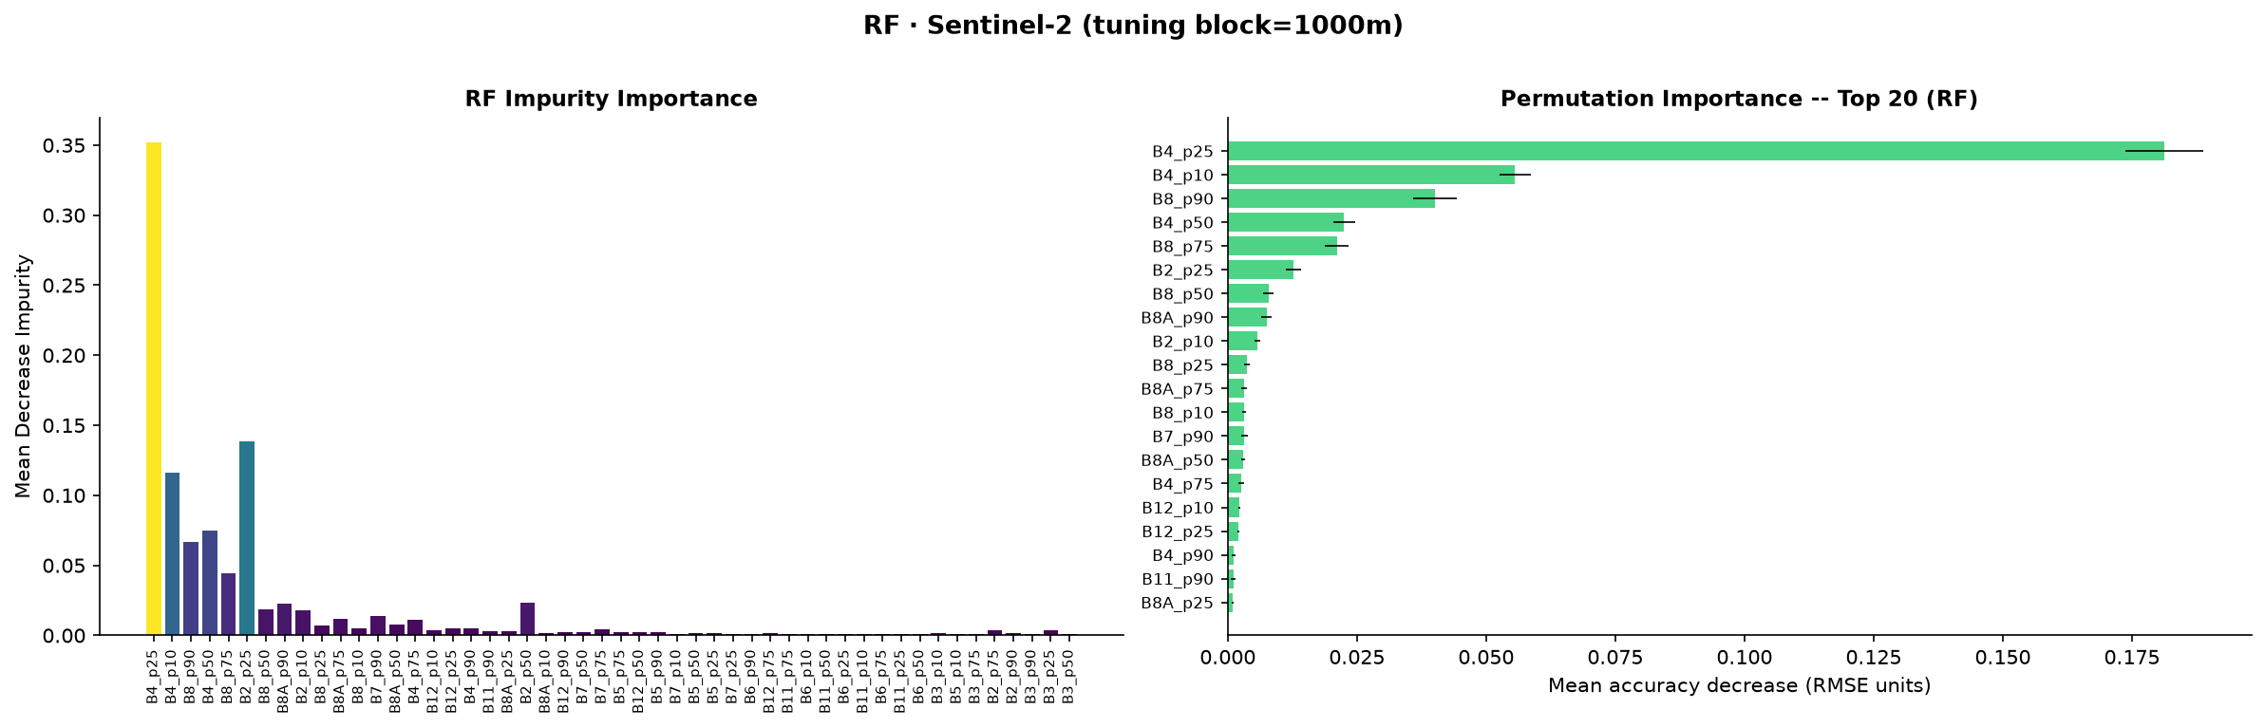
MILAN · MECHANISM
The advantage is interpretable: it comes from the quantiles a median discards
Four of the top five bands are low percentiles of red or high percentiles of near infrared. B4_p25 alone carries more than three times the permutation importance of the next band.
Rank | Band | Permutation importance | Impurity importance
1 | B4_p25 | 0.1812 | 0.3518
2 | B4_p10 | 0.0556 | 0.1163
3 | B8_p90 | 0.0401 | 0.0664
4 | B4_p50 | 0.0225 | 0.0751
5 | B8_p75 | 0.0211 | 0.0446
Permutation importance on the holdout, with mean decrease in impurity alongside.
Notes:
The point: the percentile composite does not simply carry more bands than the
median — it carries the particular bands the median throws away. That is a
mechanistic explanation of the ranking, not just an empirical one.
On the embeddings comparison, and be precise here. Žgela reports band importance
for the embeddings in his study; his two most important predictors are bands B16
and B08 of the 64-dimensional embedding, which have no direct physical
interpretation. What this project did not do is run the equivalent comparison
between the two feature spaces, so no claim is made here about how the two
explanations compare. The honest statement is that the Sentinel-2 side gives an
interpretable account of why it works, and that this project did not test
whether the embeddings admit one.

Slide 18
SECTION 4 OF 7
Vietnam · transfer
Zero-shot fails; local retraining repairs it, but not everywhere
1. Design and data · 2. Method · 3. Milan · same-source validation · 4. Vietnam · transfer · 5. Independent validation · 6. Why transfer fails · 7. Conclusions and limitations

Slide 19
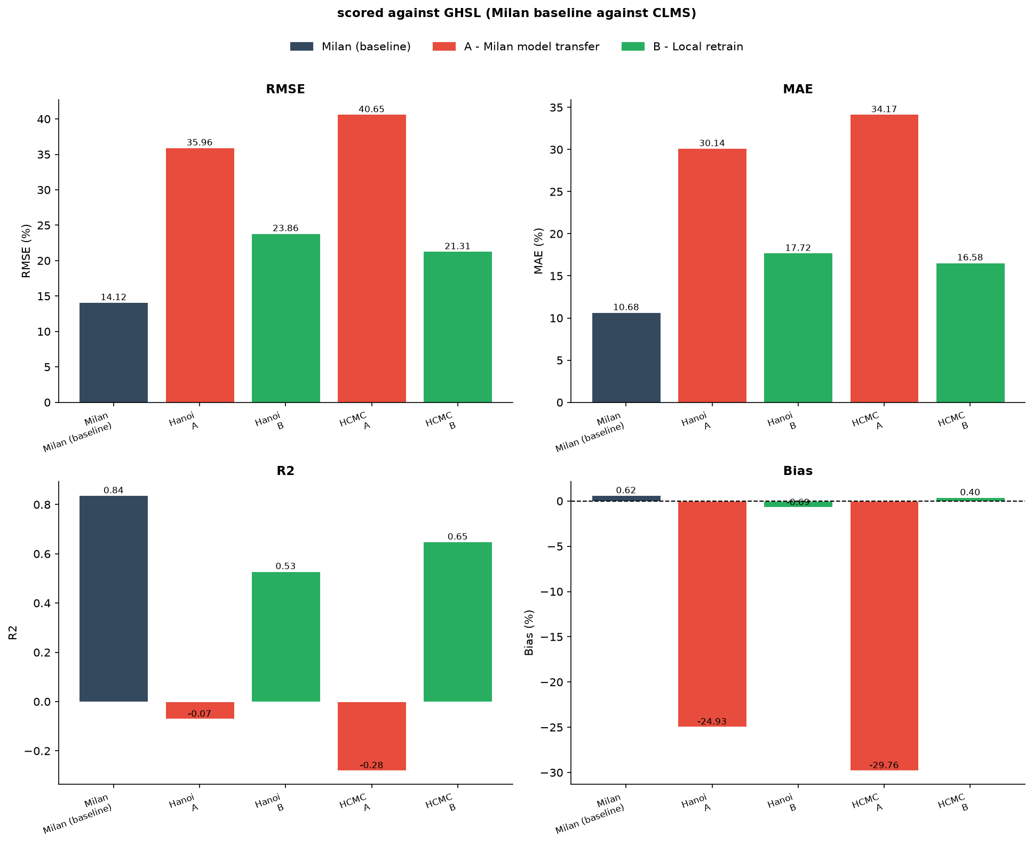
VIETNAM · SAME-SOURCE
Zero-shot transfer of a Milan-trained model fails in both cities
AlphaEarth embeddings. R² is at or below zero in three of the four city and predictor combinations, which is no more informative than predicting the mean everywhere.
Every bar is scored against the training target, so a bias bar near zero means agreement with GHSL, not a correct map.
Notes:
Local retraining recovers R-squared to between 0.522 and 0.649 in every case,
and cuts RMSE by roughly a third to a half: 35.960 to 23.860 and 37.150 to
24.050 in Hanoi, 40.650 to 21.310 and 35.190 to 22.880 in HCMC.
The bias column identifies the failure mode. Every zero-shot bias is large and
negative, between −23.180 and −29.760, so the transferred models read
systematically more impervious than GHSL across the whole test set. They are not
scattered around the reference; they sit above it. Local retrains bring bias to
between −2.080 and +0.400.
The fourth combination, S2 median in HCMC at R-squared 0.042, is not a
counter-example so much as a weaker instance of the same failure.
The raster view of this same failure — GHSL, the Milan transfer and the local
retrain side by side for both cities — is available if the level shift needs
showing directly rather than as a metric.

Slide 20
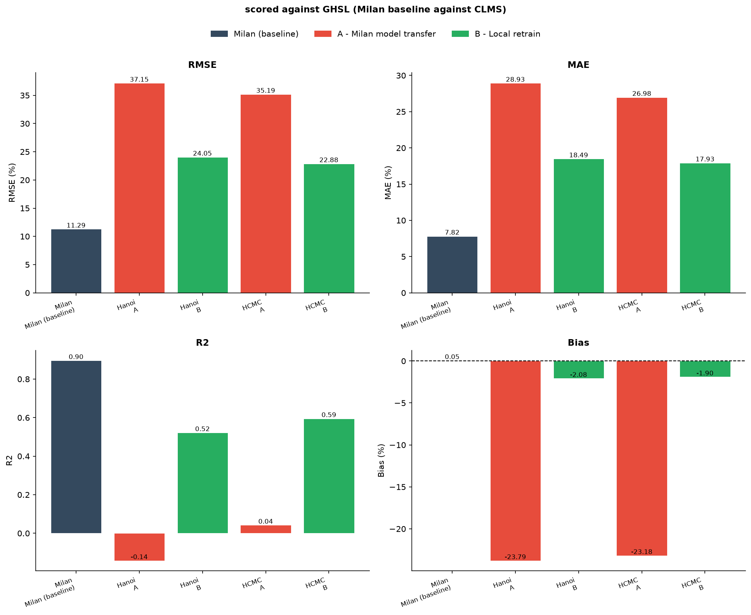
VIETNAM · SAME-SOURCE
The Sentinel-2 features fail the same way
S2 median composite: the same four metrics and the same two scenarios. Read the two slides as a pair — the shape of the result is the same in both.
Caveat: composite depth is confounded with predictor type here, so the ordering between the two arms is not controlled.
Notes:
Both predictor sets fail in the same way and to a similar degree, which is what
makes this a statement about transfer rather than about a particular feature
space.
The caveat in full. The two zero-shot experiments are not equally handicapped:
the embeddings compare annual coverage against annual coverage, while the S2
median compares Milan's 30-date composite against 3 to 4 Vietnamese dates. So
the near-equality of the two failures should not be read as a controlled
comparison between them, and nothing supports a statement that one predictor set
transfers better than the other. The shared conclusion — both fail, local
retraining repairs both — does not rest on that ordering and is unaffected.
The figure code is identical in the two notebooks; only the raster suffix and
one suptitle differ, which is why each figure names its own predictor set and
reference.

Slide 21
VIETNAM · SAME-SOURCE
Both scenarios, both predictor sets, both cities
Scored against GHS-BUILT-S on each city's spatial holdout: 895 points in Hanoi, 887 in HCMC. Bias is observed minus predicted, so a negative value means the map over-predicts.
City | Predictors | Scenario | RMSE | MAE | R² | Bias
Hanoi | AlphaEarth | zero-shot | 35.960 | 30.140 | −0.070 | −24.930
Hanoi | AlphaEarth | local retrain | 23.860 | 17.720 | 0.529 | −0.690
Hanoi | S2 median | zero-shot | 37.150 | 28.930 | −0.142 | −23.790
Hanoi | S2 median | local retrain | 24.050 | 18.490 | 0.522 | −2.080
HCMC | AlphaEarth | zero-shot | 40.650 | 34.170 | −0.279 | −29.760
HCMC | AlphaEarth | local retrain | 21.310 | 16.580 | 0.649 | 0.400
HCMC | S2 median | zero-shot | 35.190 | 26.980 | 0.042 | −23.180
HCMC | S2 median | local retrain | 22.880 | 17.930 | 0.595 | −1.900
Zero-shot R² is at or below zero in three of four combinations; every local retrain lands between 0.522 and 0.649.
Notes:
The numbers behind the two previous figures, if anyone wants to read a specific
cell.
The pattern to point at: every zero-shot bias is large and negative, between
−23.180 and −29.760, and every local retrain sits between −2.080 and +0.400.
That is the level mismatch the discussion section takes up as mechanism one.

Slide 22
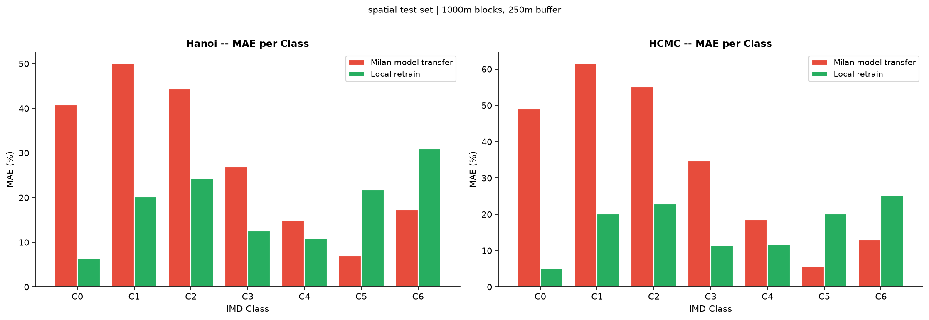
VIETNAM · SAME-SOURCE
Retraining is not uniformly better: above 80 % imperviousness it is worse
Large gains in the low and middle classes, a clear reversal in the top class, in both cities and for both predictor sets.
City | Predictors | Class | Zero-shot MAE | Retrain MAE | Direction
Hanoi | AlphaEarth | C0 (0 %) | 40.75 | 6.36 | retrain better
Hanoi | AlphaEarth | C1 (1–20 %) | 50.08 | 20.12 | retrain better
HCMC | AlphaEarth | C0 (0 %) | 49.05 | 5.15 | retrain better
Hanoi | AlphaEarth | C6 (100 %) | 17.25 | 30.95 | retrain worse
HCMC | AlphaEarth | C6 (100 %) | 12.93 | 25.20 | retrain worse
Hanoi | S2 median | C6 (100 %) | 8.07 | 26.16 | retrain worse
HCMC | S2 median | C6 (100 %) | 5.91 | 22.58 | retrain worse
MAE per IMD class, AlphaEarth embeddings, scored against GHS-BUILT-S. Žgela reports the same pattern.
Notes:
This is a real limitation of local retraining, not noise, and it is reported
rather than set aside.
The mechanism is visible in the same rows. The transferred models over-predict
everywhere, which is ruinous in the low classes — a map that cannot predict low
values is worst where the reference is lowest — and incidentally close to right
in the highest class, where the reference is near 100 % and a map biased upward
has little room to err. Retraining removes the upward bias globally, which fixes
the low classes and removes the accident that was flattering the top one.
Žgela reports the same pattern: improvements mainly in classes C0 to C3, with
the retrained model challenged at the top of the range.
If asked why there is no per-class R-squared: restricting to a single IMD class
removes most of the variance R-squared is normalised by, so every defined
per-class value is negative even where the same model reaches a global 0.522 to
0.649. That is arithmetic, not model failure. C0 and C6 are single-valued
strata, so their variance is exactly zero and R-squared is undefined. Per-class
RMSE, MAE and bias are the appropriate within-class measures.

Slide 23
SECTION 5 OF 7
Independent validation
Change the reference and most of that margin turns out to be agreement
1. Design and data · 2. Method · 3. Milan · same-source validation · 4. Vietnam · transfer · 5. Independent validation · 6. Why transfer fails · 7. Conclusions and limitations

Slide 24
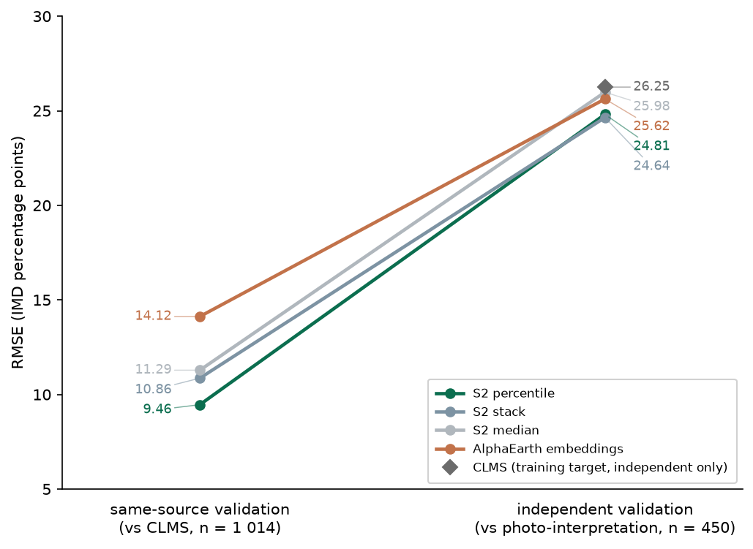
INDEPENDENT VALIDATION · THE RESULT
Change the reference and the Milan spread compresses about 6.4-fold
The four-way spread falls from 4.661 RMSE — 33.0 % of the worst map — to 1.340, or 5.2 %. Most of what the first validation measured as separation was agreement with CLMS rather than accuracy.
City | Map | Role | RMSE | MAE | Bias
Milan | S2 stack | model | 24.644 | 16.551 | −3.344
Milan | S2 percentile | model | 24.809 | 16.486 | −3.342
Milan | emb_RF | model | 25.625 | 18.299 | −1.622
Milan | S2 median | model | 25.984 | 18.363 | −4.176
Milan | CLMS | reference | 26.253 | 14.606 | 2.263
Hanoi | emb_localrf | model | 26.502 | 19.588 | 6.592
Hanoi | S2_median_localrf | model | 27.282 | 21.320 | 8.181
Hanoi | S2_median_zeroshot | model | 33.791 | 24.469 | −15.876
Hanoi | emb_zeroshot | model | 34.352 | 29.537 | −15.716
Hanoi | GHSL | reference | 40.345 | 27.052 | 19.680
HCMC | S2_median_zeroshot | model | 25.950 | 16.779 | −6.827
HCMC | emb_localrf | model | 27.242 | 20.294 | 11.088
HCMC | S2_median_localrf | model | 29.615 | 23.030 | 12.233
HCMC | GHSL | reference | 37.355 | 25.730 | 19.800
HCMC | emb_zeroshot | model | 38.494 | 32.404 | −19.641
All fifteen maps, strict rule, 450 plots per city. The two axes are different references on different samples.
Notes:
This is the turn of the whole deck. Say the claim plainly: most of the
separation the same-source validation reported was agreement with CLMS rather
than accuracy.
Part of the collapse is a reshuffle, not only a compression. The worst map
differs between the two validations: the embeddings are last on the same-source
validation at 14.123, while on the independent one the S2 median is last at
25.984 and the embeddings sit third at 25.625. An ordering that survived three
metrics within the first validation does not survive the change of reference
intact.
On the left panel: the connecting lines trace each map's position within each
validation, not a change in its error. The two axes are different measurements
against different references on different samples — do not read a slope as an
improvement or a degradation.
In Vietnam the spread is wider and its structure different, because the maps
compared differ in kind rather than only in predictor set. In both cities the
two local retrains sit well ahead of both zero-shot maps — 26.502 and 27.282 in
Hanoi against 33.791 and 34.352 — reproducing the transfer conclusion against a
reference the models never saw.
HCMC is the exception, and the mechanism section accounts for it: the S2 median
zero-shot map records the city's best RMSE at 25.950, ahead of both local
retrains. That is about where the city's reference level falls relative to the
transferred map's level, not evidence that transfer succeeded. The embeddings
zero-shot map in the same city is the worst of all fifteen at 38.494.
Do not compare any number here with a same-source number. Different references,
different samples.

Slide 25
INDEPENDENT VALIDATION · PAIRED TESTING
What survives is small but real: two tiers of two, not a clean ranking of four
Paired Wilcoxon on per-plot absolute error, Milan, 450 plots, Benjamini-Hochberg within the city.
Map A | Map B | MAE A | MAE B | Median diff. | p | q (BH) | Distinguishable
S2 median | S2 percentile | 18.36 | 16.49 | 0.92 | 5.95e-09 | 3.57e-08 | yes
S2 median | S2 stack | 18.36 | 16.55 | 1.07 | 4.33e-05 | 1.30e-04 | yes
emb_RF | S2 stack | 18.30 | 16.55 | 0.60 | 9.62e-04 | 1.92e-03 | yes
emb_RF | S2 percentile | 18.30 | 16.49 | 0.31 | 4.56e-03 | 6.84e-03 | yes
S2 stack | S2 percentile | 16.55 | 16.49 | 0.19 | 6.55e-01 | 7.86e-01 | no
emb_RF | S2 median | 18.30 | 18.36 | −0.64 | 7.90e-01 | 7.90e-01 | no
Between tiers q runs from 3.57e-08 to 6.84e-03; neither within-tier pair separates, both at q = 0.79.
Notes:
The tiers: S2 stack with S2 percentile, and emb_RF with S2 median.
Indistinguishable within each tier, separated between them.
Two points need stating explicitly, because the previous slide showed
overlapping confidence intervals for these same maps.
First, the paired test and the confidence intervals measure different quantities
and both are correct. An interval describes the uncertainty of one map's RMSE
taken on its own, across resamples of the plots. The paired test compares two
maps on the same 450 plots, which removes the plot-level variance common to both
and therefore has more power to detect a consistent difference. Overlapping
intervals together with a significant paired difference is the expected
signature of a small but consistent difference, not a contradiction.
Second, the compression and the tier structure are both true. The spread falls
from 4.661 to 1.340, a compression of about 6.4 times — it shrinks sharply, it
does not vanish. What survives is small relative to each map's own error and
still resolvable across 450 paired plots. Neither half of that statement may be
dropped.
This analysis belongs to the independent validation, not to the Milan section:
it runs on per-plot absolute error against photo-interpretation, so placing it
beside the CLMS-scored holdout numbers would merge the two validations.
One non-result worth having ready: the paired test of S2_median_zeroshot against
S2_median_localrf in Hanoi reaches q = 0.063 and does not separate them. That is
not evidence the two are equivalent — absence of a detected difference is not a
demonstration of no difference — and nothing in the transfer argument rests on
that pair.

Slide 26
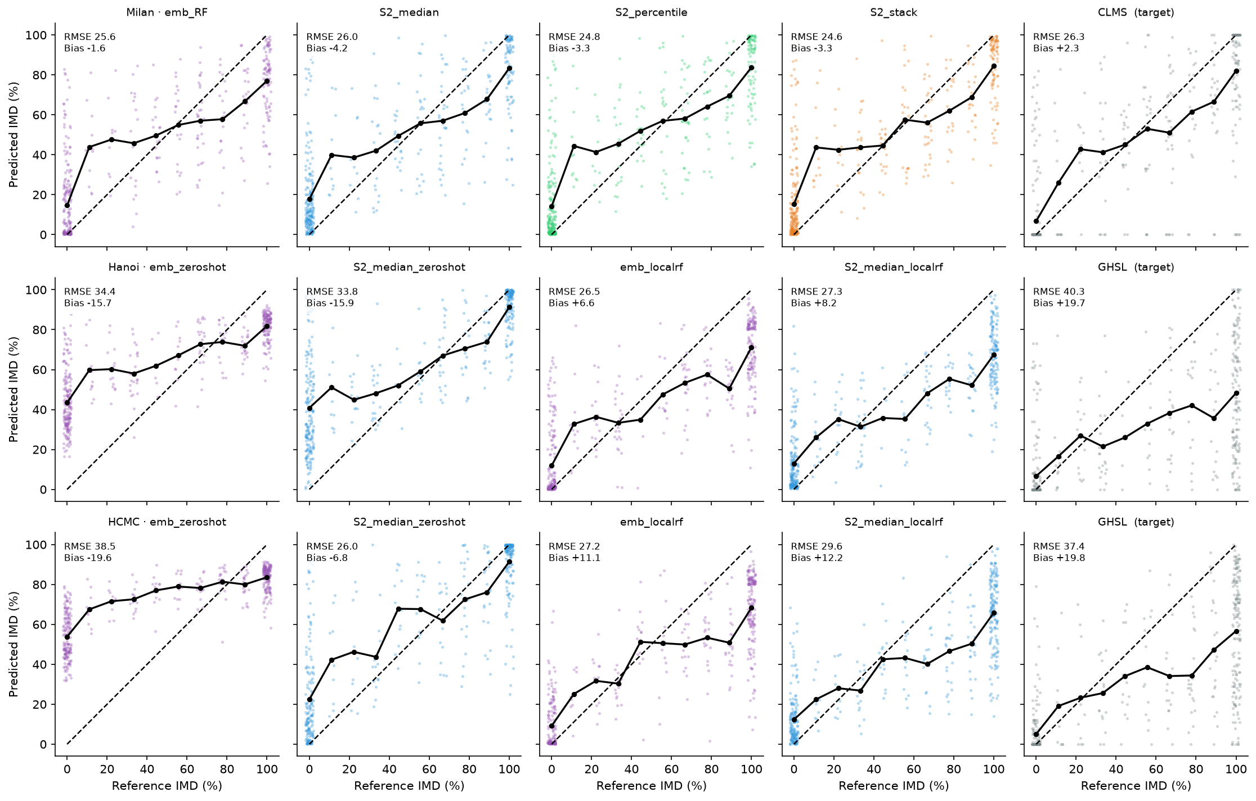
INDEPENDENT VALIDATION
Every registered map in all three cities, at plot level
Photo-interpreted reference against predicted IMD, strict rule. The one place the scatter is shown rather than reduced to a metric.
Notes:
The shape to point at: in the Vietnamese zero-shot panels the mass is held away
from the 1:1 line at low reference values. That is the distributional failure the
next section measures — the lost low tail.

Slide 27
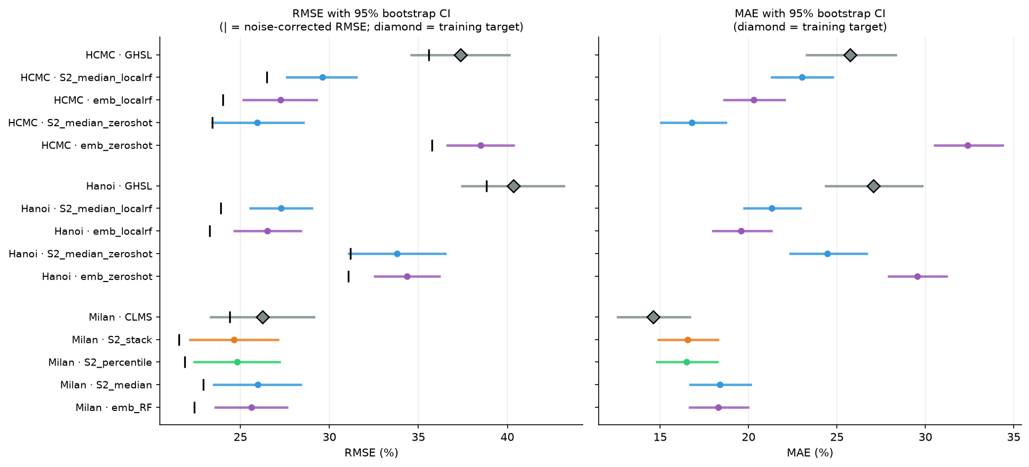
INDEPENDENT VALIDATION · THE DIAMONDS
Both training products score no better than the models fitted to them
The diamonds mark CLMS and GHS-BUILT-S, scored here as maps under test rather than as targets, on the same 450 plots and the same terms as every model.
What this measures is label quality, not a ceiling on achievable accuracy.
Notes:
CLMS reaches an RMSE of 26.253 in Milan, worse than all four of the Milan models
it trained, the closest of which is the S2 median at 25.984. GHS-BUILT-S reaches
40.345 in Hanoi — worse than every map of any kind — and 37.355 in HCMC. Its
bias is +19.680 in Hanoi and +19.800 in HCMC, so it under-marks the interpreted
reference by close to 20 percentage points in both cities. That is the road
exclusion from the data section appearing as a number.
Be careful with what this means. It says the products these models were fitted
to disagree with careful photo-interpretation by about as much as the models
themselves do, which bears on where further gains are likely to come from. It
does not measure a ceiling on achievable model performance, and nothing here
should be read as one: a model is not confined to the accuracy of its labels.
The bias-recovery slide gives the mechanism and measures it.
The intervals are 95 % percentile bootstrap over 10 000 resamples of the 450
plots, the plot being the independent unit. The Milan intervals overlap one
another substantially, and the Milan models' intervals overlap CLMS's — which is
why the paired test, not the intervals, carries the tier result.
The tick on each RMSE bar is the noise-corrected RMSE, an upper bound.

Slide 28
INDEPENDENT VALIDATION · ONE APPARENT COUNTER-EXAMPLE
CLMS holds the best MAE of any Milan map and the worst RMSE, and both are correct
Distribution of per-plot absolute error, Milan, strict rule, 450 plots.
Map | MAE | RMSE | Median error | p90 | Max | Within 5 pp (%) | Over 50 pp (%)
S2 stack | 16.55 | 24.64 | 10.38 | 39.37 | 96.26 | 32.7 | 6.7
S2 percentile | 16.49 | 24.81 | 9.09 | 40.76 | 94.92 | 34.2 | 6.7
emb_RF | 18.30 | 25.63 | 14.38 | 43.67 | 82.84 | 29.8 | 7.3
S2 median | 18.36 | 25.98 | 12.17 | 41.49 | 94.41 | 21.8 | 6.9
CLMS | 14.61 | 26.25 | 3.00 | 45.20 | 100.00 | 53.3 | 8.7
MAE and RMSE measure two halves of one trade rather than contradicting each other.
Notes:
CLMS is right far more often than any model, landing within 5 percentage points
of the interpretation on 53.3 % of plots against 34.2 % for the closest model,
and wrong by more when it is wrong, carrying the largest share of gross errors
at 8.7 % of plots above 50 pp.
That is a product resolving each plot decisively where the models fitted to it
hedge. It costs the models where CLMS is nearly exact and saves them where it
fails badly. MAE rewards the first behaviour and RMSE penalises the second.
This is also the concrete case behind the metrics slide's warning that the two
can disagree about which of two maps is better, which is why both are reported
and neither is treated as a summary of the other.

Slide 29
INDEPENDENT VALIDATION · ROBUSTNESS
The conclusion does not depend on how the impervious classes are coded
Milan RMSE under all three rules, with the resulting ranks. Rule B adds permeable pavement, rule C adds unpaved dirt road. Paved roads are impervious under all three.
Map | Strict | B | C | Rank strict | Rank B | Rank C
S2 stack | 24.64 | 24.54 | 20.98 | 1 | 1 | 1
S2 percentile | 24.81 | 24.71 | 21.37 | 2 | 2 | 2
emb_RF | 25.63 | 25.54 | 23.03 | 3 | 3 | 4
S2 median | 25.98 | 25.94 | 22.98 | 4 | 4 | 3
CLMS | 26.25 | 25.97 | 24.08 | 5 | 5 | 5
Under C the only change is a swap between the pair already found indistinguishable at q = 0.79.
Notes:
Under rule B the ranking is unchanged. B reclassifies 23 cells across 6 plots in
Milan and C reclassifies 112 across 18, so B is much the smaller perturbation.
In Hanoi and HCMC the permeable-pavement code does not occur at all, so B is
identical to strict there by construction and only C differs.
Under rule C the top two maps and CLMS hold their positions, while emb_RF and S2
median exchange third and fourth: 23.03 against 22.98, a difference of 0.05. The
two maps that swap are exactly the pair the paired testing finds statistically
indistinguishable at q = 0.79, so the swap is a reordering within noise and not
a change of result.
All five Milan maps improve under rule C, by between 2.18 and 3.67 RMSE, and
CLMS is among them. Counting compacted dirt roads as impervious moves every map
closer to the reference, including the training target itself, which indicates
the disagreement rule C resolves is in the reference coding rather than in any
particular map.

Slide 30
SECTION 6 OF 7
Why transfer fails
Level matching, and the low tail that no level correction could repair
1. Design and data · 2. Method · 3. Milan · same-source validation · 4. Vietnam · transfer · 5. Independent validation · 6. Why transfer fails · 7. Conclusions and limitations

Slide 31
MECHANISM · 1 OF 2
The transferred maps inherit Milan's level, and the retrains inherit GHSL's
Mean predicted IMD against the interpreted reference mean, all eight Vietnamese maps. The two scenarios straddle the reference from opposite sides.
City | Map | Scenario | Mean predicted | Reference mean | Bias
Hanoi | emb_zeroshot | zero-shot | 61.77 | 46.05 | −15.716
Hanoi | S2_median_zeroshot | zero-shot | 61.93 | 46.05 | −15.876
Hanoi | emb_localrf | local retrain | 37.87 … 39.97 | 46.05 | 6.592
Hanoi | S2_median_localrf | local retrain | 37.87 … 39.97 | 46.05 | 8.181
HCMC | emb_zeroshot | zero-shot | 70.70 | 51.06 | −19.641
HCMC | S2_median_zeroshot | zero-shot | 57.89 | 51.06 | −6.827
HCMC | emb_localrf | local retrain | 37.87 … 39.97 | 51.06 | 11.088
HCMC | S2_median_localrf | local retrain | 37.87 … 39.97 | 51.06 | 12.233
So which scenario scores better in a city depends partly on where that city's reference level falls between them.
Notes:
Both zero-shot maps carry Milan's high level: 61.77 and 61.93 in Hanoi against a
reference mean of 46.05, and 70.70 and 57.89 in HCMC against 51.06. Both local
retrains inherit GHS-BUILT-S's low level, predicting between 37.87 and 39.97
across the two cities.
Note on the table: the report gives the four retrain means only as that range,
without assigning either endpoint to a specific city and map, so the rows carry
the range rather than a per-map value. The bias column is the
independent-validation bias.
This is the weaker of the two mechanisms — it is about where a distribution
sits, not what shape it has. The next-but-one slide gives the stronger one.

Slide 32
MECHANISM · THE CONSEQUENCE
Which is why HCMC's best map is a zero-shot map — and why that is not evidence transfer worked
The four HCMC maps against photo-interpretation, strict rule.
Map | RMSE | MAE | R² | Bias
S2_median_zeroshot | 25.950 | 16.779 | 0.665 | −6.827
emb_localrf | 27.242 | 20.294 | 0.630 | 11.088
S2_median_localrf | 29.615 | 23.030 | 0.563 | 12.233
GHSL | 37.355 | 25.730 | 0.305 | 19.800
emb_zeroshot | 38.494 | 32.404 | 0.262 | −19.641
A ranking that flips with the target city's level is a ranking set by level matching.
Notes:
S2 median zero-shot records the city's best RMSE at 25.950, ahead of both local
retrains at 27.242 and 29.615. Its level gap is 6.83, the smallest of the four
HCMC maps, where the local retrains sit 11.09 and 12.23 below the reference.
The zero-shot map wins there because Milan's level happens to land closer to
HCMC's reference level than GHSL's does, not because the transfer worked.
In Hanoi, where the reference mean is lower at 46.05 and the zero-shot maps
overshoot by close to 16 points, the same two scenarios reverse and the local
retrains lead by six to eight RMSE.
That reversal between the two cities is the argument. If a ranking flips with
the target city's level, the ranking is set by level matching rather than by map
quality.

Slide 33
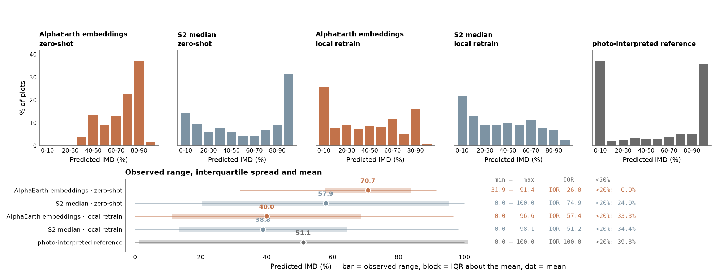
MECHANISM · 2 OF 2
The low tail is gone, and no level correction could repair it
Predicted IMD over the 450 HCMC plots for the four maps and the photo-interpreted reference, with each map's mean level marked.
The reference is bimodal; the embeddings zero-shot distribution is a narrow band with no low tail.
Notes:
This is the stronger evidence, because it does not depend on level at all.
HCMC is the severe case and is shown here for that reason. The next slide shows
the same quantities for all eight maps across both cities, which is where the
mechanism is shown to generalise to Hanoi — do not let this slide stand alone as
if it were a one-city result.
Why no level correction could repair it: both references are strongly bimodal —
41.6 % of Hanoi plots below 10 % and 31.8 % above 90 %, 37.3 % and 35.8 % in
HCMC — and a map with no low tail cannot represent the lower mode wherever its
centre is placed. Shifting such a map downward would move its mass off the upper
mode without populating the lower one.
This is not a displaced distribution: a shifted map would keep its spread and
move only its centre.

Slide 34
MECHANISM · 2 OF 2, BOTH CITIES
The tail is lost in Hanoi too, and every local retrain restores it
Low-tail and spread retention for all eight Vietnamese maps, computed over the full predicted rasters: 8.4 million valid pixels in Hanoi, 8.2 million in HCMC.
City | Map | Scenario | Tail retained (%) | Spread retained (%)
Hanoi | emb_zeroshot | zero-shot | 3.1 | 37
Hanoi | S2_median_zeroshot | zero-shot | 30.6 | 53
Hanoi | emb_localrf | local retrain | 136.0 | 61
Hanoi | S2_median_localrf | local retrain | 124.4 | 51
HCMC | emb_zeroshot | zero-shot | 0.0 | 26
HCMC | S2_median_zeroshot | zero-shot | 68.7 | 75
HCMC | emb_localrf | local retrain | 108.3 | 57
HCMC | S2_median_localrf | local retrain | 104.0 | 51
Zero-shot embeddings retain 3.1 % of the reference's sub-20 % mass in Hanoi and 0.0 % in HCMC; the retrains retain 104–136 %.
Notes:
This slide is where the mechanism generalises. The histogram was HCMC only; this
covers both cities and both predictor sets, and the pattern holds across all
eight maps.
Both embeddings zero-shot maps have lost the low tail. Below 10 % both rasters
are empty to four decimal places. The loss is a property of the transferred
embedding map rather than of one city, which is what makes it a mechanism rather
than an anecdote.
The two cities differ in how far the spread collapses alongside the tail. HCMC
holds 26 % of the reference interquartile range against Hanoi's 37 %, on IQRs of
26.0 and 37.4 against a reference IQR of 100.0, and its standard deviation is
15.95 against the reference's 44.81. HCMC is the severe case: the range has
narrowed around the missing tail as well as losing it. That severity shows in
the scores, where the HCMC embeddings zero-shot map is the worst of all fifteen
at 38.494 despite a mean of 70.70 that is not absurd for the city.
The complement: all four local retrains reach a raster floor of 0.00 and retain
between 104.0 % and 136.0 % of the sub-20 % mass — full recovery within the
precision this comparison supports. So: zero-shot transfer destroys the low end
of the distribution and local retraining restores it, in both cities and for
both predictor sets. That is the distributional counterpart of the R-squared
recovery.
The S2 median zero-shot maps sit between the two at 30.6 % and 68.7 %: degraded
rather than emptied. Consistent with both predictor sets failing while the
embeddings fail harder — but the composite-depth confound applies to that
contrast, so it is not a controlled comparison.
On reading the numbers: the tail figure compares a raster-wide share against a
450-plot share, so read it as an order of magnitude rather than to the
percentage point. A value at or above 100 % means the tail is fully present
rather than oversized.

Slide 35
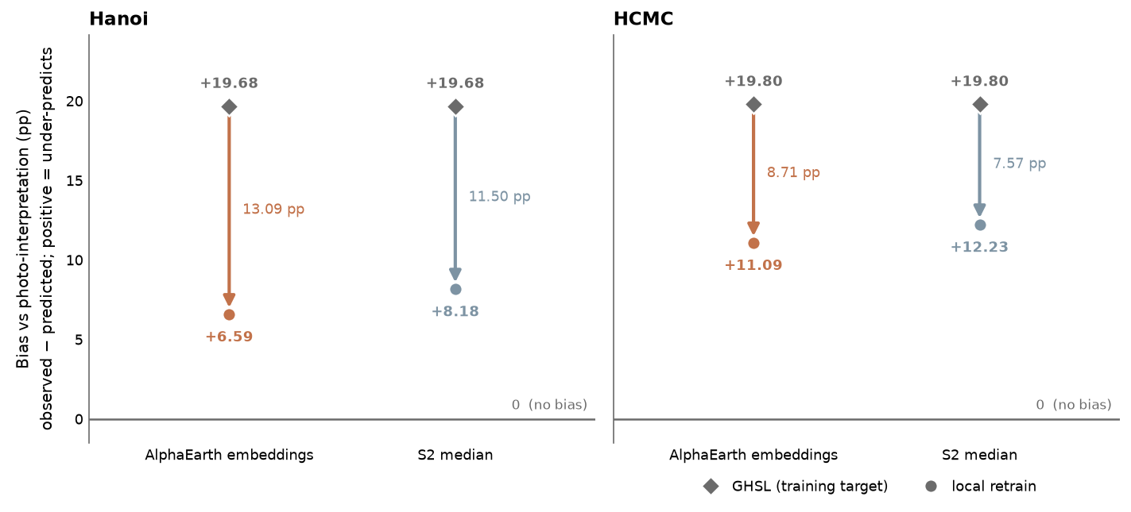
MECHANISM · WHAT RETRAINING RECOVERS
A model can score better than its own training target
GHS-BUILT-S under-marks by 19.68 pp in Hanoi and 19.80 in HCMC. The models fitted to it are biased by only 6.59 to 12.23, recovering 38 % to 67 % of the deficit.
City | Target | Target bias | Map | Map bias | Recovered (pp) | Recovered (%)
Hanoi | GHSL | 19.68 | emb_localrf | 6.59 | 13.09 | 66.5
Hanoi | GHSL | 19.68 | S2_median_localrf | 8.18 | 11.50 | 58.4
HCMC | GHSL | 19.80 | emb_localrf | 11.09 | 8.71 | 44.0
HCMC | GHSL | 19.80 | S2_median_localrf | 12.23 | 7.57 | 38.2
Bounded, not complete: a target that under-marks by 20 points still yields maps that under-mark by 7 to 12.
Notes:
This is the mechanism behind the training-product result, and it is what keeps
that result from meaning something it does not. The earlier slide showed the
training products score no better than the models fitted to them, and said that
measures label quality rather than a ceiling. This is why the two statements are
consistent.
Two mechanisms. Label error that is random from pixel to pixel cannot be fitted
by a model with limited capacity, so it is smoothed away rather than learned, and
the fitted surface lands closer to the truth than the individual labels do.
Systematic label error is different: GHS-BUILT-S's deficit is systematic,
arising from its exclusion of roads by design, yet the predictors still respond
to the sealed surfaces the target omits. A road GHS-BUILT-S does not mark is
still visible to the embeddings and to the Sentinel-2 reflectance percentiles,
and a model trained on plots where roads co-occur with marked built-up area
learns a response that partly recovers them.
Neither mechanism recovers the deficit fully, and the numbers say so: 38 % to
67 %, not 100 %. The residual bias of +6.59 to +12.23 is the part of the
target's systematic error the models do inherit.
Attribution: Žgela reports this effect qualitatively, observing that roads and
unroofed impervious surfaces are visibly better represented in the predicted
maps although still imperfectly, and that this highlights the model's ability to
recover information beyond what was explicitly provided during training. He
established it by visual inspection. Measuring it against an independent
reference is this project's contribution — his study had no means to do it.

Slide 36
SECTION 7 OF 7
Conclusions and limitations
What the study supports, and the five constraints that bound it
1. Design and data · 2. Method · 3. Milan · same-source validation · 4. Vietnam · transfer · 5. Independent validation · 6. Why transfer fails · 7. Conclusions and limitations

Slide 37
CONCLUSIONS
Four answers
1 · Composite choice
Composite choice matters more than the foundation model on the same-source validation: percentile 9.462 against the embeddings' 14.123, a 33 % reduction, with the same ordering on RMSE, MAE and R². The advantage is mechanistically interpretable — B4_p25 carries a permutation importance of 0.1812, more than three times the next band.
2 · The compression
Against an independent reference the four-way spread compresses about 6.4-fold, from 33.0 % to 5.2 % of the worst map, yet paired testing still resolves two tiers. Same-source validation is the right instrument for model selection and the wrong one for claiming accuracy: reporting a 33 % same-source reduction as a 33 % gain in accuracy would misdescribe it by a factor of six.
3 · Transfer
Zero-shot transfer fails — R² at or below zero in three of four combinations — and local retraining is necessary, recovering R² to 0.522–0.649. It is not uniformly better: above 80 % imperviousness it is worse.
4 · The targets
The training products are not ceilings. CLMS scores 26.253 and GHS-BUILT-S 40.345 and 37.355, in each case no better than the models fitted to them. That measures label quality; the models recover 38–67 % of GHSL's systematic deficit.
Notes:
The two that qualify each other are 1 and 2. A reader who takes the first
without the second will overstate what the study shows — that is exactly the
failure this deck is built to prevent.
The reshuffle belongs with conclusion 2: the S2 median is last on the
independent validation at 25.984 where the embeddings were last on the
same-source one at 14.123. The ordering is partly reshuffled, not merely
compressed.
Conclusion 3's mechanisms: level inheritance, and the lost low tail — 3.1 % of
the sub-20 % mass retained in Hanoi and 0.0 % in HCMC, restored to 104–136 % by
every local retrain. And the honest caveat that retraining costs accuracy above
80 %: C6 MAE rises from 17.25 to 30.95 in Hanoi and 12.93 to 25.20 in HCMC.
Conclusion 4 bounded: retraining on a product that under-marks by roughly 20
points still yields maps that under-mark by 7 to 12.

Slide 38
LIMITATIONS
Five constraints, each with the conclusion it forbids
Composite depth
Confounded with predictor type in Vietnam: the embeddings arm compares annual against annual, the Sentinel-2 arm a 30-date composite against 3 or 4 dates. Forbids any statement that one predictor set transfers better than the other.
Plot independence
Assumed and untested. If residual autocorrelation is present the effective sample is below 450, the bootstrap intervals are too narrow and the paired q values are optimistic. The tier structure is supported; its weakest pair is not established at the quoted precision.
RMSE_corr
An upper bound on map error, not a point estimate. The claim that any Milan map achieves an error of 21.559 is not supported; that they lie between 21.559 and 22.917 corrected is a statement about bounds.
One interpreter
All 1 350 plots were interpreted by one analyst under one reading of the rules, with no inter-rater estimate. Paired within-city differences are less exposed; absolute error levels, the intervals and the bias measurements carry the component in full.
Stratified plots
Plots are stratified by the product under test, not drawn at random over the city, and no area weights are applied. Comparisons between maps hold. What would be wrong is that any RMSE here describes the accuracy of a map over its city.
Notes:
Each is stated with the conclusion it forbids, because a limitation that does
not change a reading of the results is not worth recording.
On the interpreter caveat, the scope is narrow and should not be widened.
Because the paired tests difference two maps plot by plot against the same
interpreted value, an interpretation tendency that displaces a plot's reference
value affects both maps in the pair and drops out of that difference. No such
cancellation applies anywhere else: the absolute RMSE and MAE levels, the
bootstrap intervals and the bias measurements each score a map against the
reference rather than against another map. Nor does the shared reference protect
the rankings — a tendency that displaces the reference by different amounts in
different kinds of plot penalises maps unequally. The single claim it supports is
that paired within-city differences are less exposed than the error levels are.
On the stratification: strata occupying a small share of the urban area are
represented as heavily as strata occupying a large one, and the bimodality of
the Vietnamese references is a property of the plot sample, not necessarily of
the cities.
The two worth flagging in advance if the discussion runs long are composite
depth and stratification, because they limit comparisons someone might otherwise
expect this work to make.

