Slide 1
SENTINEL-2 BASELINE · PROGRESS REVIEW
How should a year of Sentinel-2 observations
be turned into features?
Three composite strategies compared against a foundation-model embedding
Impervious surface density · Milan · 2018 · 10 m
Xiao Tan · Politecnico di Milano

Slide 2
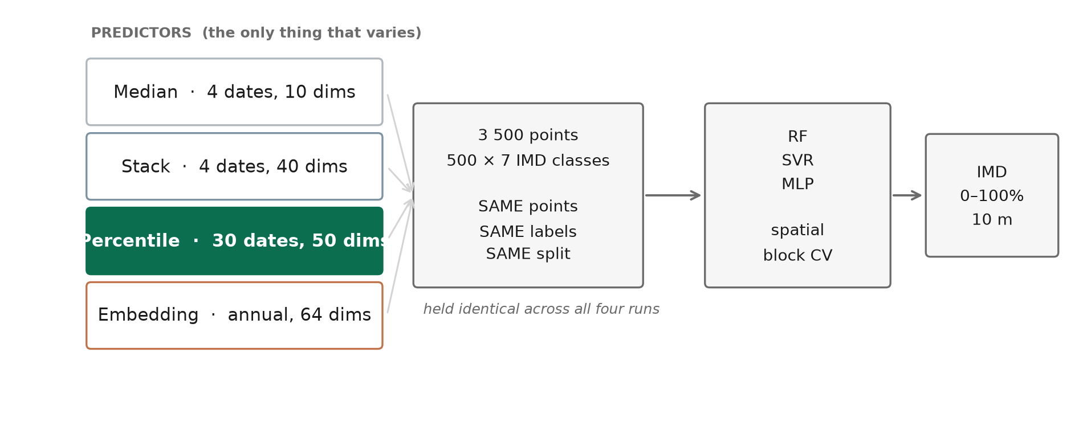
STUDY DESIGN
Four predictor sets, one target — everything else held identical
The comparison is designed so that the feature representation is the only variable. Same 3 500 points, same labels, same split, same models, same validation.

Slide 3
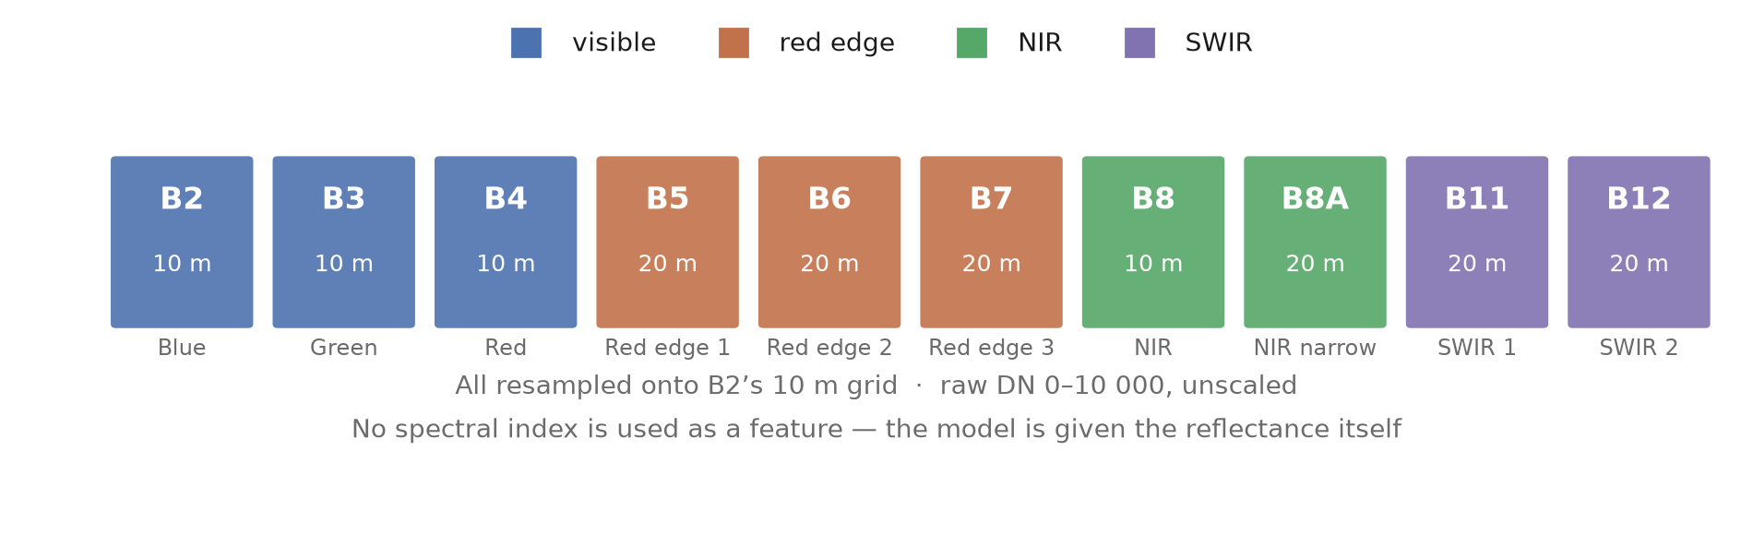
WHICH BANDS
Ten surface-reflectance bands, no engineered indices
Visible, red-edge, NIR and SWIR are all retained. Indices such as NDVI or NDBI are fixed ratios of bands the model already has — computing them adds no information a non-linear learner cannot recover itself.
Collection: COPERNICUS/S2_SR_HARMONIZED (L2A surface reflectance) — no silent fallback to top-of-atmosphere.

Slide 4
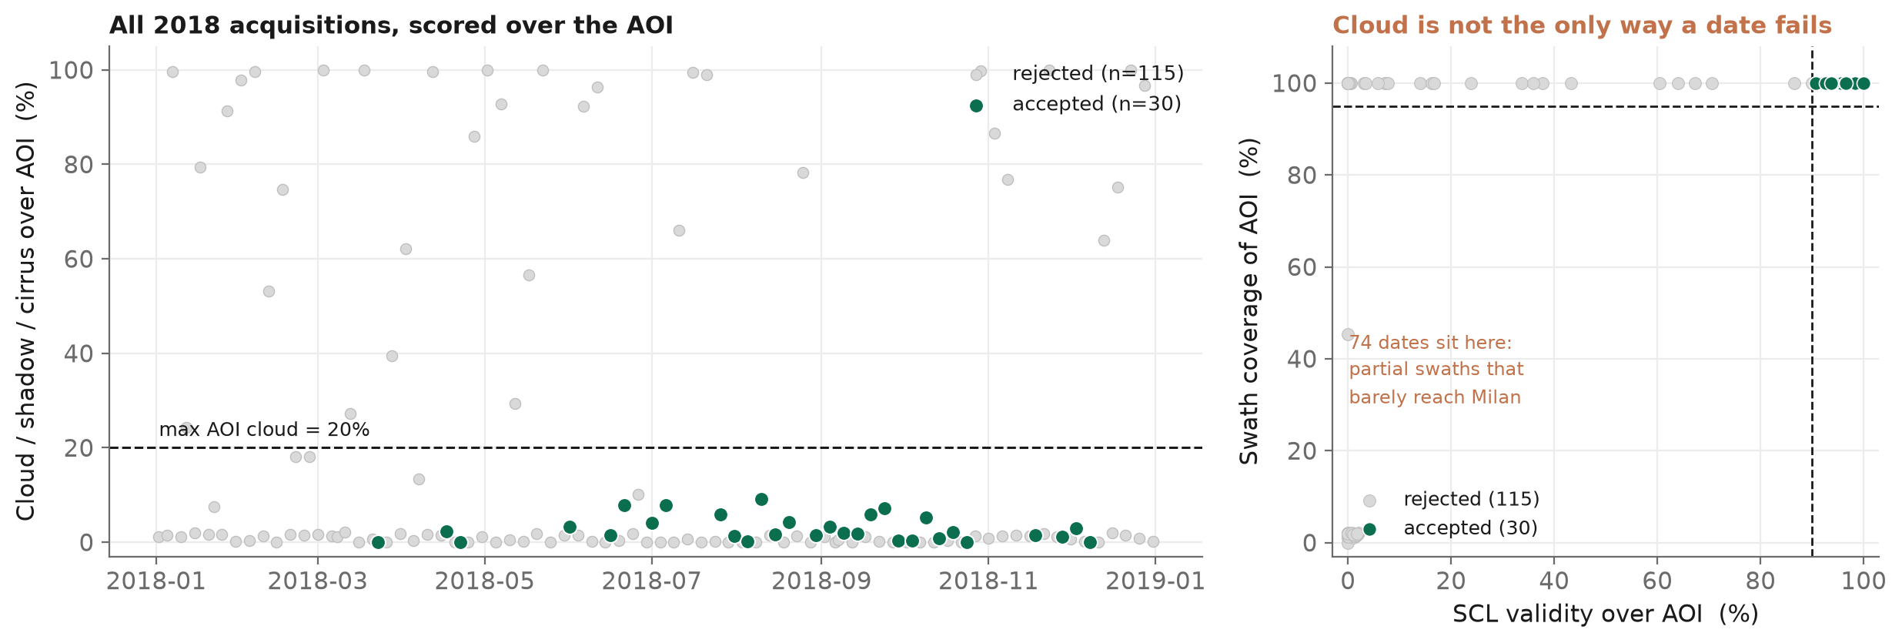
WHICH DATES
30 of 145 acquisitions pass all three AOI-based criteria
A date is accepted only if it passes cloud (≤20% over the AOI), SCL validity (≥90%) and swath coverage (≥95%) — all three, measured over Milan itself.
Why three criteria and not just cloud? 74 of the 145 candidate dates are partial swaths that barely cross the AOI — many report near-zero cloud precisely because there is almost nothing there to be cloudy. All statistics are therefore computed over Milan itself, not from the scene-level metadata, which describes a whole MGRS tile that the AOI straddles.

Slide 5
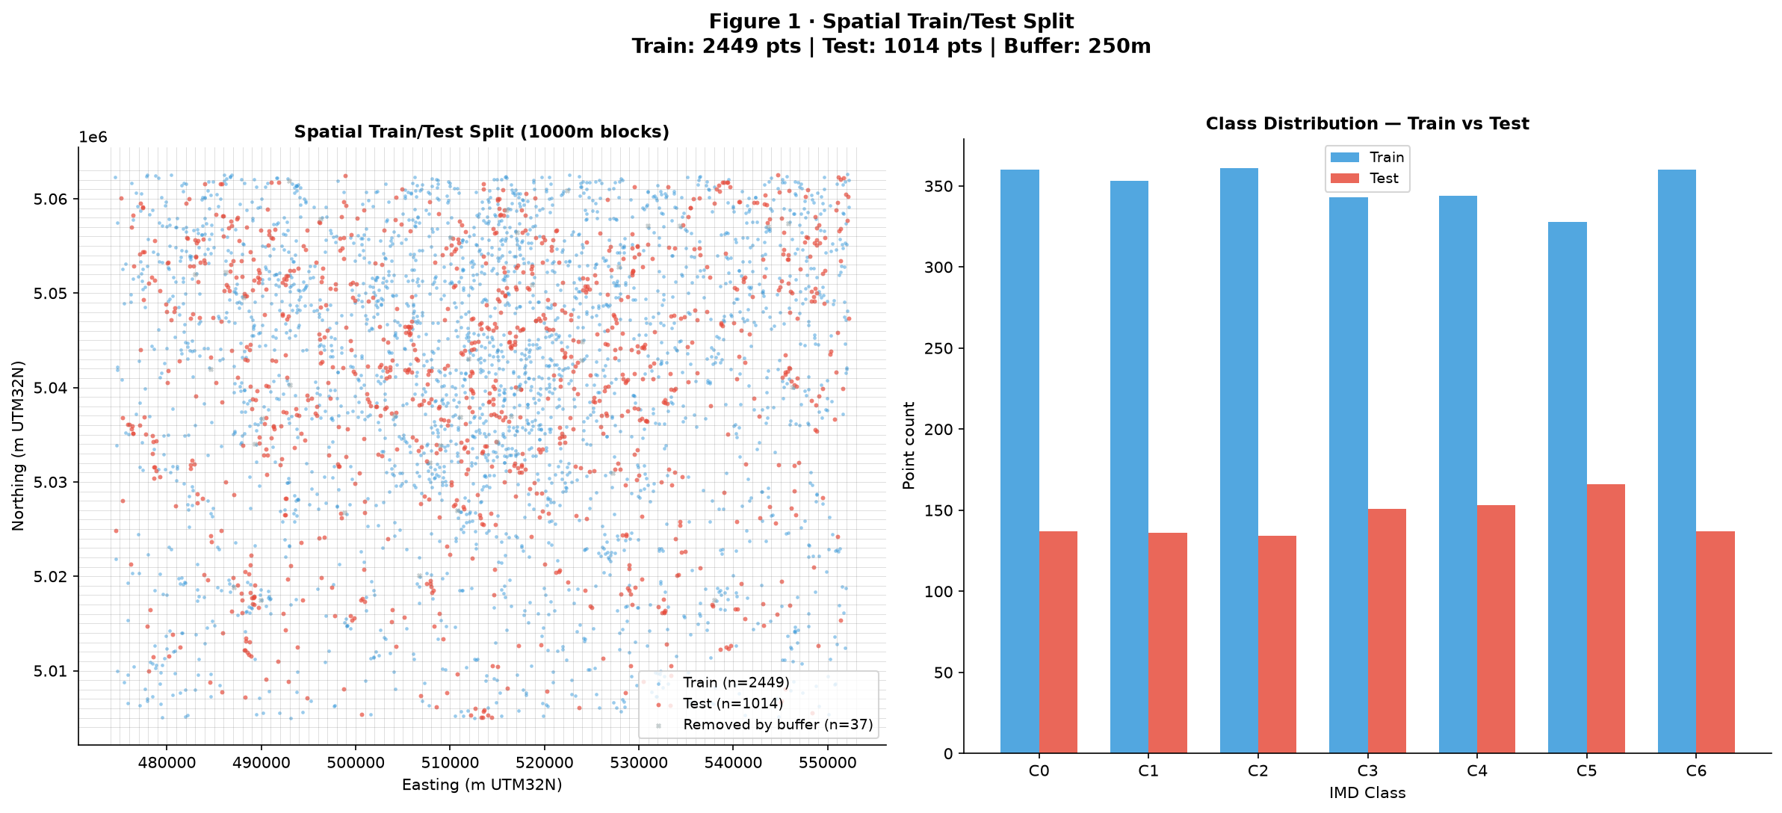
IS THE COMPARISON FAIR?
Yes — the train/test split is imported from the embedding run, not recomputed
2 449 training / 1 014 test / 37 removed by the 250 m buffer. The split is recovered by joining on point geometry, and the labels are then asserted element-wise identical. Only X differs.
Why not just re-use random seed 42? Because the split is greedy over surviving 1 km blocks. If one dropped point was the only sample in its block, that block leaves the array being permuted — so the same seed yields a different split, and whole blocks flip between train and test. Importing the membership is the only guarantee.

Slide 6
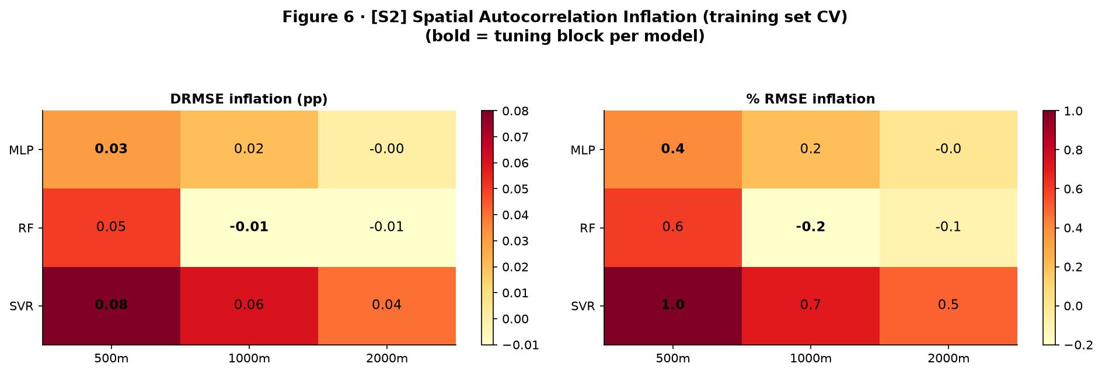
HOW IT IS VALIDATED
Spatial block CV — and the blocking confirms there is no leakage left to remove
Whole blocks (500 / 1000 / 2000 m) are assigned to folds, never individual points, with a 250 m buffer. Random CV is run alongside purely as a control.
Random-CV and spatial-CV RMSE agree to within ~1%. Read correctly, this says the block design is working and the 3 500 points are far enough apart that autocorrelation was never inflating the score — not that spatial validation was unnecessary. Reported accuracy can therefore be taken at face value.

Slide 7
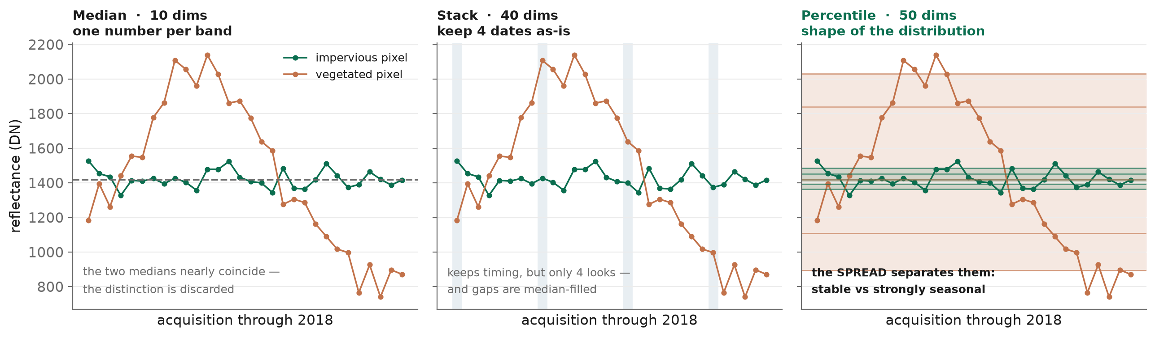
THE THREE COMPOSITE METHODS
Each method encodes a different hypothesis about what carries the signal
All three start from the same cloud-masked, water-masked observations. They differ only in how the temporal axis is collapsed.
Masking is applied BEFORE reduction, so cloudy observations are excluded from the sample rather than averaged in. Stack additionally gap-fills masked pixels from the median (0.006–1.5% of the AOI per date).

Slide 8
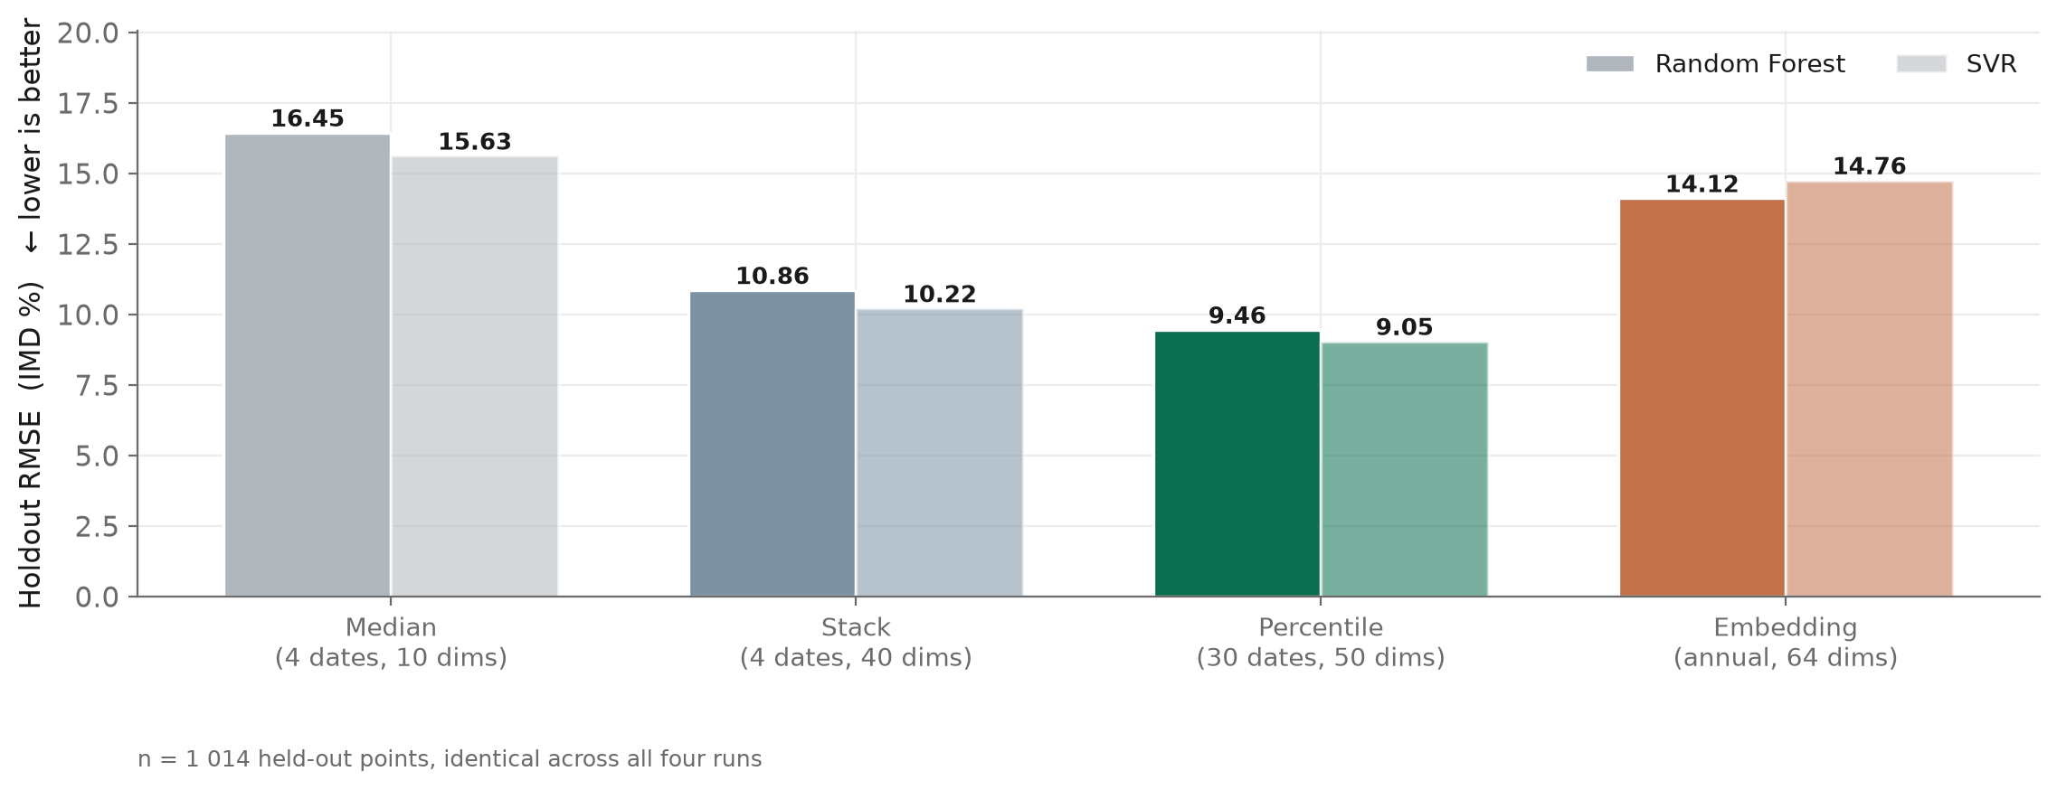
RESULT
The percentile composite is the strongest on every model and metric
Holdout RMSE falls from 15.63 (median) to 9.05 (percentile) for SVR — a 42% reduction on points no model ever saw.

Slide 9
RESULT · ALL METRICS
The ranking is the same on RMSE, MAE and R² — it is not a metric artefact
Held-out test set, predictions sampled from the exported 10 m rasters.
Predictor | Dims | Model | RMSE | MAE | R² | Bias
Median (4 dates) | 10 | RF | 16.45 | 11.49 | 0.779 | +1.12
Median (4 dates) | 10 | SVR | 15.63 | 10.34 | 0.801 | -0.76
Stack (4 dates) | 40 | RF | 10.86 | 7.64 | 0.904 | -0.17
Stack (4 dates) | 40 | SVR | 10.22 | 6.92 | 0.915 | -0.33
Percentile (30 dates) | 50 | RF | 9.46 | 6.39 | 0.927 | -0.10
Percentile (30 dates) | 50 | SVR | 9.05 | 5.81 | 0.933 | -0.51
Embedding (annual) | 64 | RF | 14.12 | 10.68 | 0.837 | +0.62
Embedding (annual) | 64 | SVR | 14.76 | 11.40 | 0.822 | +0.27
MLP is tuned and cross-validated throughout, but Earth Engine has no MLP regressor — so only RF and SVR can be exported as rasters and appear here.

Slide 10
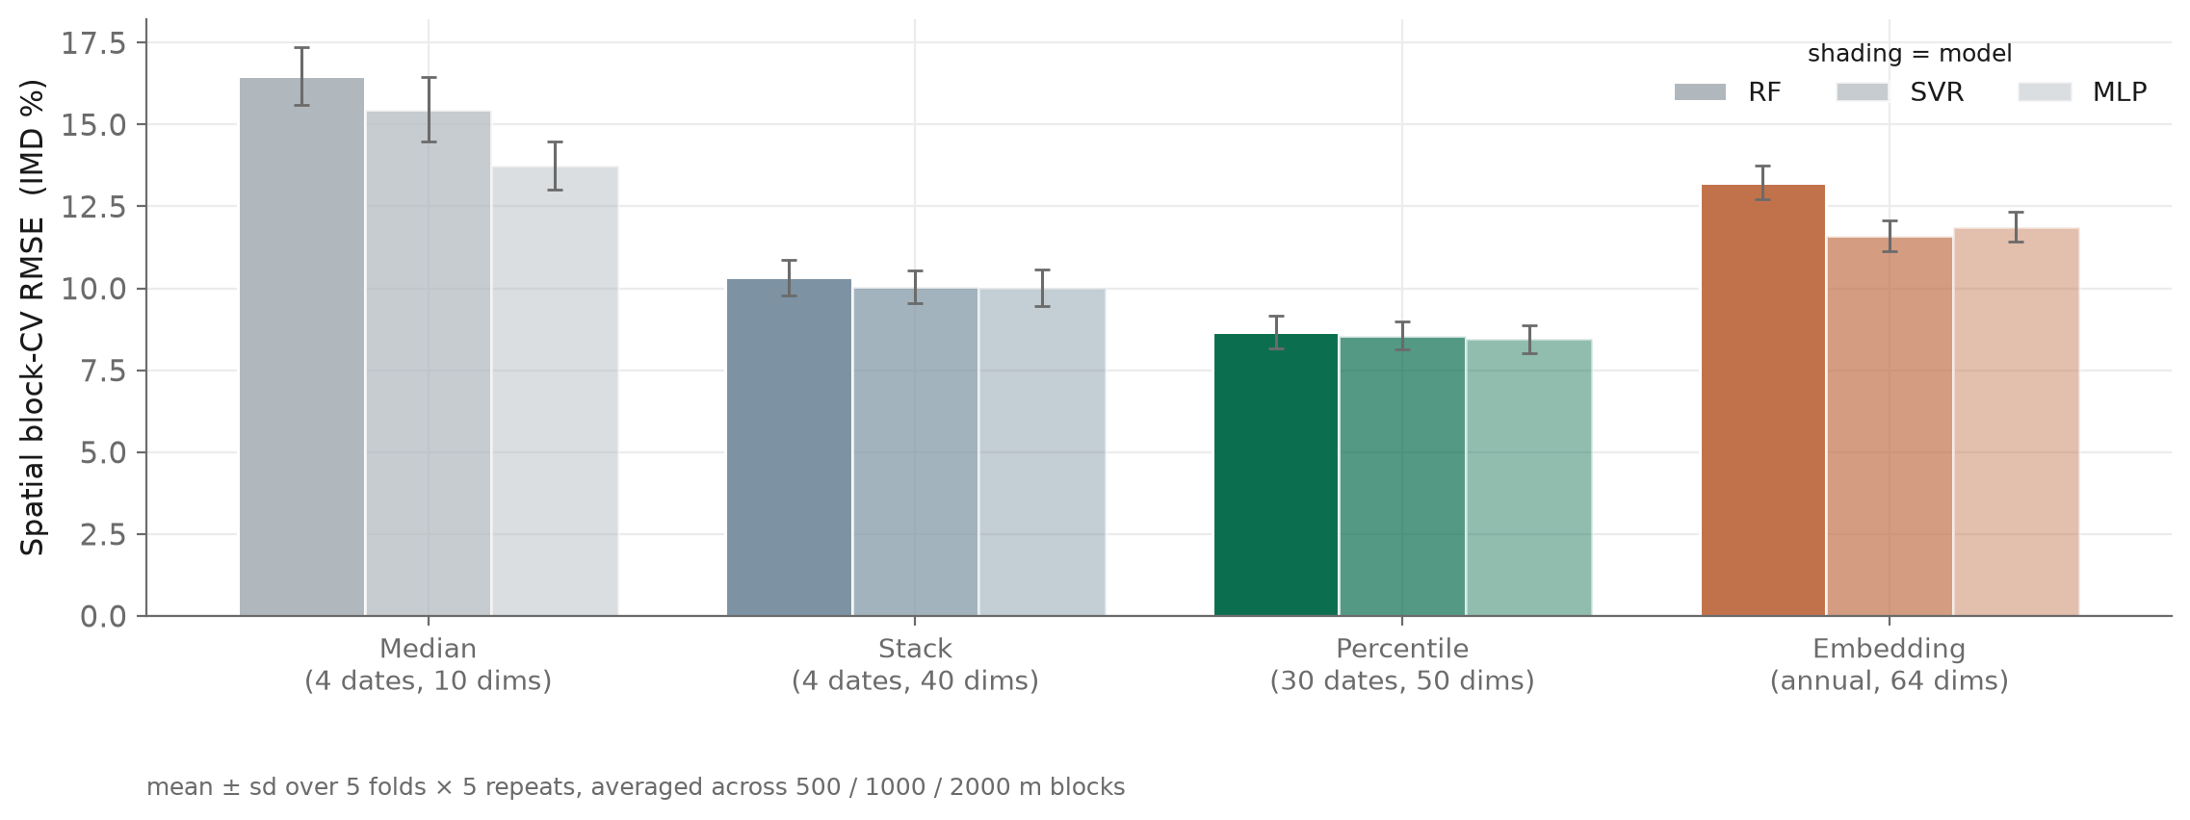
ROBUSTNESS
The ranking holds across 25 spatial folds, not just the single holdout
Five folds × five repeated fold draws, at three block sizes. Error bars are the standard deviation across folds.

Slide 11
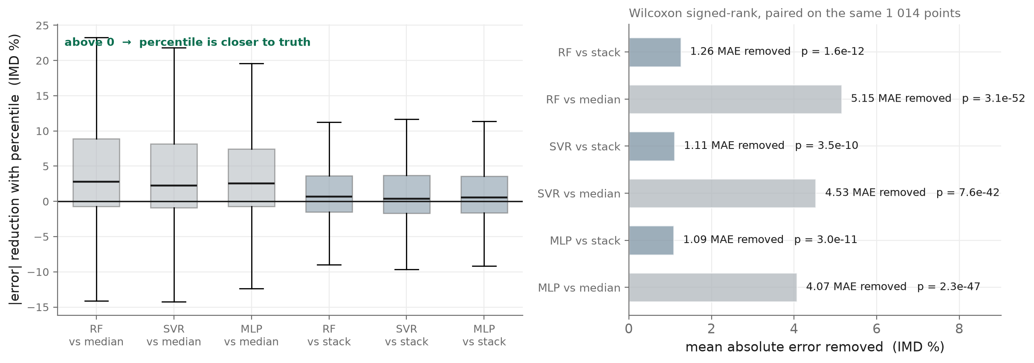
SIGNIFICANCE
The improvement is significant point-by-point, not just in aggregate
Because the split is imported, the same 1 014 holdout points appear in every run — so errors can be paired. Wilcoxon signed-rank: p ≤ 4e-10 for all six comparisons.
The embedding run did not store per-point residuals, so it is compared on aggregate metrics only and is excluded from this test.

Slide 12
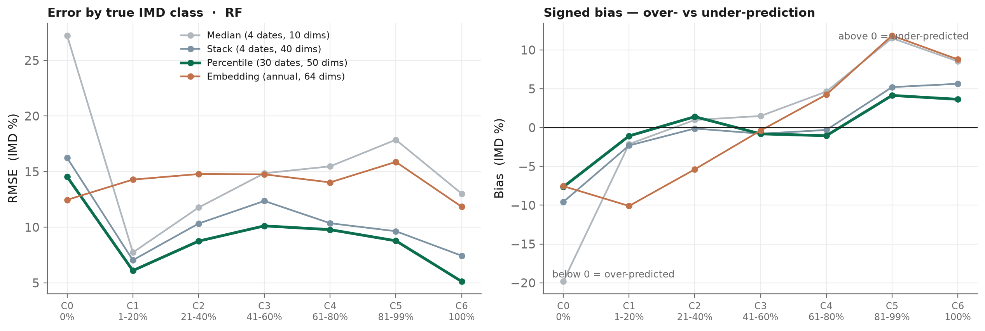
WHERE THE METHODS DIFFER
The embedding is competitive only on fully pervious pixels — percentile wins the rest
Across the six built-up classes the embedding averages 14.7 RMSE against 8.7 for percentile. Its one win is the 0% class (12.5 vs 14.5), where telling "no built-up" from "some" needs no temporal detail.
Two separate effects are visible. The median composite fails hardest at 0% (27.2 RMSE) — with only four dates it cannot tell bare winter soil from asphalt. The embedding instead fails in the mixed classes, staying near 15 RMSE everywhere: it is a general-purpose annual descriptor, not one tuned to sub-pixel imperviousness.

Slide 13
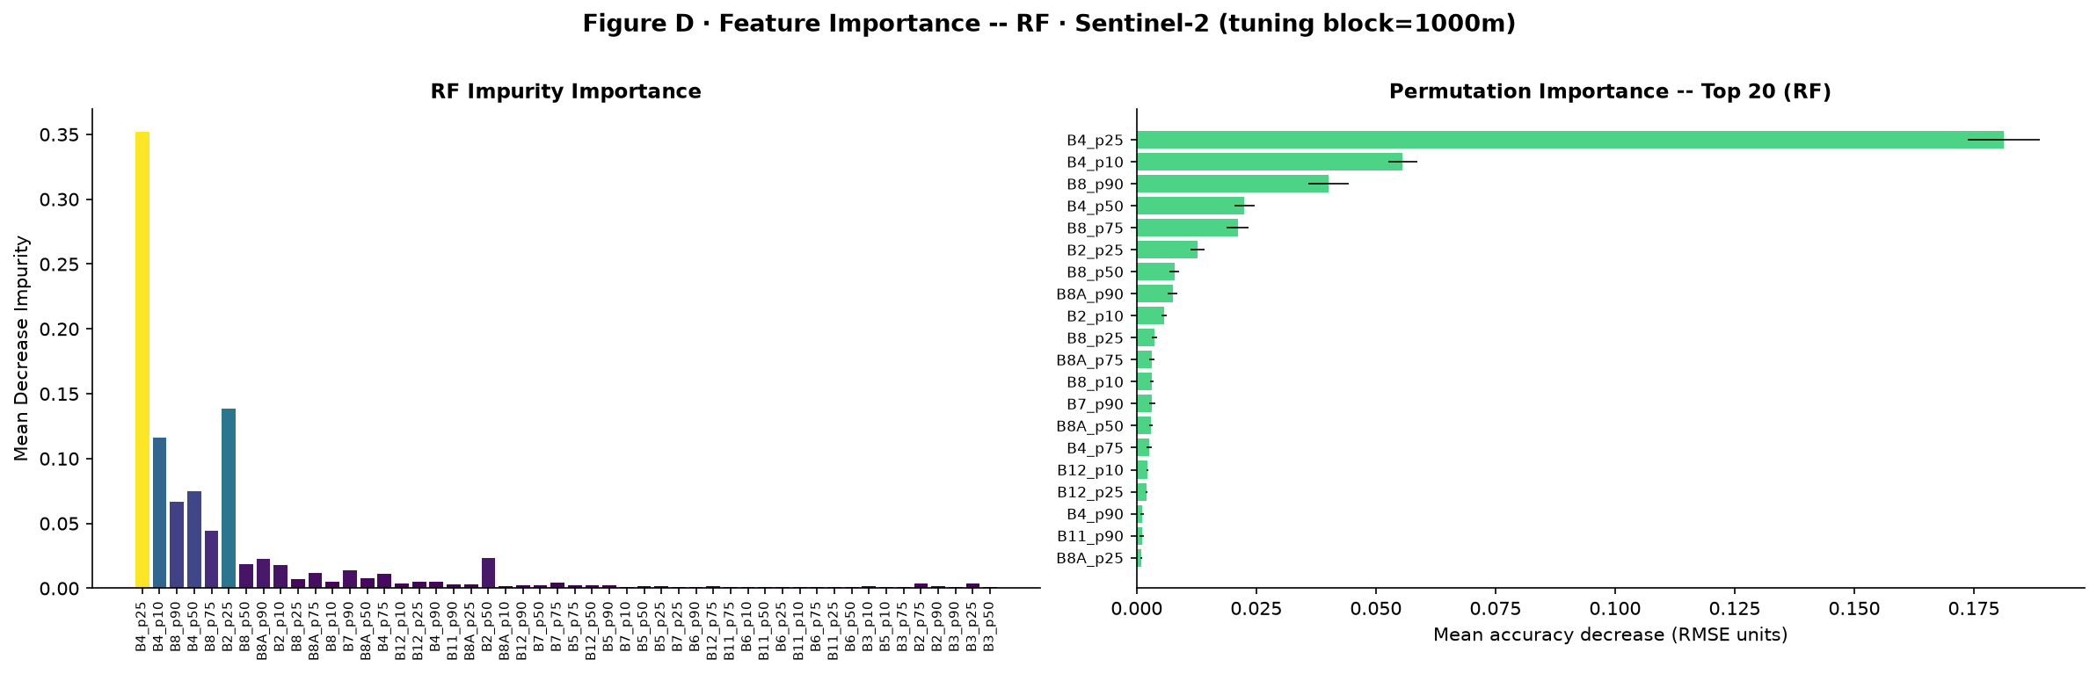
INTERPRETATION
The model relies on the low red and high NIR percentiles — a seasonality signal
The strongest features are B4_p25 / B4_p10 (how dark the pixel gets in red) and B8_p90 / B8_p75 (how bright it gets in NIR). Neither is a median.
Read together, these two describe how much a pixel greens up during the year. A vegetated or agricultural surface reaches a high NIR peak and a low red trough; asphalt and roofs stay flat. A median composite cannot express this, because it reports only where the distribution sits — not how wide it is. That is the concrete reason the percentile composite outperforms, and it explains why the outer percentiles matter more than the central one.

Slide 14
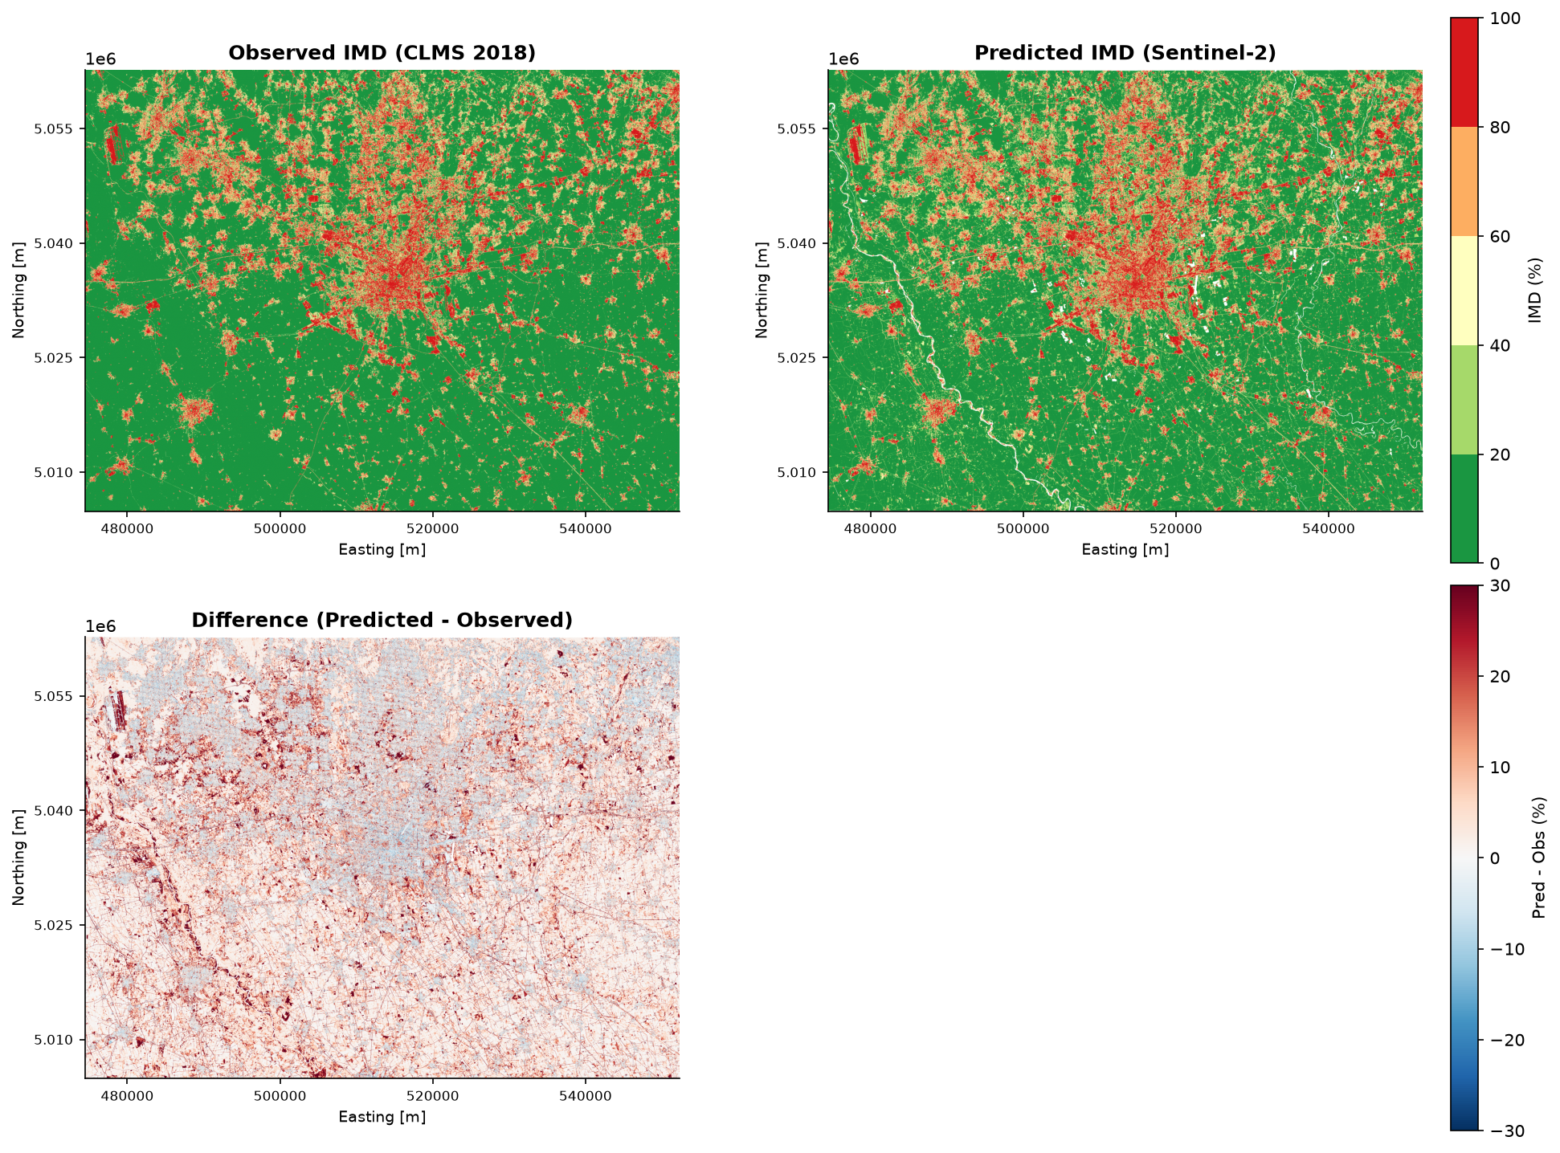
VISUAL CHECK
The map is right at the city scale, but the residuals are spatially structured
The urban core, the satellite towns and the agricultural south are all in the right places. The difference panel is where the remaining error lives.
Residuals are not white noise: linear features — the river corridor, motorways and field boundaries — are over-predicted (red), while the dense core is slightly under-predicted (blue). Both are mixed-pixel effects at 10 m, and they point at where a texture or context feature would help next.

Slide 15
LIMITATIONS
One confound is unresolved and must be stated before the result is used
These are properties of the current experiment, not of the data.
# | Limitation | Consequence
1 | Date count is confounded with method | Percentile used 30 dates; stack and median used 4. Part of its advantage may come from observation count, not the reducer.
2 | Stack is partly synthetic | Masked pixels are gap-filled from the median (0.006–1.5% per date); the model cannot distinguish filled from observed.
3 | The exported raster ≠ the tuned model | GEE’s smileRandomForest accepts only 2 of the 6 tuned RF hyper-parameters; the rest are dropped at export.
4 | MLP cannot be deployed | It often wins cross-validation but has no Earth Engine equivalent, so it never becomes a map.
5 | Single city, single year | Milan 2018 only. Nothing here demonstrates transferability yet.

Slide 16
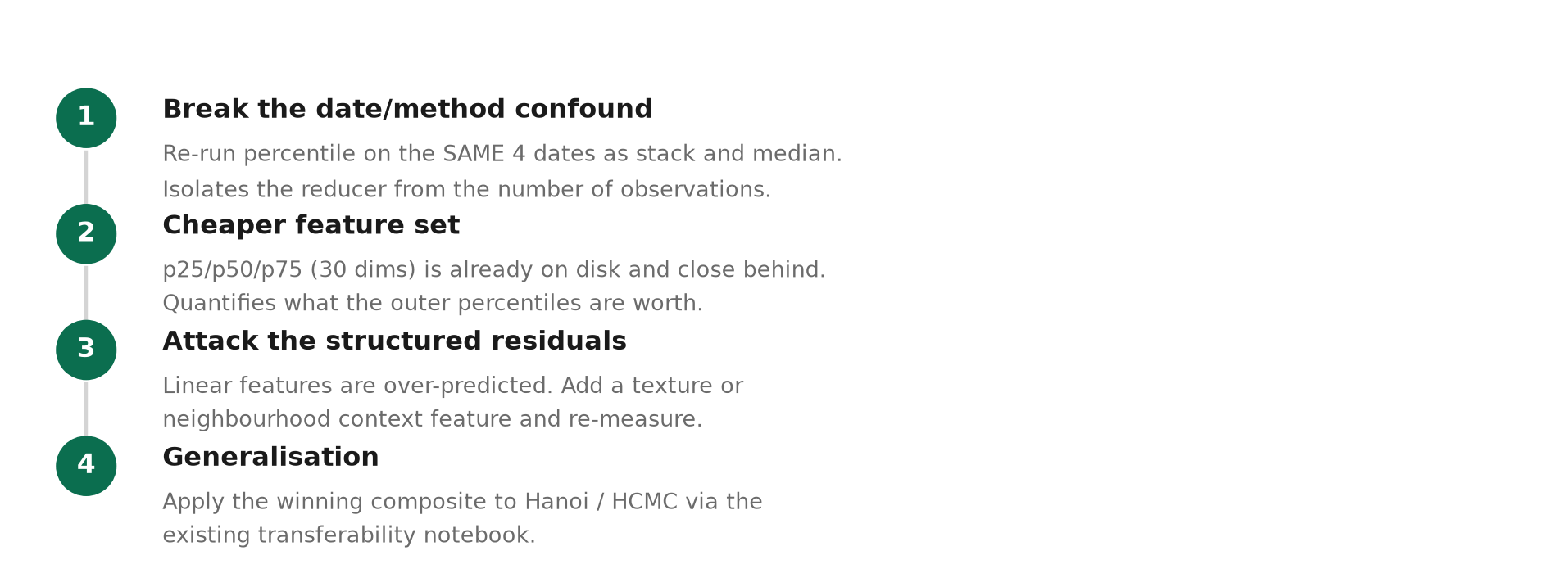
NEXT STEPS
The first experiment is the one that makes the current result conclusive

Slide 17
SUMMARY
Four answers
Bands and dates
Ten L2A reflectance bands, no indices. 30 of 145 2018 acquisitions accepted by three AOI-based criteria — cloud, validity and coverage.
Comparability
The train/test split is imported from the embedding run and labels asserted identical: 2 449 / 1 014 / 37. Only the features differ, so the runs are directly comparable and can be paired.
The three methods
Median (10 dims) keeps central tendency; stack (40 dims) keeps four individual dates; percentile (50 dims) keeps the shape of the annual distribution.
Outcome
Percentile is best on every model and metric (SVR RMSE 9.05, R² 0.933), significantly so under a paired test. The date-count confound remains to be resolved.

