Slide 1
CSC 3210 Computer Organization and programming LAB 5
Using Venus

Slide 2
INSTRUCTIONS FOR LAB 5
Tasks to be done in this lab:
Work with VSCode
Learn how to "Step" through a program
Learn how a "hello world" program works in assembly language
Study some RISC-V assembly language commands, e.g. li, ecall, as well as directives like .data, and labels.

Slide 3
ASSIGNMENT FOR LAB 5
This lab has two parts. Install Visual Studio Code with required extensions and run a sample code.
Answer the questions from both the parts mentioned in bold.
Turn in a copy of your code, and turn in your output as a text file. If iCollege gives you trouble about turning in your code, rename it to a .txt extension, and it should work. Remember to submit the lab report as it is vital for grading.

Slide 4

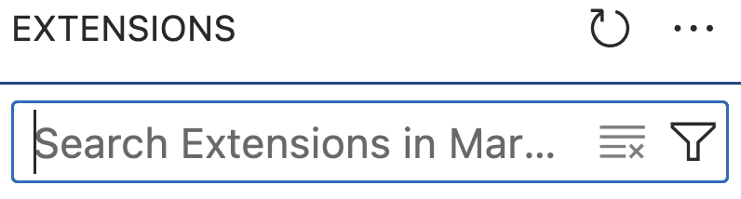
VISUAL STUDIO CODE SETUP
This lab uses visual studio code. Install it if you do not have it already. It is a good idea to organize your files from the start, such as creating a directory for RISC_V files, and directory under that for each assignment.
Download and install Visual Studio Code
Start Visual Studio Code
Click on the "Extensions" icon
Search for and install riscv-venus through the "search extensions..." box
Also install RISC-V Support (from zhwu95)

Slide 5
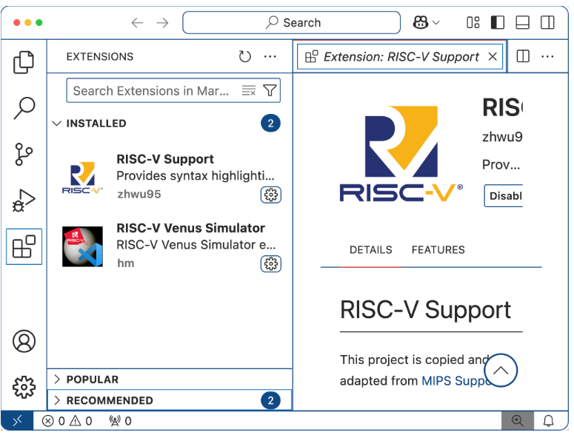
VISUAL STUDIO CODE SETUP
The image below shows what it should look like when you are done. You may need too remove the text in the search extensions box to see this.
Before we begin Lab 5, refer to Lab 4 to get a quick reminder on commands like li (load immediate), add, jal (jump and link). You should also have an understanding of how we print the values by ecall (environment call), similar to "call printf".

Slide 6
PART-1
Download the code found at HelloWorld.S. As the comments indicate, this is based on a couple of examples and modified. See here and here for the originals.
Copy the code to your workspace.
On my system, I have a directory called “LAB/RISC_V", then another directory called "hello_world" under this, with the .S file under that.
That is, the full name is ~/LAB/RISC_V/hello_world/HelloWorld.S. However, you should use whatever makes sense for you. Open the file in VSCode.
Note that registers are x0, x1, x2, etc. Register x0 always has a value of 0.
Also, Venus supports alternate register names a0, a1, s0, s1, etc. The "a" stands for argument, used for interfacing with other code (like calling a subroutine). The "s" stands for saved, meaning that its value will be preserved even if calling a subroutine. There are also "t" registers (e.g. t0, t1, t2) meaning temporary.

Slide 7
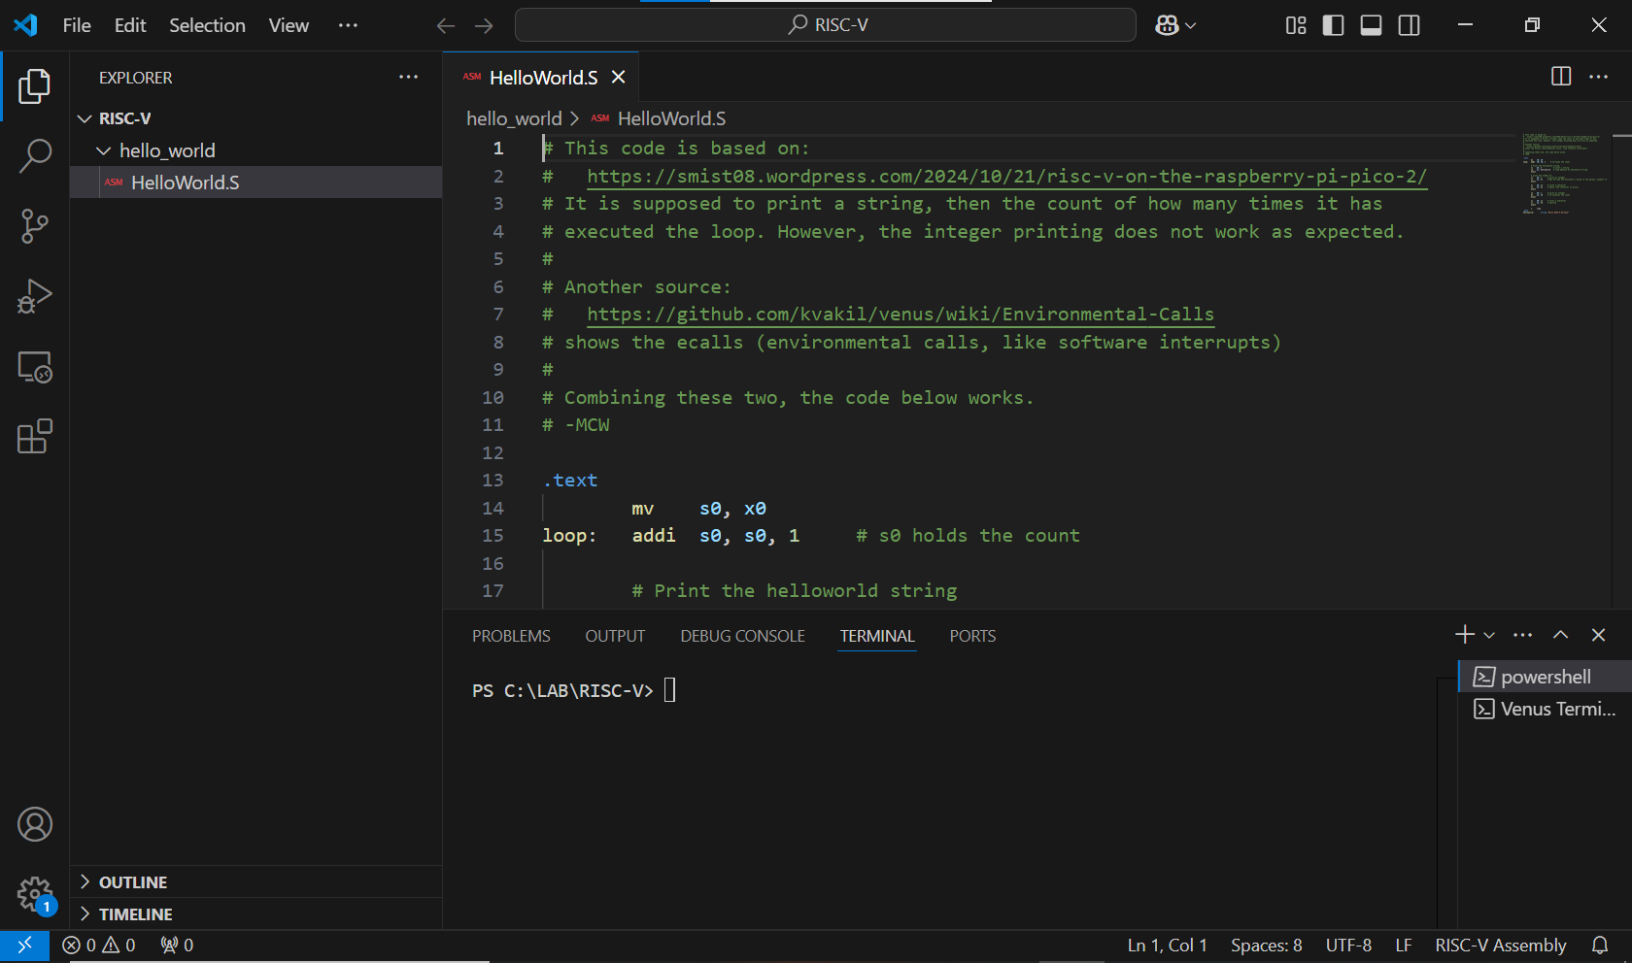
OPENING THE FILE IN VS CODE
Use the file option in VS Code to browse the system and open the HelloWorld.S file which was previously stored.

Slide 8
PART-1
Let's take a look at the code.
#
# This is a comment.
# You should put your name on any code that you create/modify.
# If you use someone else's code, also include the original author(s),
# and any other relevant info.
Everything after the pound-sign is ignored. It is important to document your code with comments. If you include someone else's code, you should say what it is, e.g. put comments like the following around it.
# Begin code modified from https://....
# End code modified from https://....
The following command moves the value of register x0 to another register called s0. Register x0 always has the value 0, which is just an efficient way to get this value.
mv s0, x0

Slide 9
PART-1
The next line has several parts.
loop: addi s0, s0, 1 # s0 holds the count
The text loop: specifies a label. Further down in the code, you will see j loop which says to unconditionally jump to the "loop" label.
If you examine the code, you will probably notice that it is an infinite loop. Normally, we would not want this. However, you will be able to stop it in the simulator.
The next part of that line says addi s0, s0, 1 which says to add the immediate value of 1 to the s0 register's value, and store the result in the s0 register.
You may have noticed a pattern: destination, source, and possibly a second source. The mv s0, x0 is much like s0 = x0 in another language. Similarly, addi s0, s0, 1 is much like s0 = s0 + 1 in another language.
You know that the pound-sign starts a comment, so the assembler ignores everything after that. Comments help anyone reading the code to understand exactly what it is doing.
While it is possible to read the code and know what the code does, the instructions alone do not inform you about the intent. The comments will help in that regard.

Slide 10
PART-1
The next three lines go together. As the comments indicate, these instructions will print a string. The "environment call" (ecall) is used to work with the OS and/or libraries.
But we have to specify what we want it to do, and the code that is called uses the registers to figure out what we mean.
In this case, we give it the value 4 in register a0 to indicate that we want to print a string, and put the address of the string to print in a1.
li a0, 4 # print a string
la a1, helloworld # load address of helloworld string
ecall
This is much like the printf command in C, the print command in Python, or the System.out.println command in Java. We define the label "helloworld" a bit later, in the .data section.
.data # Data section, initialized variables
helloworld: .string "Hello RISC-V World\n"

Slide 11
PART-1
There are two more blocks of code to examine. The next three lines say to print an integer. We use a0 again to specify what operation we want to do, and use a1 to specify the data.
This time, instead of a string, we will print the value 42.
li a0, 1 # print an integer
li a1, 42 # See The Hitchiker's Guide to the Galaxy
ecall
The number 42 is a cultural reference from Hitchiker's Guide to the Galaxy. Obviously, you do not have to read that book for this class, but it is good to know where that number comes from.
The last block of code that we discuss here is the following. There are a couple more blocks in the program, but you should be able to figure out what they do.
li a0, 11 # print a character
li a1, 32 # space (the character to print)
ecall
This block is similar to the previous block. This prints a character, with 32 (decimal) as the character code. This corresponds to a space.
Consult an ASCII table to see what other character codes exist.

Slide 12
PART-1
Questions:
Suppose that we have the following code.
li a0, 1
li a1, 100
ecall
What do you expect will happen when this is executed?
Suppose that we have the following code.
li a0, 11
li a1, 100
ecall
What do you expect will happen when this is executed?

Slide 13


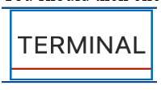

PART-2
Make sure that you have the "HelloWorld.S" program loaded in VS Code. Click on the "Run and Debug" icon on the left. It looks like this:
Click on the three dots next to "run and debug", then choose "Debug Console".
You should then click on Terminal
Now select "Run" then "Start Debugging" from the drop-down menu at the top (or top of your window).
You should see a group of buttons appear above the code. The first button is "Continue" (if you hover your pointer over a button in VSCode, it will say what it is). The second button is "Step Over", then "Step Into" after that, then "Step Out", then "Restart", and finally "Stop".
Next, "step" through the program by clicking on the icon at the top. You do not want to "run" this one, since it has an infinite loop and will quickly fill the output section.

Slide 14
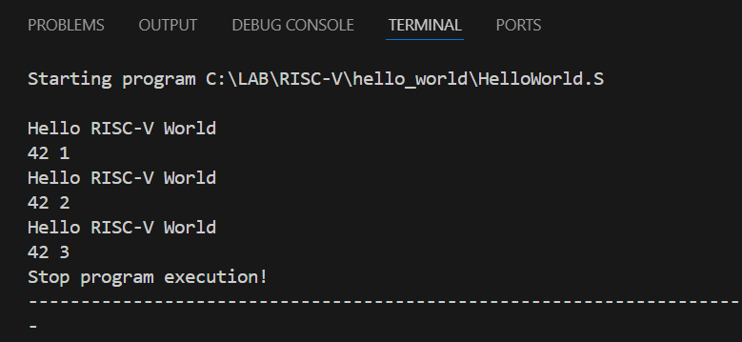
PART-2
When you "step" through the program, you should see it advance line by line.
You will not see any output until it gets to one of the ecall instructions.
Repeat stepping through until you have executed three iterations of the loop.
Your output should look like the following. Include your output in your lab report. Also, include a screen-shot of VSCode with the HelloWorld.S program in your lab report.

Slide 15
PART-2
Questions:
For each of these, you might need to find documentation. If you consult a source (such as a webpage), make sure to include that source in your answer.
You should notice how the "PC" value on the left (under Variables) changes as you step through the program. What does PC stand for in this context? Why does it change from 0x00000004 to 0x00000008 in one step?
Examine the "Integer" values on the left (under Variables). Describe what happens with x10 and x11 as you step through the code. Give an example of one line of the code, and what effect it has on x10. Give an example of one line of the code, and what effect it has on x11.
What does the "Continue" button do? Describe it in your own words.
What does the "Restart" button do? Describe it in your own words.
What does the "Step Out" button do? Describe it in your own words.
What is the difference between "Step Over" and "Step Into"? Describe it in your own words

Slide 16
IMPORTANT NOTE:
Note about submitting your work: The lab instructions say to "Turn in the log as a text file", but in this lab, you did not need to connect to the server, and thus do not have a log. In cases like this, turn in a copy of your code, and turn in your output as a text file. If iCollege gives you trouble about turning in your code, rename it to a .txt extension, and it should work.
Remember that we will grade your lab report so it is vital to turn that in. The other files (your code, a text version of any log file, etc.) are to document your work in case we need more information..

