Slide 1
NETCHEX / VISITOR SIGNALS
Demo walkthrough
Anonymous website traffic → identified visitor
→ ICP-scored lead → personalized outbound email
→ simulated Gong Engage send.
One pipeline. Five integrations. Zero black boxes.
Turn anonymous traffic
into vetted outreach
A single pipeline from RB2B pixel hit to a personalized email sitting in front of an SDR — in under 15 seconds and under 15 cents.
Presented by the Sales Ops team

Slide 2
THE GAP
97% of visitors never fill out a form
Identified ≠ qualified.
• RB2B surfaces ~40% of visitors by name, email, company, LinkedIn.
• Most of those aren't buyers — wrong title, wrong industry, wrong size.
• An SDR reading the feed manually burns an hour a day and still misses the real leads.
The bottleneck is triage and personalization — not identification.
Netchex Visitor Signals — demo deck

Slide 3
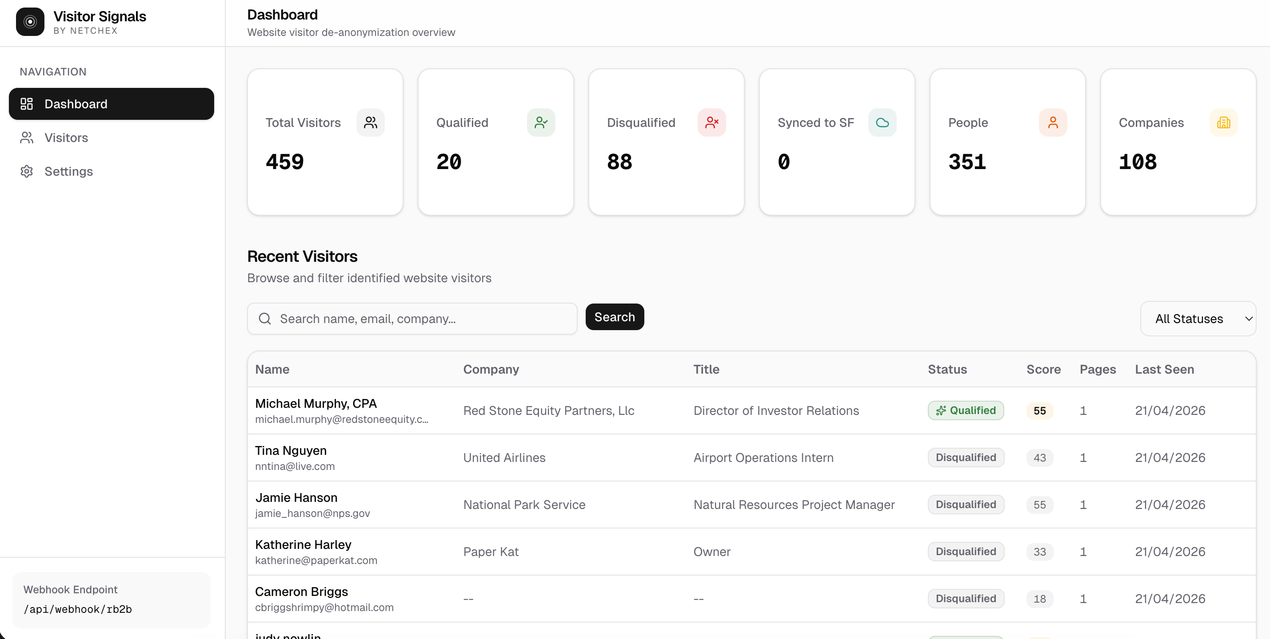
ARCHITECTURE
Five steps, fully configurable
RB2B → Clay → ICP score → SF/Gong dedup → LLM draft → SDR
• RB2B webhook (or CSV bulk) drops identified visitors into Postgres.
• Clay enriches on LinkedIn URL → work email, title, company firmographics.
• ICP engine scores 0–100 against editable rules; tiers leads 1/2/3.
• Before drafting, we check Salesforce + Gong for existing deals or prior contact.
• Gemini 2.5 Flash drafts a voice-matched email; SDR copies or simulates send.
Netchex Visitor Signals — demo deck

Slide 4
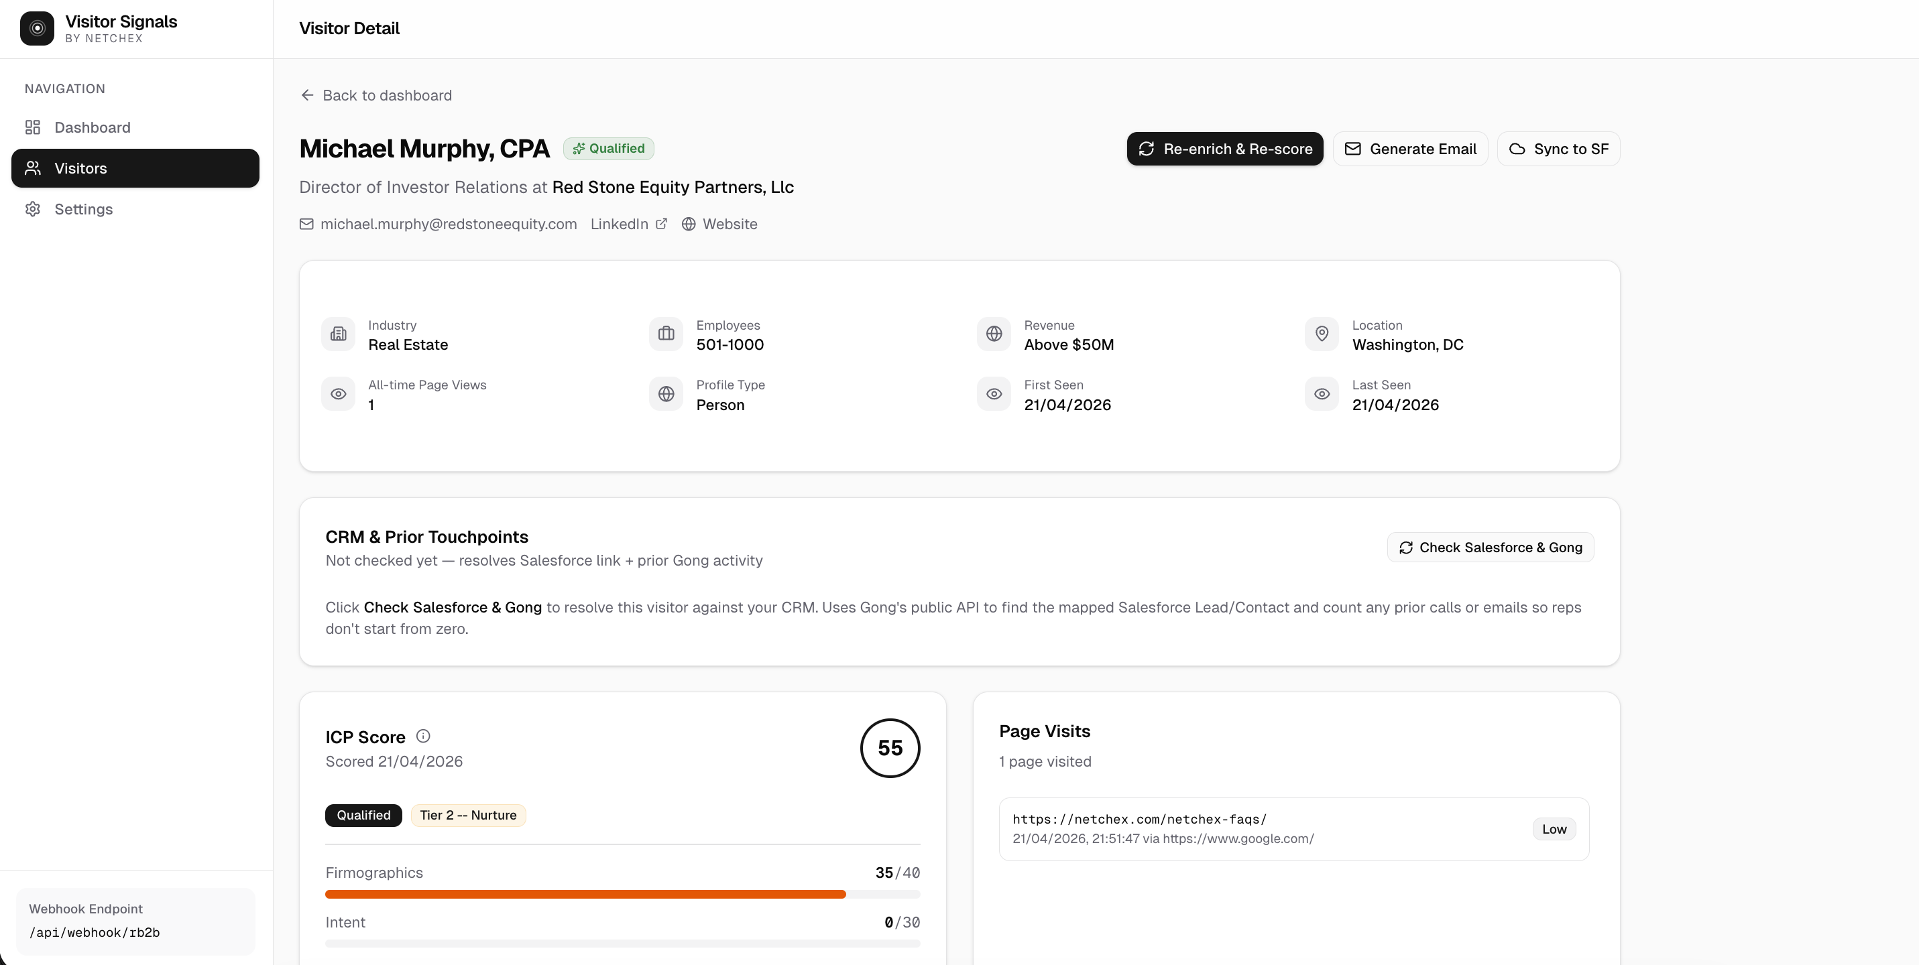
SCORING THE FUNNEL
The ICP lives in the app, not in code
Four signals, 100 points total.
• Firmographics (40) — industry, size 50–500, US-based.
• Intent (30) — which product pages; /pricing and /demo weigh extra.
• Persona fit (20) — HR / payroll / ops / owner titles.
• Capacity (10) — revenue band, repeat visits.
Sales Ops edits the rules in Settings.** One-click re-score on the top 50.
Netchex Visitor Signals — demo deck

Slide 5
DON'T STEP ON A LIVE DEAL
Every email is checked against Salesforce + Gong first
One click: Check Salesforce & Gong.
• SOQL lookup by email — Lead or Contact, with owner + last activity.
• Gong API — prior call count, prior email count, last touchpoint.
• Results cache on the visitor row; repeat dashboard loads are free.
• If this person is already in-play, the SDR gets a warning — not a draft.
Netchex Visitor Signals — demo deck

Slide 6
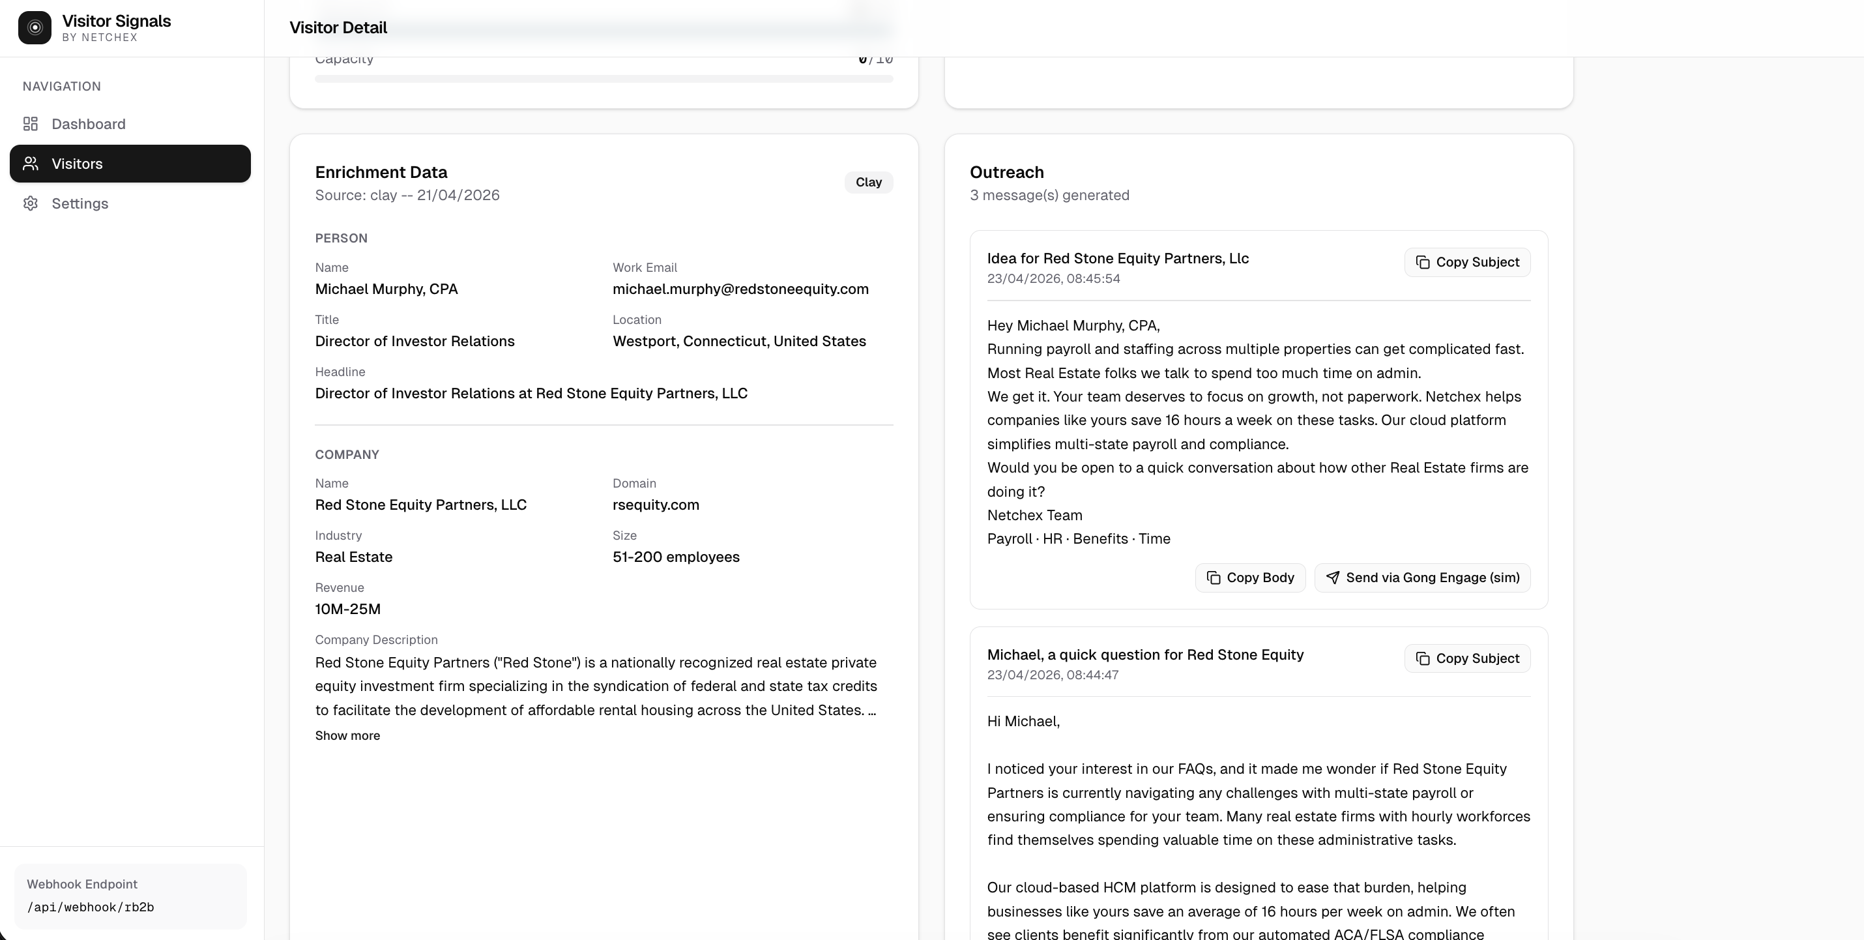
THE TONE IS THE PRODUCT
Voice-matched email, regenerable on demand
Gemini 2.5 Flash, ~3s, ~$0.0005 per draft.
• Prompt reverse-engineered from 10 real SDR emails (Teresa, Scott).
• Greeting: "Hey [first name]," — never "Dear".
• A real Netchex customer name (IVY, CFAN, Willbanks) when the industry matches.
• CTA always ends with a duration: "Is a 10-minute overview worth scheduling?"
• Marketing retunes the voice by editing the template — no deploy.
Netchex Visitor Signals — demo deck

Slide 7
WHAT'S NEXT
From demo to production
Real Gong Engage send
Behind a feature flag. Awaiting Legal sign-off.
Auto-assign to AE
Gong's CRM mapping already tells us the owner.
Slack alert for Tier 1 leads
Same hook, different endpoint.
Daily SDR digest
Top 10 qualified visitors from the last 24h.
Monitoring dashboard
Time-to-qualification, LLM spend, enrichment credits.
Questions?

