Slide 1
ANN Artificial Neural Network
Tanya Djavaherpour

Slide 2
Table of contents
01
02
03
04
Introduction
Goal Satement
Assumptions
Model

Slide 3
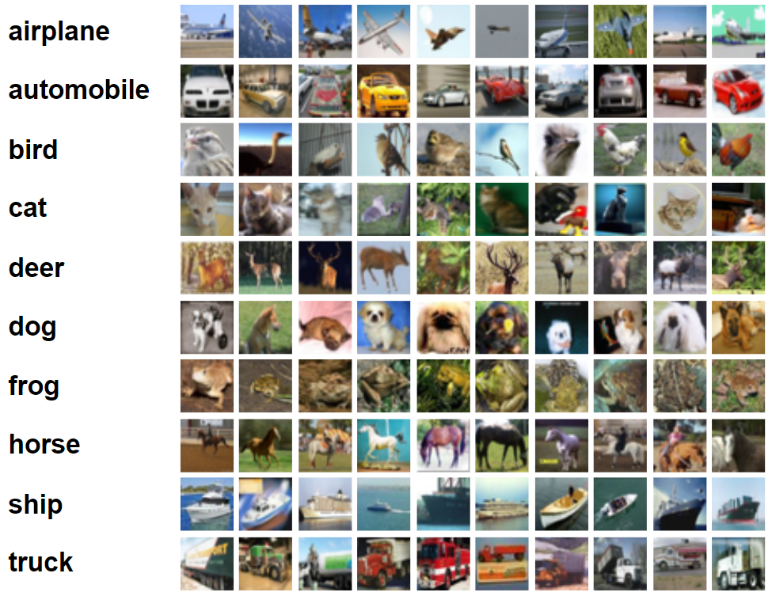
Introduction
Artificial Neural Network (ANN): A computational model inspired by the human
brain’s network of neurons, used for tasks like image recognition and classification.
Image Classification: The process of identifying and categorizing elements in a
digital image into predefined classes.
CIFAR-10 Dataset: A collection of images used for evaluating machine learning
models, consisting of 60,000 32x32 color images in 10 different classes.

Slide 4
Goal Statement
System Inputs: An image with an object
System Output: Category name into which the image is classified
GS1: Predict the class of uploaded image

Slide 5
Assumptions
A1: All images are of a size of 32x32
A2: The input image contains only one object
A3: Every uploaded image belongs to one of the 10 predefined classes in the
CIFAR-10 dataset

Slide 6
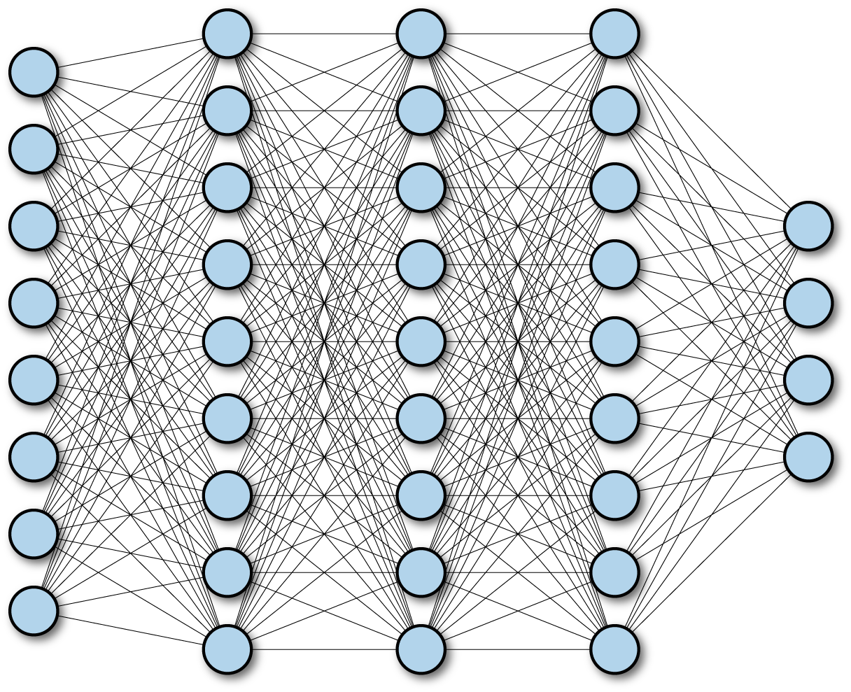
Model
Fully Connected Neural Network:
Inputs: number of pixels (32*32=1024)
Outputs: number of classes (10)
Hidden Layers: will be decided

Slide 7
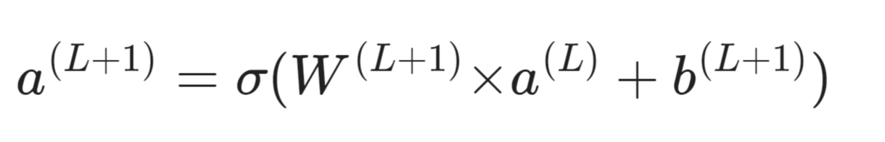
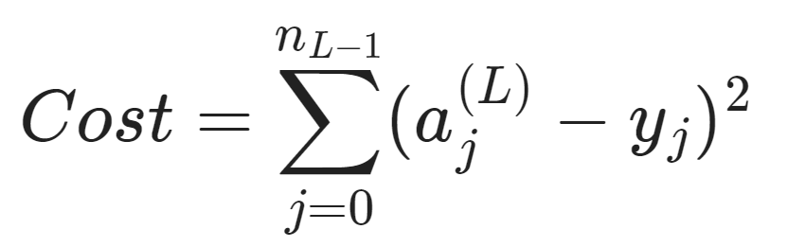
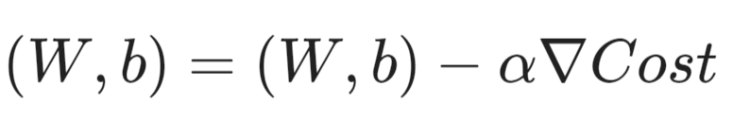
Model
Feedfroward:
Backpropagation:
In this project the cost function is sum of squared errors (SSE)
Gradient Descent is applied to minimize cost function

Slide 8
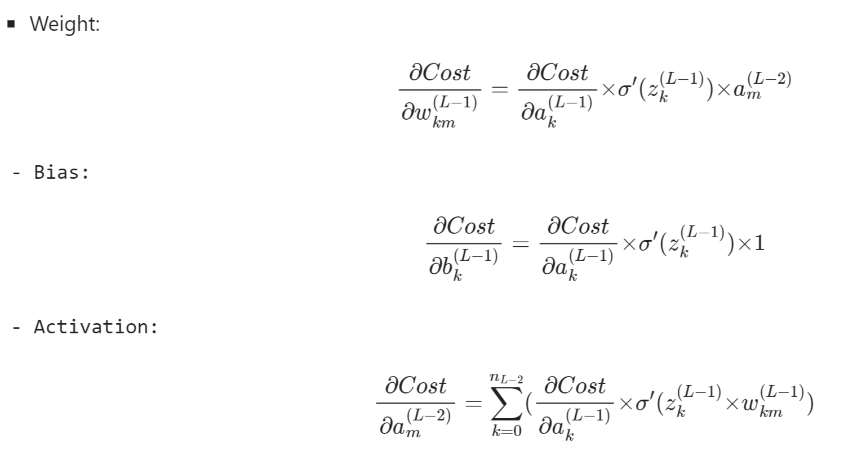
Model
Chain rule is applied to find the gradient

Slide 9
Thanks for Your Attention!

