Slide 1
ANN Artificial Neural Network
Tanya Djavaherpour

Slide 2
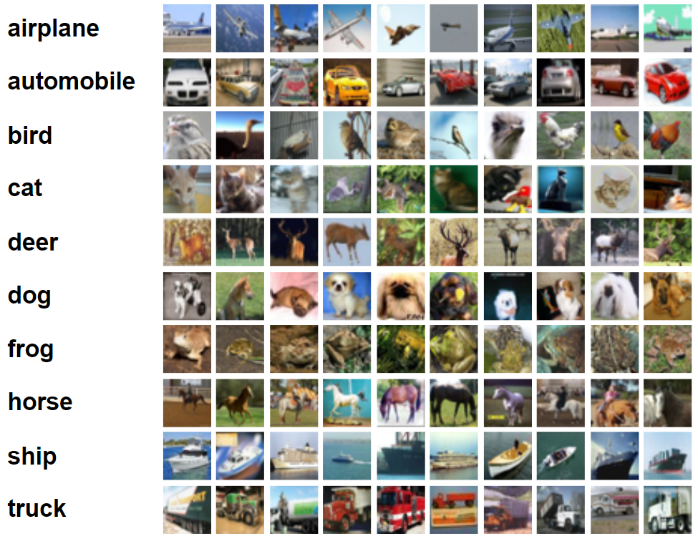
Review
The software is an Artificial Neural Network for Image Classification, optimized for the CIFAR-10 dataset, allowing efficient categorization of images within its specific dataset constraints.

Slide 3
Likely Changes
The specific hardware on which the software is running.
The format of the initial input data.
Changes in the algorithms and techniques used for image classification.
Modifications in neural network training algorithms and parameter adjustments.
Updates in the scheduling and methodology for model training and updating.
Evolution in the format and structure of the output data, including classification results, by developing GUI.

Slide 4
Required Modules
Hardware-Hiding Module
Behaviour-Hiding Modules:
ANN Control Module
Saved ANN Model Module
Output Module
Input Classifier Module
Setting Input Image Module
Training Model Module
Setting Feedback Module
Software Decision Modules:
Input Preparing and Preprocessing Module
Training Data Preparing and Preprocessing Module
Training Module
Testing Module

Slide 5
Important Software Decision Modules
Training Data Preparing and Preprocessing Module
Secret: Preparing training dataset in a format that can be used by model for training.
Implemented by: Numpy
Training Module
Secret: Finding wight and biases of the model.
Implemented by: Numpy

Slide 6
Saved ANN Model Module
Secret: The weights and biases that make up the ANN classification model
Type of Module: Record
Uses: Training Module
State Variables: Numpy arrays
Environment Variable: The system path to save the arrays

Slide 7
Input Classifier Module
Secret: The algorithm for classification given the input image and using the saved ANN model.
Type of Module: Abstract Data Type
Uses: Input Preparing and Preprocessing Module, Saved ANN Model Module
State Variables: Char
Environment Variable: Numpy array of input image and saved model

Slide 8
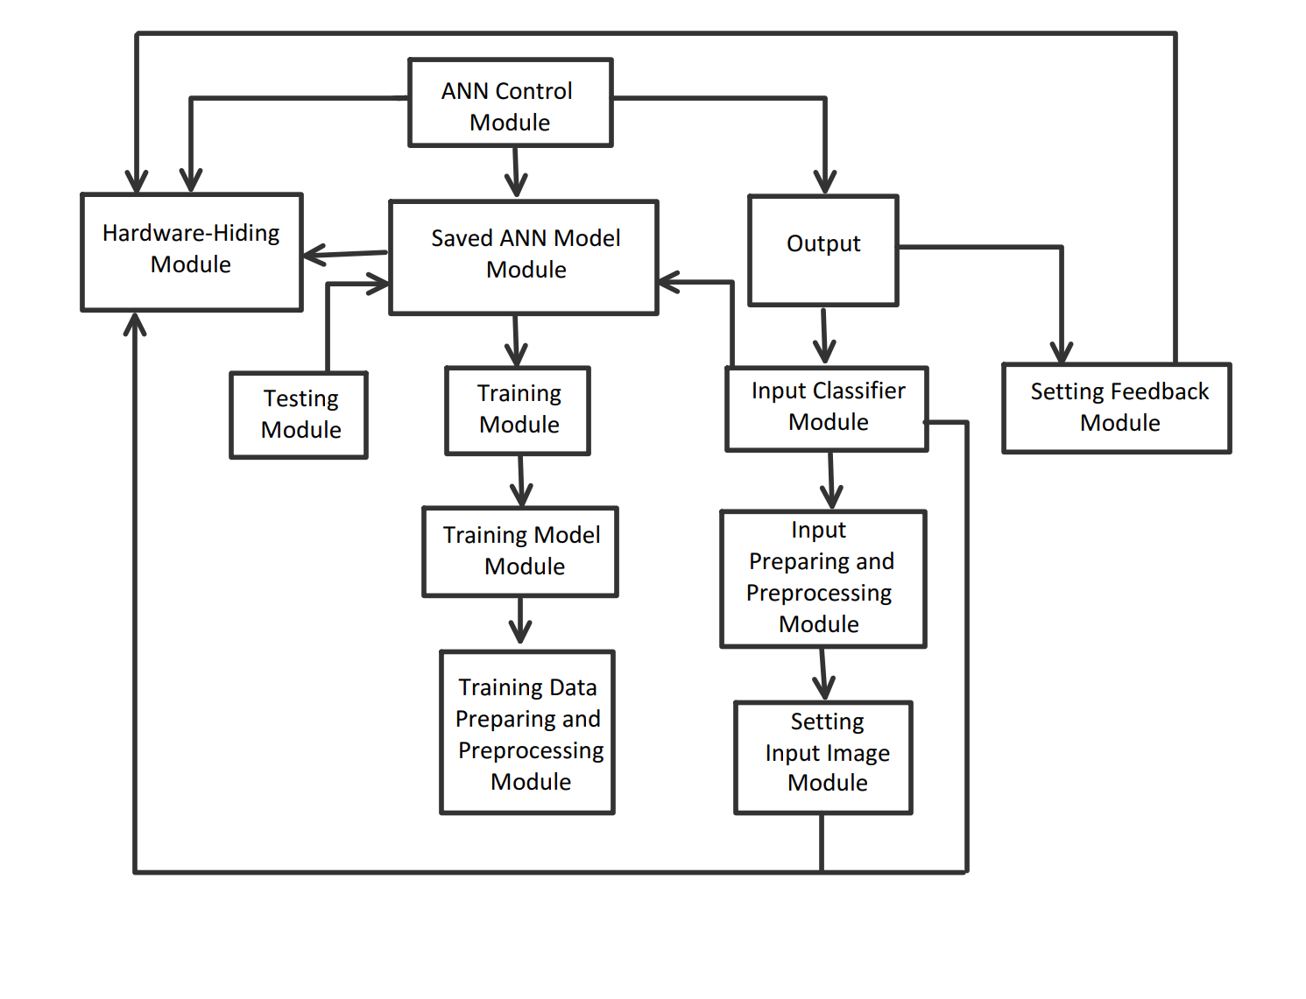
Use Hierarchy Between Modules

Slide 9
Thanks for Your Attention!

