Slide 1
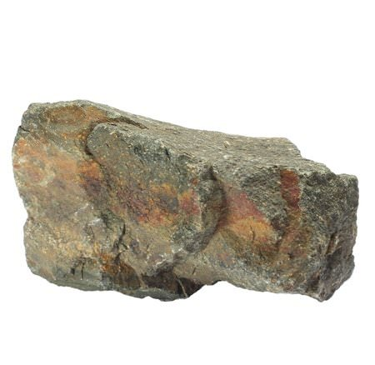
soft
hard

Slide 2
4 + 6 > 5 + 7
true
false

Slide 3
cabbage
2 syllables
3 syllables

