Slide 1
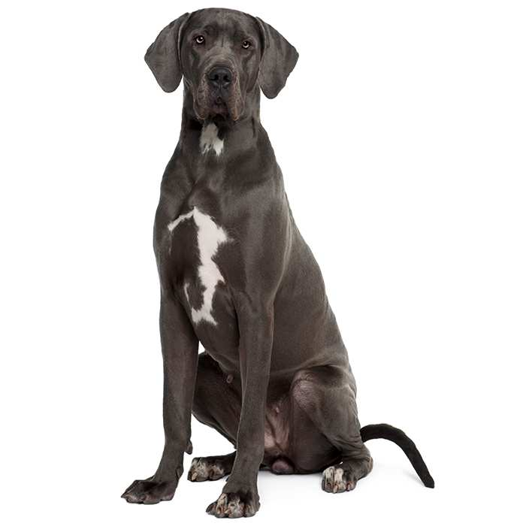
manmade
natural

Slide 2
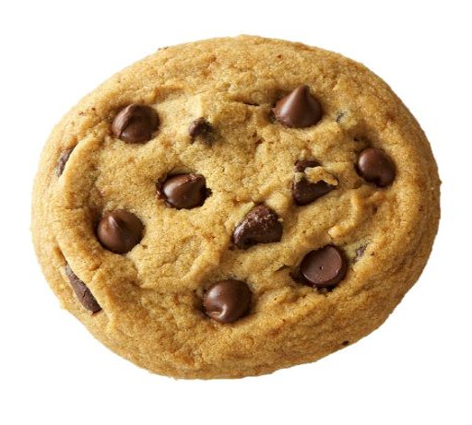
small
large

Slide 3
love
abstract
concrete

Slide 4
cabbage
1 syllable
2 syllable

Slide 5
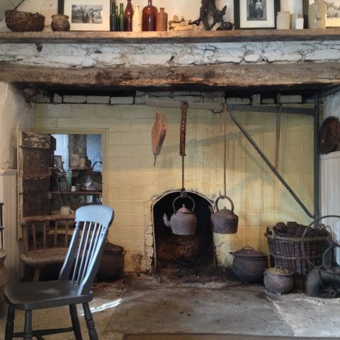
cottage
skyscraper

Slide 6
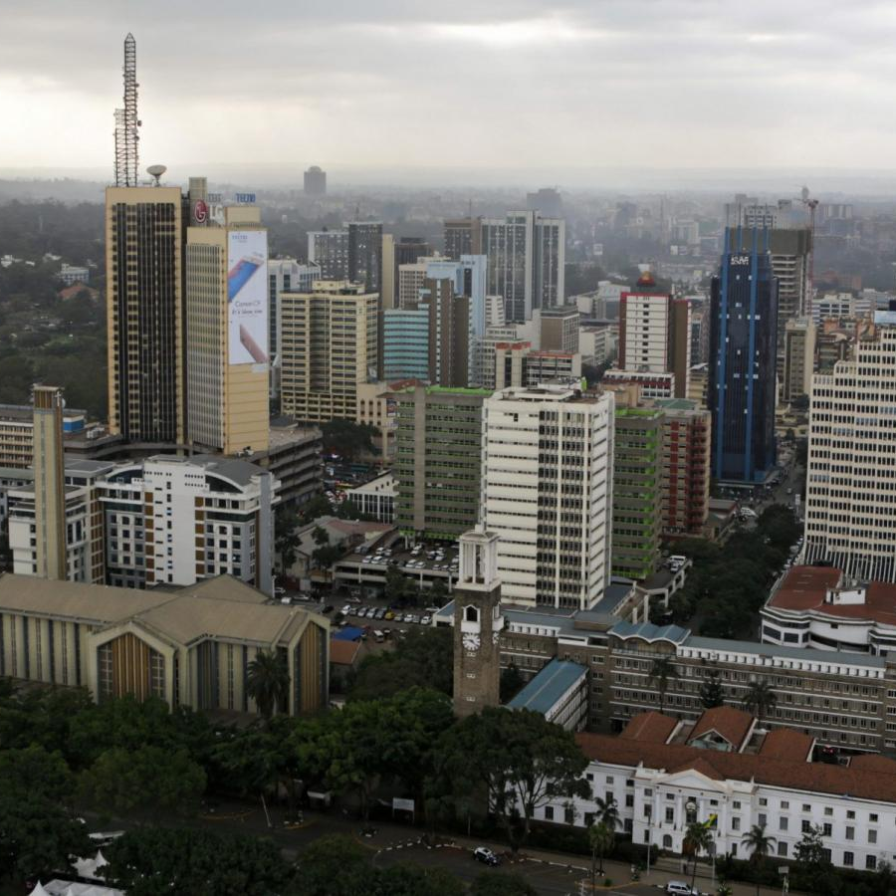
indoor
outdoor

