Slide 1
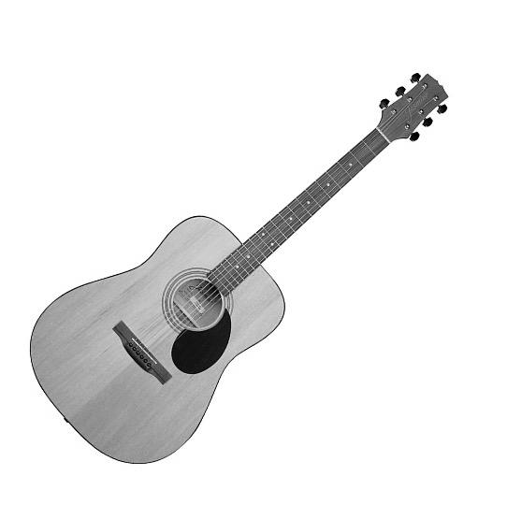
pleasant
unpleasant

Slide 2
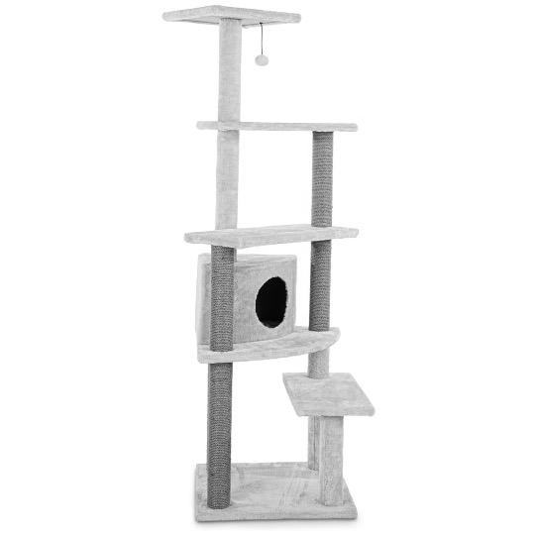
unpleasant
pleasant

Slide 3
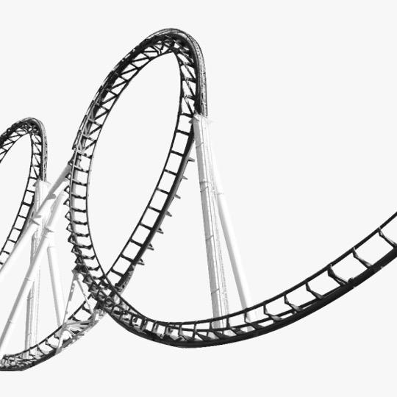
pleasant
unpleasant

