Slide 1
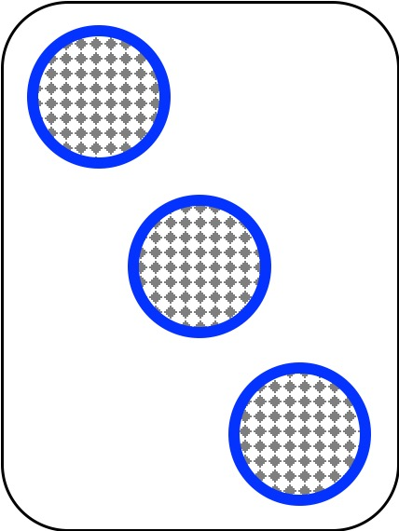
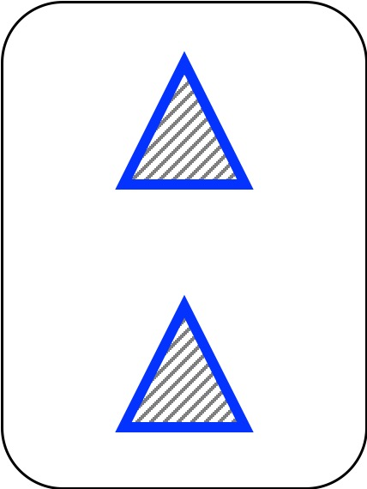
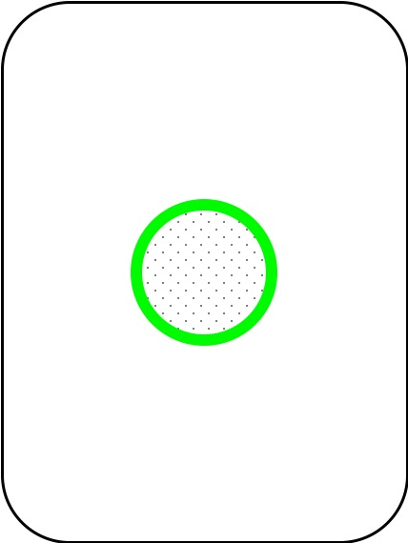

Slide 2

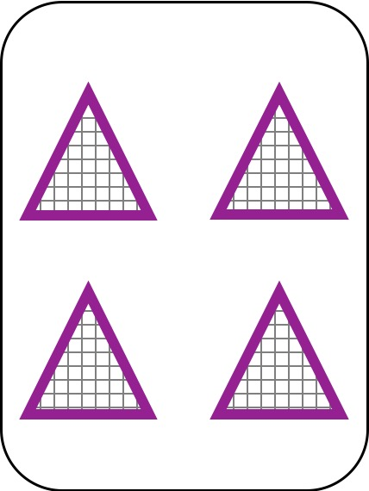
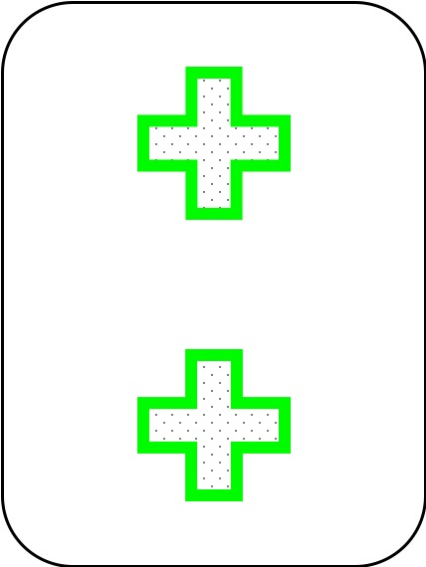

Slide 3

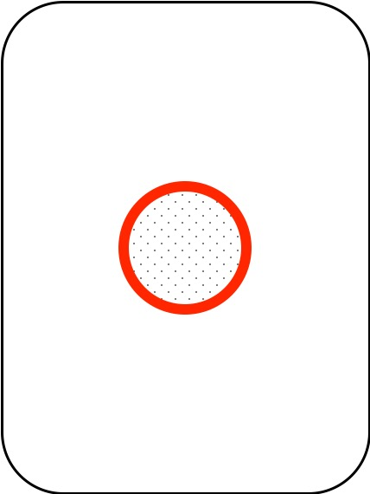


Slide 4


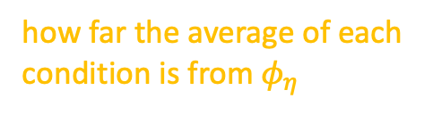
group
low/high volatility
average learning rate of each condition
phase
learning/transfer
experiment
1 / 2 / 3
population average for all subject of all conditions
how far the average of each condition is from $φ_{η}$

Slide 5

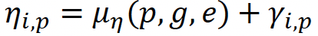
learning rate of each individual
group
low/high volatility
phase
learning/transfer
experiment
1 / 2 / 3
average learning rate of each condition
how far each individual i is from the condition average

Slide 6
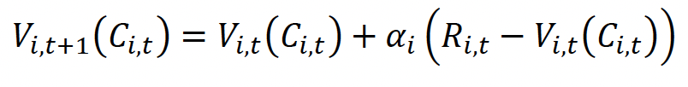
individual learning rate
updated value estimate of chosen rule
value estimate of chosen rule
feedback
(reward)

Slide 7

group
low/high volatility
phase
learning/transfer
experiment
1 / 2 / 3
population average for all subjects of all conditions
how far the average of each condition is from $φ_{β}$

Slide 8

group
low/high volatility
phase
learning/transfer
experiment
1 / 2 / 3
average inverse temperature of each condition
how far each individual i is from the condition average

Slide 9
