Slide 1
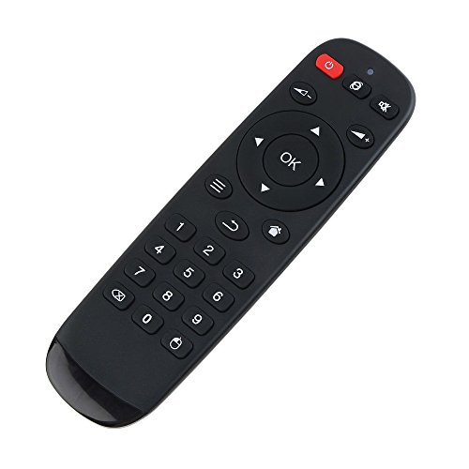
manmade
natural

Slide 2

manmade
natural

Slide 3
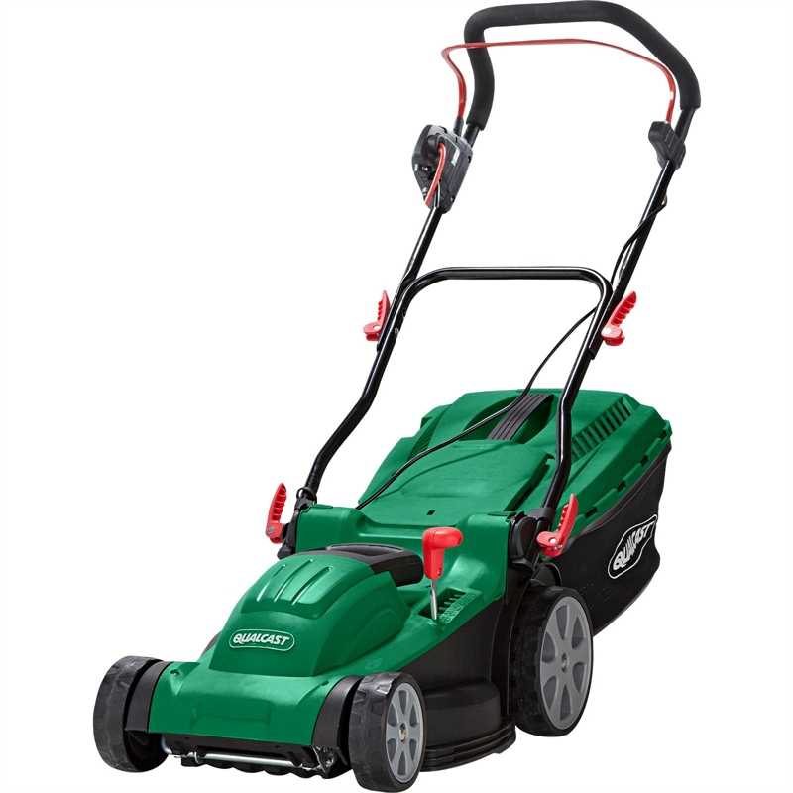
natural
manmade

Slide 4
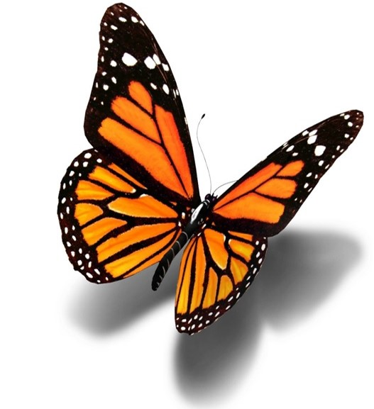
natural
manmade

Slide 5
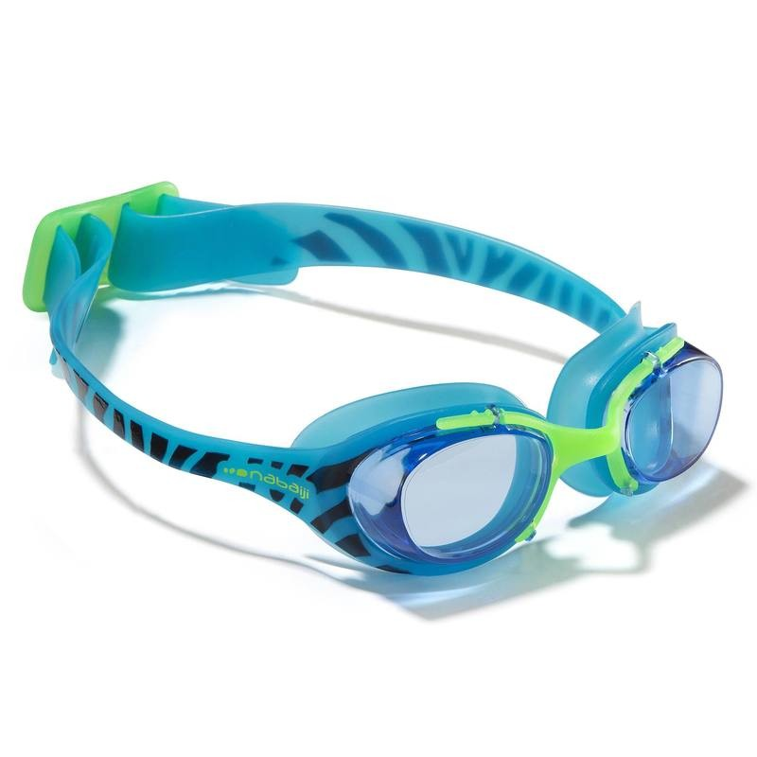
manmade
natural

Slide 6
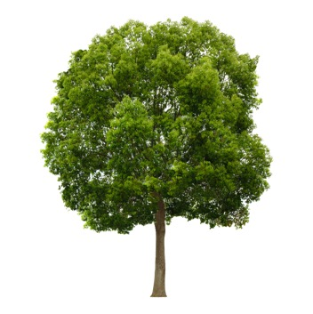
small
large

Slide 7
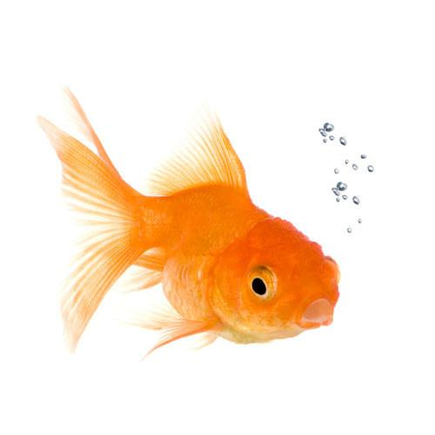
large
small

Slide 8
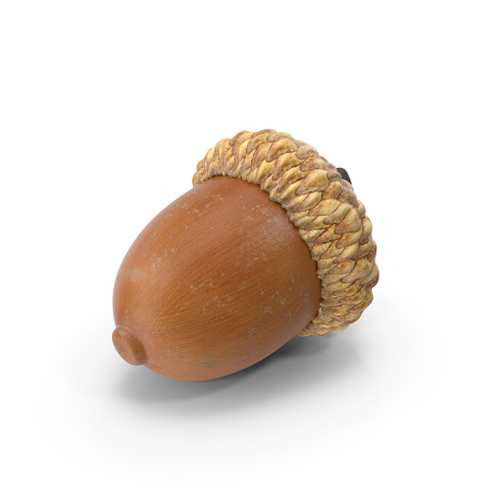
large
small

Slide 9
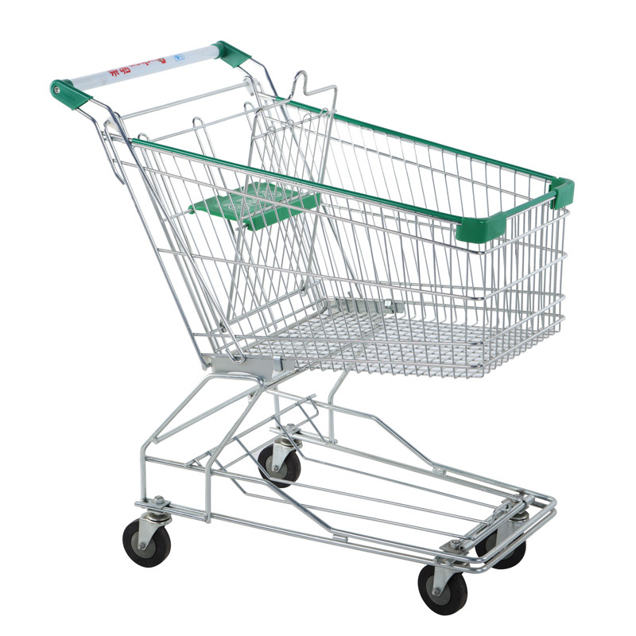
small
large

Slide 10
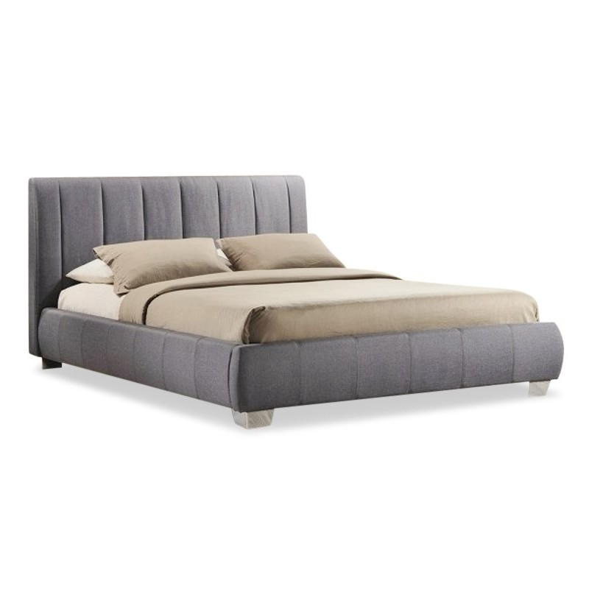
large
small

Slide 11

abstract
concrete

Slide 12

concrete
abstract

Slide 13

abstract
concrete

Slide 14
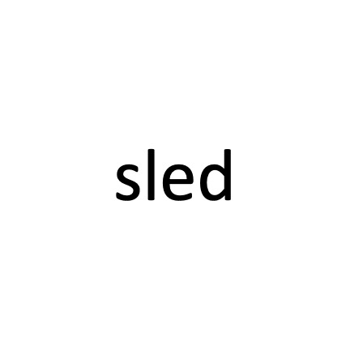
concrete
abstract

Slide 15

abstract
concrete

Slide 16

1 syllable
2 syllables

Slide 17
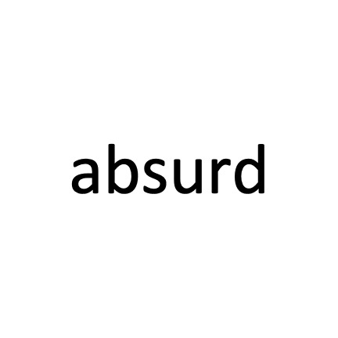
1 syllable
2 syllables

Slide 18

2 syllables
1 syllable

Slide 19
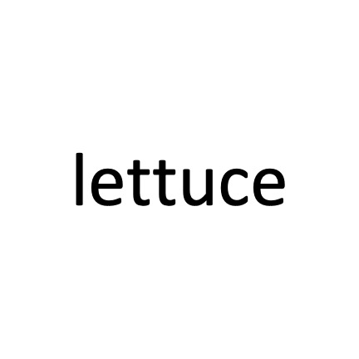
2 syllables
1 syllable

Slide 20
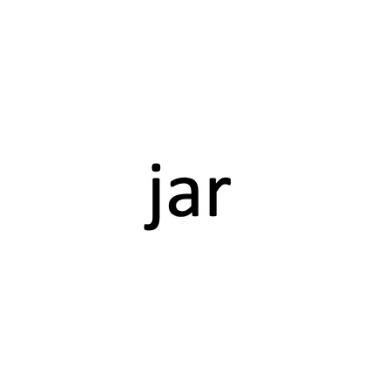
2 syllables
1 syllable

Slide 21
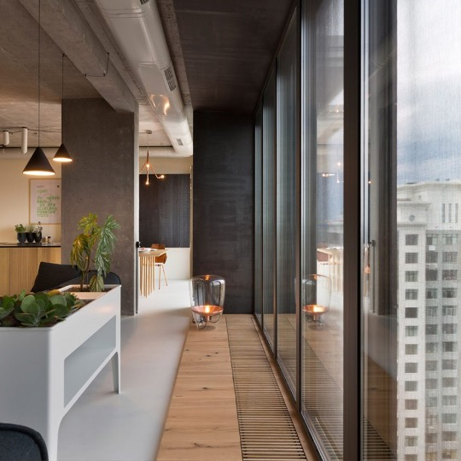
indoor
outdoor

Slide 22
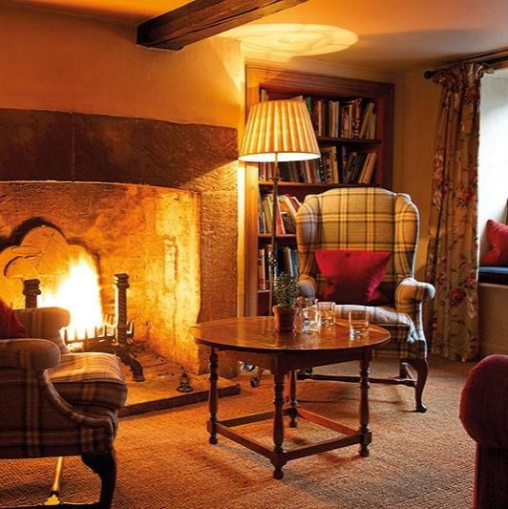
outdoor
indoor

Slide 23
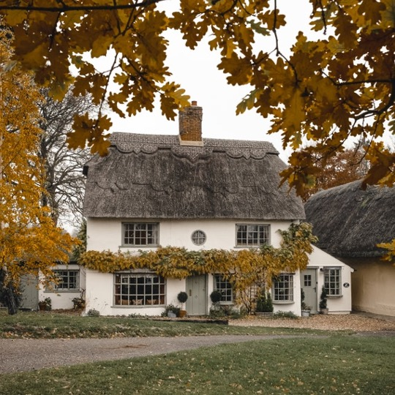
outdoor
indoor

Slide 24
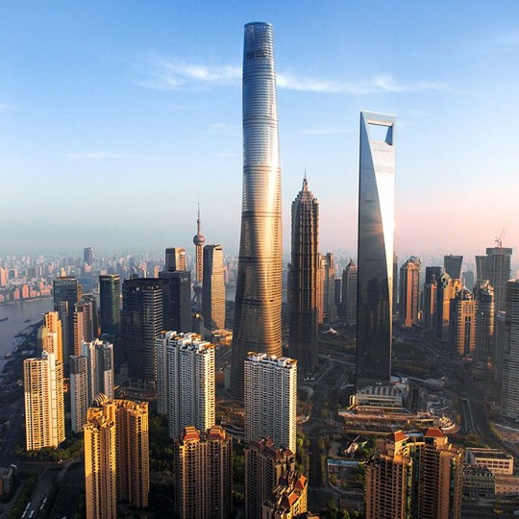
outdoor
indoor

Slide 25
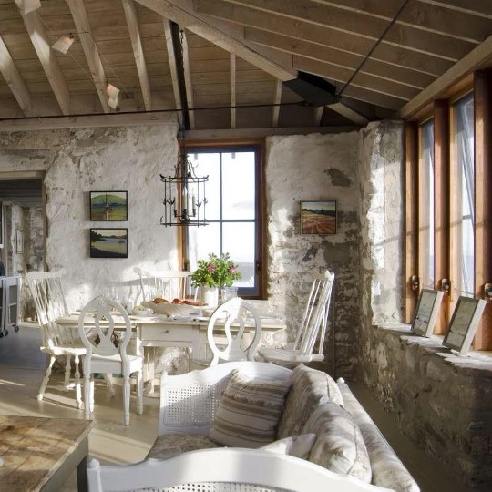
indoor
outdoor

Slide 26
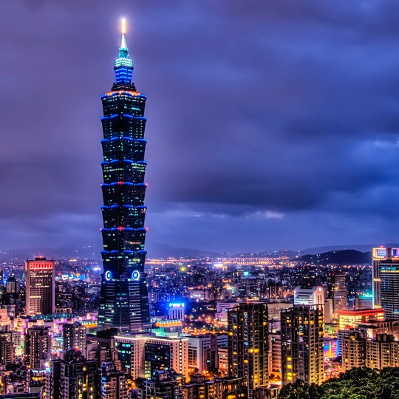
cottage
skyscraper

Slide 27
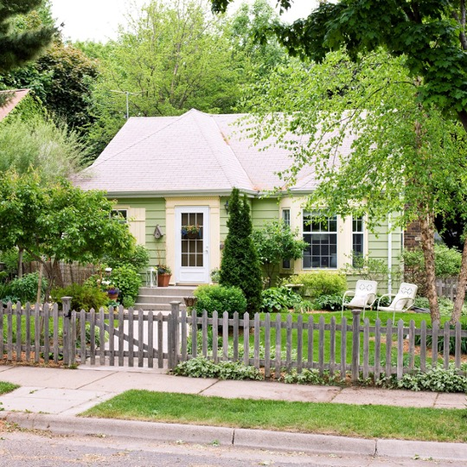
cottage
skyscraper

Slide 28
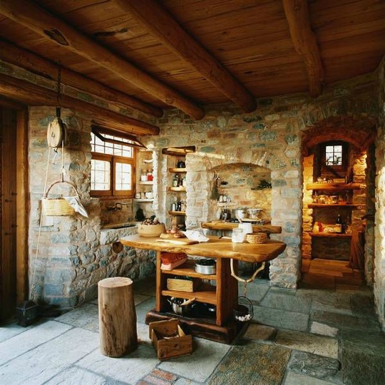
skyscraper
cottage

Slide 29
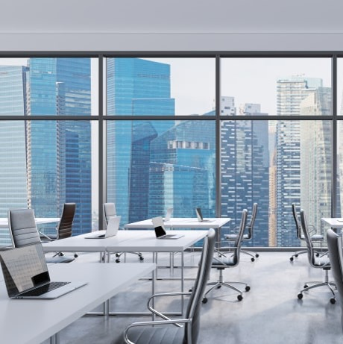
skyscraper
cottage

Slide 30
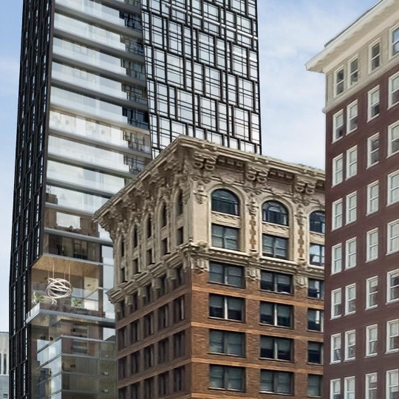
cottage
skyscraper

Slide 31
Please select the image that was seen first

Slide 32
Please select the image that was seen first

Slide 33
Please select the image that was seen first

Slide 34
Please select the image that was seen first

Slide 35
How far apart in time were the images presented?
very close
close
far
very far

Slide 36
How far apart in time were the images presented?
very close
close
far
very far

Slide 37
How far apart in time were the images presented?
very close
close
far
very far

Slide 38
How far apart in time were the images presented?
very close
close
far
very far

