Slide 1
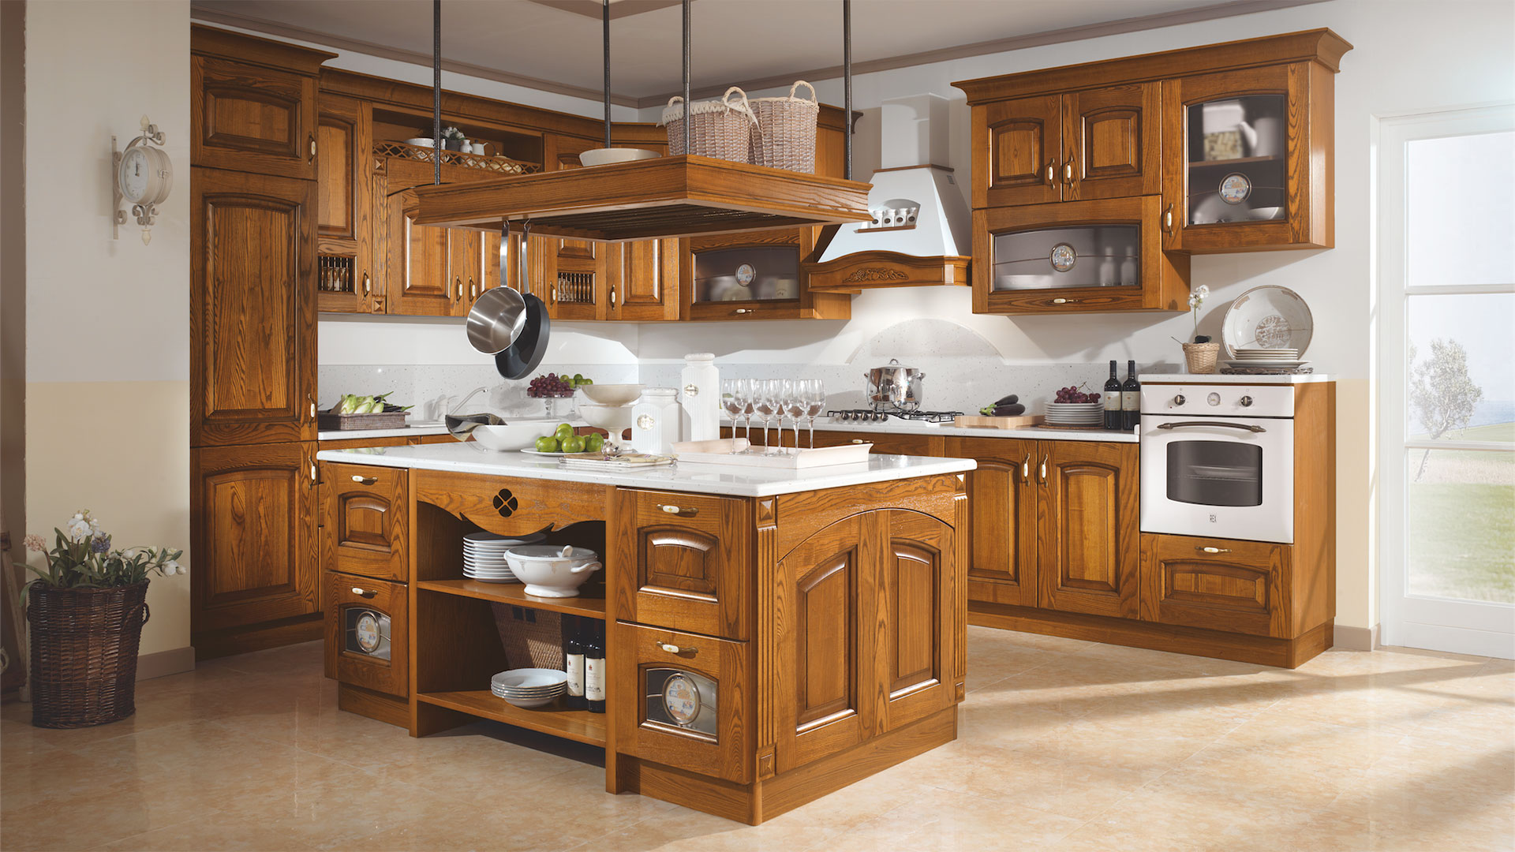
Make a stew

Slide 2
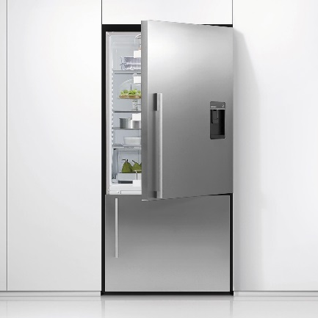
Take food from fridge

Slide 3
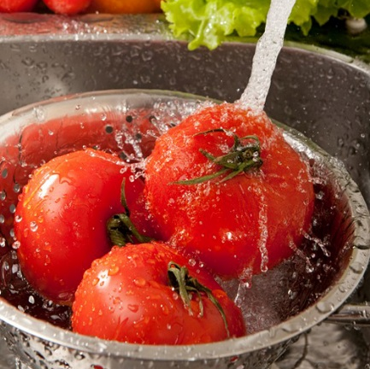
Wash vegetables

Slide 4
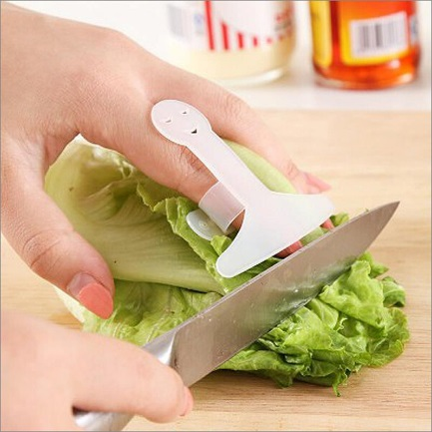
Chop vegetables

Slide 5
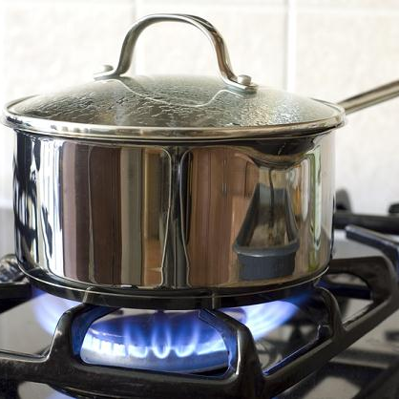
Cook on stove

Slide 6

Wash face

Slide 7
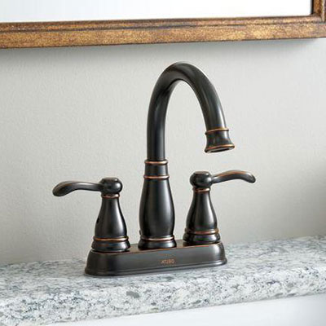
Turn on tap

Slide 8
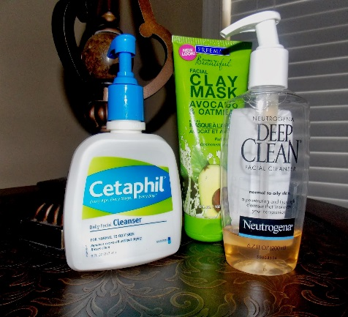
Use facial wash

Slide 9

Rinse face

Slide 10
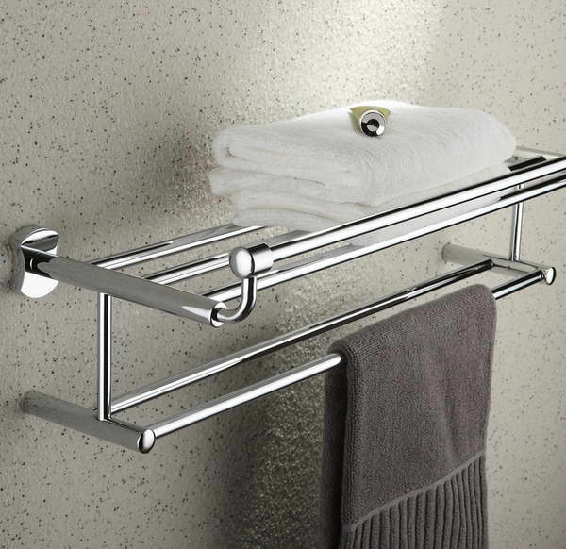
Dry with towel

