Slide 1
Mobile Price Prediction Project
By Tanya Gera • NextHikes • 15/11/2025

Slide 2
Project Overview
  Goal: Predict smartphone prices using ML models
  Dataset includes specs like RAM, memory, cameras, processor, battery
  Multiple models tested for best performance

Slide 3
Dataset Summary
  541 rows, 11 columns
  Features include model, RAM, memory, battery, camera specs, processor
  Target variable: Price (Prize)

Slide 4
EDA Highlights
  Price distribution is right-skewed
  Significant high-end outliers
  Weak linear correlations overall
  Feature importance shows processor is dominant

Slide 5
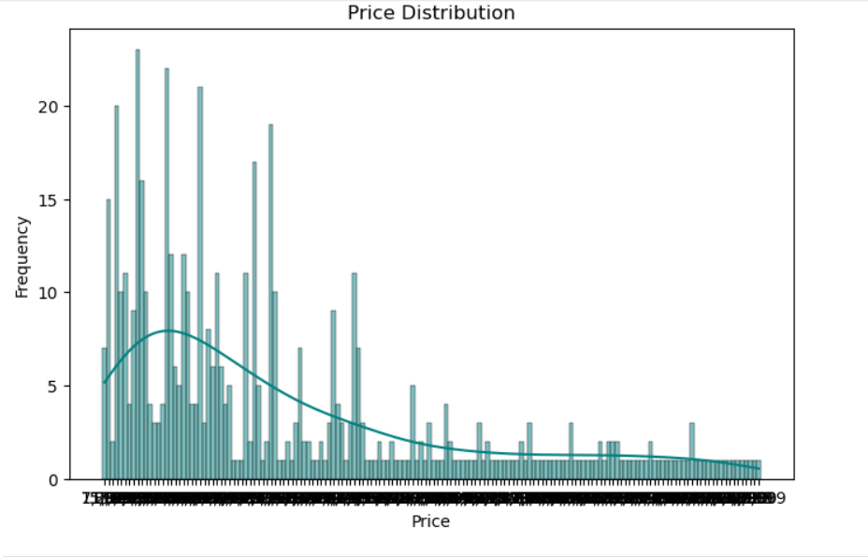
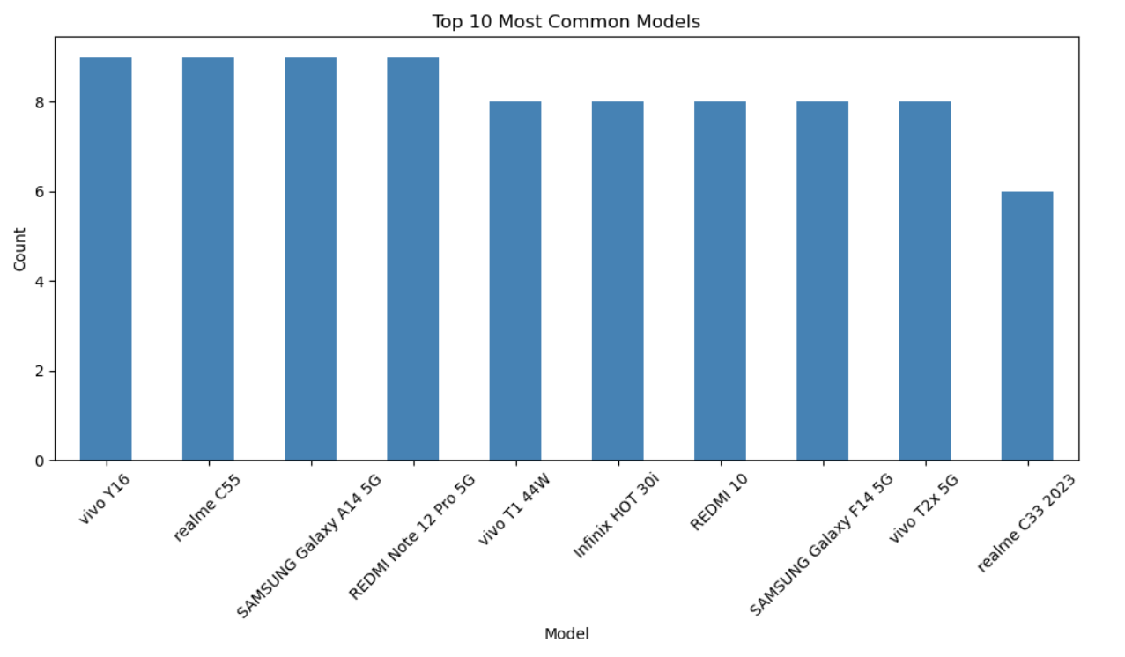
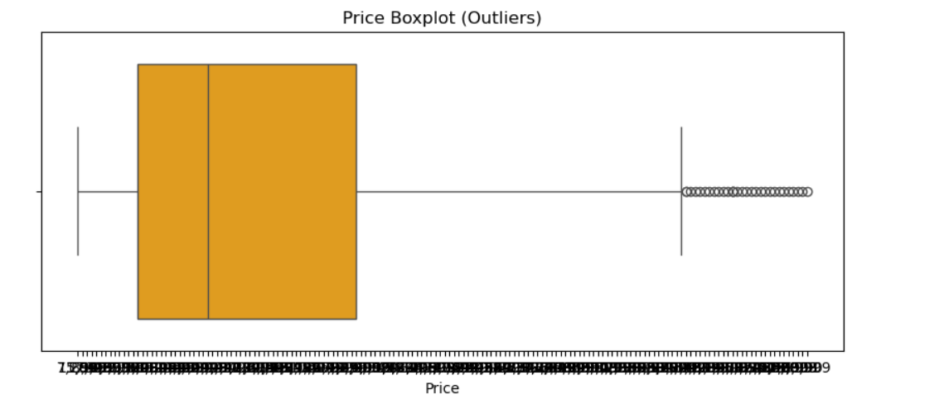
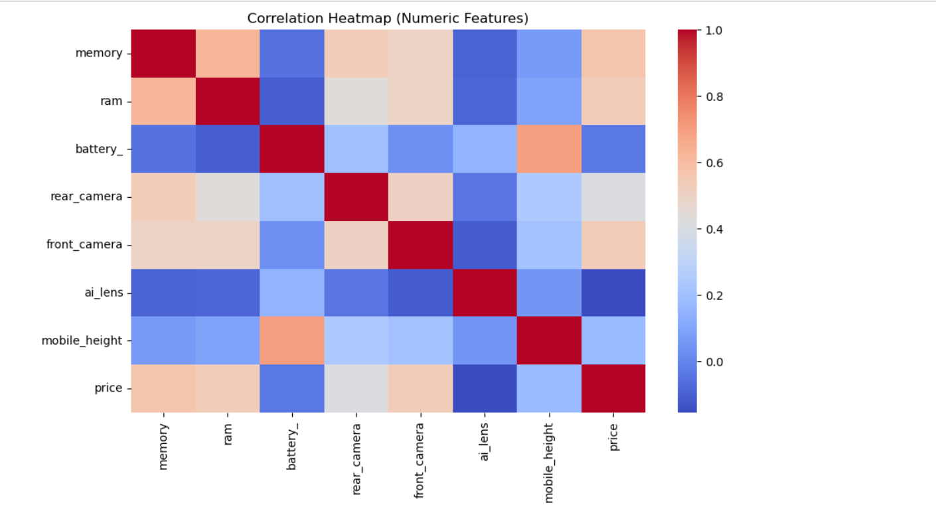
Visual Insights

Slide 6
Preprocessing Steps
  Handled missing values
  One-Hot Encoding for categorical features
  Train-test split (80/20)
  Scaling using StandardScaler & MinMaxScaler

Slide 7
Modeling Approach
  Linear Regression (baseline, poor performance)
  Decision Tree Regressor
  Random Forest Regressor
  Gradient Boosting Regressor
  XGBoost Regressor

Slide 8
Model Results
  Decision Tree: R² ≈ 0.89 (Best)
  XGBoost: R² ≈ 0.88
  Random Forest: R² ≈ 0.84
  Gradient Boosting: R² ≈ 0.82
  Linear Regression performed poorly

Slide 9
Key Insights
  Processor type strongly affects price
  Camera quality, RAM, and memory also contribute
  Tree-based models outperform linear models

Slide 10
Conclusion & Future Scope
  Best model: Decision Tree / XGBoost
  Can be used in pricing engines for e-commerce
  Future: More data, PCA, brand grouping, LightGBM/CatBoost, deployment

