Slide 1
Identification & Optical character recognition (OCR) for Structured Documents - SBI
Powered By - Microsoft Corporation Pvt Ltd.
Presented By : Tanya Kumari

Slide 2

Problem Being Solved
There are various types of documents which are being handled in Bank. It is a very tedious task to extract appropriate information from all the documents manually . So various different types of tools are being used to solve this problem.
Analysing different types of documents in Bank with the help azure cognitive services and python
Optical Character Recognition (OCR) has been performed and the accuracy score has been calculated.

Slide 3
FLOWCHART OF THE APPROACH WHICH IS BEING USED
The uploaded document is being then analysed using python . And also if anything is attested.
Identification of what type of document it is (eg PDF, JPEG, TIFF)
Then we will perform different image and text analysis on the documents.
The document is first being uploaded using python
And the end the training data set is used for performing OCRs on different types of documents from the input which is given.
The information gathered includes
Name , Address , Additional document masking.
Image analysis, including signatures.
Tables or form recognition.
After this the essential information from the all the document are being stored and used as training data set.

Slide 4

Microsoft Azure Cognitive Services -
Extract printed and handwritten text from images and documents with mixed languages and writing styles.
Used to generate value from your visual assets.
Analyse how people move in a space in real time for occupancy count, social distancing and face mask
Run Computer Vision in the cloud or on the edge, in containers for detection.

Slide 5
Using Microsoft Azure Cognitive Services
Extracting Text from JPEG files has been done.
Extracting the images from JPEG file and adding suitable tagging has also been done .
And also using form recognizer tools to analyse the forms and tables in the documents.

Slide 6
Different packages which are being used are
Operation Status Code from azure cognitive services vision.
Visual features types from azure cognitive services vision.
Cognitive Services Credentials from mrest. authentication.
Image from PIL.
Computer vision client from azure cognitive services vision.

Slide 7
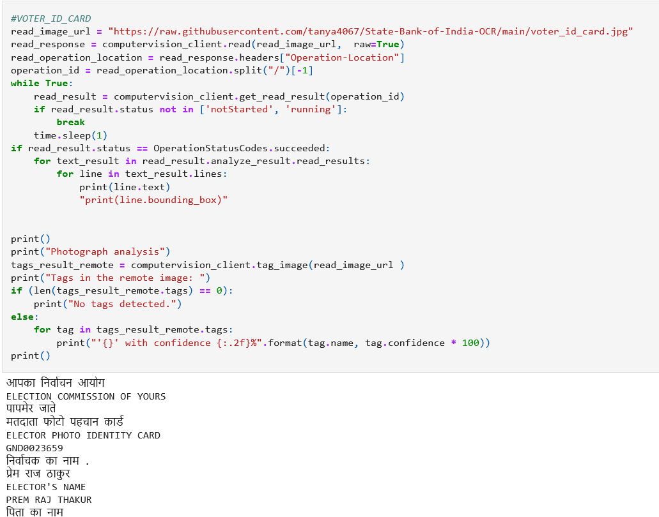
Sample of the codeS

Slide 8
Analyzing the texts
The extracted text from the documents are already obtained in String format.
So the next step is to analyze certain specific keywords which are present in the document using for loop and storing it in a list.
Different types of keywords which we are searching for -
Aadhar Card | Agreement Form | First Name | Phone no.
Election commision | Bank Account Opening | Last Name | Email id
PAN Card | Report | Address | Hand written documents
Driving License | Bank Statements | KYC | Account no. Identification

Slide 9
Prerequisites
Sample documents as per various document type / language / format, etc.
Sample scanned document / image format:
1. JPEG
2. PDF
3. TIFF

Slide 10
Key points of my solutions are -
There are various types of formats which my model is able to identify. eg Application forms, KYC Documents, Agreements , Reports , Tables Bank Account Statements, Confidential Documents, other types of OVDS.
It can identify mostly two types of documents formats named - JPEG and PDF.
It has the ability to identify and perform OCR on less than optimal scans.
And also be able to mask AAdhar Card number , Pan Card Number , DL numbers from different varied documents.

Slide 11
Source code (Github Repository Link)
https://github.com/tanya4067/State-Bank-of-India-OCR

Slide 12

Submitted By : Tanya Kumari
Email : tanyakumari29@gmail.com
Mobile No: 7759034535

