Slide 1
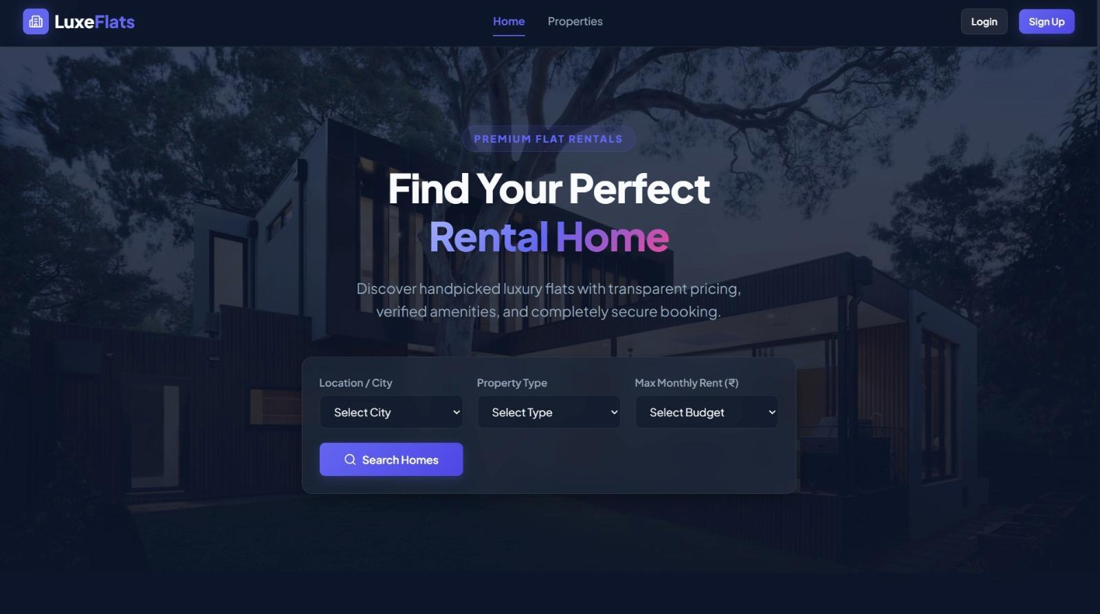


COFORGE GRADUATE ENGINEER TRAINEE PROJECT
LuxeFlats
Flat Rental Microservices Platform
Project Metadata
Presented By: Tanya Gupta, Harsh Sahu, Kshitij Goel
Role: Graduate Engineer Trainee
Technology Stack: Java | Spring Boot | React + Vite | MySQL
Emp Code: 85011019
Email: Tanya.Gupta@coforge.com

Slide 2
LUXEFLATS - FLAT RENTAL SYSTEM
Table of Contents
01. Project Overview
• Introduction to the Flat Rental System
• Problem statement and proposed solution
• Key objectives and project scope
02. Technology & Architecture
• Technology Stack: Java, Spring Boot, React + Vite, MySQL
• Microservices: User, Flat & Rental Services
• Architecture: Eureka Service Discovery + API Gateway
03. System Implementation
• Development of REST APIs using Spring Boot
• Integration of React + Vite frontend with backend
• Database operations using MySQL and JPA/Hibernate
04. Results & Features
• User, flat, and rental management
• Flat availability and rental operations
• Integrated frontend with microservices backend
05. Future Scope & Conclusion
• Add secure authentication and online payment
• Enable Docker/Kubernetes and cloud scaling
• Scalable architecture for future enhancements
06. Testing & Performance
• API testing using Postman
• Validation of service communication and database operations

Slide 3

LUXEFLATS - FLAT RENTAL SYSTEM
Problem Statement & Project Objectives
The Problem
• Traditional rental processes involve manual communication and scattered information.
• Difficult to efficiently track flat availability and rental records.
• Lack of a centralized platform for managing rental operations.
Key Objectives
• Simplify flat discovery and rental management.
• Centralize user, flat, and rental information.
• Build a scalable and maintainable microservices-based system.

Slide 4
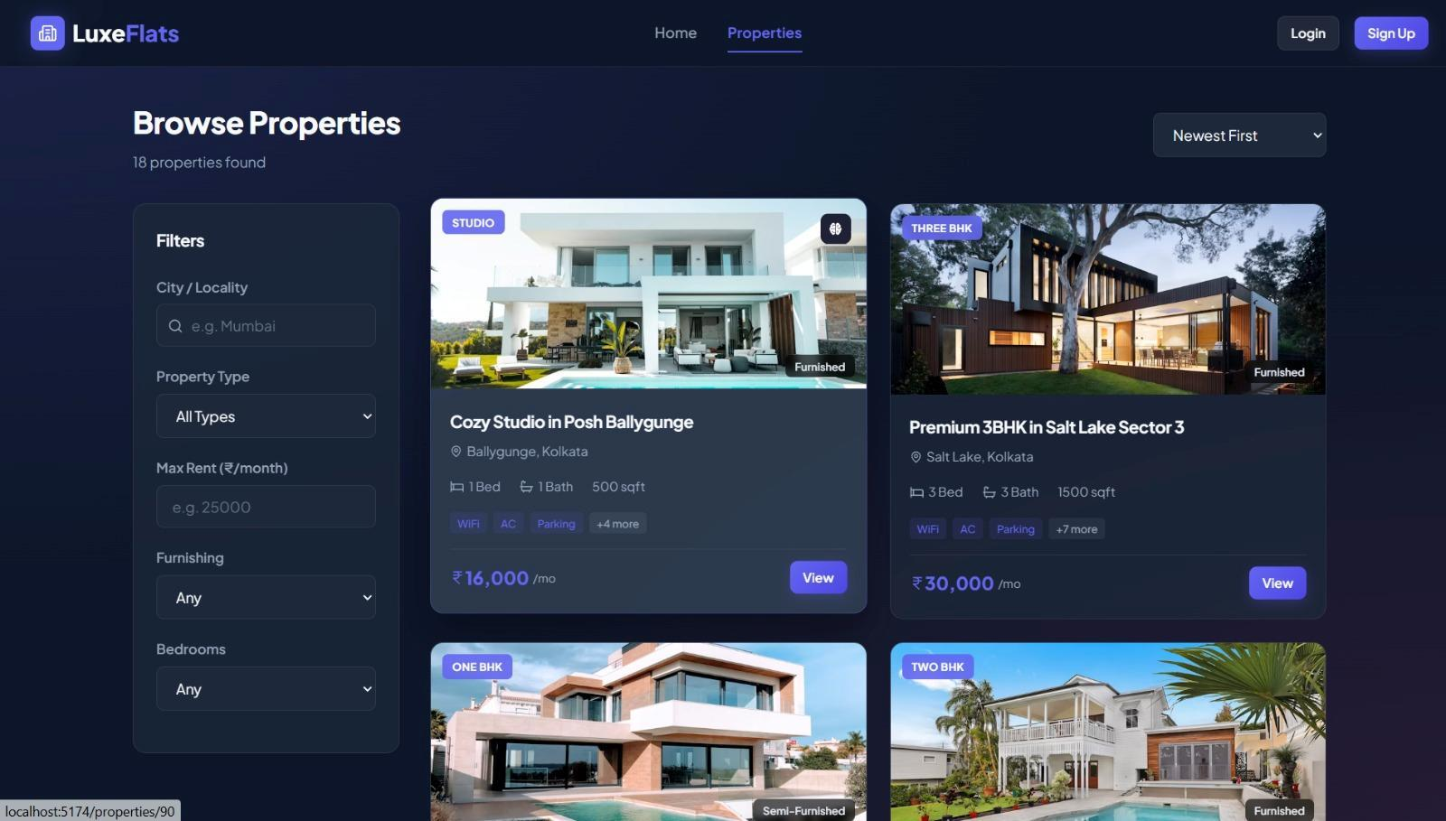
LUXEFLATS - FLAT RENTAL SYSTEM
Project Overview & Key Idea
System Definition
• The Flat Rental System is a web-based application designed to simplify and manage the complete flat rental process.
• A React + Vite frontend provides the user interface, while Spring Boot REST APIs handle backend operations.
• It provides a centralized platform for managing users, flats, availability and rental information.
• The system follows a microservices architecture, where different business functionalities are developed as independent services.
Core Architecture Idea
• Users interact with the system through the React + Vite application.
• Requests are routed through the API Gateway to the appropriate microservice.
• Eureka Server enables service discovery between the microservices.
• Data is stored and managed using MySQL databases.

Slide 5
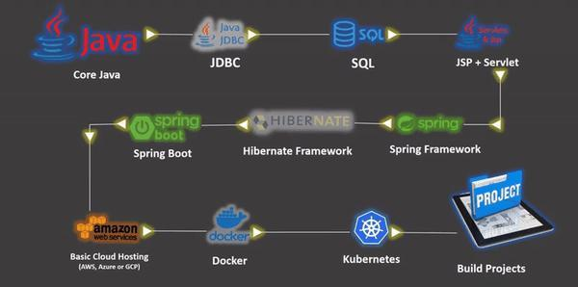
LUXEFLATS - FLAT RENTAL SYSTEM
Development Tools & Environment Setup
Development Stack: Core Java -> JDBC -> SQL -> JSP/Servlet -> Spring Framework -> Hibernate -> Spring Boot.
Deployment Pipeline: Basic Cloud Hosting (AWS/Azure/GCP) -> Docker Containers -> Kubernetes Orchestration.

Slide 6

LUXEFLATS - FLAT RENTAL SYSTEM
Project Folder Directory Structure
Service Module Breakdown
• api-gateway: Routes incoming client calls to targeted downstream ports.
• flat-service (property-service): Manages flat properties data, images, and locality parameters.
• rental-service (booking-service): Coordinates lease agreements, check-in validation, and state changes.
• service-registry (eureka): Dynamic service discoverer mapping container IPs.
• user-service (auth-service): Handles credential registration, password hashing, and user role records.

Slide 7
LUXEFLATS - FLAT RENTAL SYSTEM
Project Technology Stack
FRONTEND
• React
• Vite
• HTML5 & CSS3
• TypeScript
• Axios Client
CLOUD & INFRA
• Spring Gateway
• Eureka Server
• OpenFeign Client
• Cloud Service
BACKEND
• Java
• Spring Boot
• REST APIs
• IOC Container
PERSISTENCE
• MySQL DB
• Spring Data JPA
• Hibernate ORM
• Repositories
DEV & OPS
• Maven Tool
• Postman Test
• Git / GitHub
• Docker & K8s

Slide 8
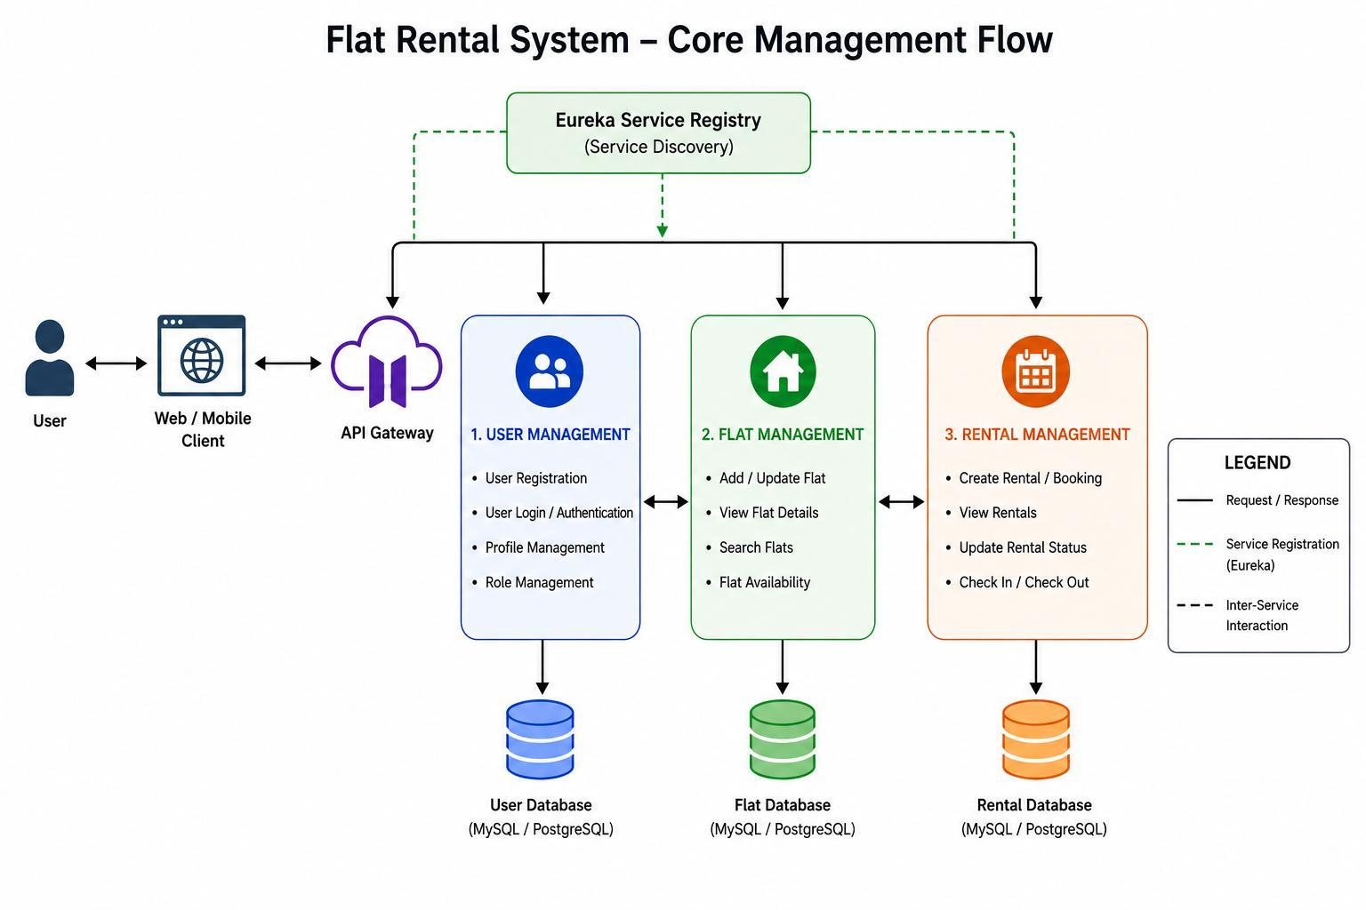
LUXEFLATS - FLAT RENTAL SYSTEM
Flat Rental System - Core Management Flow

Slide 9
LUXEFLATS - FLAT RENTAL SYSTEM
Microservices System Architecture
React + Vite Frontend
Port 5173
Eureka Server
Port 8761
(Service Registry)
API Gateway
Port 8080
User Service
Port 8081
Flat Service
Port 8082
Rental Service
Port 8083
User DB
MySQL
Flat DB
MySQL
Rental DB
MySQL

Slide 10
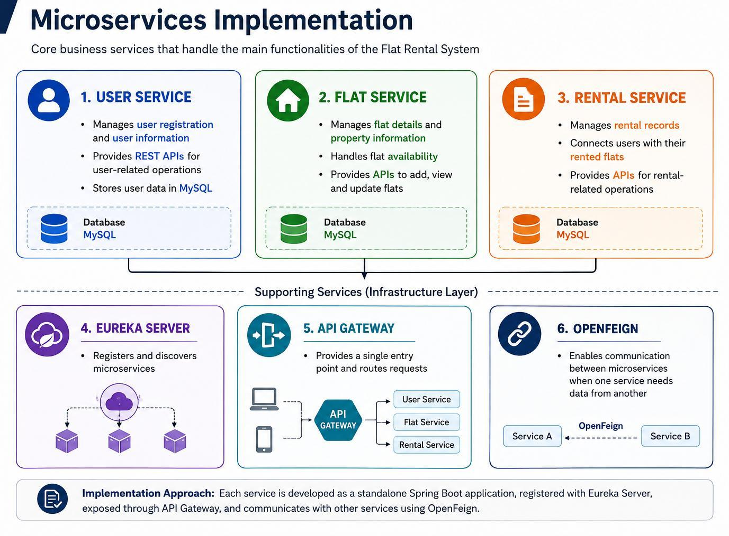
LUXEFLATS - FLAT RENTAL SYSTEM
Microservices Functional Mapping

Slide 11
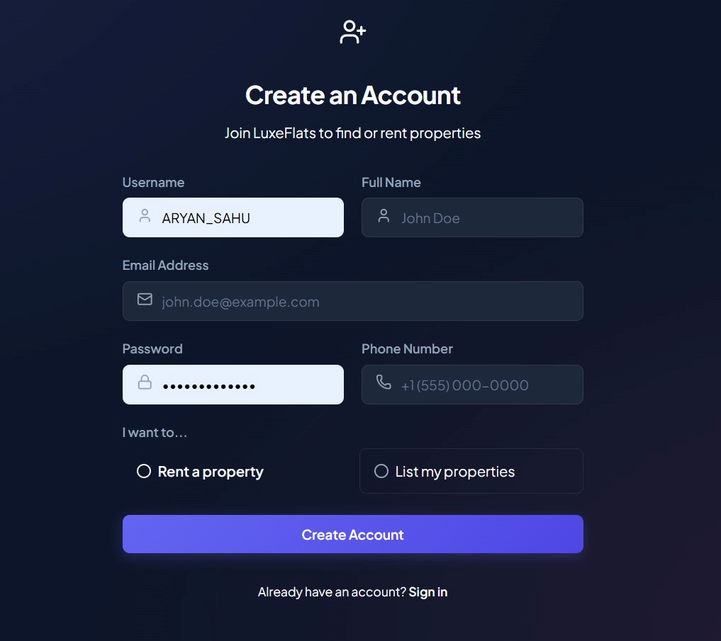
LUXEFLATS - FLAT RENTAL SYSTEM
Project Snapshots - User Registration
Registration Workflow
• Provides a secure and intuitive user registration screen.
• Differentiates between roles: Renting a property (Tenant) and Listing a property (Owner).
• Validates fields client-side before forwarding HTTP requests to auth-service.
• Standard credentials initialized for immediate end-to-end testing: tenant/password123, owner/password123.

Slide 12
LUXEFLATS - FLAT RENTAL SYSTEM
Project Snapshots - Property Discovery
Properties Marketplace
• Renders property listings inside glassmorphic layout cards.
• Allows dynamic client-side filtering by: City/Locality, Property Type (Studio, 1 BHK, 2 BHK, etc.), Rent Budget range, and Furnishing status.
• Displays responsive cards with price metrics, active amenities, and a link to view details.
• Features realistic property images loaded dynamically from Unsplash CDNs.

Slide 13
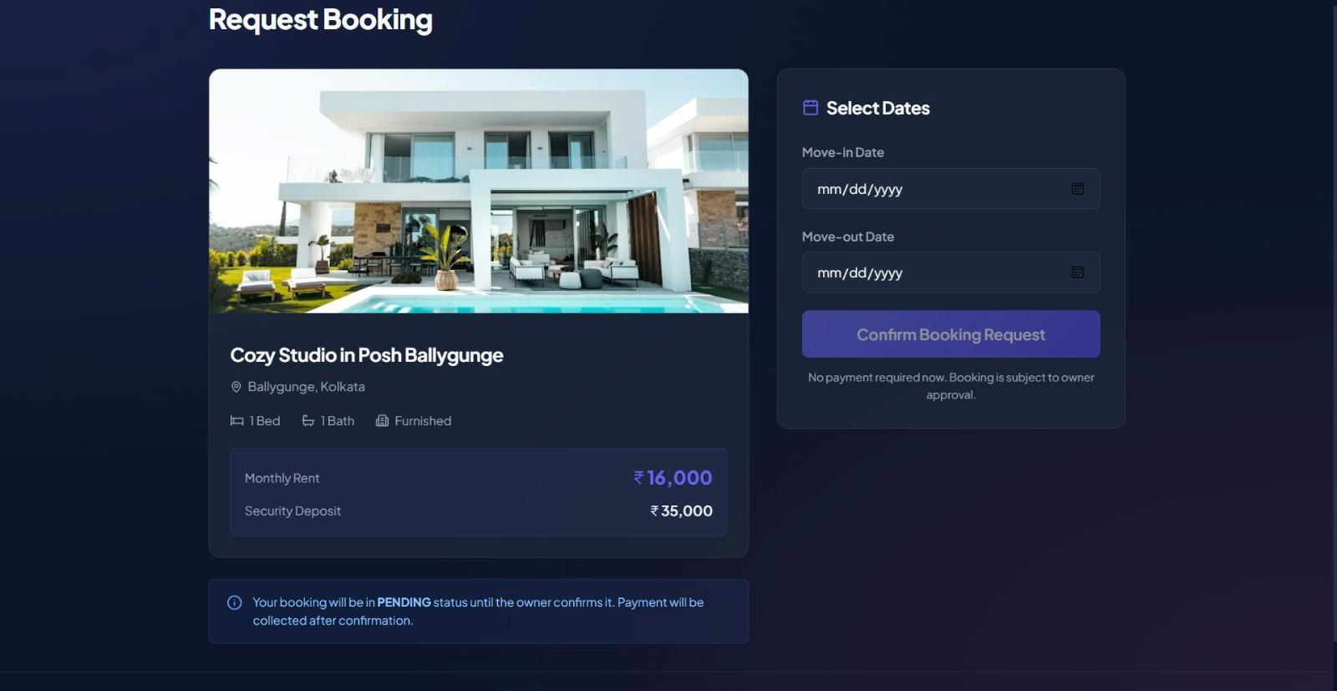
LUXEFLATS - FLAT RENTAL SYSTEM
Project Snapshots - Booking Requests
Booking stays Flow
• Allows tenants to pick custom move-in/move-out dates on an interactive calendar.
• Automatically displays property pricing parameters, including monthly rent and security deposits.
• Triggers validation on dates (move-out must be after check-in, check-in must be present/future).
• Saves the initial contract with status PENDING, waiting for owner approval.

Slide 14
LUXEFLATS - FLAT RENTAL SYSTEM
Testing & Performance Overview
API Testing
• Tested REST APIs using Postman
• Verified GET, POST, PUT, and DELETE operations
• Checked HTTP response codes and response DTO schemas
Integration Testing
• Verified communication between React + Vite and Spring Boot
• Validated API Gateway dynamic request routing
• Confirmed microservice registry with Eureka Server
Database Testing
• Verified CRUD operations directly inside MySQL
• Validated Hibernate-based insertion, retrieval, and updates
• Ensured API payloads matched MySQL table records
Performance & Reliability
• Independent services minimize module-to-module dependencies
• Centralized gateway routing simplifies CORS and filter configs
• Microservices architecture allows services to scale independently

Slide 15
LUXEFLATS - FLAT RENTAL SYSTEM
API Validation & Testing Approach
API Testing Overview
• API Testing is a software testing approach that focuses on validating the functionality, reliability, performance, and security of Application Programming Interfaces (APIs).
• Unlike GUI testing, API testing verifies the communication between different software components by sending requests and validating responses without interacting with the user interface.
• It ensures that APIs function correctly, exchange accurate data, and meet the specified business and technical requirements. Popular tools such as Postman, Rest Assured, and JMeter are widely used for API testing.
Importance of API Testing
• Validates the functionality and reliability of APIs.
• Ensures accurate data exchange between applications.
• Detects defects early before the user interface is developed.
• Improves application performance and response validation.
• Supports functional, regression, and integration testing.
• Enhances software quality by verifying API contracts and business logic.
• Facilitates Continuous Integration and Continuous Delivery (CI/CD) through automated API testing.

Slide 16
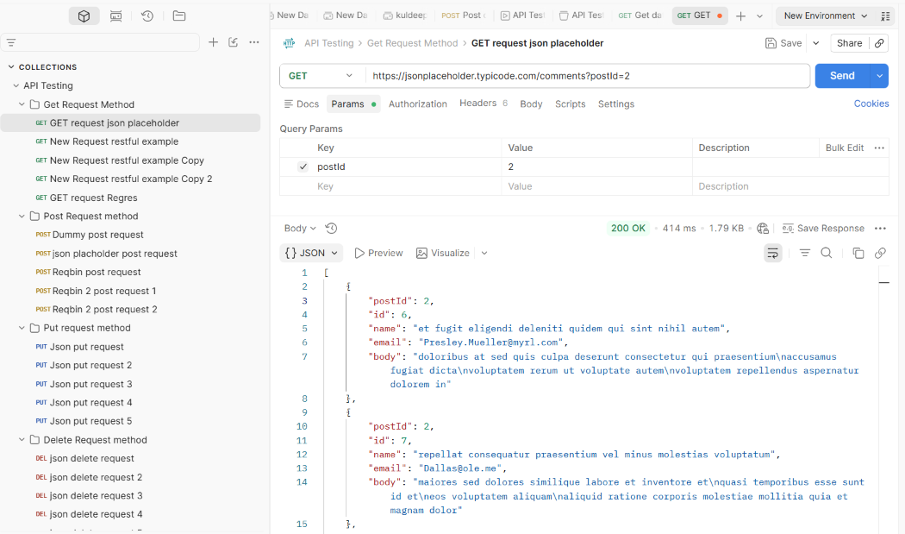
LUXEFLATS - FLAT RENTAL SYSTEM
API Validation - GET Request
Postman GET Request Analysis
Used to retrieve resources or data lists from a specified URL endpoint without modifying any database records.

Slide 17
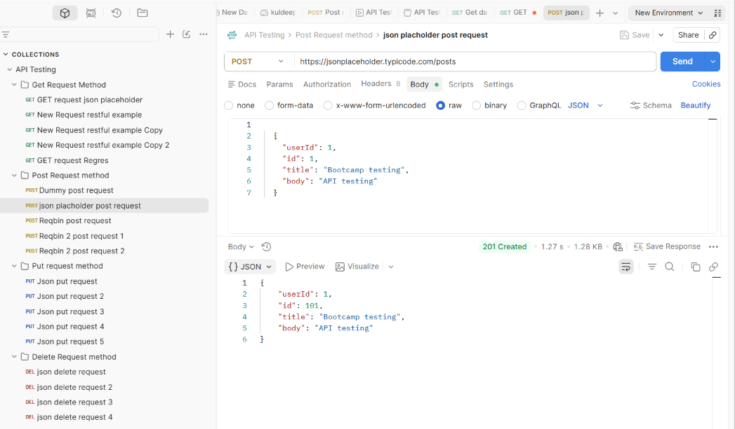
LUXEFLATS - FLAT RENTAL SYSTEM
API Validation - POST Request
Postman POST Request Analysis
Used to submit data payloads to create new resources on the server, resulting in a database insertion (returns 201 Created).

Slide 18
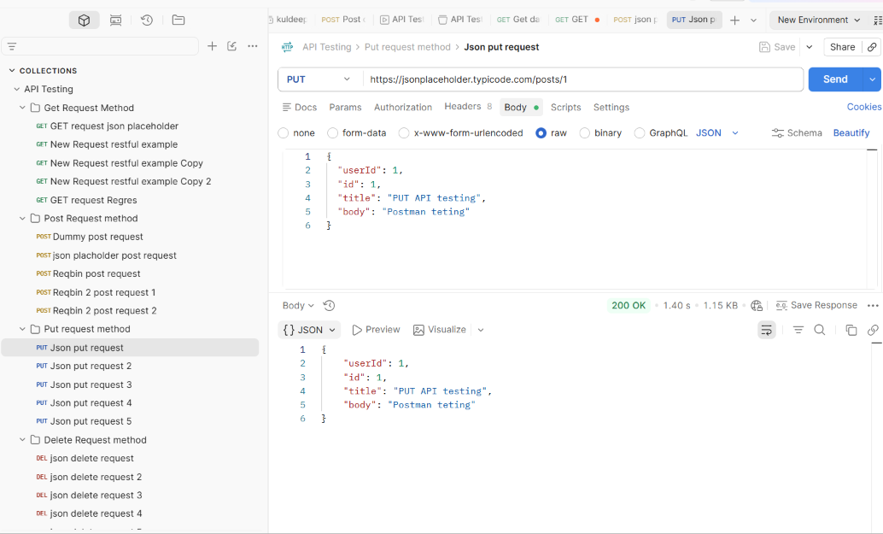
LUXEFLATS - FLAT RENTAL SYSTEM
API Validation - PUT Request
Postman PUT Request Analysis
Used to update an existing resource with a complete new representation payload, replacing the database row fields.

Slide 19
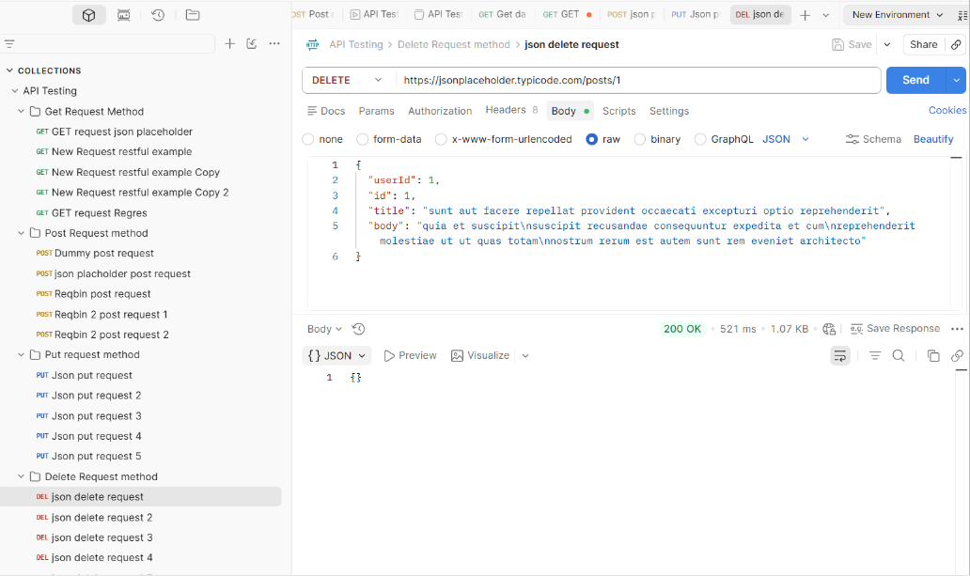
LUXEFLATS - FLAT RENTAL SYSTEM
API Validation - DELETE Request
Postman DELETE Request Analysis
Used to remove a specific resource from the database based on target ID parameters (returns 204 No Content).

Slide 20
LUXEFLATS - FLAT RENTAL SYSTEM
Project Conclusion & Takeaways
Key Accomplishments
• Developed a highly modular, microservices-based Flat Rental System for managing users, flats, and bookings.
• Successfully implemented User, Flat, and Rental Services using independent Spring Boot applications.
• Integrated the frontend using React + Vite, API Gateway routing, Eureka service registry, and MySQL databases.
• Verified all endpoints, security filters, and inter-service communications using Postman.
• Provides a highly scalable, maintainable, and robust architecture suited for cloud deployment.

Slide 21
Thank You
"Quality is never an accident; it is always the result of intelligent effort."
Presented By: Tanya Gupta, Harsh Sahu, Kshitij Goel
Graduate Engineer Trainees

